Slide 1
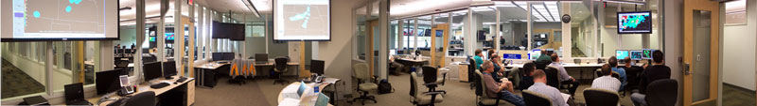
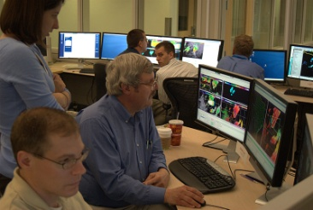
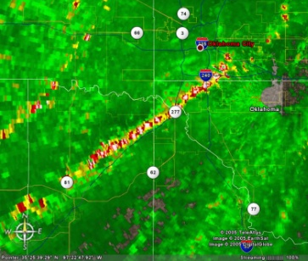
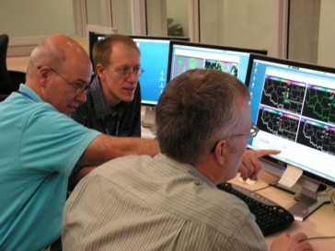
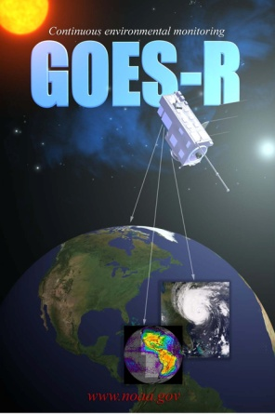
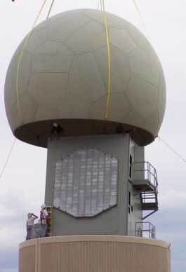
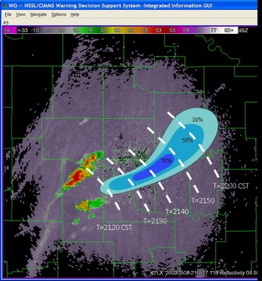
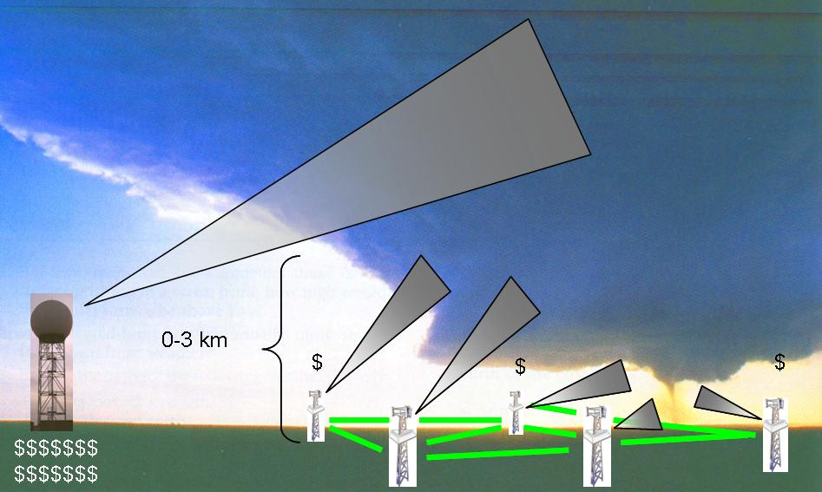
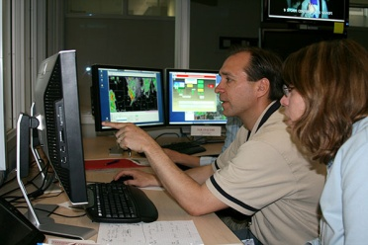
Overview of the NSSL 2012 Experimental Warning Program
EWP2012
Greg Stumpf
NOAA Hazardous Weather Testbed
CIMMS/NWS-MDL
Norman, OK

Slide 2
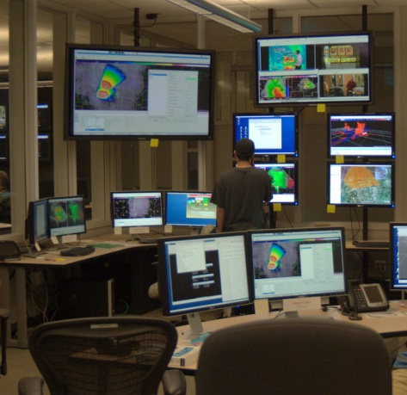
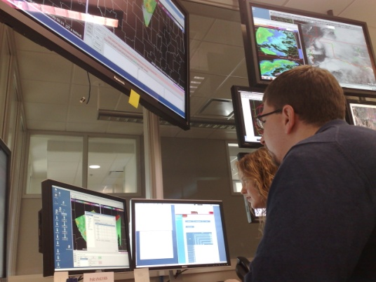
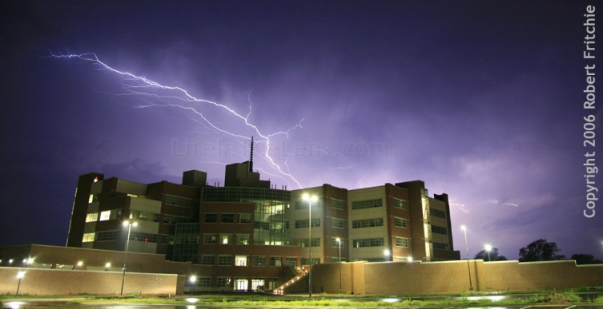
The NOAA Hazardous Weather Testbed
Collaboration
FORECASTERS
RESEARCHERS
DEVELOPERS
TRAINERS
USERS
Evaluation
OBSERVING PLATFORMS
NUMERICAL MODELS
ALGORITHMS
PRODUCTS
SERVICES

Slide 3
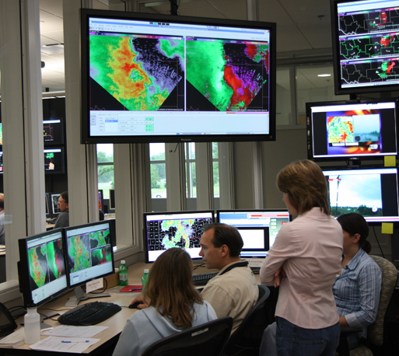
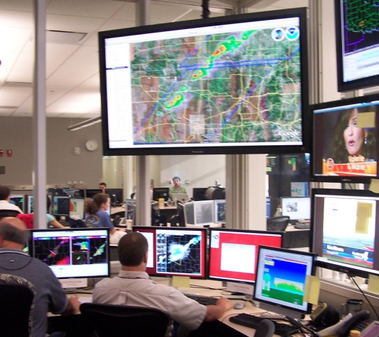
HWT Motivation
Improve understanding of convective weather hazards
More accurate and timely forecasts and warning services
To protect life, body, well-being, productivity, and property.

Slide 4
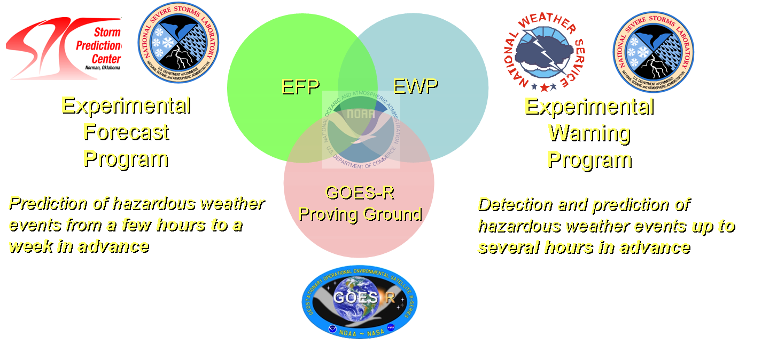
What is the HWT?
Not just a facility…
…but an organization:

Slide 5








HWT Experimental Warning Program (EWP)
Mission: Improve prediction of severe convective weather at the “warning scale” (0-2 hours).
Norman has a large community of researchers, operational meteorologists, students, industry.
But, we serve all National Weather Service WFOs and CWSUs nationwide.

Slide 6
What is tested?
New sensors:
  Radar, satellite, lightning, etc.
New Applications/Algorithms:
  Multi-sensor integration (MRMS), GOES-R proxies, lightning jump, etc.
New Methodologies:
  Best practices, new concepts, products, services
  Social Science integration

Slide 7
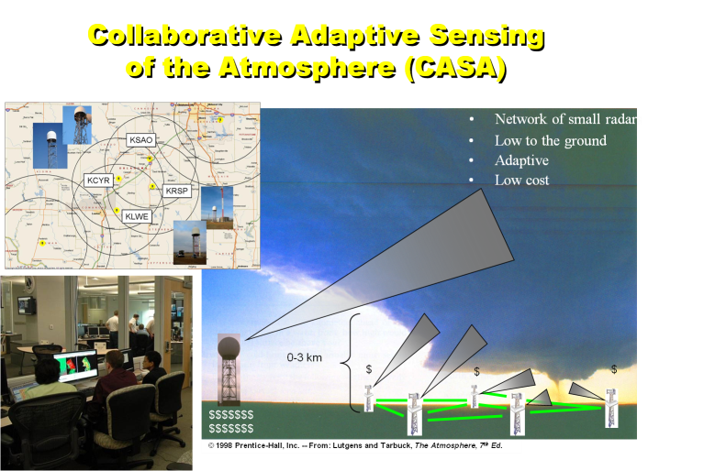
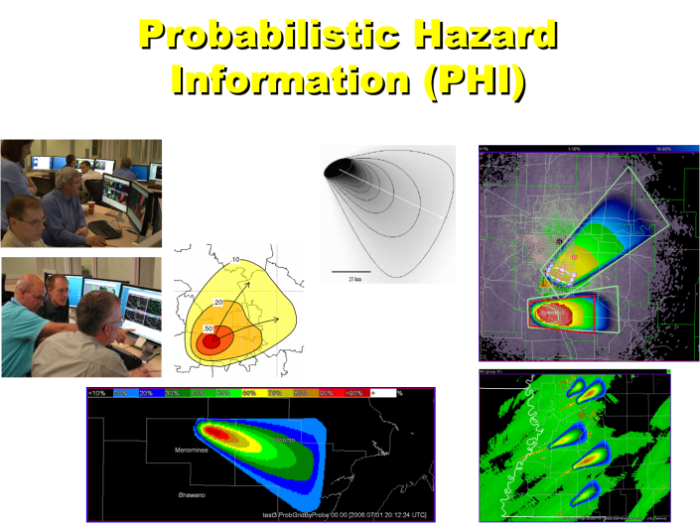
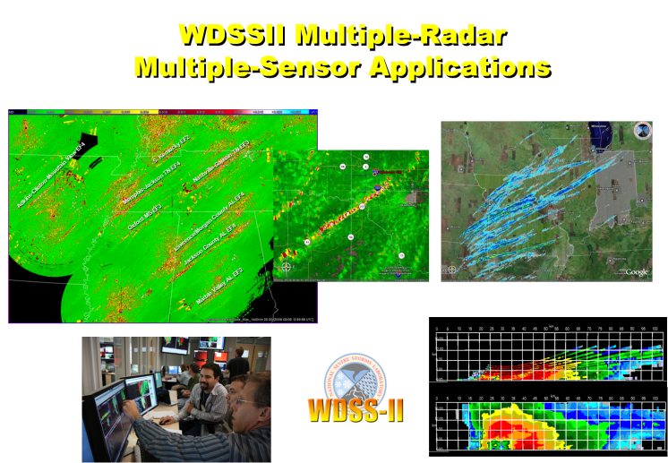
Former EWP Experiments
2007 - 2011

Slide 8
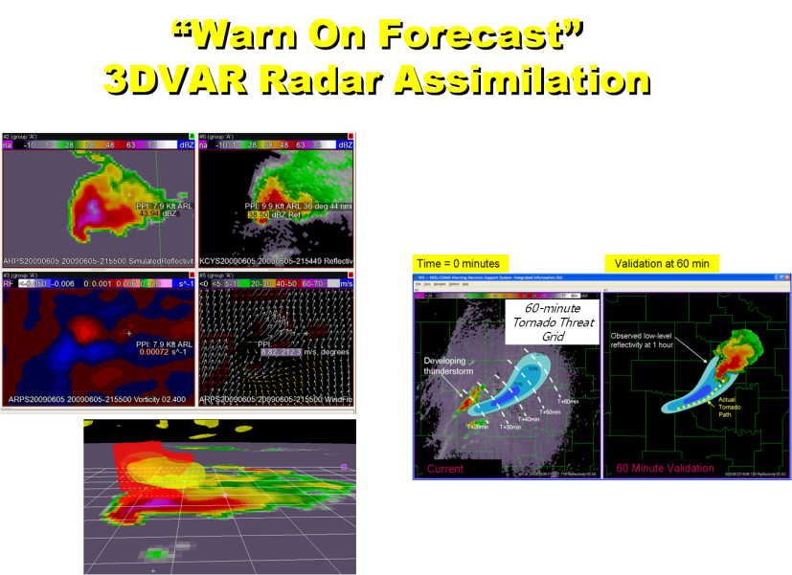
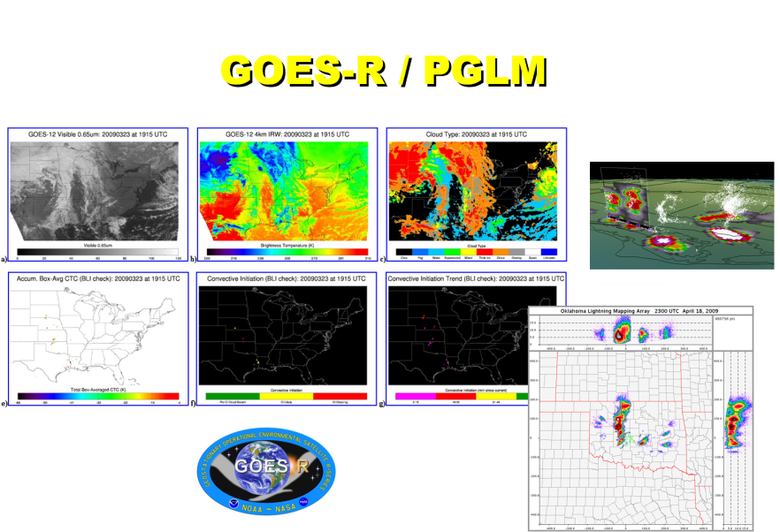
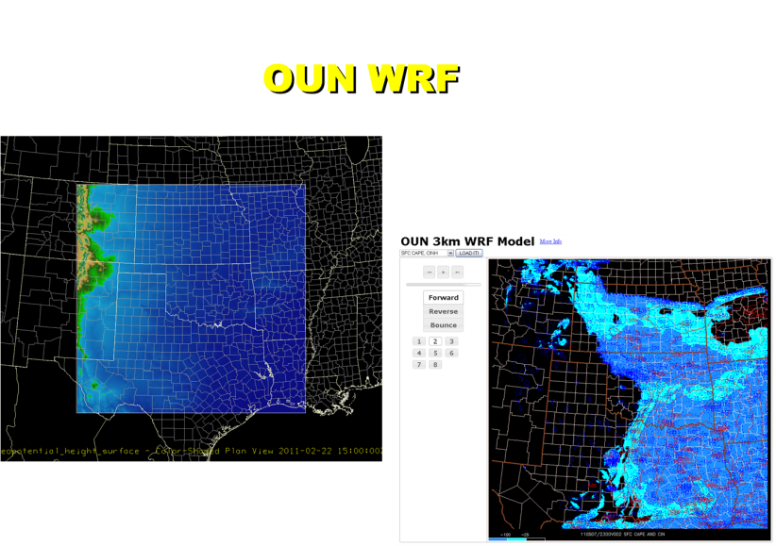
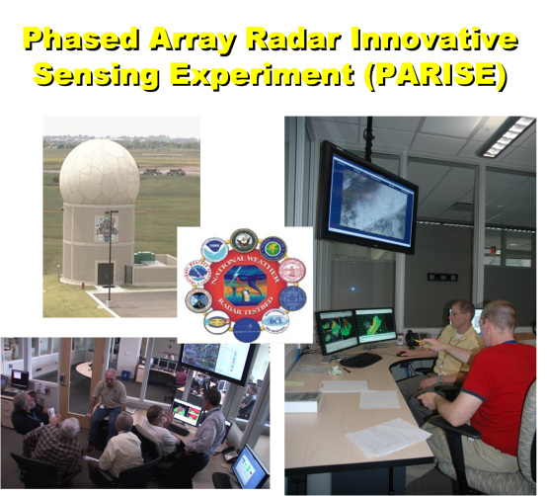
Current EWP Experiments
2012

Slide 9
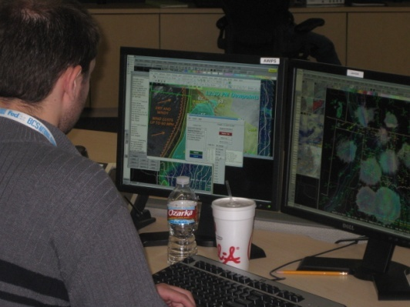
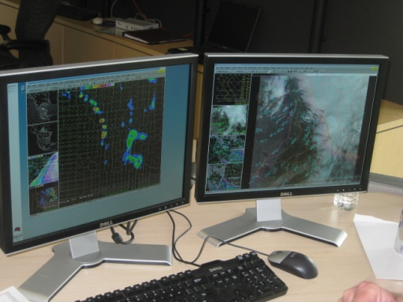
EWP2012 Timeline
Spring Experiment (May, Jun):
  GOES-R Satellite
  OUN-WRF Local high-resolution modeling
  Warn-On-Forecast (WOF) real-time data assimilation
  4-6 forecasters per week
Summer Experiment (Jun, Jul, Aug):
  Phased Array Radar Innovative Sensing Experiment (PARISE)
  2 forecasters per week
  Independent of spring experiment
  Project still under development
    Will have significant component devoted to forecaster decision making and cognitive task analysis

Slide 10
Spring Experiment
5 weeks (7 May, 14 May, 21 May, 4 June, 11 June)
  4-6 forecasters per week
Will be evaluating all components simultaneously
Using AWIPS2 for the first time
Get forecasters to think about how products are used in nowcast and warning decision making.
  Mention experiment products in the warnings.
Not necessarily trying to “compete” with warning issuance.
  Slip out of your “comfort zones”!

Slide 11
“Warn On Forecast” (WOF)
Today: Warn based on detection and extrapolation
Tomorrow: Warn aided by very high-resolution storm-scale models
30 min ago
Now
30 min from now
60 min from now
30 min ago
Now
30 min from now
60 min from now

Slide 12
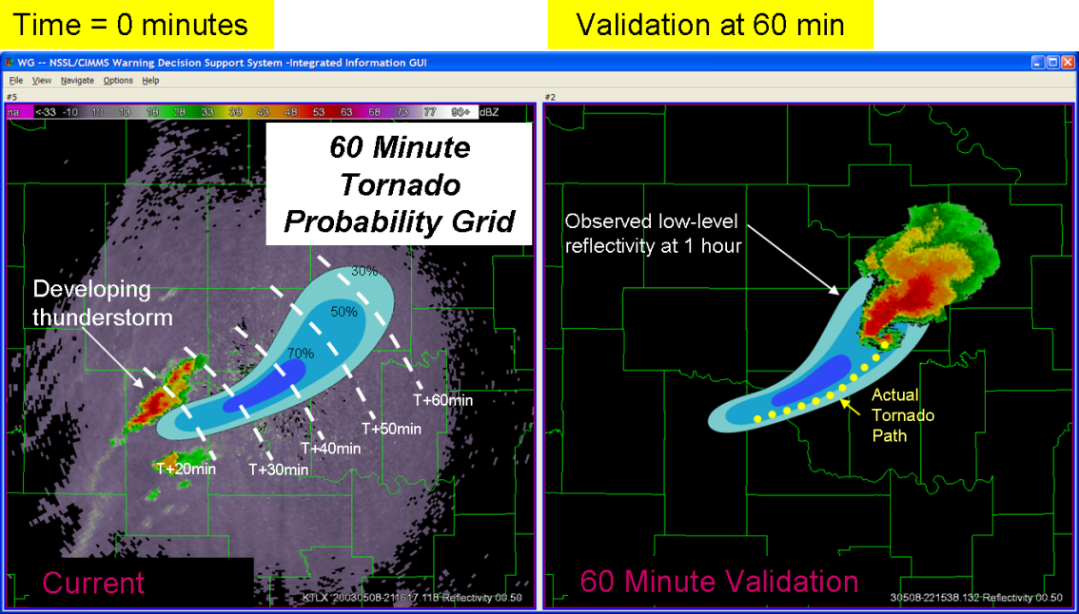
“Warn On Forecast” (WOF)
60-minute
Tornado Threat
Grid

Slide 13
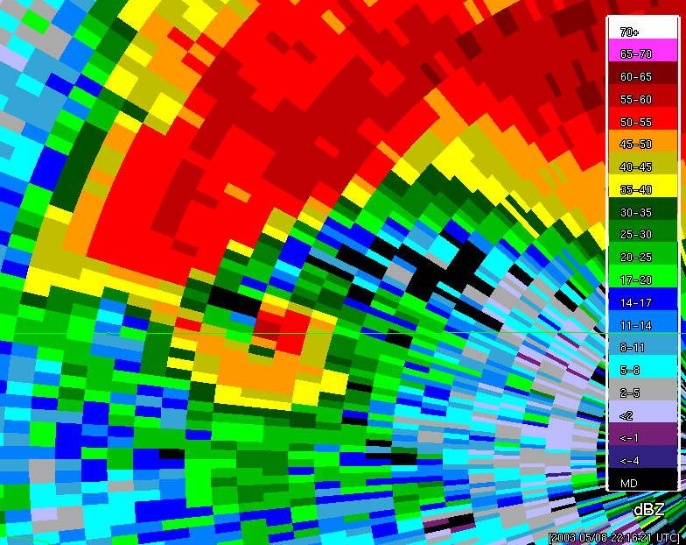
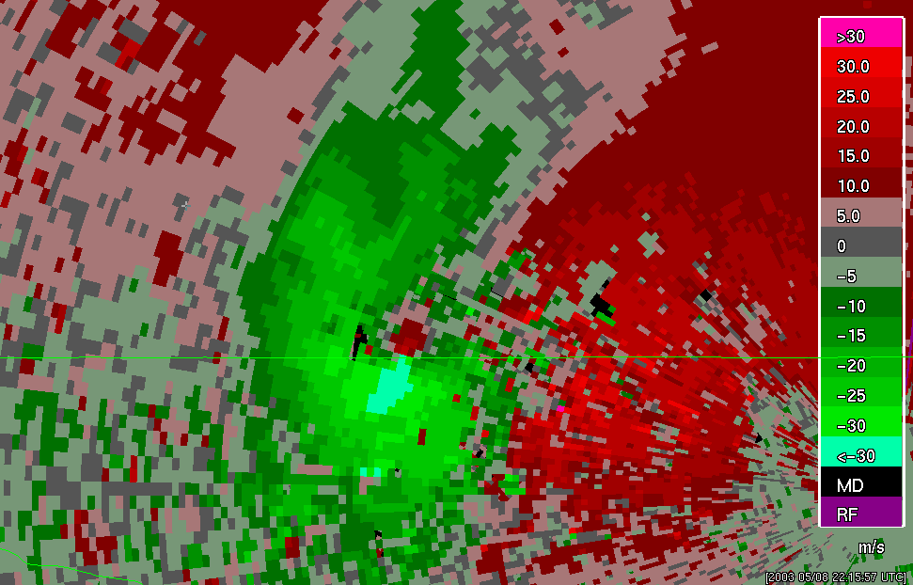
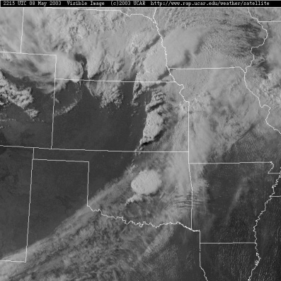
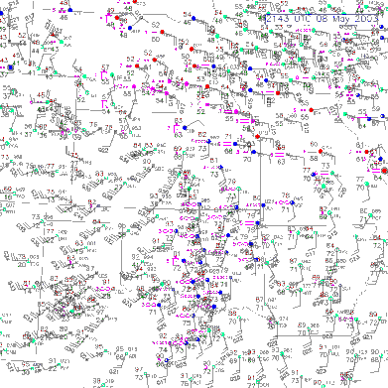
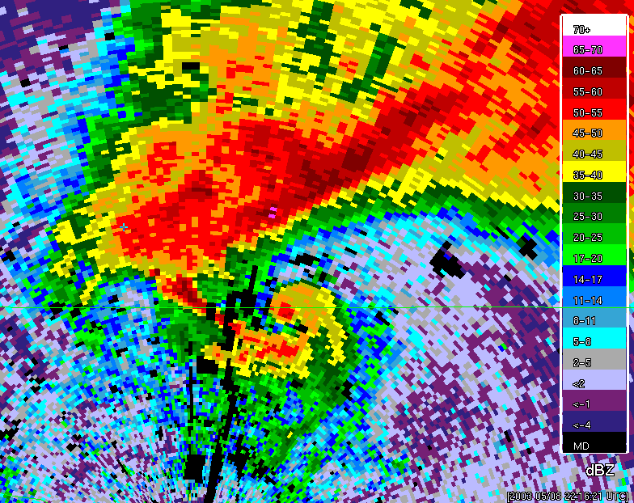
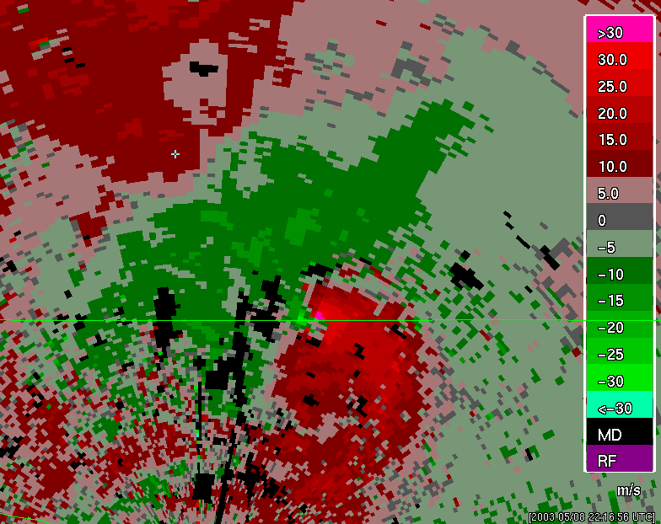
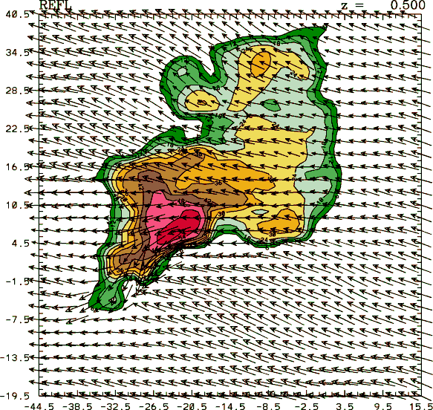
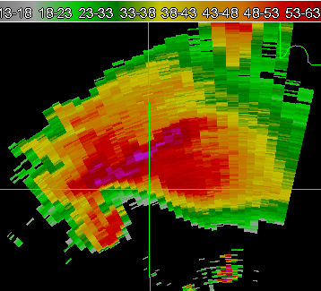
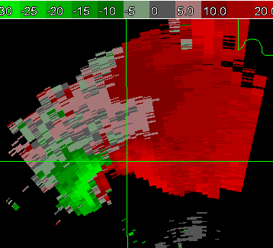
Real-time 3D data assimilation
(3DVAR)
The ultimate multi-sensor data integration – data assimilation
  Combine multi-sensor data with numerical models, in a physically-realistic manner.
New types of
products:
  3D wind fields
  Simulated
  Reflectivity
  Updraft strength
  Vorticity

Slide 14
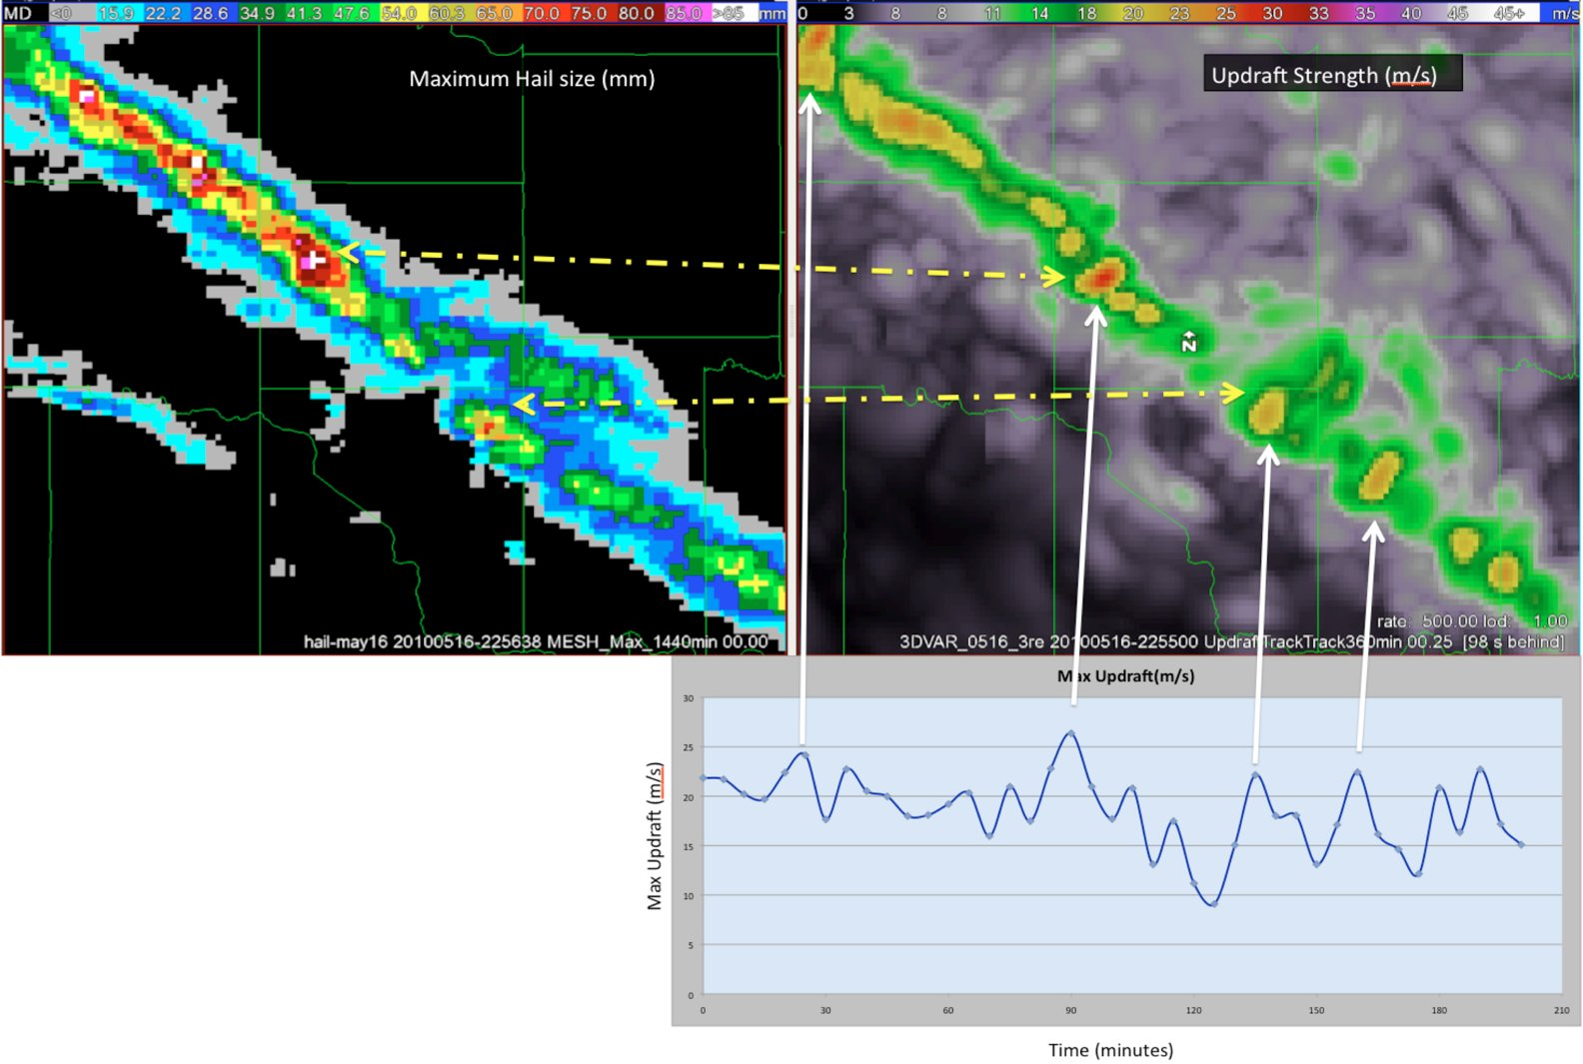
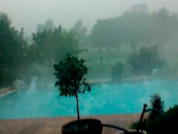
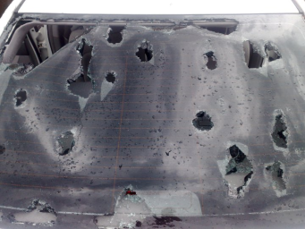
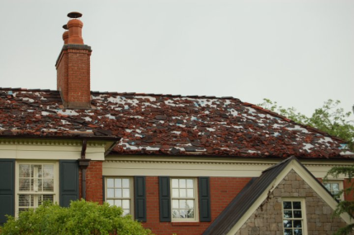
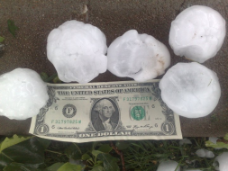
May 16, 2010 Hail Storm / OKC:
Hail Size vs. Updraft Intensity

Slide 15
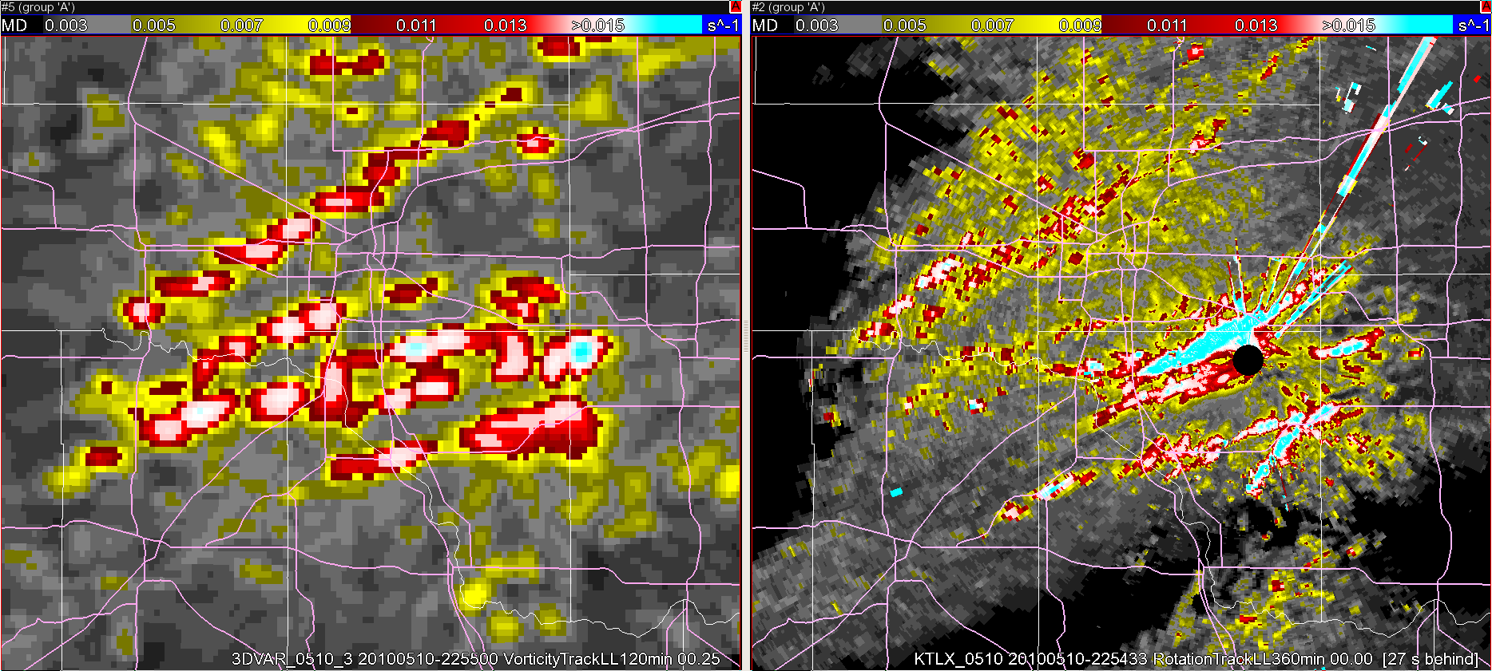
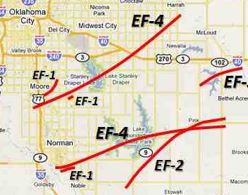
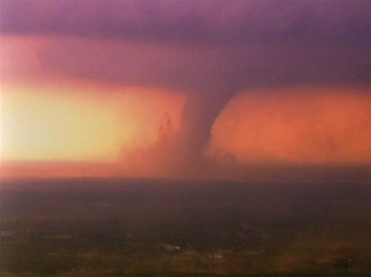
May 10, 2010 Oklahoma Tornadoes:
Radar Shear vs. Vorticity
KTLX azimuthal shear track
0-3 km MSL
3DVAR assimilation vorticity track
0-3 km MSL
Norman, OK

Slide 16
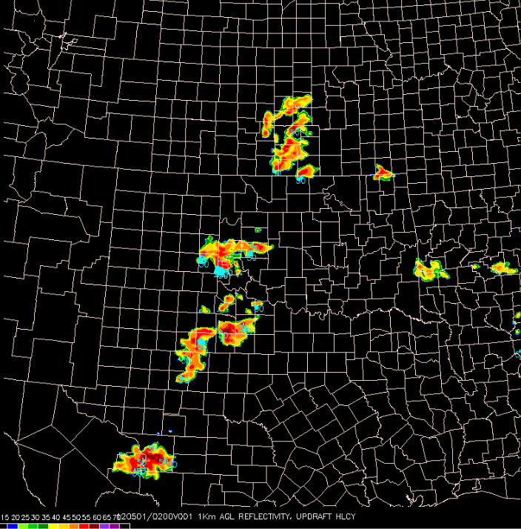
OUN WRF
Specs:
  3-km grid
  Hourly cycle
  15 min fcst intervals out to 8 h
Products:
  Composite Reflectivity
  1-km Reflectivity
  Instantaneous Updraft Helicity
  Maximum Hourly Updraft Helicity
  Maximum Hourly Column Hail
  10-m Wind Speed

Slide 17

Geostationary Operational
Environmental Satellite – R series
To determine readiness of GOES-R “baseline” and “future” products prior to launch of the satellite
  Develop best practices for nowcast/warning decision making
  Prepare for display within AWIPS2

Slide 18
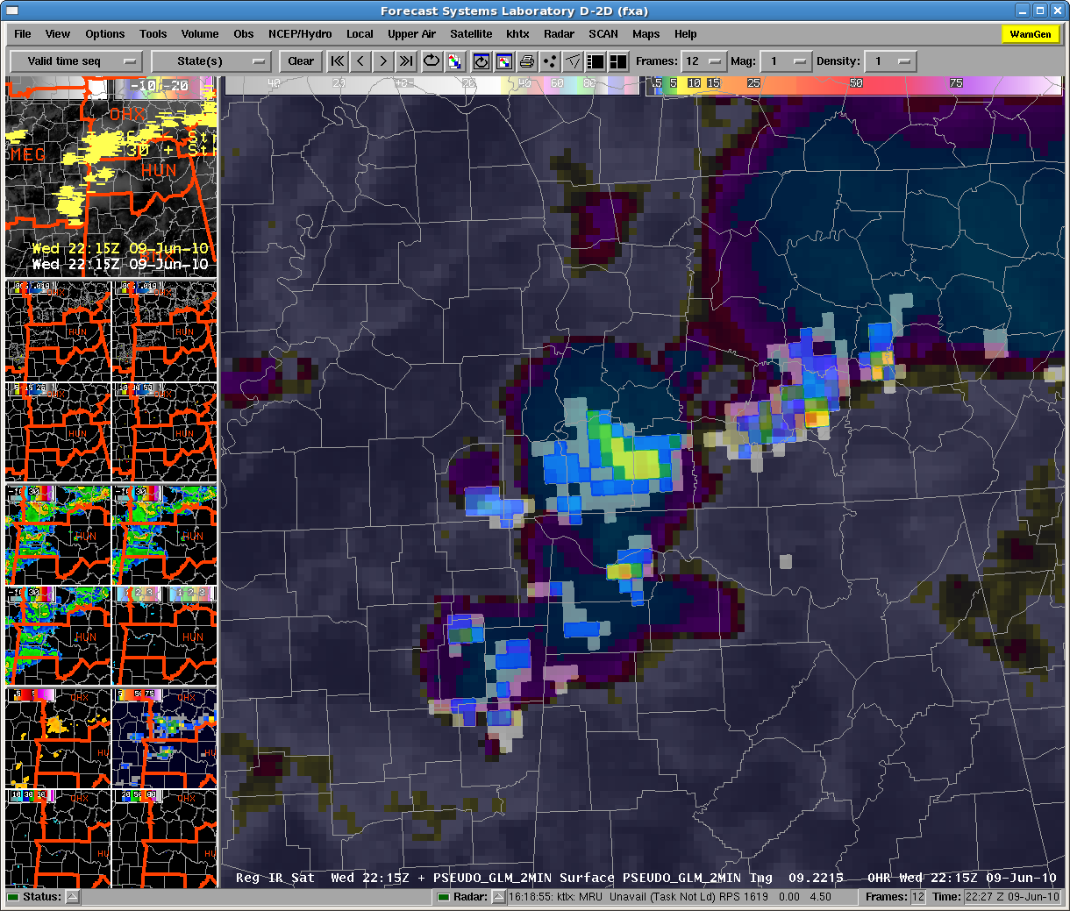
Pseudo-Geostationary Lightning
Mapper (PGLM)

Slide 19
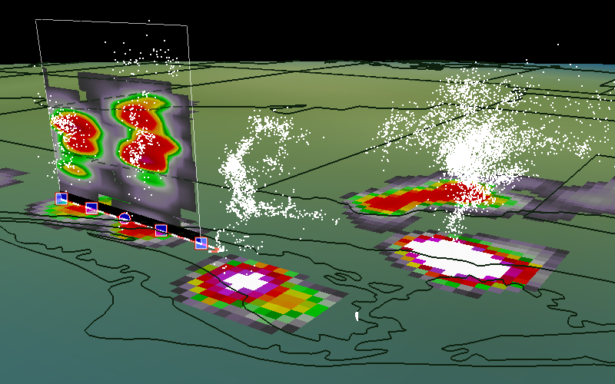
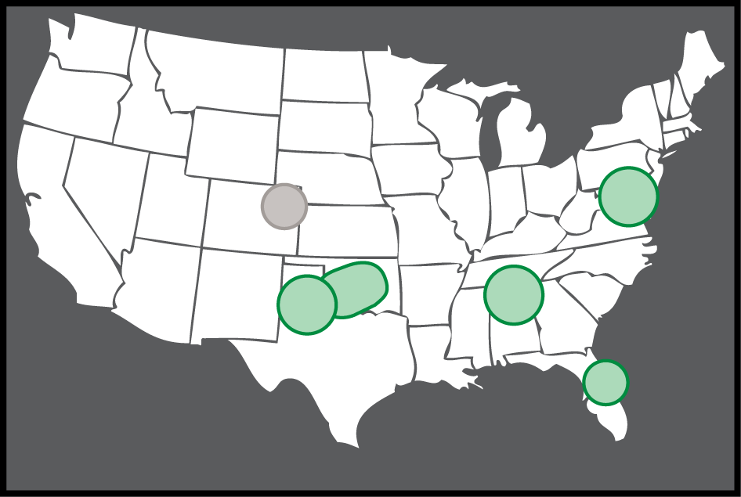
3D Lightning Mapping Array (LMA)
Cloud-to-ground + intra-cloud = total lightning
Used to create PGLM proxy
LMA visualization and attribute extraction (Courtesy: Scott Rudolsky, Florida State University)
LMA Networks

Slide 20
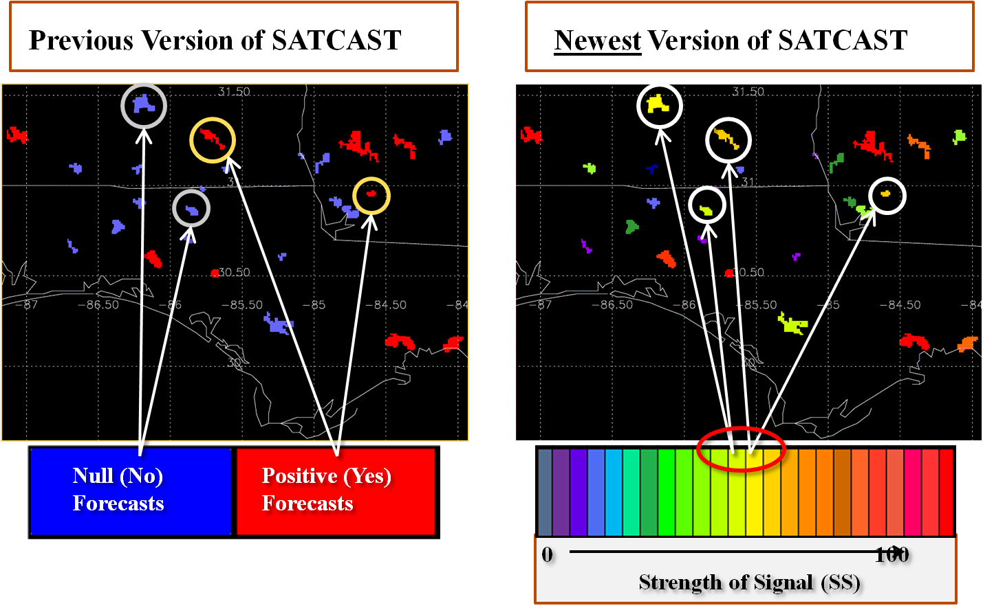
UAH Convective Initiation:
“SATCAST”

Slide 21
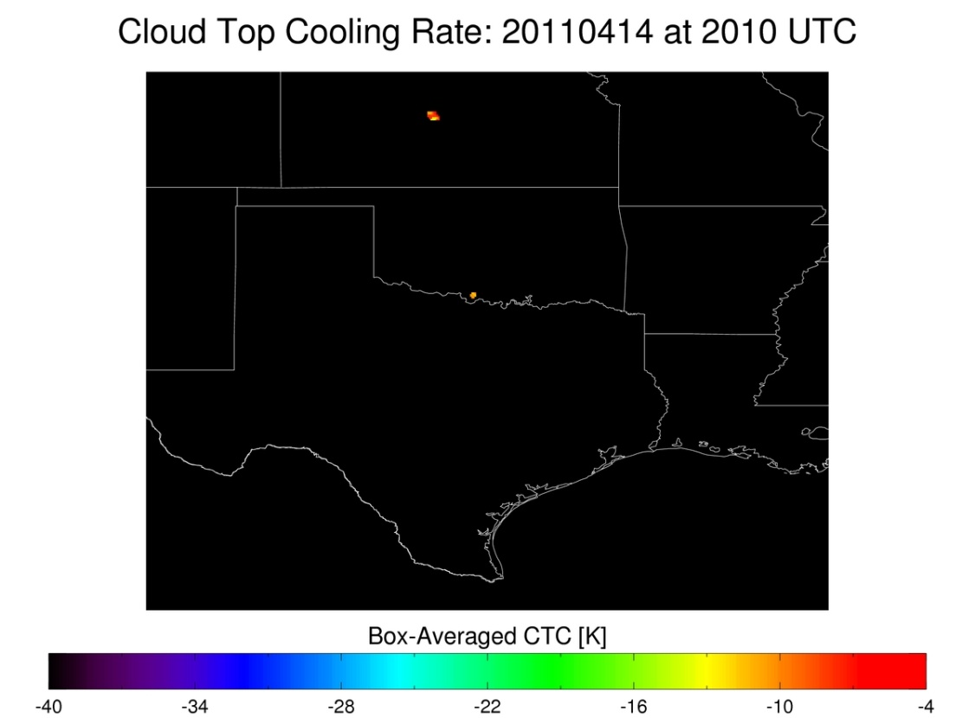

UW Convective Initiation – Cloud Top Cooling:
Detection in Cirrus-covered areas
Thin cirrus above developing convective line prevents detection of vertically growing convective clouds; addition of cloud optical depth allows diagnosis of valid UW-CTC rates

Slide 22
UW Convective Initiation – Cloud Top Cooling:
Relating CTC to Radar/MRMS products
Weak Moderate Strong
UW-CTC UW-CTC UW-CTC
> -10 -10 >= CTC > -20 <= -20

Slide 23
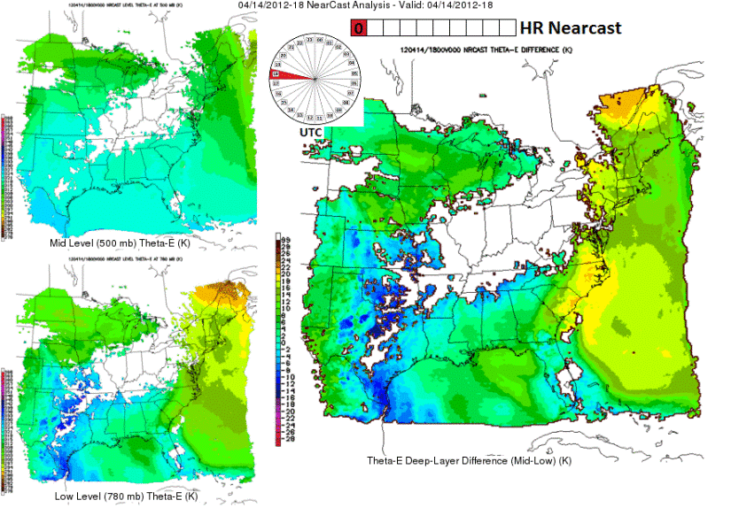
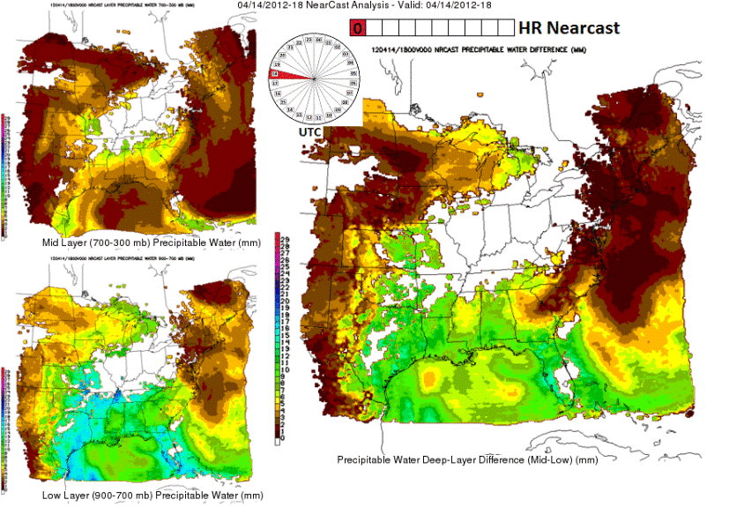
GOES-R - Nearcast
GOES sounder observed PW / theta-e fields advected using a Lagrangian model
  Up to 9-hour forecast
  30-minute intervals
Multi-layer PW difference / gradient
  900-300mb, 900-700mb and 700-300mb
Level theta-e and multi-layer theta-e difference
  500 mb and 780 mb level
  780-500 mb difference

Slide 24
New for EWP in 2012
(Spring Experiment only)
Added an EWP training shift (a 6th day; 8h supernumerary):
  Taken at WFO within two weeks prior to travel to Norman
  Training materials posted online
  WES Virtual Machine Case on DVD, job sheets online
“Flex” shifts
  On Tue, Wed, Thu only
  Normally: 1-9pm
  If weather dictates, may choose: 12-8pm, 2-10pm, 3-11pm
  Time determined at the end of previous day shift
  Based on expected timing of severe using Day2 outlook.
  Allows for greater flexibility to capture weather events.
EWP2012 Webinars: “Tales From the Testbed”

Slide 25
Weekly Webinars
“Tales from the Testbed”
A summary of that week's experience, presented by the NWS participants.
Each Friday from 12-1 CDT (1-2 EDT) from the NWC in Norman.
Each forecaster has 5 minutes to discuss their key takeaway that week.
Audience: WFO/CWSU peers, RHQ, NWHQ, funding agencies.
Facilitated by WDTB (similar to dual-pol "Storm of the Month").
Remainder of the hour will be devoted to Q&A.

Slide 26
Monday Schedule
100p Convene to NSSL Dev Lab (NWC2820)
100p Welcome and Introductions
115p EWP2011 Orientation Briefing
145p Daily weather discussion
215p Break
230p Convene in HWT Operations Area for on-hands AWIPS2 Familiarization; procedure building; screen captures for Webinars
415p Break
445p Real-time warning operations in HWT Operations Area
???p Dinner Break (time chosen based on wx)
815p Fill out feedback survey
845p Day 2 forecast discussion to choose tomorrow’s “flex” shift time
900p Adjourn

Slide 27
Tue-Wed-Thu
“Flex” Shift Schedule
Determined at the end of the previous day’s operations shift, based on expected timing of weather
Start time 12pm, 1pm, 2pm, or 3pm (1-9pm preferred)
Finish 8 hours later
Dinner break time will be based on wx activity
Tue-Wed (last 45 min of shift):
  30 min: forecasters fill out feedback surveys
  15 min: Day 2 “flex” shift time discussion and decision
Thu (last 60 min of shift):
  30 min: forecasters fill out feedback surveys
  30 min: Prepare for Webinar with WDTB facilitator.

Slide 28
Friday Schedule
900am Convene in the WDTB Conference Room
900-1000am Complete Webinar, do dry run (WDTB Conference Room)
1000am Move to the Dev Lab
1000am-1140am Weekly debrief (Dev Lab)
1140am Break to grab lunch, move to WDTB Conference Room
1200pm-100pm EWP2012 Weekly Webinar (WDTB Conference Room)
100pm Operations End for the week

Slide 29
EWP Personnel
Forecasters/Evaluators
Weekly Coordinator
Webinar Facilitator (WDTB)
Project Scientists
EWP Officers
  Travis Smith (co-Team Leader)
  David Andra (co-Team Leader)
  Greg Stumpf (Operations Coordinator)
  Darrel Kingfield (IT Coordinator)

Slide 30


EWP Technology in the HWT
NWS Advanced Weather Interactive Processing System 2 (AWIPS2):
  Can emulate any forecast office nationwide
  Displays experimental products
  Issue experimental warnings
Situational Awareness Display (SAD)
  Television feeds
  Streaming storm chaser dash cams
  etc…

Slide 31


EWP Web Presence
External (public)
  http://ewp.nssl.noaa.gov
  Content:
    General Information about the EWP
    Past experiment information
Internal (private)
  https://secure.nssl.noaa.gov/projects/ewp2012/
    NOAA LDAP user and password
  Content:
    The EWP Blog
    Operations Plans
    Training Materials
    Schedules (Google Calendar)
    Other useful links

Slide 32
Future EWP Possibilities
AWIPS2
Activities outside of Spring season
Crossover project with EFP
Social Science customer studies of new services

Slide 33
EWP Final Thoughts
This is a research experiment…
  …therefore, expect to be glitches, bugs, and wrinkles!
Try to focus beyond these glitches toward the bigger picture:
  To the future of NWS nowcast/warning operations and services

Slide 34
EWP Final Thoughts
Learn about exciting new technology
Share your knowledge with your peers
Have fun!

