Slide 1
University of Wisconsin Convective Initiation – Cloud Top Cooling (UWCI-CTC)
Algorithm Overview
2012 SPC HWT Training
Justin Sieglaff
Lee Cronce
Wayne Feltz

Slide 2
UW-CTC Users/History
History
Spring 2009 initial SPC HWT evaluation
Fall 2009 modifications to approach based on HWT feedback
Early 2011 peer-reviewed journal article published
Spring 2012 added capability to operate in thin cirrus during daytime
Users
SPC Hazardous Weather Testbed (2009-2012)
Local NWS MKX WFO GOES-R PG Testbed (2009-2012)
9 total NWS WFOs receiving UW-CTC products (since 2009) from eastern, central, and western regions

Slide 3
UW-CTC Inputs
11 μm brightness temperatures
GOES(-R) Cloud Mask (utilizes multiple spectral bands)
  Heidinger, 2010
GOES(-R) Cloud Type (utilizes multiple spectral bands)
  Pavolonis, 2010
GOES(-R) Cloud Optical Depth Retrievals
  Walther et al., 2012
UWCI-CTC utilizes operational GOES (and later GOES-R) products

Slide 4
UW-CTC Goals
Quantitatively diagnose vertical convective cloud growth using cloud-top cooling rate; capture more significant convection
Relate UW-CTC rate to future NEXRAD observations for the same storms
  Allows for relationships to be determined between UW-CTC rate magnitudes and NEXRAD observations
  Show prognostic value of satellite-based measure of vertical cloud growth rate
4

Slide 5
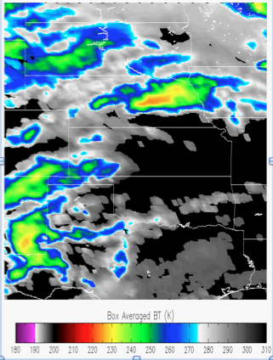
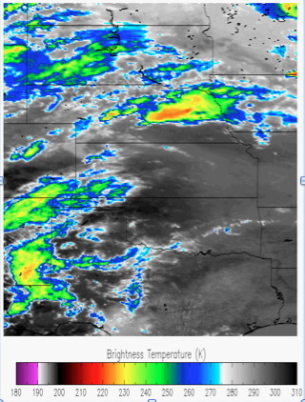
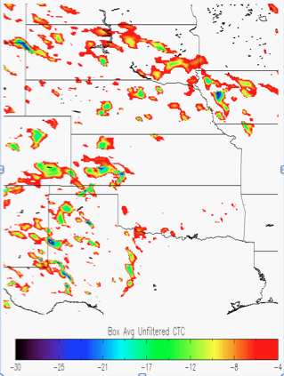
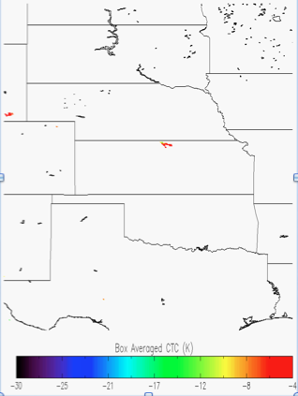
UW-CTC Overview
High-level algorithm overview
Compute box-averaged 11 micron brightness temperature (BT) for current time and previous time, using specific categories from GOES Cloud Typing product (Sieglaff et al., 2011)
Unfiltered Cloud Top Cooling (CTC) Rate is calculated by differencing box average 11 micron BT for current time from previous time
Large/small box approach eliminates most of false CTC due to cloud motion (and additional checks reduce false cooling further)
Complete approach details can be found in Sieglaff et al., 2011
5

Slide 6
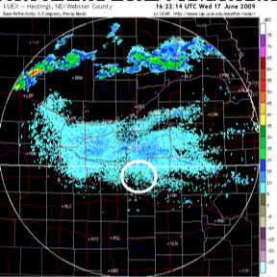
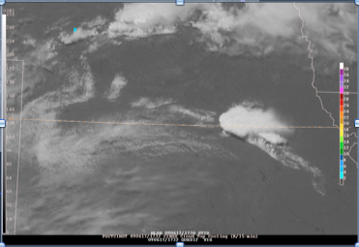
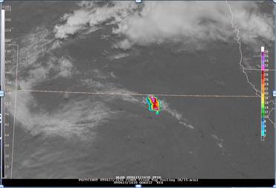
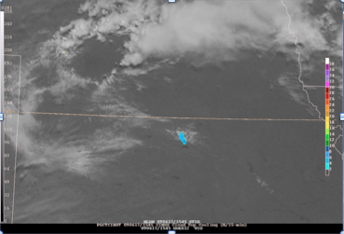
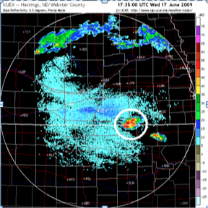
First NEXRAD 35+ dBz echo at 1622 UTC
Example from June 17, 2009
over Northern KS
First UW-CTC rate signal precedes
NEXRAD 35 dBZ signal by 37 minutes
NEXRAD at 1735 UTC
1545 UTC- First cloud top cooling signal
1610 UTC- Continued cooling signal
1732 UTC- Severe thunderstorm on radar
Hastings, NE Base Refl.
6

Slide 7
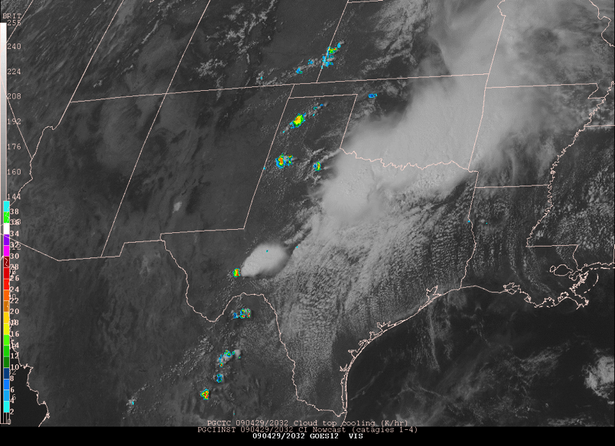
2009-04-29 Dryline Case
Notes:
Dryline case in Texas. You know convection will fire. How can you tell where? Cloud-top cooling on top of visible imagery keys on strongest vertical growth

Slide 8
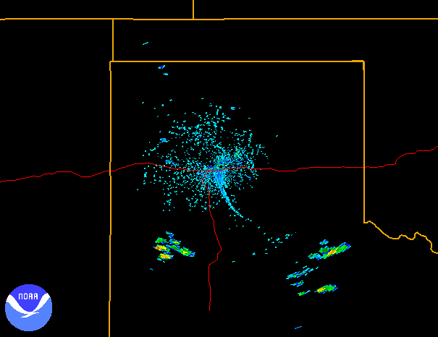
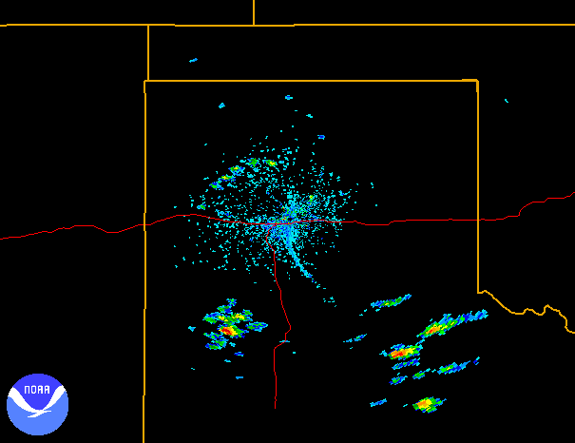
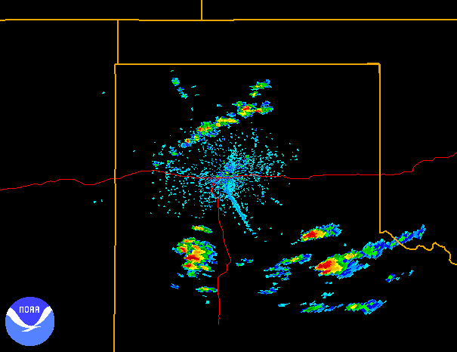
KAMA 2018 UTC Base Reflectivity
Strong UW-CTC rate at 2015 UTC
KAMA 2035 UTC Base Reflectivity
KAMA 2103 UTC Base Reflectivity
First echo >= 35 dBZ, 17 minutes after ~ -25 K /15 min CTC rate
Notes:
UW CTC rates before radar echoes show up: Lead time is there in convective development

Slide 9
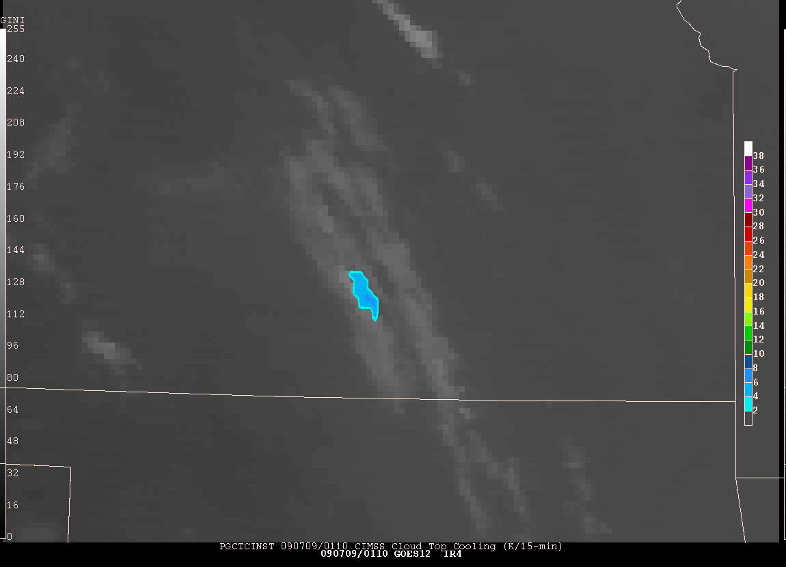
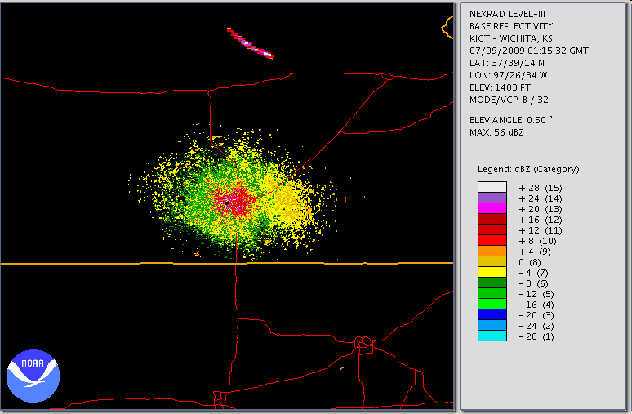
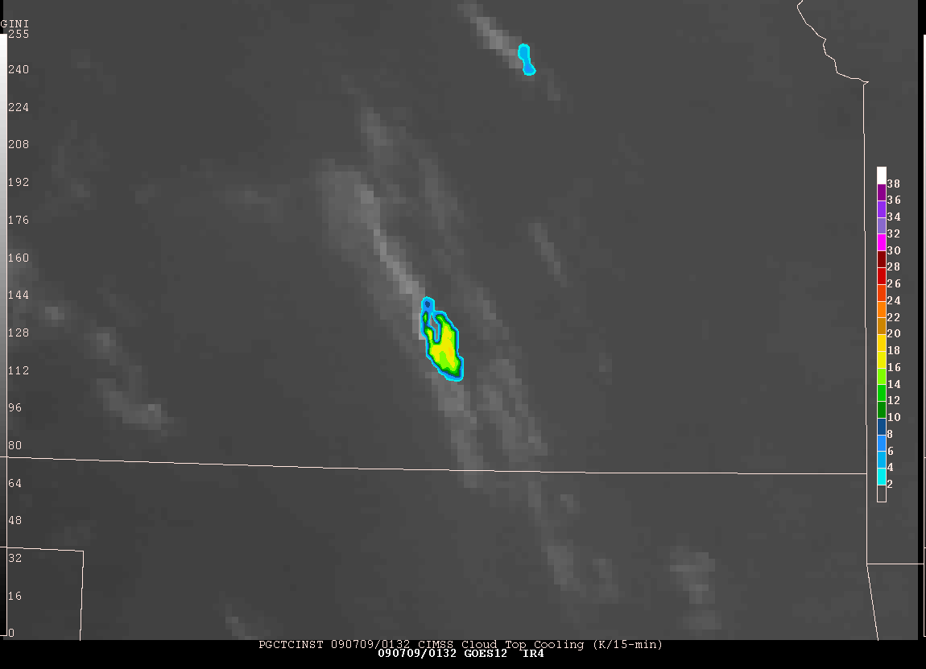
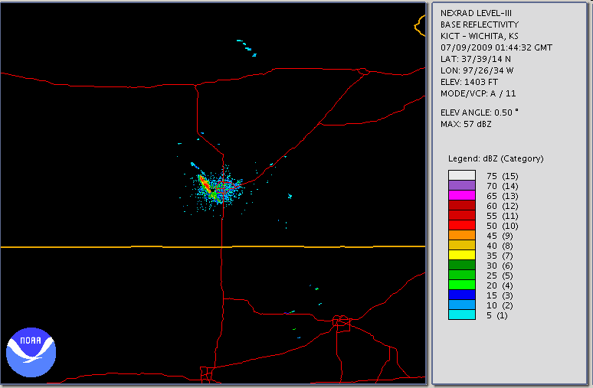
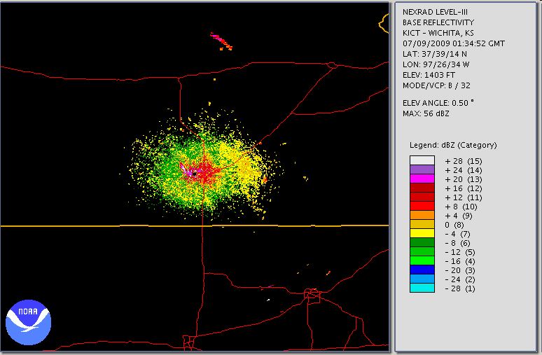
2009-07-09 Evening Example
Radar reflectivity in clear
air mode at 0115Z
CTC on IR4 image at 0110Z
IR4 image at 0202Z
CTC on IR4 image at 0132Z
Radar reflectivity
at 0144Z
IR4 and CI at 0145Z
Radar reflectivity above
28 dBz at 0134Z
Again UW-CTC overlaid on infrared window
Kansas reported hail (largest 2.75” at 0216Z)
Notes:
Cloud-top cooling gives lead time for severe thunderstorm

Slide 10
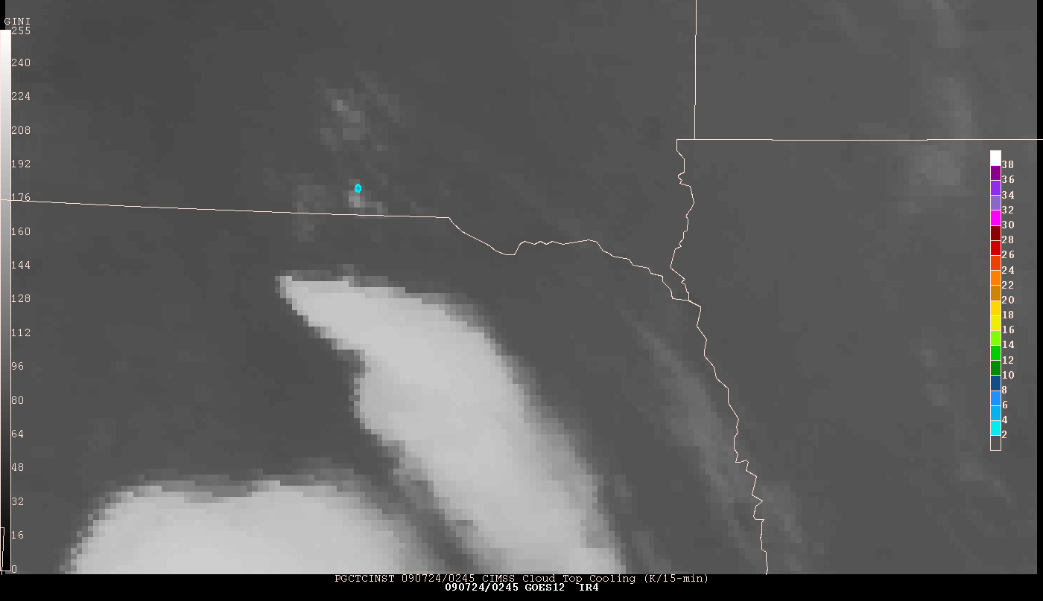
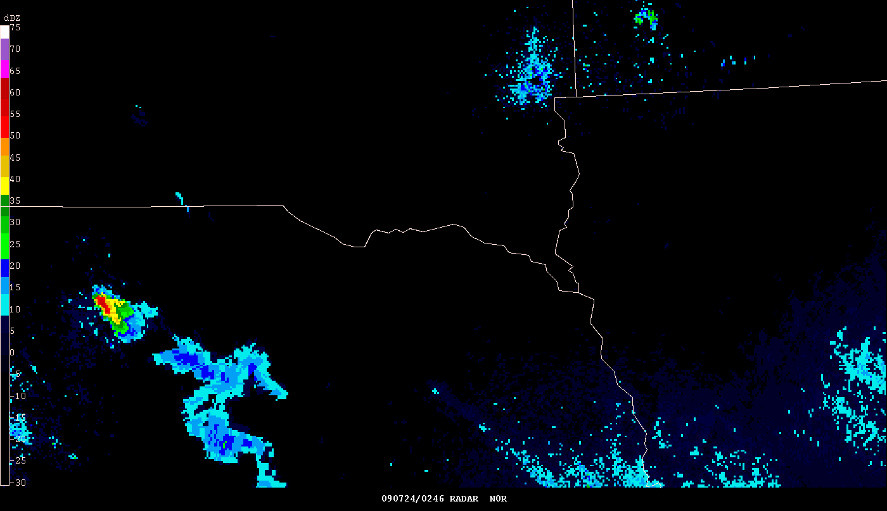
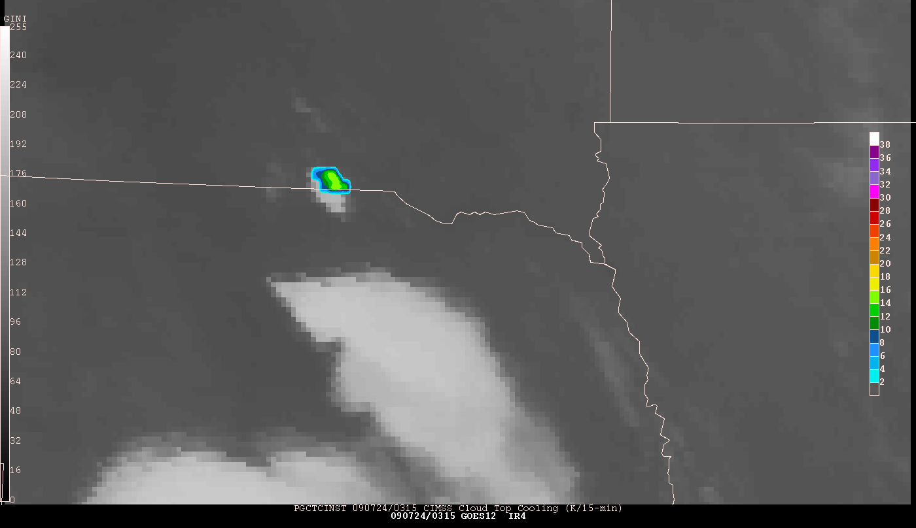
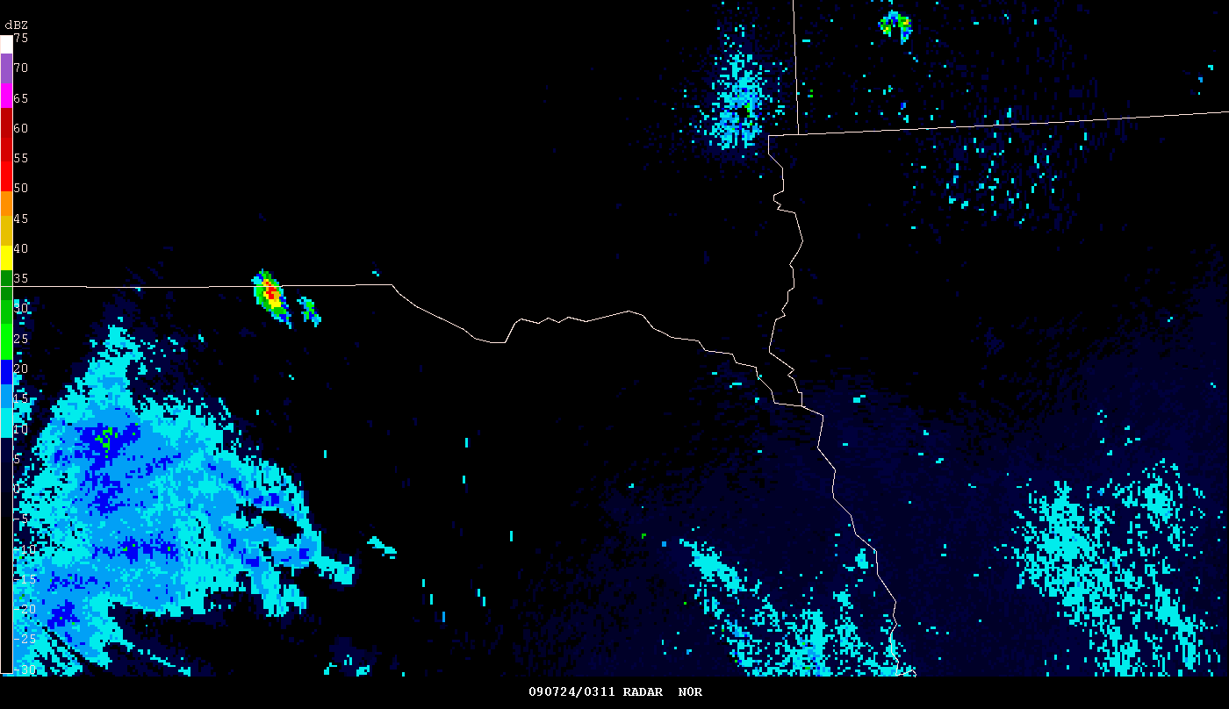
Nebraska 2009-07-24: Nighttime Example
IRW image andUW-CTC at 0245Z
Radar reflectivity at 0246Z
IRW image and UW-CTC at 0315Z
Radar reflectivity at 0311Z
Notes:
CTC keys on pixels that are growing most rapidly

Slide 11
Responding to Forecaster Feedback
Spring 2012 added ability to monitor vertical cloud growth during daytime in areas of thin cirrus clouds by incorporating GOES Visible Cloud Optical Depth retrievals
  This was the largest deficiency identified by forecasters at various testbeds.
Relating Cloud-Top Cooling rates to various NEXRAD fields (reflectivity, VIL, MESH, Echo Tops, etc.)
  Most forecasters preferred the cloud-top cooling rate over the CI nowcast decision; many hypothesized more intense cloud-top cooling rates correspond to more rapid and vigorous short-term convective development
  UW-CTC rates and future radar development is the focus for 2012.

Slide 12
Responding to Forecaster Feedback
UW-CTC in areas thin cirrus
Original UWCI-CTC algorithm was designed to NOT operate in areas of ice clouds
  A cloud-top cooling rate when ice clouds are above lower water clouds can be ambiguous:
    Upper ice cloud is thickening and hence BT is cooling
    Lower water cloud is growing vertically and hence BT is cooling
    Any combination of the two processes
Inclusion of GOES Cloud Optical Depth retrieval allows for operation in areas of cirrus clouds
  Increasing cloud optical depth is related to rapidly growing lower level clouds in these two cloud layer situations (cirrus clouds have very low cloud optical depths)
    Allows us to trust cooling rate signal is due to vertical growth of lower clouds
  Following examples illustrate added daytime cirrus covered monitoring capability
  If optical depth of cirrus is too thick (e.g.-mature thunderstorm anvils) satellite-based growth cannot be used/determined

Slide 13
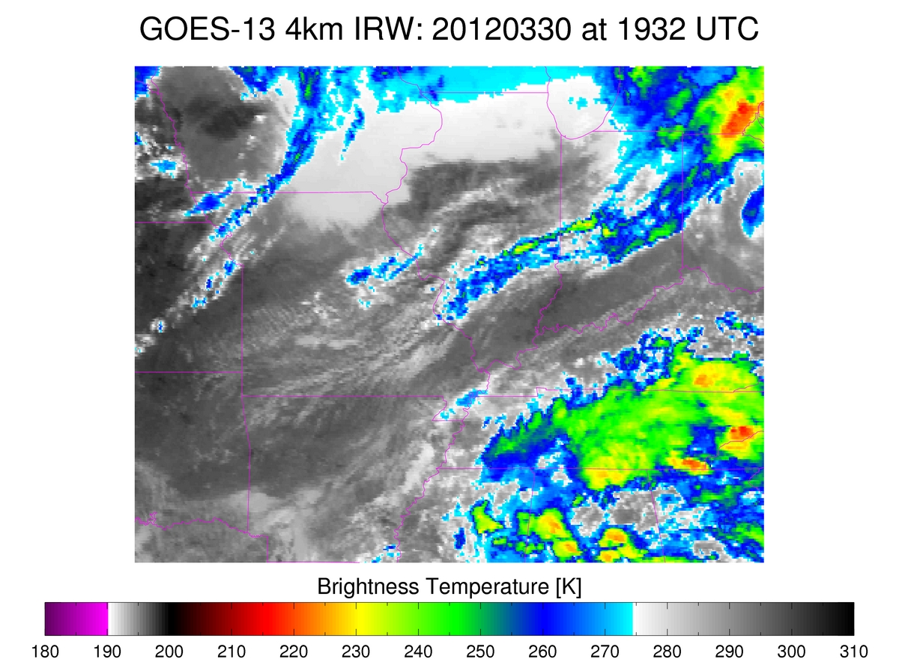
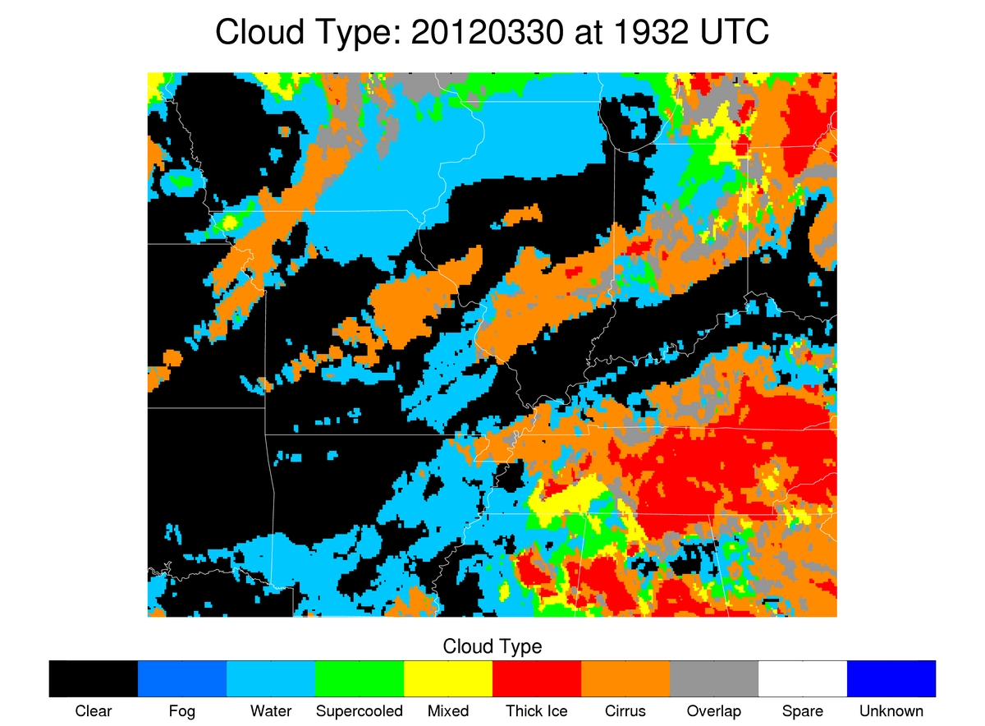
Responding to Forecaster Feedback
UW-CTC in areas thin cirrus
Thin cirrus above developing convective line prevents detection of vertically growing convective clouds

Slide 14
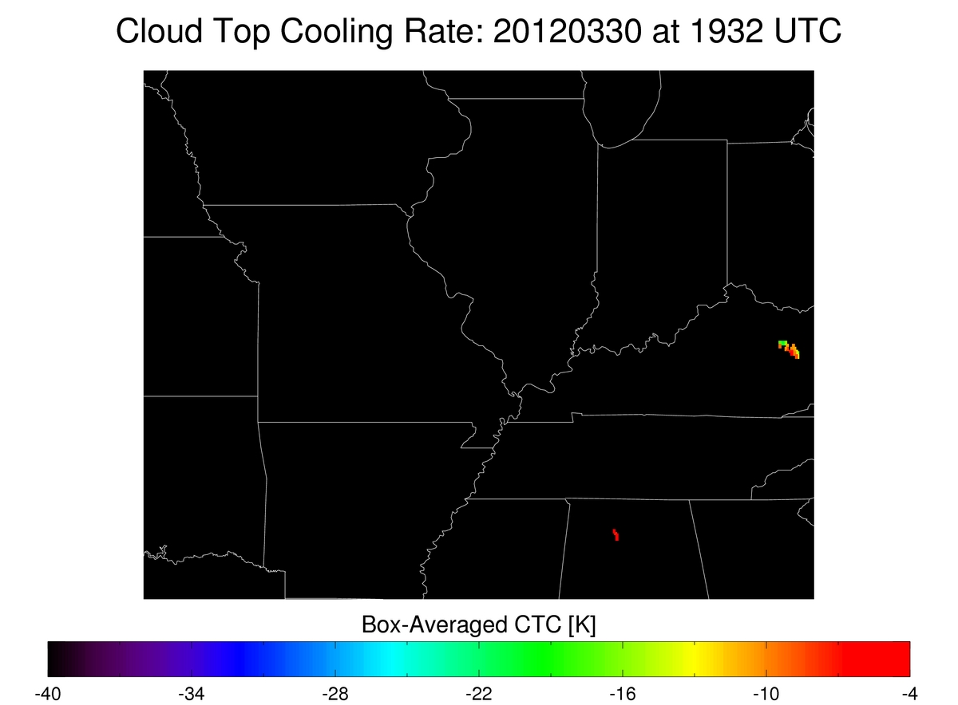

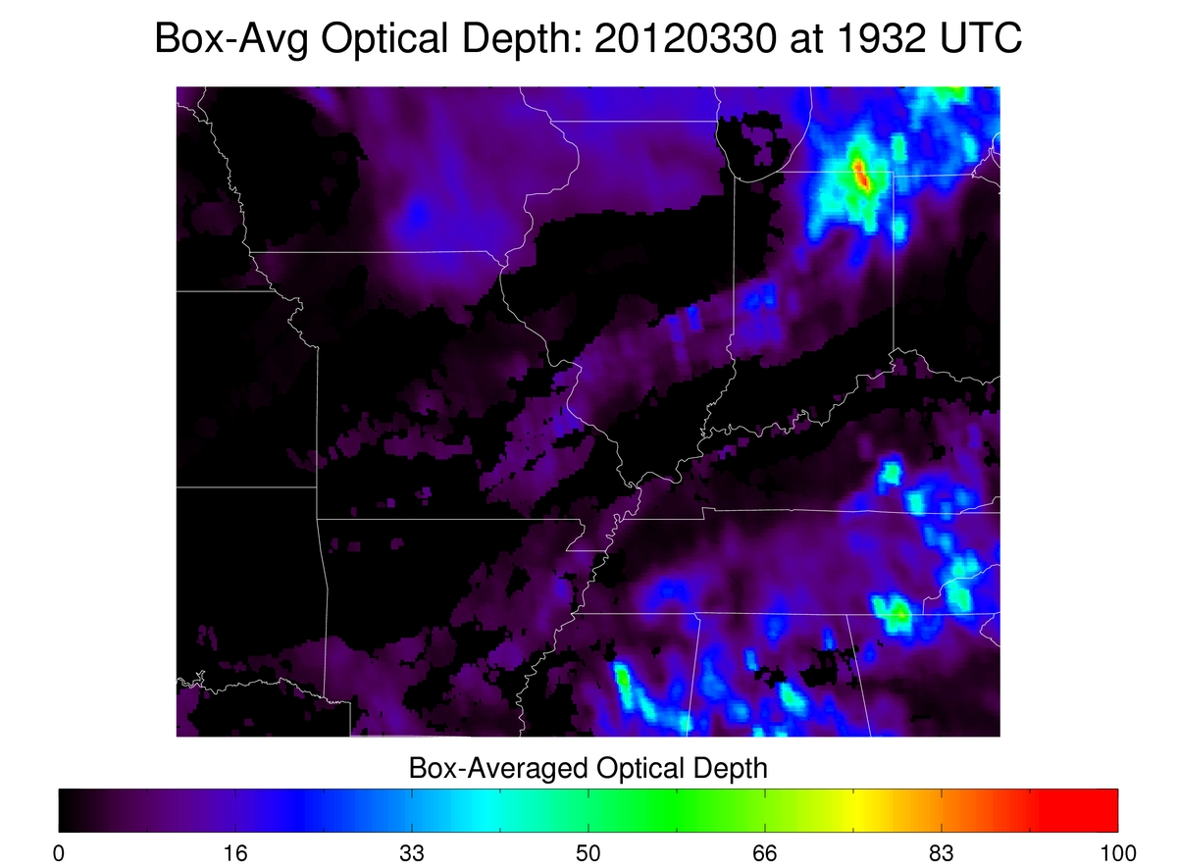
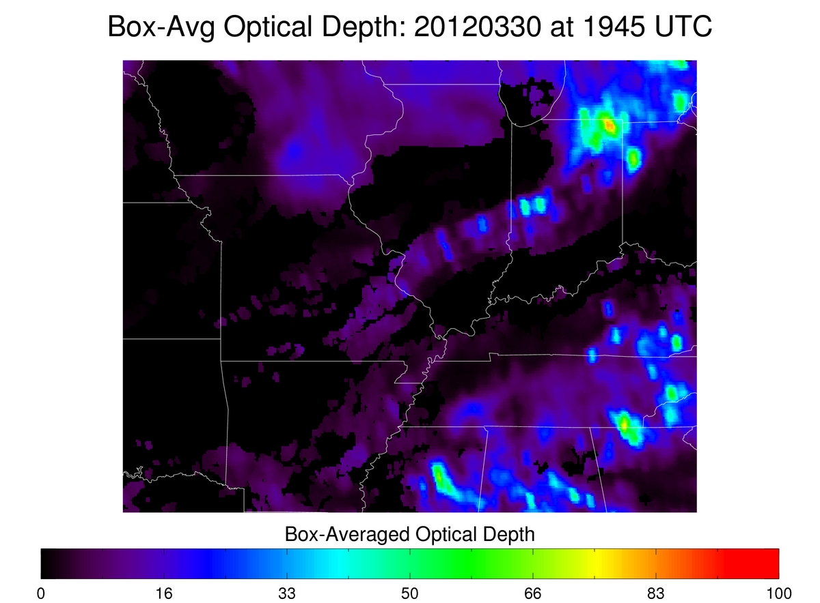
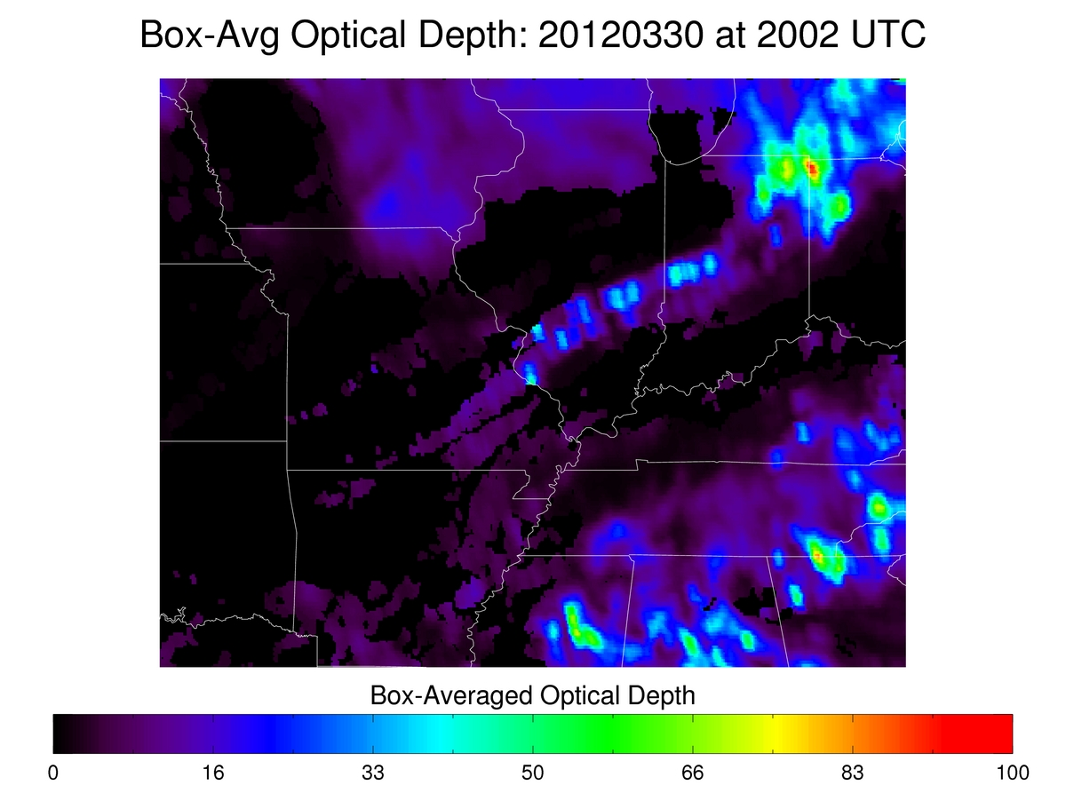
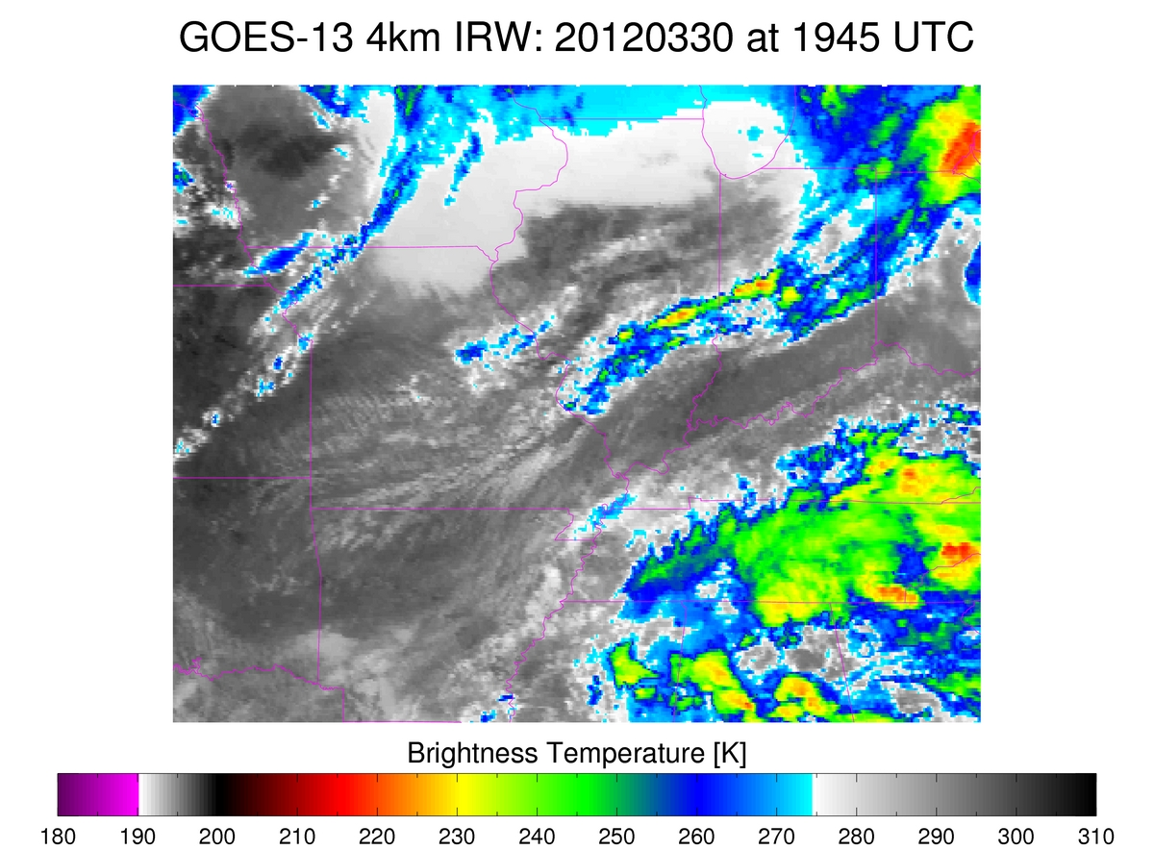
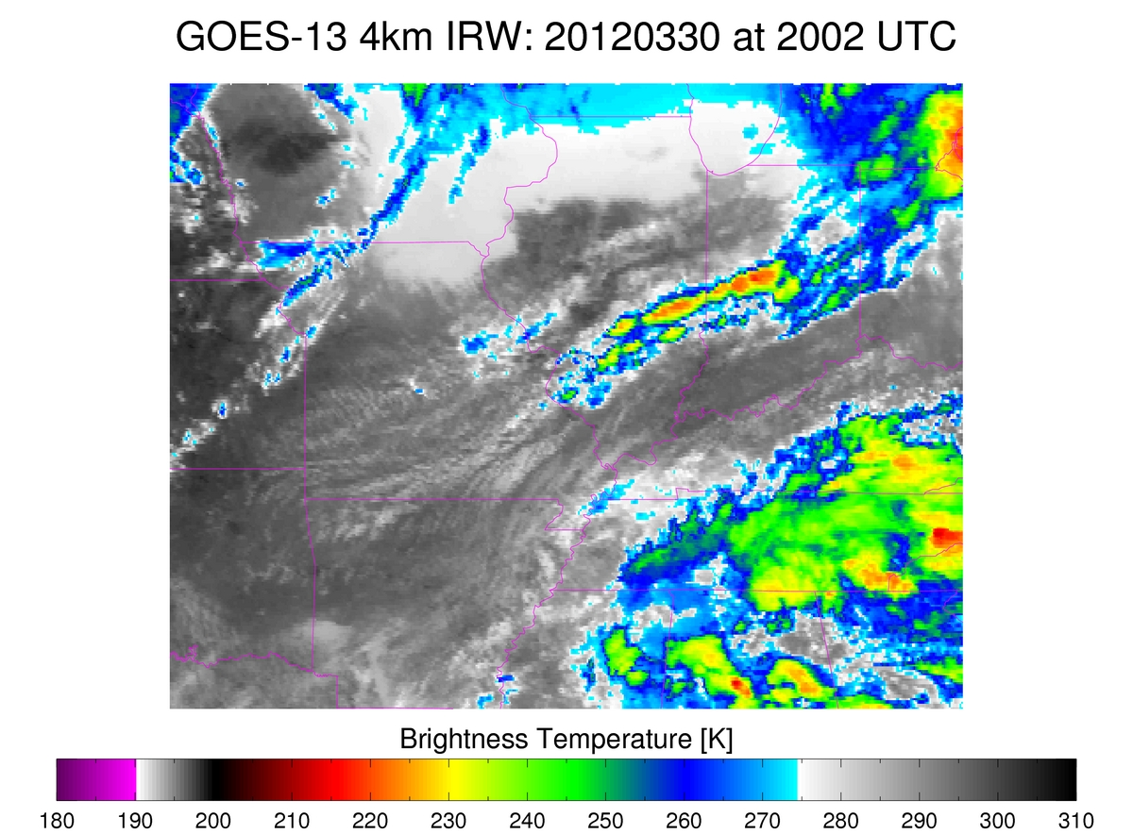
Responding to Forecaster Feedback
UW-CTC in areas thin cirrus
Note how previously developing convection was missed, but by adding cloud optical depth the developing line was diagnosed with valid UW-CTC rates. (Development on the southwestern portion of the line was captured after 1932 UTC.)
Thin cirrus above developing convective line prevents detection of vertically growing convective clouds
Cloud optical depth increase allows cloud-top cooling rate to be used

Slide 15
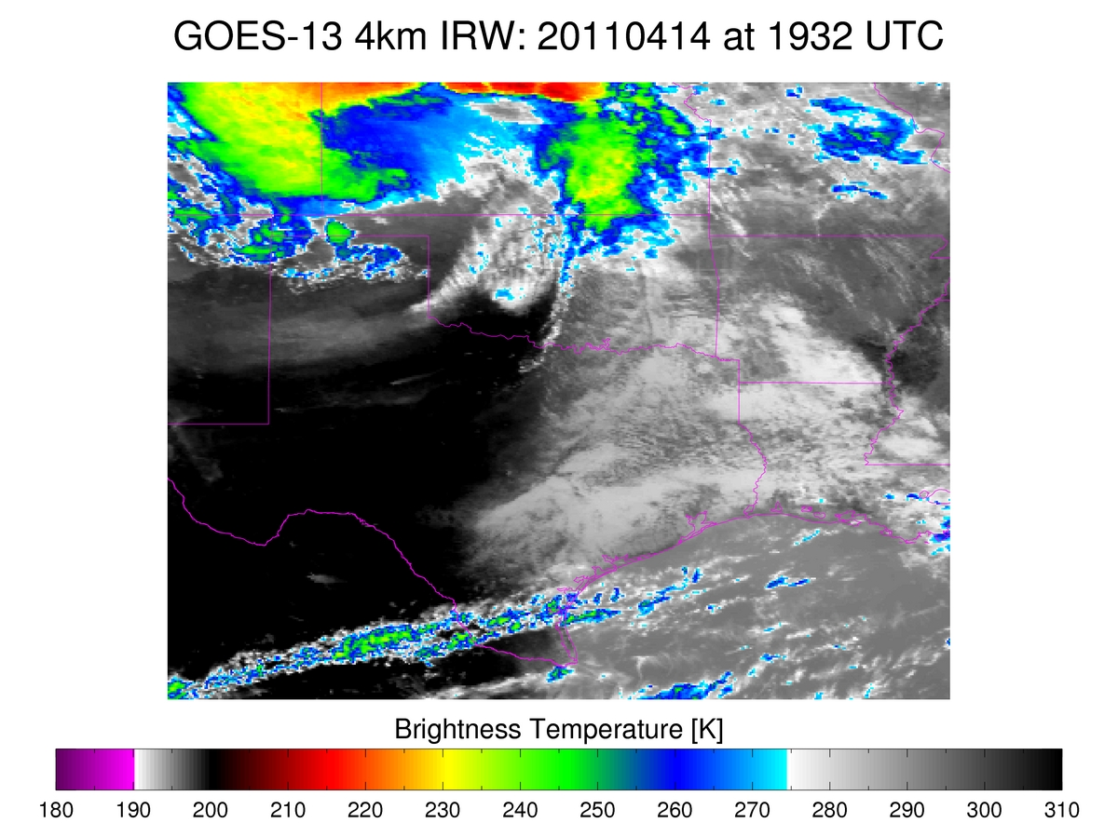
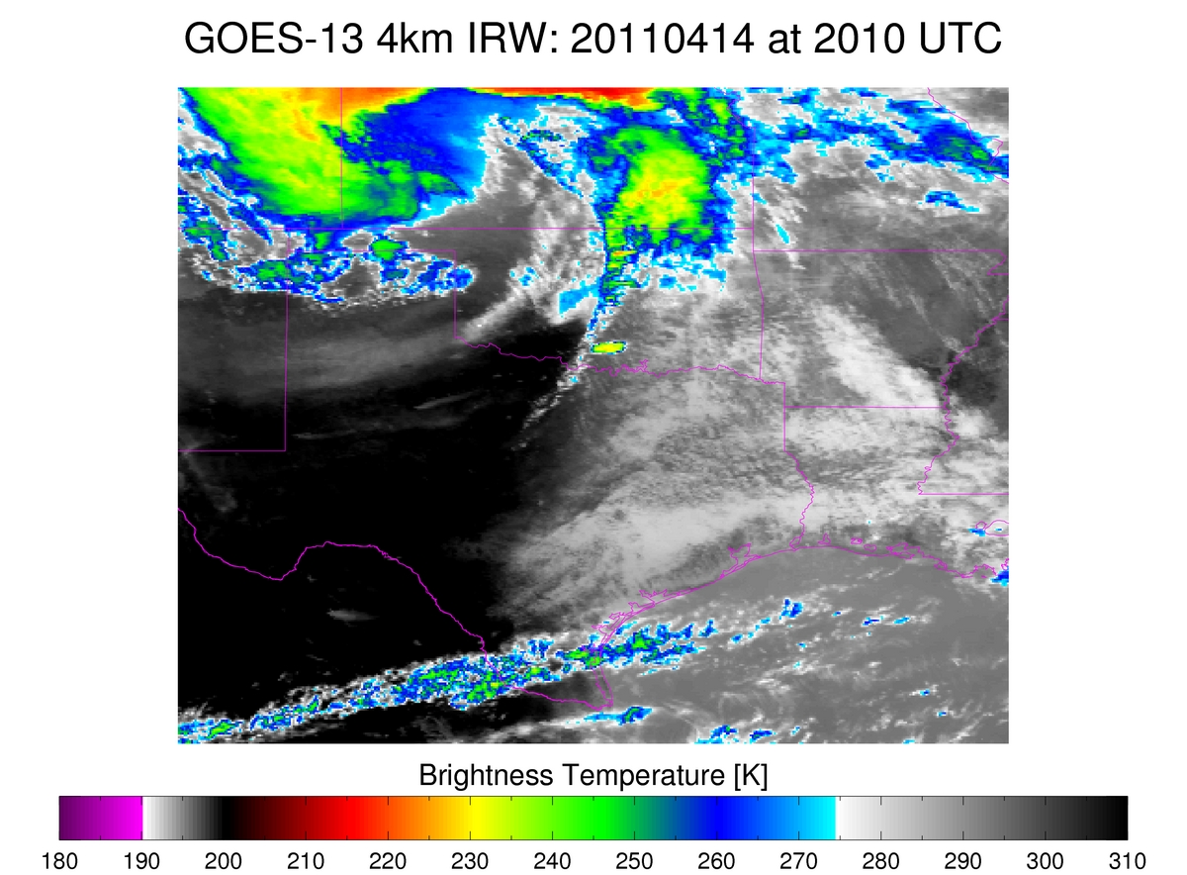
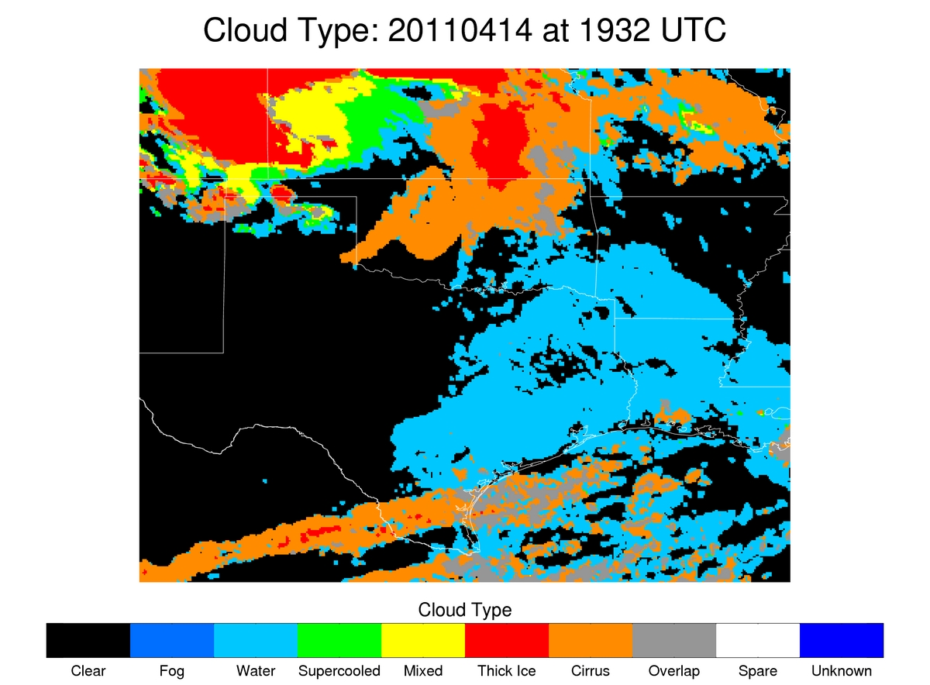
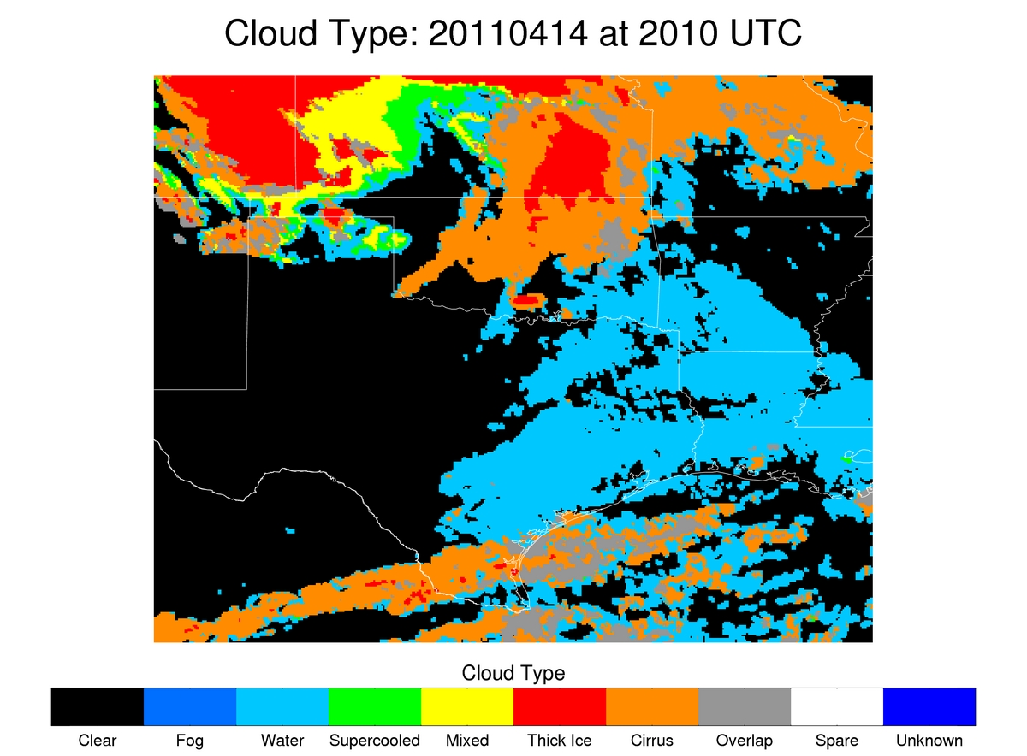
Responding to Forecaster Feedback
UW-CTC in areas thin cirrus
Thin cirrus above developing convective line prevents detection of vertically growing convective clouds; addition of cloud optical depth allows diagnosis of valid UW-CTC rates

Slide 16
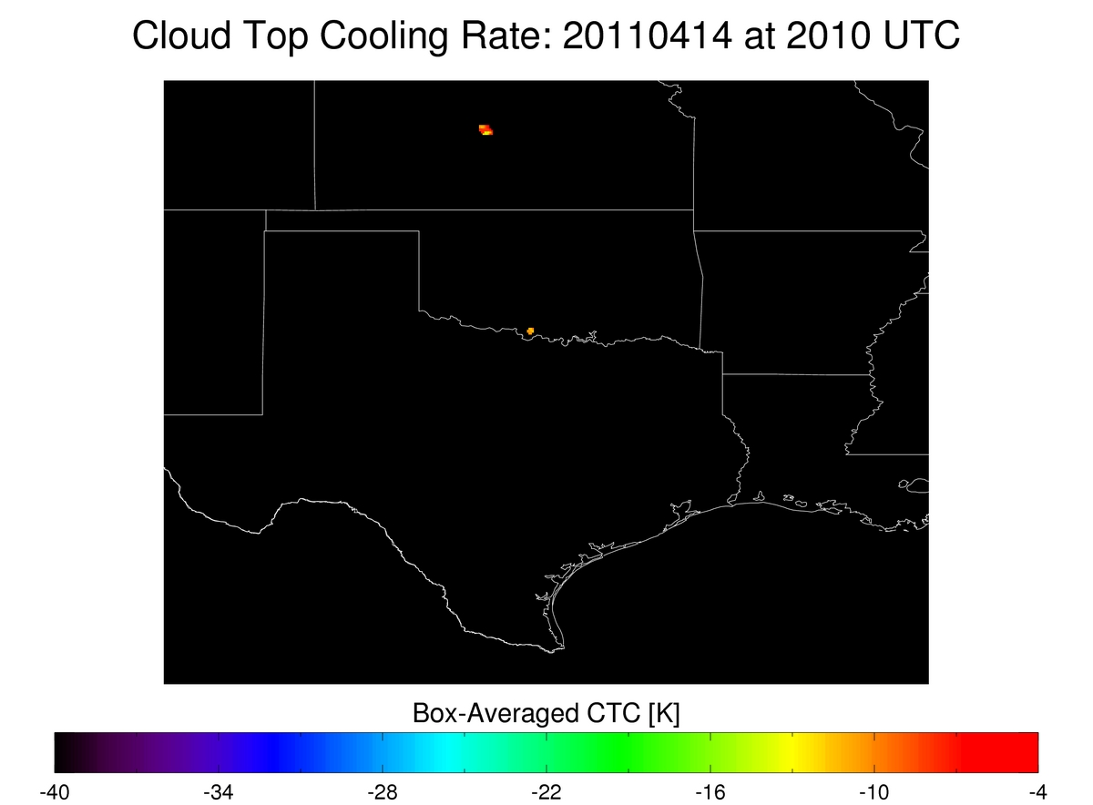

Responding to Forecaster Feedback
UW-CTC in areas thin cirrus
Thin cirrus above developing convective line prevents detection of vertically growing convective clouds; addition of cloud optical depth allows diagnosis of valid UW-CTC rates

Slide 17
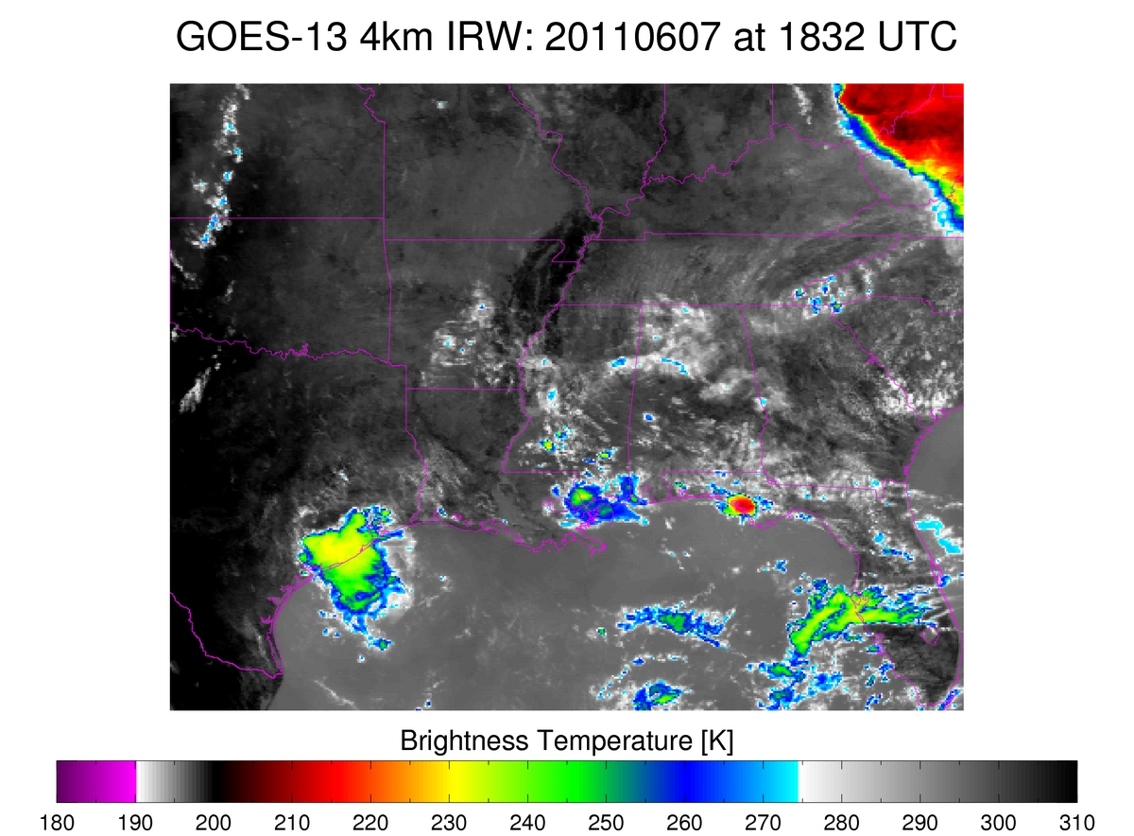
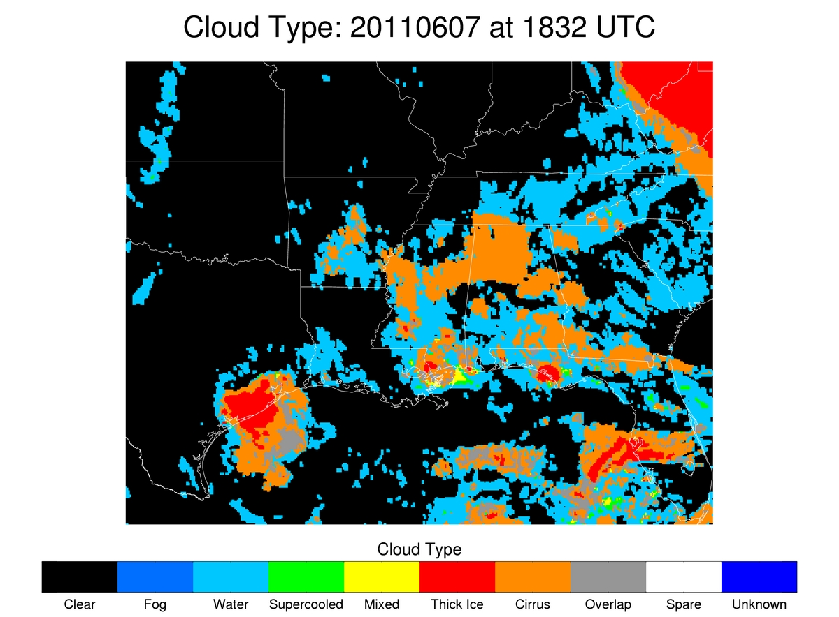
Responding to Forecaster Feedback
UW-CTC in areas thin cirrus
Thin cirrus above developing convection prevents detection of vertically growing convective clouds; addition of cloud optical depth allows diagnosis of valid UW-CTC rates

Slide 18
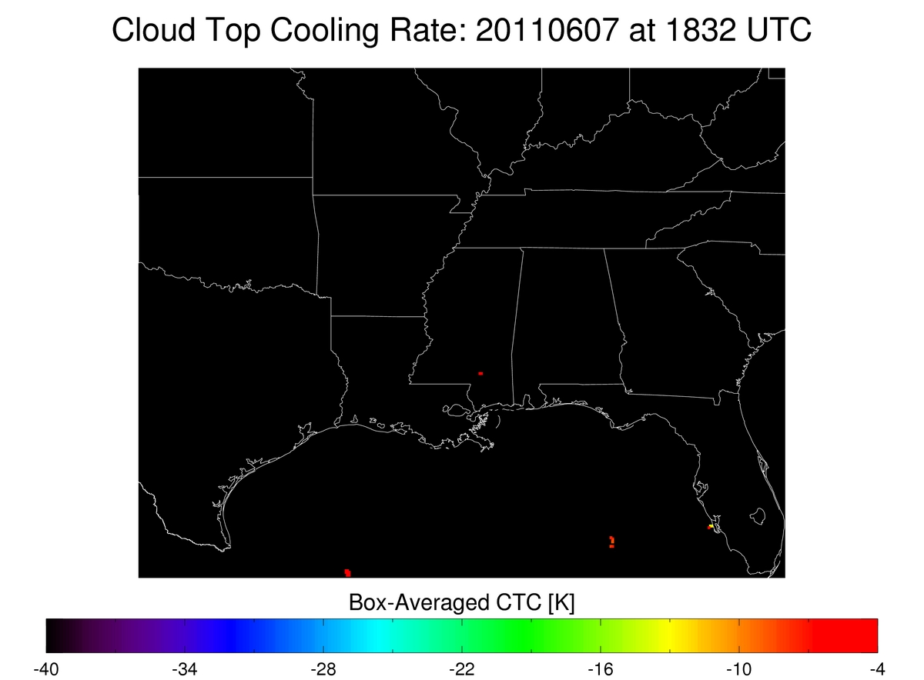
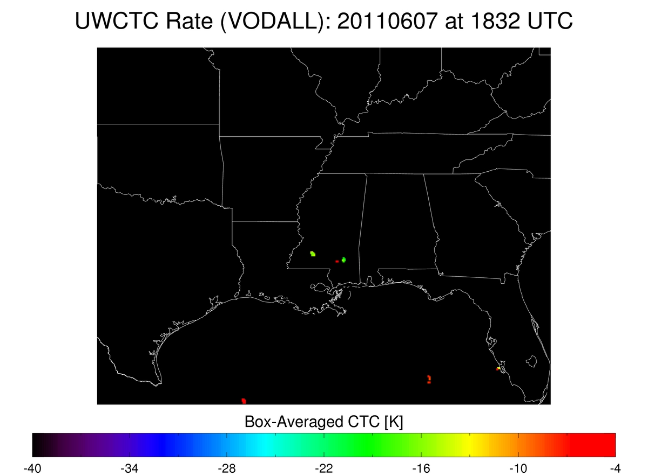
Responding to Forecaster Feedback
UW-CTC in areas thin cirrus
Thin cirrus above developing convection prevents detection of vertically growing convective clouds; addition of cloud optical depth allows diagnosis of valid UW-CTC rates

Slide 19
Responding to Forecaster Feedback Relating UW-CTC to NEXRAD
UW/CIMSS developed a methodology to automatically identify convective cloud-objects and track those objects from their infancy into the mature phase (Sieglaff et al., 2012)
Utilizing the above convective cloud object-tracking methodology Hartung et al., 2012 have related UW-CTC rates to various NEXRAD fields for 34 convective events over the Central and Southern Plains
Key objective: Understand prognostic value of UW-CTC with future NEXRAD observations/algorithm output
  Can added information help increase severe thunderstorm warning lead-time?

Slide 20
Responding to Forecaster Feedback Relating UW-CTC to NEXRAD
An example of the cloud object creation, tracking, and data fusing capability. The time above contains convective clouds at various stages of convective life cycle created from GOES infrared window top of troposphere emissivity (left). Corresponding cloud objects are outlined in gray atop the NEXRAD composite reflectivity and those cloud objects are color shaded by maximum reflectivity (right).
The cloud objects are tracked through time and space from their infancy (very small objects) into the mature phase (hundreds of GOES IR pixels). By associating a unique ID with each cloud object it is possible to track the evolution of multiple data fields specific to each object (for example UWCTC rate, various NEXRAD fields, NLDN, NWP data, etc.)

Slide 21
Responding to Forecaster Feedback Relating UW-CTC to NEXRAD
Analysis grouped UW-CTC rates into three bins; weak, moderate, and strong
Red line indicates median value of each UW-CTC bin, blue box represents 25th and 75th percentiles of the data, and whiskers correspond to 1σ values of each bin
Lack of overlap of notches in the blue boxes between each UW-CTC bin indicates the medians are statistically different to the 95% confidence level
Weak Moderate Strong
UW-CTC UW-CTC UW-CTC
> -10 K -10 >= CTC > -20 <= -20

Slide 22
Responding to Forecaster Feedback Relating UW-CTC to NEXRAD
Stronger UW-CTC rates correlates to higher composite reflectivity when compared to weaker UW-CTC rates
  Weak UW-CTC Median Composite : 45 dBZ
  Mod. UW-CTC Median Composite : 50 dBZ
  Strong UW-CTC Median Composite : 55 dBZ
Strongest UW-CTC rates have strongest 1σ composite reflectivity (70 dBZ)
False alarm rate decreases with stronger UW-CTC rates (not shown)
Weak Moderate Strong
UW-CTC UW-CTC UW-CTC
> -10 K -10 >= CTC > -20 <= -20

Slide 23
Responding to Forecaster Feedback Relating UW-CTC to NEXRAD
Median lead-time of maximum UW-CTC rate versus composite reflectivity thresholds
  ~10 min median lead-time for 30 → 50 dBZ; then rapid increase of lead-time
    55 dBZ: ~15 min
    60 dBZ: ~25 min
    65+ dBZ: 60+ min
Distribution of 35 and 60 dBZ shows the spread (negative lead-times are largely due to larger temporal gaps of satellite data compared to NEXRAD; e.g.-satellite scans at 1902 and 1915 UTC, NEXRAD might observe at 1900, 1905, 1910, 1915 UTC)

Slide 24
Responding to Forecaster Feedback Relating UW-CTC to NEXRAD
Similar analysis for reflectivity at -10°^{C} (REF₋₁₀) isotherm
POD for various REF₋₁₀ thresholds:
  35 dBZ: 0.25
  45 dBZ: 0.40
  55 dBZ: 0.57
  65+ dBZ: 0.65
  Conservative design of UW-CTC algorithm means some moderate reflectivity towers will be missed, but the intense cores are most likely to be successfully hit
Like composite reflectivity, false alarm rate decreases with stronger UW-CTC rates for all reflectivity thresholds

Slide 25
Responding to Forecaster Feedback Relating UW-CTC to NEXRAD
Stronger UW-CTC rates correlates to higher MESH (maximum expected hail size) when compared to weaker UW-CTC rates
  Weak UW-CTC Median MESH : 0.63”
  Mod. UW-CTC Median MESH : 0.75”
  Strong UW-CTC Median MESH : 1.00”
Strongest UW-CTC rates have largest 1σ MESH (2.00”) (weak 1.25” and moderate 1.5”)
POD of storms with severe hail MESH (1.00”) is 0.71 (0.72 for 2.00” MESH)
Weak Moderate Strong
UW-CTC UW-CTC UW-CTC
> -10 -10 >= CTC > -20 <= -20

Slide 26
Responding to Forecaster Feedback Relating UW-CTC to NEXRAD
Median lead-time of maximum UW-CTC rate to various MESH thresholds :
  ~28 min to 0.25” MESH
  ~33 min to 0.5” MESH
  ~45 min to 1.0” MESH
  ~60+ min to 1.25+” MESH
Distribution lead-times for 0.25” and 1.00” MESH show significant increase of lead-time due for severe hail versus small hail. The lead-time is attributed to the time necessary for organization of convective updrafts to produce severe hail

Slide 27
Responding to Forecaster Feedback Relating UW-CTC to NEXRAD
Key Conclusions
Stronger UW-CTC rates are correlated to more intense precipitation cores (composite reflectivity, REF₋₁₀, and MESH)
False alarm rates decrease as UW-CTC rate strength increases for all NEXRAD fields
Conservative nature of UW-CTC algorithm may miss some storms, but it is most skillful in identifying the eventual strongest cores
Lead-time is small for moderate reflectivity (~10 min) but then increases substantially for strong/intense reflectivity (25-60+ min)
  Lead-time for severe hail is 45 min (median); with ~45% of storms exhibited 60+ min lead-time
71% of storms with severe MESH were captured by UW-CTC algorithm
65% of storms with 60+ dBZ REF₋₁₀ were captured by UW-CTC algorithm

Slide 28
Responding to Forecaster Feedback Relating UW-CTC to NEXRAD
How can this information be used in an operational environment?
  Consider the environment the developing convective cloud resides; what threats are likely given the instability and wind shear?
  Recall the UW-CTC rate vs NEXRAD validation results; including the prognostic value.
  Can the use of UW-CTC rates combined with UW-CTC rate vs NEXRAD validation study results and knowledge of synoptic/mesoscale meteorological conditions be used to increase warning lead-time by 1-3 radar volume scans? How can the information be used for QPF related issues? Remember the maximum UW-CTC rate will occur fairly early in a storm’s life cycle and temporal looping will be necessary to utilize the information in a severe warning application.

Slide 29
References
Hartung, D. C., J. M. Sieglaff, L. M. Cronce, and W. F. Feltz, 2012: An Inter-Comparison of UWCI-CTC Algorithm Cloud-Top Cooling Rates with WSR-88D Radar Data. Submitted to Wea. Forecasting.
Heidinger, A.K., 2010: ABI Cloud Mask Algorithm Theoretical Basis Document. NOAA NESDIS Center for Satellite Applications and Research (STAR), 67 pp.
Pavolonis, M. J., 2010: ABI Cloud Type/Phase Algorithm Theoretical Basis Document. NOAA NESDIS Center for Satellite Applications and Research (STAR), 60 pp.
Sieglaff, J. M., D. C. Hartung, W. F. Feltz, L. M. Cronce, and V. Lakshmanan, 2012: Development and application of a satellite-based convective cloud object-tracking methodology: A multipurpose data fusion tool. Submitted to J. Appl. Meteor. Climatol.
Sieglaff, J. M., L. M. Cronce, W. F. Feltz, K. M. Bedka, M. J. Pavolonis, and A. K. Heidinger, 2011: Nowcasting convective storm initiation using satellite-based box-averaged cloud-top cooling and cloud-type trends. J. Appl. Meteor. Climatol., 50, 110–126.
Walther, A., A. Heidinger, and M. Foster, 2012: Implementation of the Daytime Cloud Optical and Microphysical Properties Algorithm (DCOMP) in PATMOS-X. J. Appl. Meteor. Climatol., In review.

