Slide 1
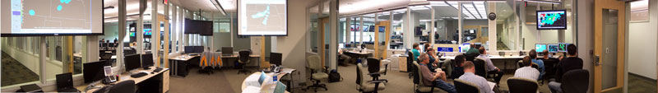
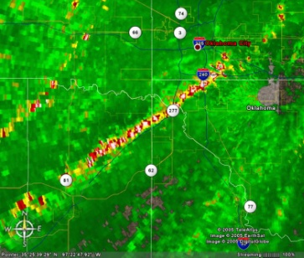
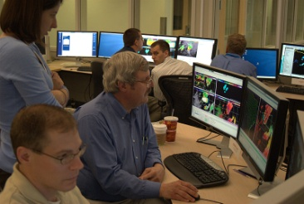
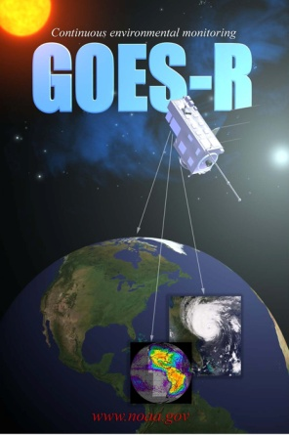
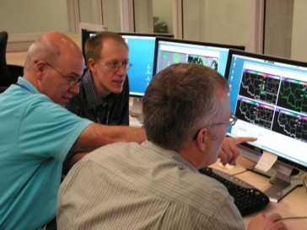
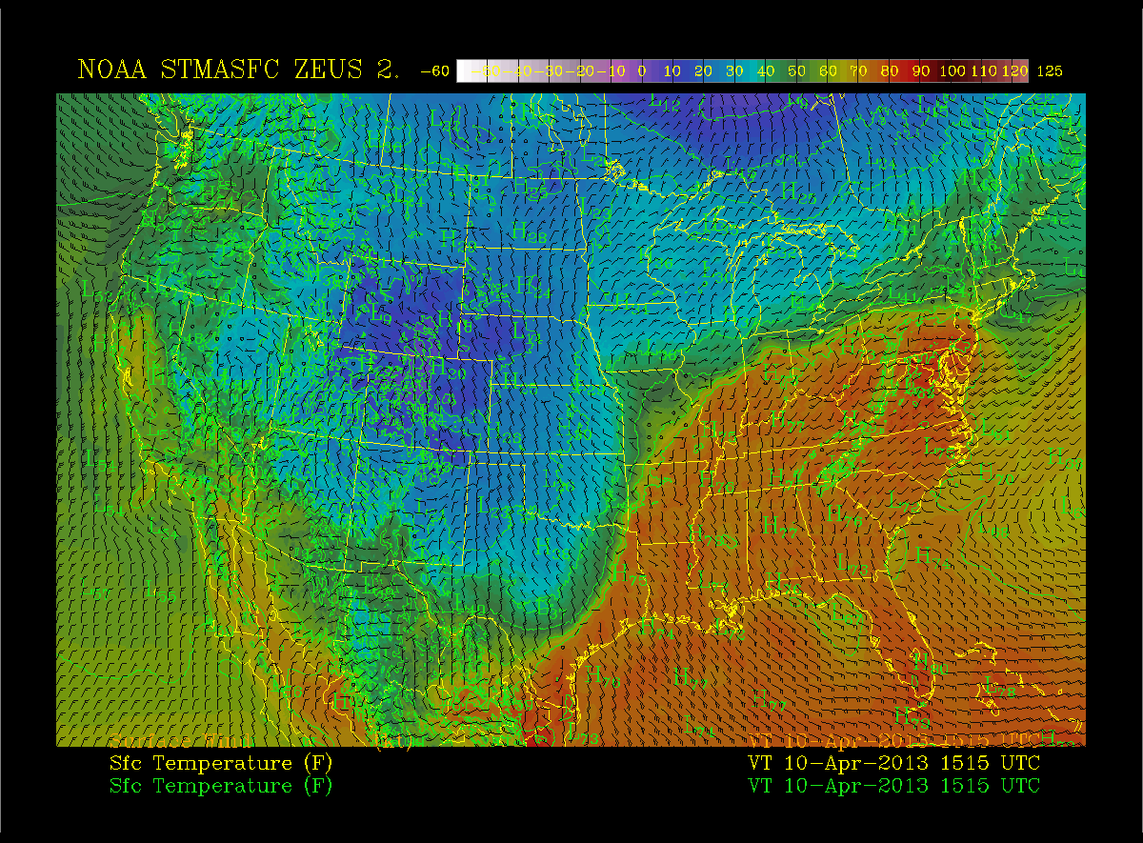
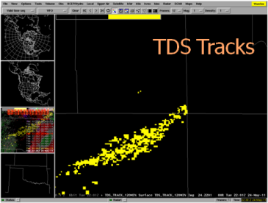
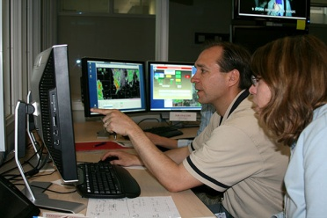
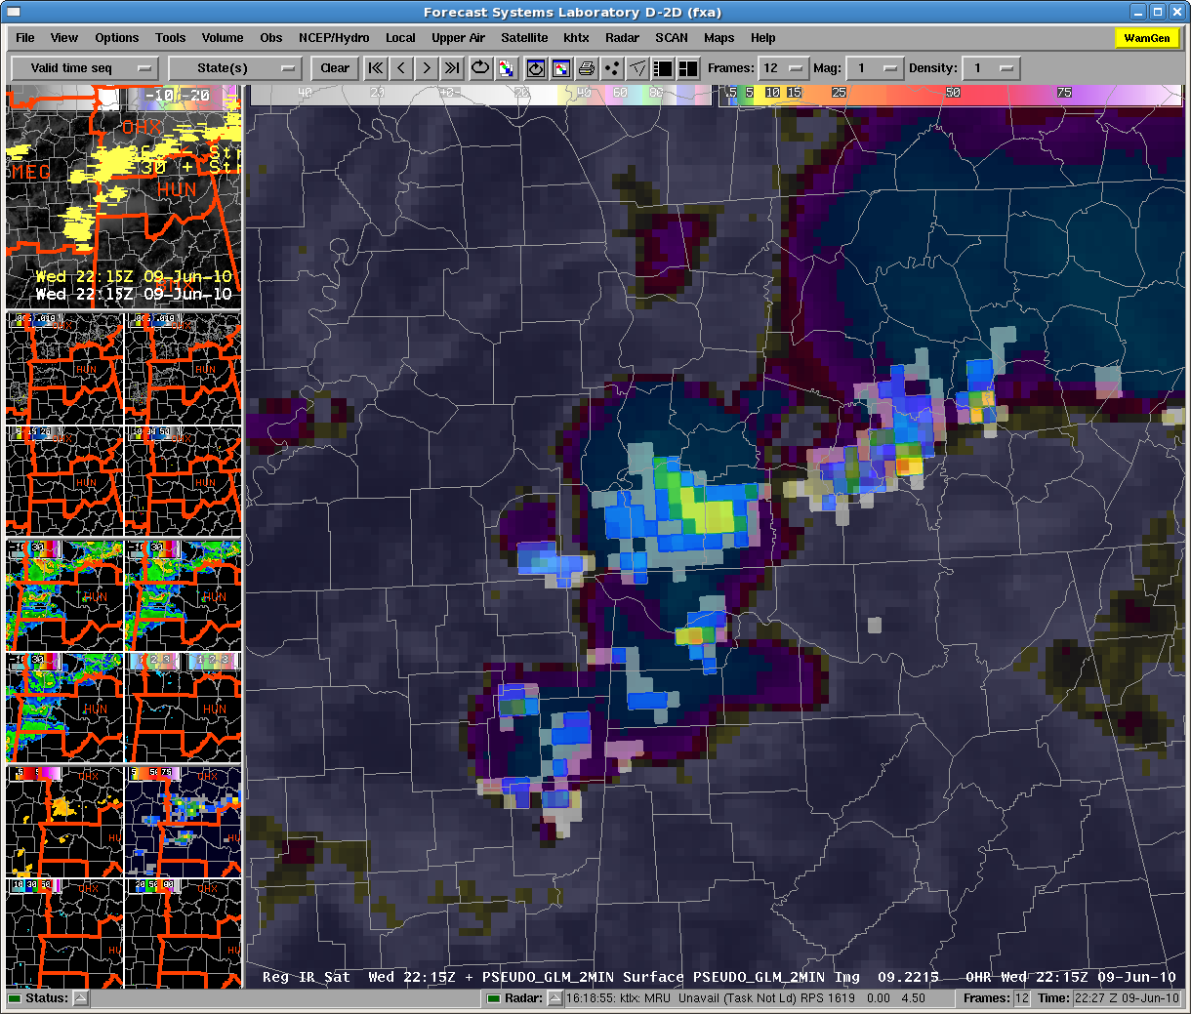
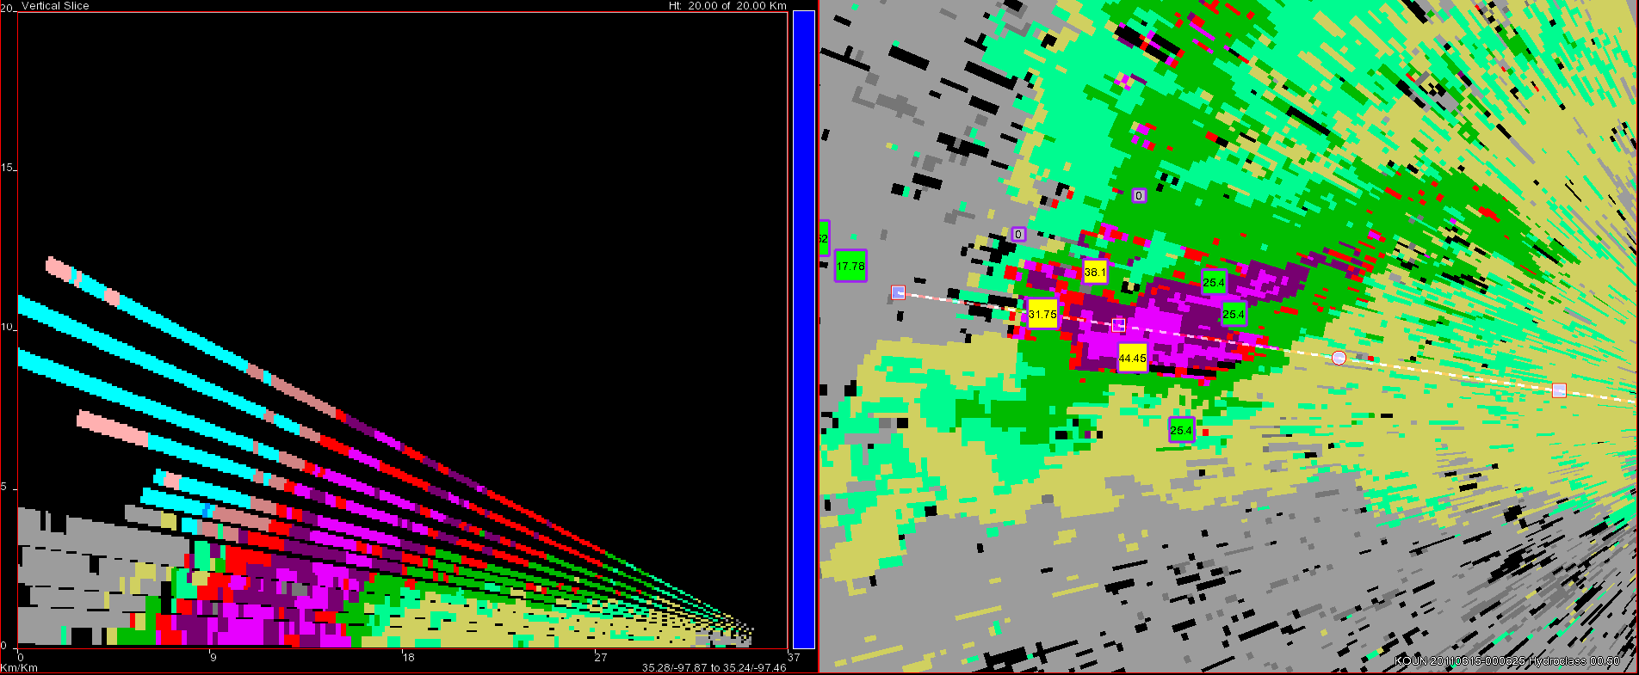
Overview of the NSSL 2013 Spring Warning Experiment in the HWT
EWP2013
Greg Stumpf
NOAA Hazardous Weather Testbed
CIMMS/NWS-MDL
Norman, OK

Slide 2
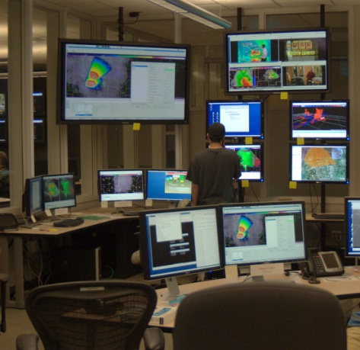
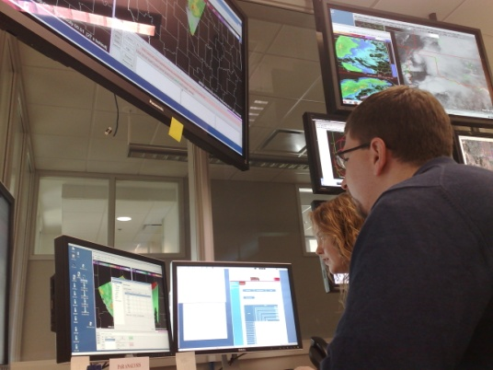
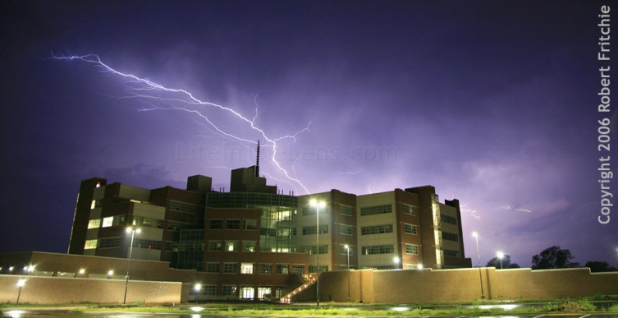
The NOAA Hazardous Weather Testbed
Collaboration
FORECASTERS
RESEARCHERS
DEVELOPERS
TRAINERS
USERS
Evaluation
OBSERVING PLATFORMS
NUMERICAL MODELS
ALGORITHMS
PRODUCTS
SERVICES

Slide 3
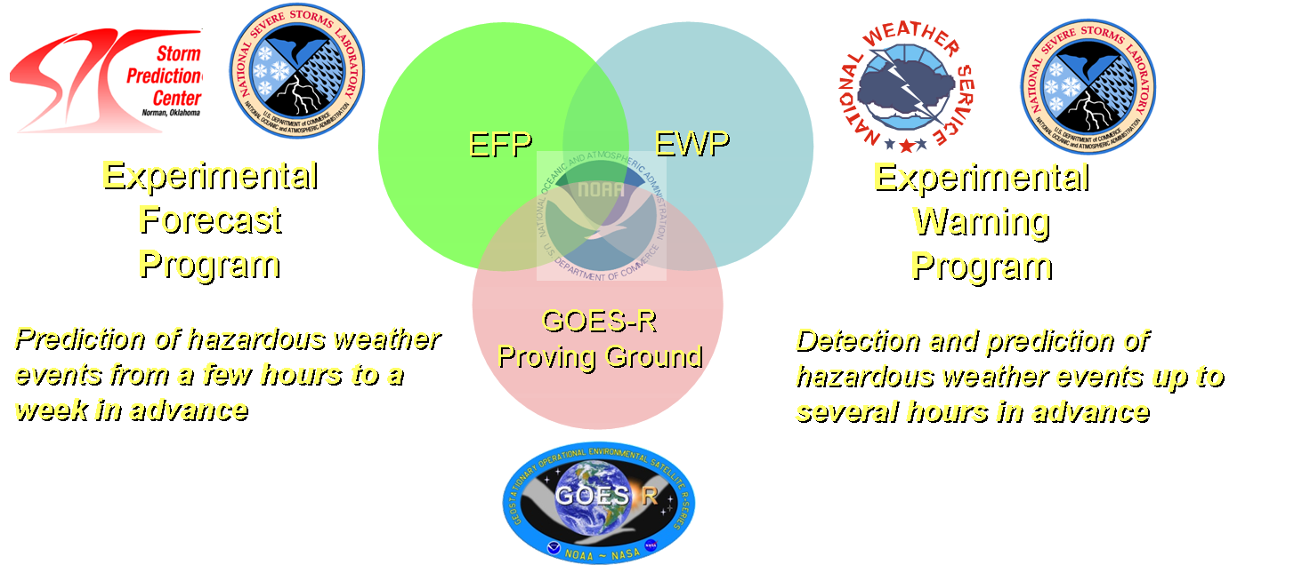
What is the HWT?
Not just a facility…
…but an organization:

Slide 4








HWT Experimental Warning Program (EWP)
Mission: Improve prediction of severe convective weather at the “warning scale” (0-2 hours).
Norman has a large community of researchers, operational meteorologists, students, industry.
But, we serve all National Weather Service WFOs and CWSUs nationwide.
A vital component to the Research To Operations (R2O) process.

Slide 5
What is tested?
New sensors:
  Radar, satellite, lightning, etc.
New Applications/Algorithms:
  Multi-sensor integration (MRMS), GOES-R proxies, lightning jump, very short term models, etc.
New Methodologies:
  Best practices, new concepts, products, services
  Social Science integration

Slide 6
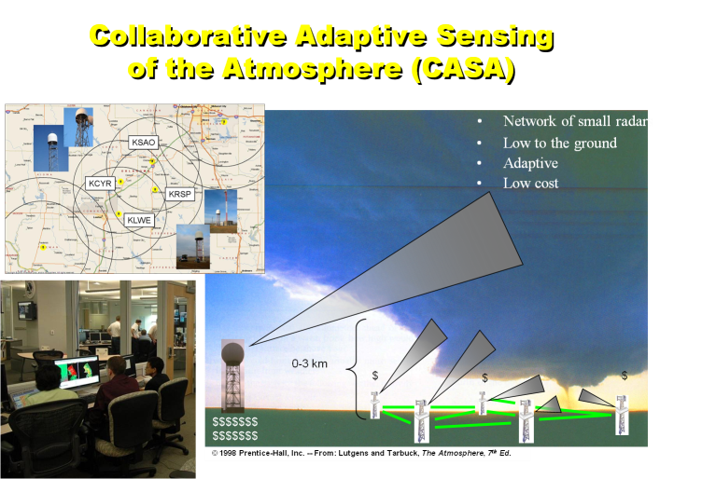
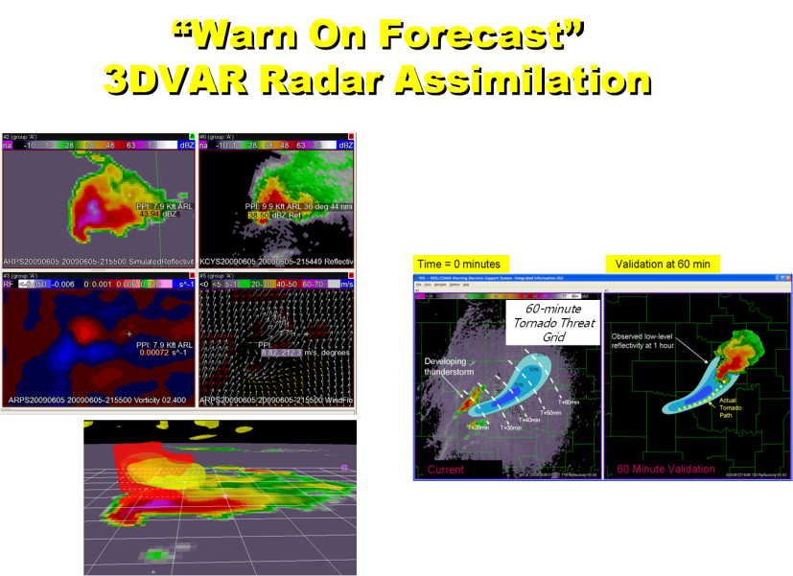
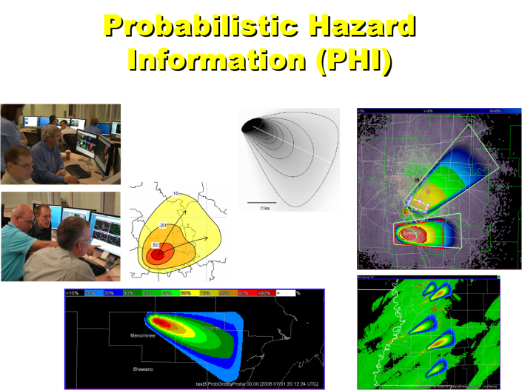
Former EWP Experiments
2007 - 2012

Slide 7
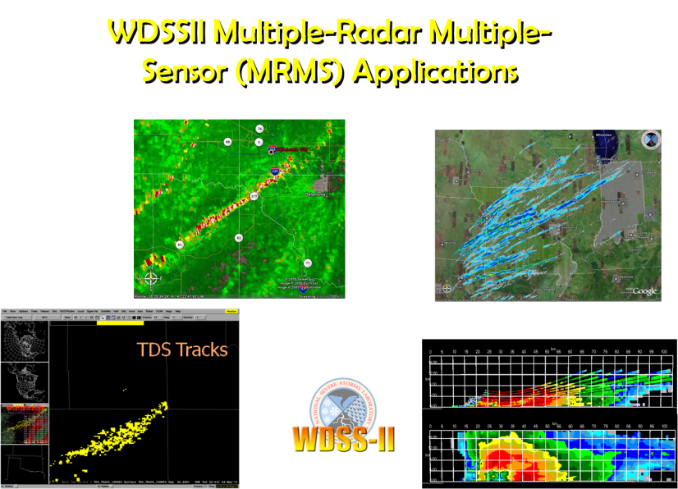
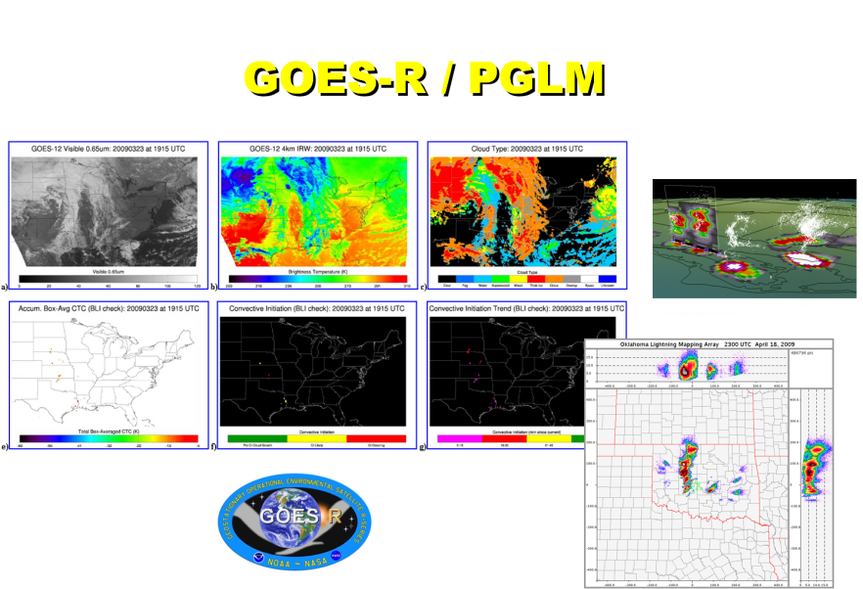
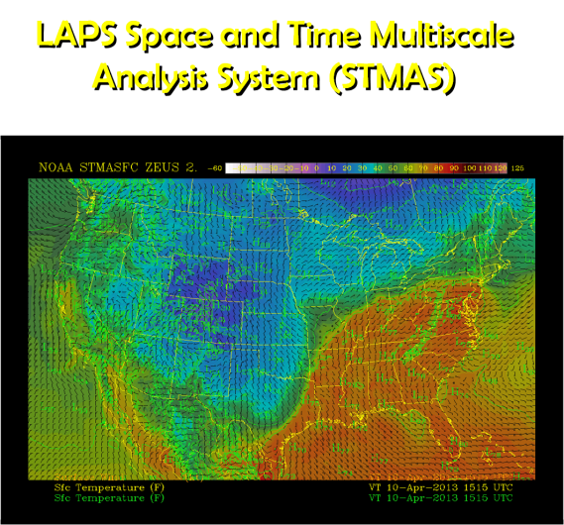
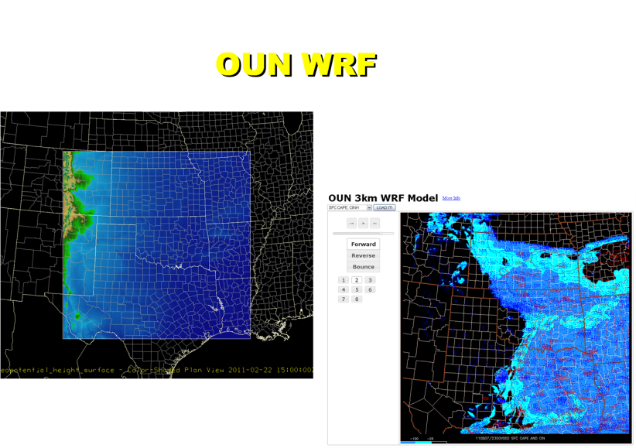
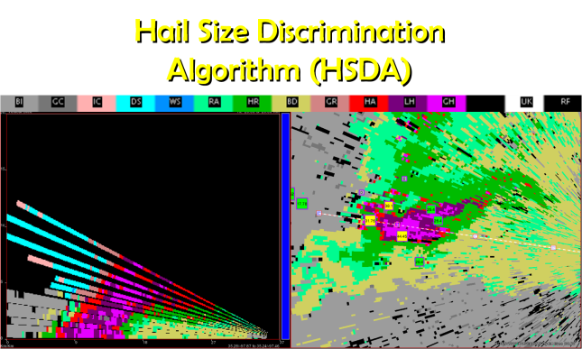
Current EWP Experiments
2013

Slide 8
EWP2013 Spring Experiment
3 weeks (6 May, 13 May, 20 May)
  6 forecasters per week
Using AWIPS2 for the second year
Get forecasters to think about how products are used in nowcast and warning decision making.
  Live blogging
  Mention experiment products in the warnings.
  Slip out of your “comfort zones”!

Slide 9
New for EWP in 2013
For the “6th day” EWP training shift on station:
  All presentations are now self-paced PowerPoint Articulates
EWP2013 Webinars: “Tales From the Testbed”
  Pre-selected topics each of the three weeks.
EFP Coordination
  Discuss their experimental probabilistic severe wx outlooks and provide them feedback
  Help to inform our CWA choices

Slide 10
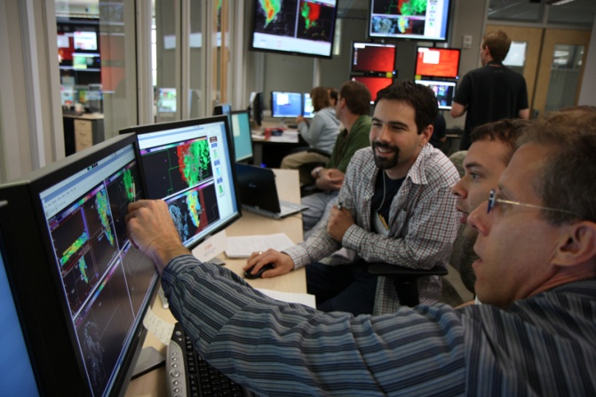
Daily Operations Procedure
All 6 forecasters to start with mesoscale and nowcast operations
  EFP collaboration meeting
As storms begin, move off a team of two to a warning desk
  Lead warning forecasters (main warnings)
  Assistant warning forecasters (SVSs, blog)
When more storms, break off another group of two to a warning desk (one lead, one assistant)
  Different sector in same CWA
  Adjacent CWA
Keep two forecasters on a “meso desk”
to inform the warning desks
(one lead, one assistant)
May modify any of this on the fly as we
settle into an optimal procedure.

Slide 11
EFP Collaboration
EFP to prepare experimental probabilistic severe weather outlooks
  5-15-30-45% (may add 60%; may add sig severe)
  Full period outlook complete: 9am CDT
  Three 3-hour period outlooks complete: 11am, 2pm, 4pm CDT
    18-21, 21-00, 00-03 UTC
  EFP map discussion: 100-130pm CDT
EWP and EFP will have a 15-min coordination meeting in the HWT following our daily debriefing
  11am and 12pm flex shift may join the EFP map discussion too
EFP outlooks will be available on AWIPS2 (and the Web)

Slide 12
CWA Selection “Triage”
EFP experimental outlook and official SPC outlooks inform selection
  LMA domains have highest priority (> SLGT)
  OUN WRF domain has next priority (> SLGT)
  Greatest severe prob has next priority
Ideally, will stick with one domain for entire shift
  May all move to a new domain if severe weather dissipates or moves offshore

Slide 13
Mesoscale Forecast Operations
To inform later warning activities and to monitor during warning (“mesoscale desk”)
  EFP Probabilistic Severe Wx Outlooks
  WRF Synthetic Cloud & Moisture Imagery
  NearCast
Forecasters will issue afternoon/evening local severe wx discussion on blog.
Provide hourly updates.

Slide 14
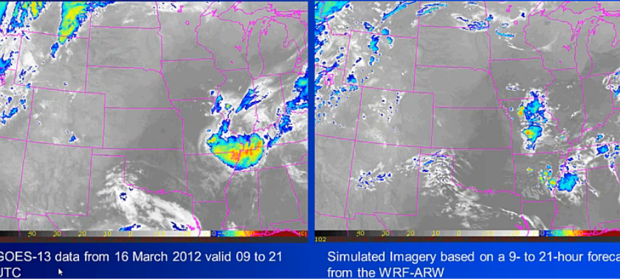
WRF Synthetic Cloud & Moisture Imagery

Slide 15
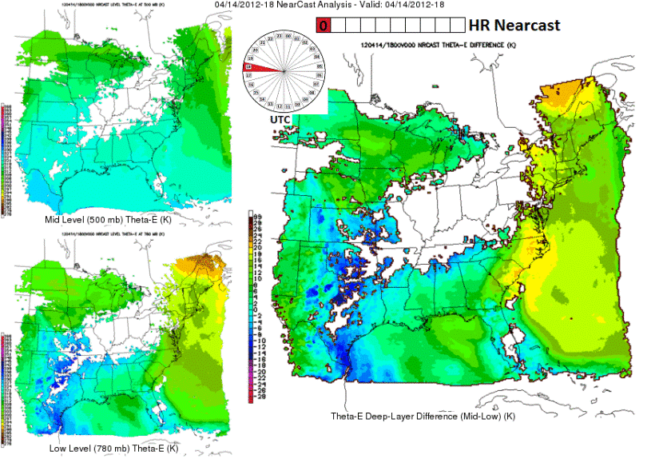
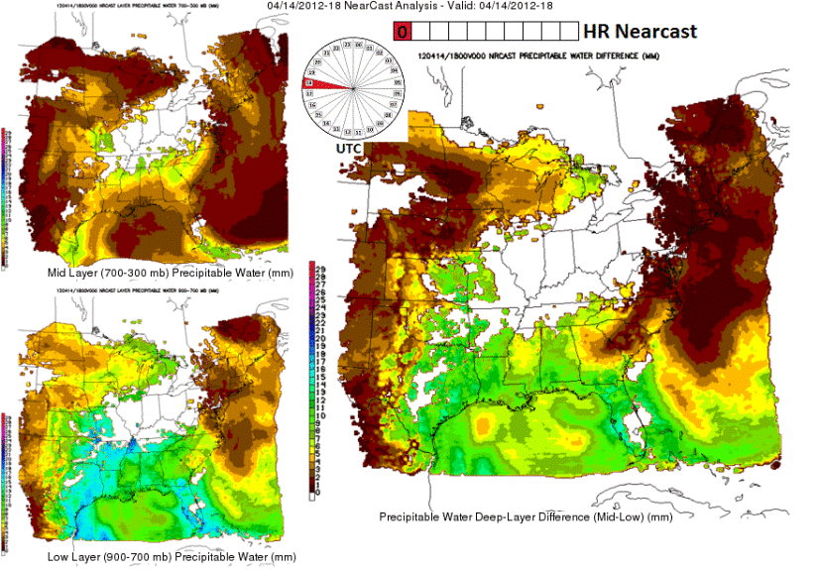
GOES-R - Nearcast
GOES sounder observed PW / theta-e fields advected using a Lagrangian model
  Up to 9-hour forecast
  30-minute intervals
Multi-layer PW difference / gradient
  900-300mb, 900-700mb and 700-300mb
Level theta-e and multi-layer theta-e difference
  500 mb and 780 mb level
  780-500 mb difference

Slide 16
Nowcast Operations
To monitor the 0-2 hour time frame before and during warning operations
To determine location and timing of convective initiation and evolution
Issue nowcasts via live blogging
  OUN WRF
  Variational LAPS
  UAH Convective Initiation

Slide 17
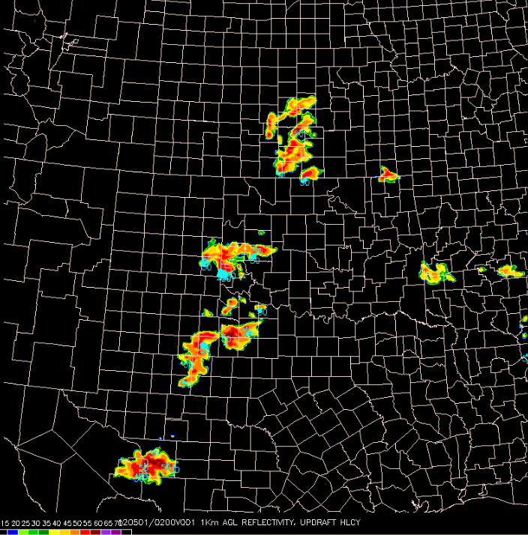
OUN WRF
Specs:
  3-km grid
  3DVAR hot start
  2-hourly cycle
  15 min fcst intervals out to 8 h
Products:
  Composite Reflectivity
  1-km Reflectivity
  Instantaneous Updraft Helicity
  Maximum Hourly Updraft Helicity
  Maximum Hourly Column Hail
  10-m Wind Speed

Slide 18
LAPS Space and Time Multiscale Analysis System (STMAS)
Evaluate timeliness and performance of variational, high temporal and spatial resolution LAPS in real time.
Evaluate performance of the 0-3 h convective forecasts initialized with high resolution variational LAPS in the Warn-on-Forecast paradigm.
Answer the question, how useful are the variational LAPS analysis and the short term convective forecasts initialized with LAPS for operational use? What improvements are needed?

Slide 19
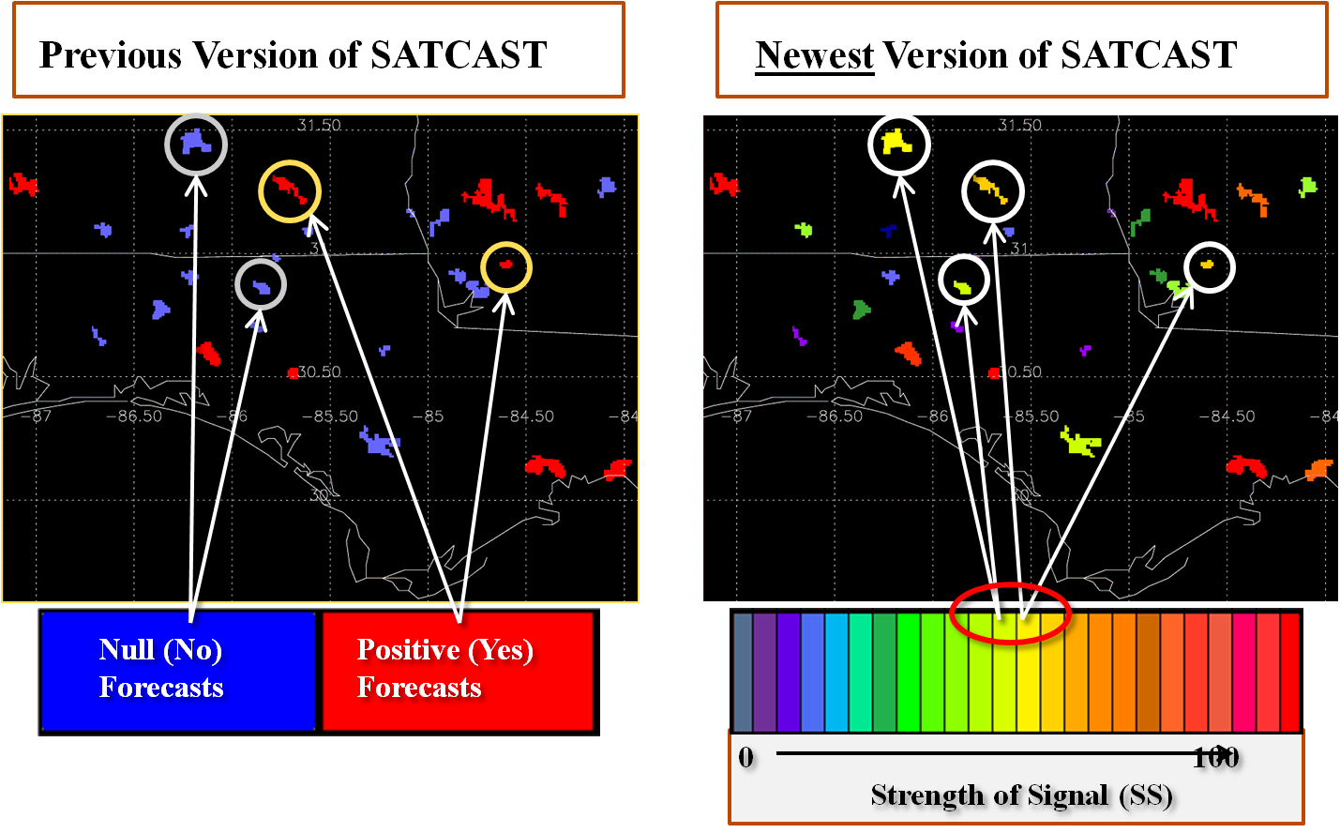
UAH Convective Initiation:
“SATCAST”

Slide 20
Warning Operations
Issuing experimental warnings using AWIPS2 WarnGen
Include experimental product in warning description
  UW Cloud Top Cooling
  Pseudo Geostationary Lightning Mapper
  Multi-Radar/Multi-Sensor Severe Wx Products
  Hail Size Discrimination Algorithm
Students will provide real-time storm report information during ops.

Slide 21
UW Convective Initiation – Cloud Top Cooling:
Relating CTC to Radar/MRMS products
Weak Moderate Strong
UW-CTC UW-CTC UW-CTC
> -10 -10 >= CTC > -20 <= -20

Slide 22
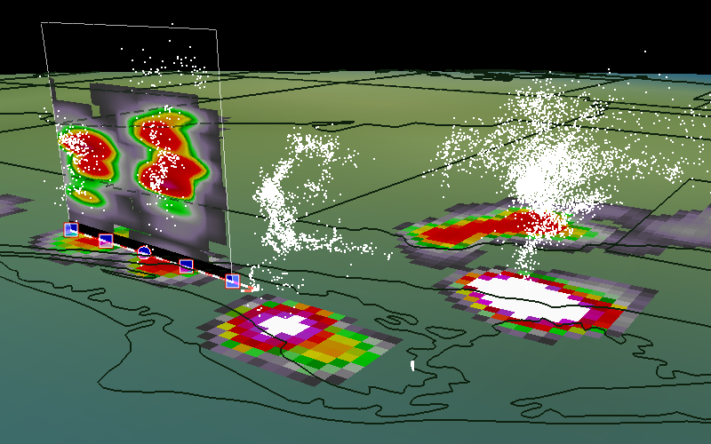
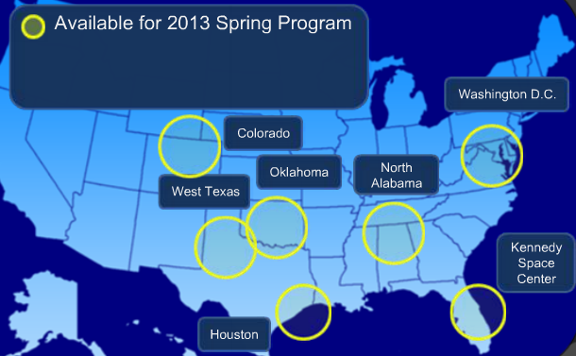
Pseudo-Geostationary Lightning
Mapper (PGLM)
Cloud-to-ground + intra-cloud = total lightning
Used to create PGLM proxy
LMA visualization and attribute extraction (Courtesy: Scott Rudolsky, Florida State University)

Slide 23
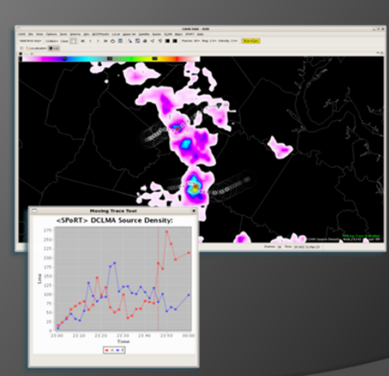
pGLM Trending Tool for AWIPS2

Slide 24

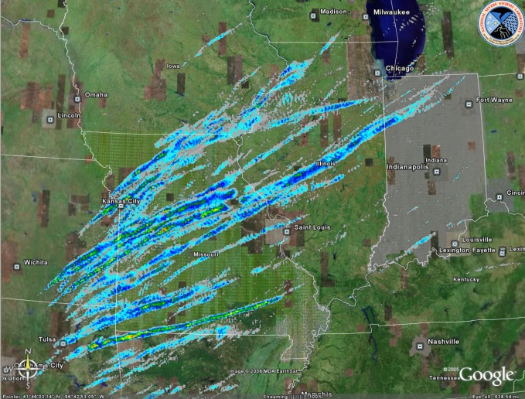
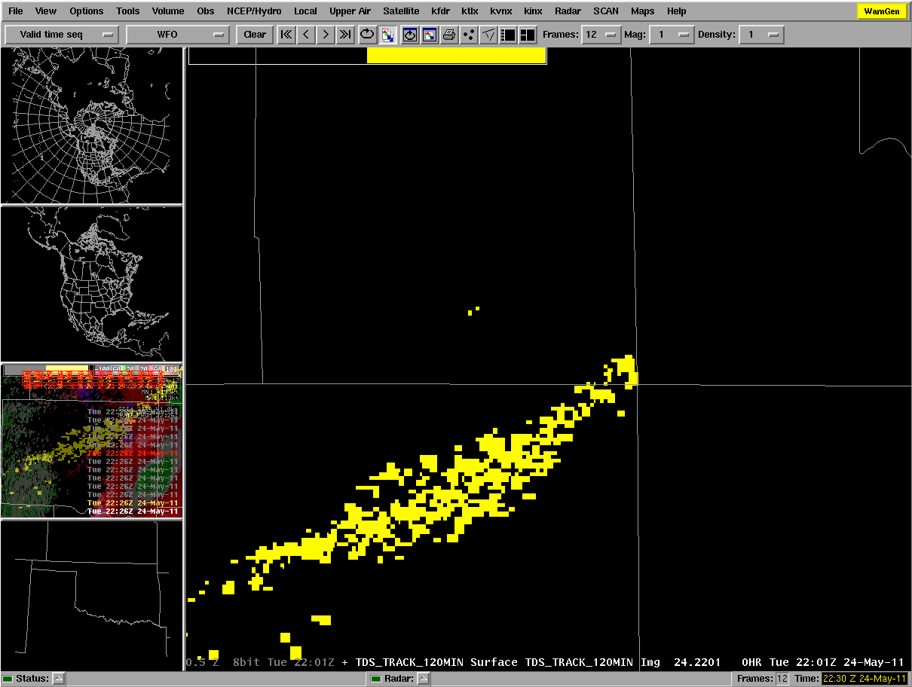
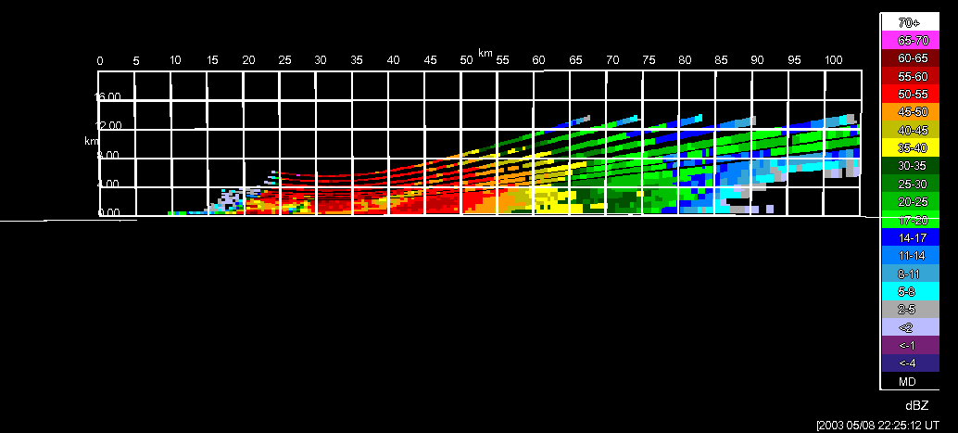

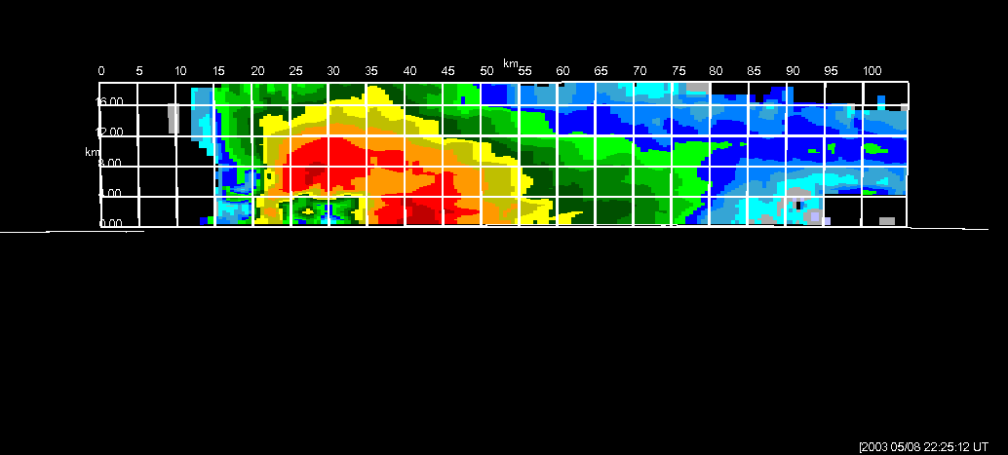
WDSSII Multiple-Radar Multiple-Sensor (MRMS) Applications
TDS Tracks

Slide 25
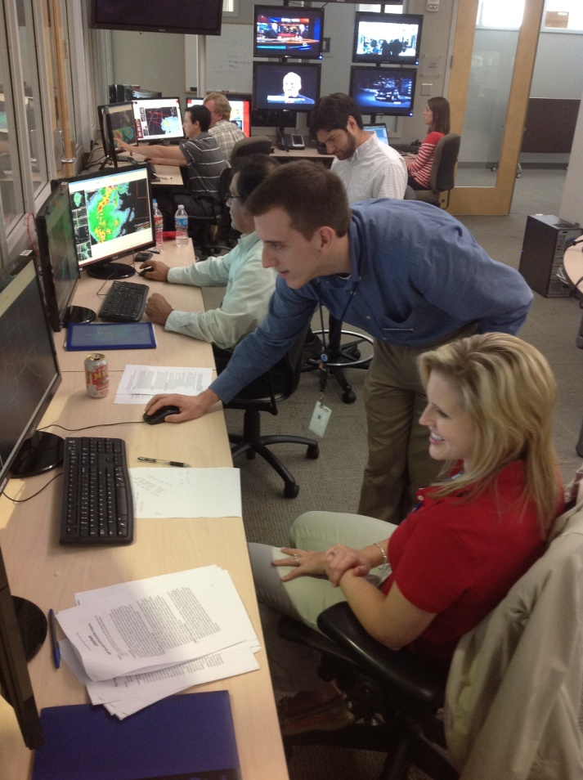
MRMS “Best Practices”
How will forecasters integrate MRMS products into their traditional diagnosis?
Which products are most useful?
What new products, menus, and displays should be considered?
What data values should be considered operationally significant?
Build optimal procedures for wind, hail, and tornado warnings.
NWA Journal of Operational Meteorology submission

Slide 26
Hail Size Discrimination Algorithm (HSDA)
Splitting Hail category from HCA into:
  Small Hail (< 1”)
  Large Hail (> 1”)
  Giant Hail (> 2”)

Slide 27
Feedback
Pre-operations online survey for MRMS
  Collect data about present warning decision practices
Post-operations online survey for all products
Blog
Real-time discussions
Debriefings (daily, weekly)

Slide 28
Weekly Schedule

Slide 29
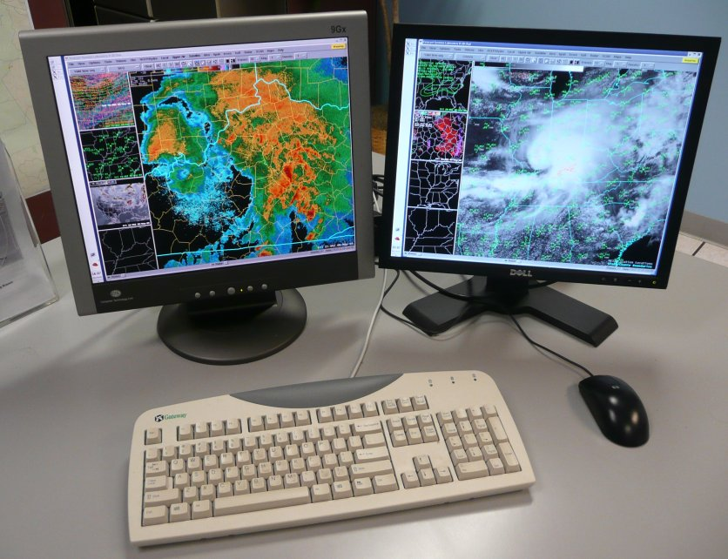
Before Monday:
WFO Training Shift
EWP training shift on station:
  Taken at WFO within two weeks prior to travel to Norman
  Training materials posted online
  Presentations are now all self-paced PowerPoint Articulates
  WES Virtual Machine Case on DVD, job sheets online

Slide 30
Monday Schedule
100p Convene to NSSL Dev Lab (NWC2820)
100p Welcome and Introductions (everyone)
115p EWP2011 Orientation Briefing (Stumpf)
145p Tales from the Testbed Orientation (Payne)
215p Break
230p Convene in HWT Operations Area:
EFP coordination meeting to determine Monday CWAs
Pre-op MRMS Survey
AWIPS2 Familiarization, procedure loading
Real-time nowcast/warning operations
???p Dinner Break (time chosen based on wx)
815p Fill out feedback survey; Day2 forecast prep
900p Adjourn

Slide 31
Tue-Wed-Thu
“Flex” Shift Schedule
Determined at the end of the previous day’s operations shift, based on expected timing of weather
  Will be posted to EWP Blog; emailed to MICs
Start time 11am, 12pm, 1pm, 2pm, or 3pm (1-9pm “default”)
Finish 8 hours later
Dinner break time will be based on wx activity
Tue-Wed (last 45 min of shift):
  Forecasters fill out feedback surveys
  Day 2 forecast to decide “flex” shift time
Thu (last 90 min of shift):
  30-45 min: Forecasters fill out feedback surveys
  45-60 min: Prepare for TftT Webinar with WDTB facilitator.

Slide 32
Friday Schedule
900am Convene in the WDTB Conference Room
900-950am Webinar dry run (WDTB Conference Room)
950am Move to the Dev Lab
1000am-1130am Weekly debrief (Dev Lab)
1130am Break to grab lunch, move to WDTB Conference Room
1200pm-1240pm EWP2012 Weekly Webinar (WDTB Conference Room)
1240-100pm Group photo
100pm Operations End for the week

Slide 33
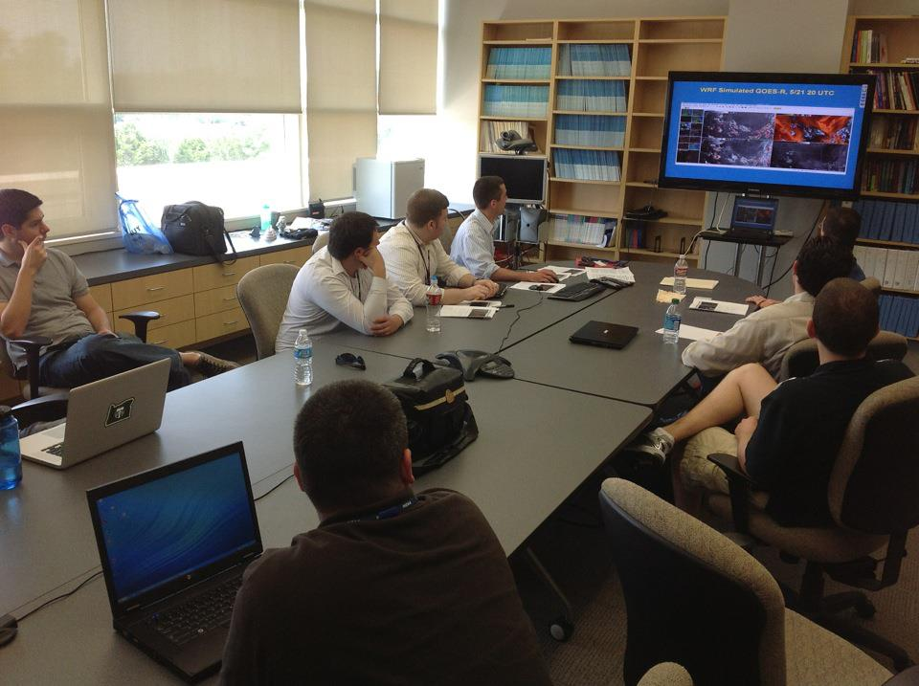
Weekly Webinars
“Tales from the Testbed”
A summary of that week's experience, presented by the NWS participants.
Each Friday from 1200-1240 CDT from the NWC in Norman.
The forecasters have 22 minutes to discuss their key takeaways that week.
Weekly topics:
  Week 1: GOES-R; pGLM
  Week 2: EFP outlooks, OUN WRF, LAPS
  Week 3: MRMS, HSDA
Audience: WFO/CWSU peers, RHQ, NWHQ,
funding agencies.
Facilitated by WDTB (similar to dual-pol "Storm of the Month").
Post-experiment Webinars to NWA and RITT in June (EFP and EWP).

Slide 34
EWP Personnel
Forecasters/Evaluators
  You!
Weekly Coordinators (Weeks 1, 2, 3)
  Gabe Garfield, Kristin Calhoun, Greg Stumpf
Webinar Facilitator (WDTB)
  Clark Payne
Project Scientists
  GOES-R, UW-CIMSS, UAH-NASA-SPORT, GSD, NSSL-CIMMS, CIRA
EWP Officers
  Lans Rothfusz (NSSL HWT Liaison)
  Travis Smith (co-Team Leader)
  David Andra (co-Team Leader)
  Greg Stumpf (Operations Coordinator)
  Darrel Kingfield (IT Coordinator)

Slide 35

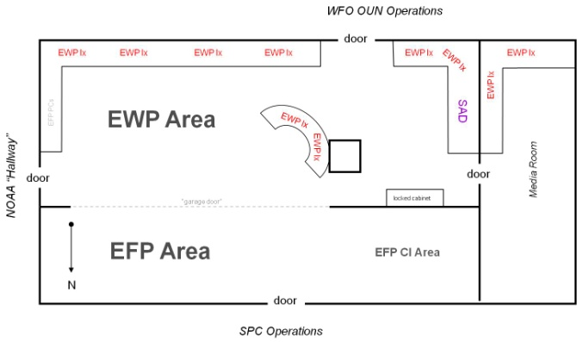
EWP Technology in the HWT
NWS Advanced Weather Interactive Processing System 2 (AWIPS2):
  Can emulate any forecast office nationwide
  Displays experimental products
  Issue experimental warnings
Situational Awareness Display (SAD)
  Television feeds
  Streaming storm chaser dash cams
  etc…

Slide 36
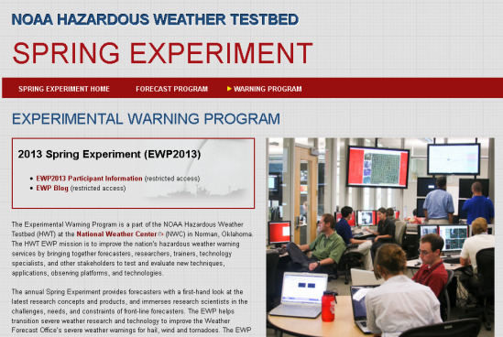
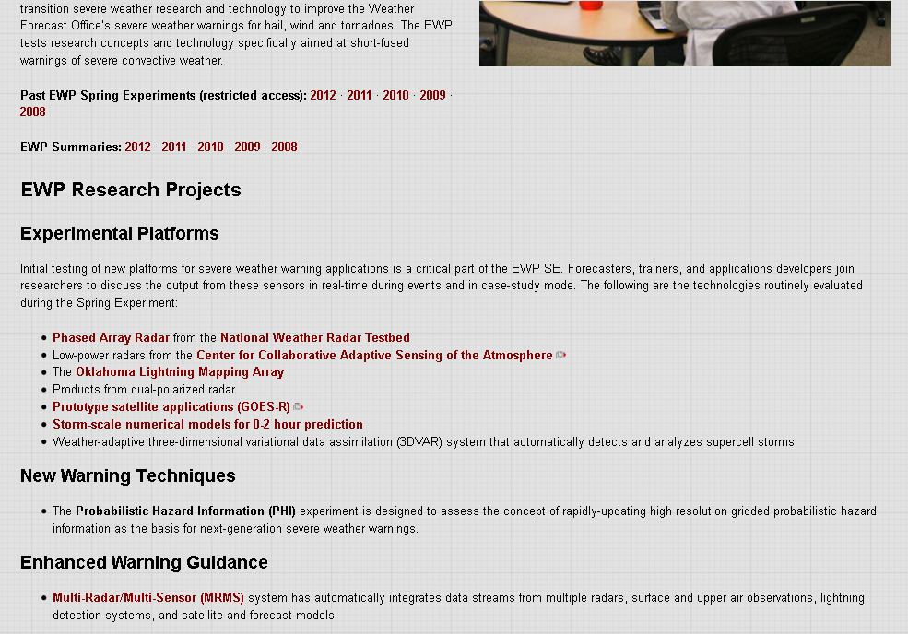
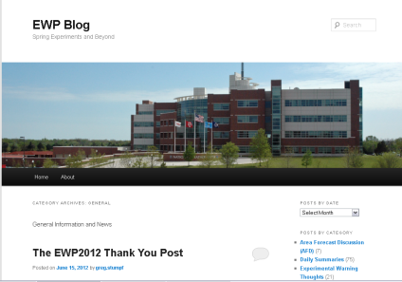
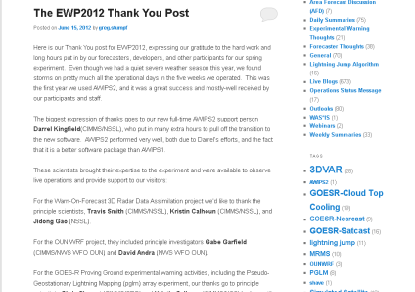
EWP Web Presence
External (public)
  http://hwt.nssl.noaa.gov/ewp
  Content:
    General Information about the EWP
    Past experiment summaries
Internal (private)
  https://secure.nssl.noaa.gov/projects/ewp2013/
    NOAA LDAP credentials required
  Content:
    The EWP Blog
    Operations Plans
    Training Materials
    Schedules (Google Calendar)
    Other useful links

Slide 37
Future EWP Possibilities
AWIPS2
Activities outside of Spring season
Collaboration with EFP
Hazard Services prototypes (this fall?)
Social Science customer studies of new services

Slide 38
EWP Final Thoughts
This is a research experiment…
  …therefore, expect glichEs, bug$` and rinkles!
Try to focus beyond these glitches toward the bigger picture:
  To the future transition of research to NWS nowcast/warning operations (R2O)

Slide 39
EWP Final Thoughts
Learn about exciting new technology
Share your knowledge with your peers
Have fun!

