Slide 1
Hazardous Weather Testbed (HWT)
“Tales from the Testbed”
Forecaster Briefing
Warning Decision Training Branch (WDTB)

Slide 2
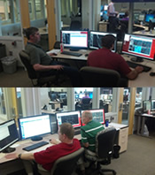
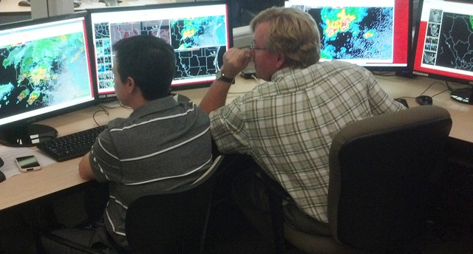
Your Role
Provide a focused assessment of the topic for this week
Stress the operational aspects of the product/service
  Both strengths AND limitations
Notes:
This week, part of your responsibilities will be to assess ONE aspect of this experience that you will take back to your office. You will present this assessment to the group on Friday in a 5-min talk that is modeled after TED talks.

Slide 3
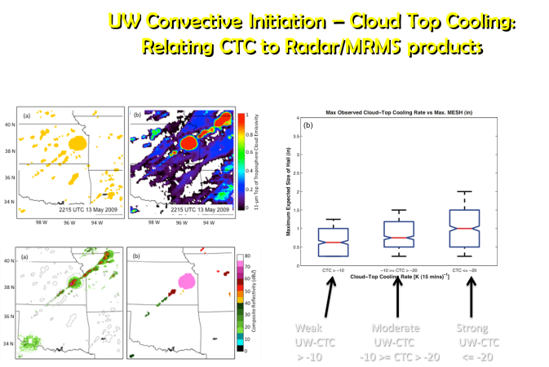
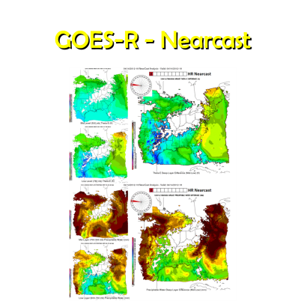
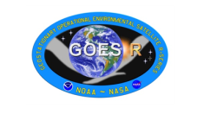
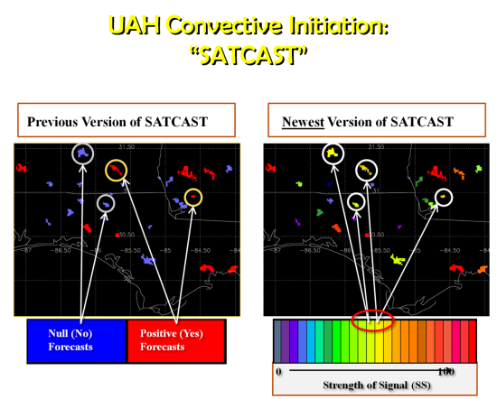
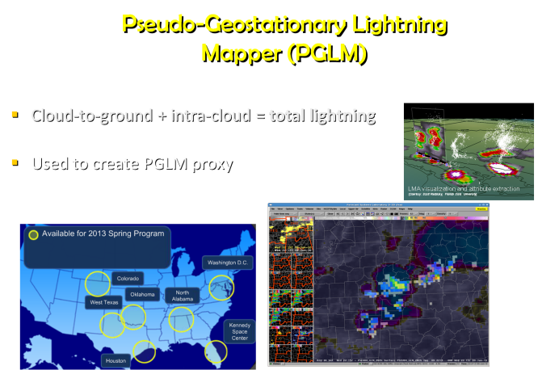
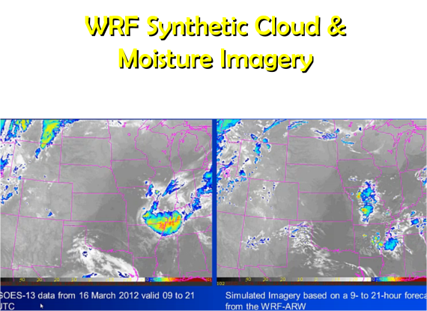
Week 1 – GOES-R Applications

Slide 4
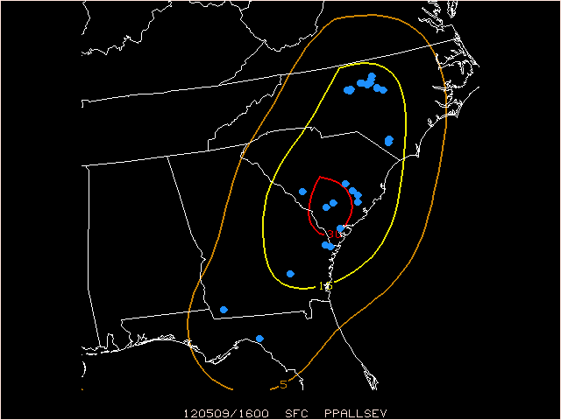
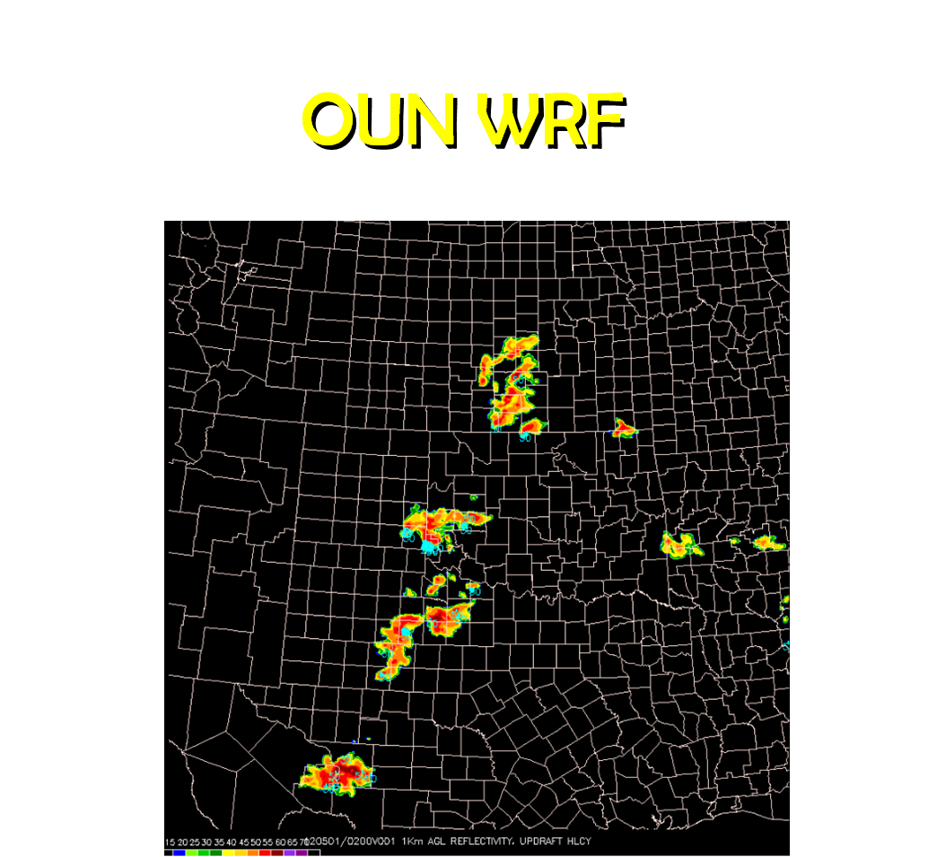
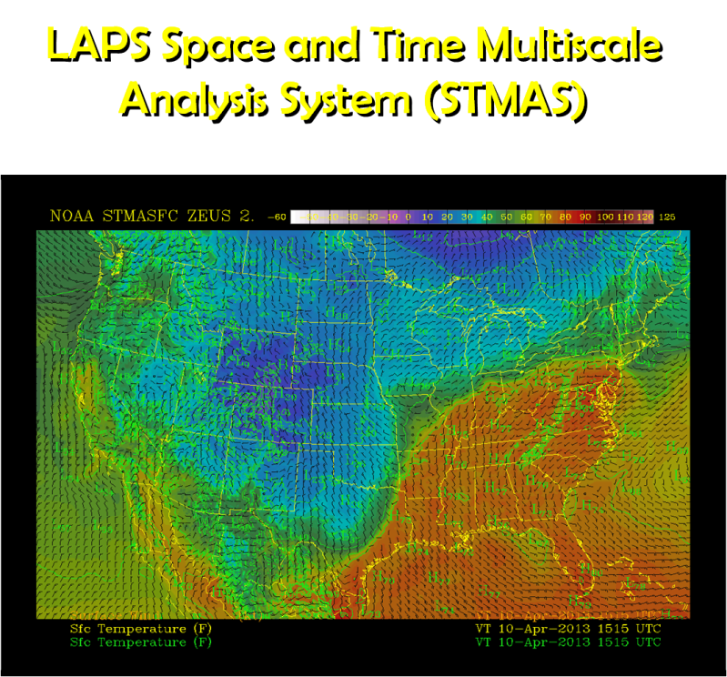
Week 2 – Nowcast Applications
EFP Probabilistic Outlooks

Slide 5
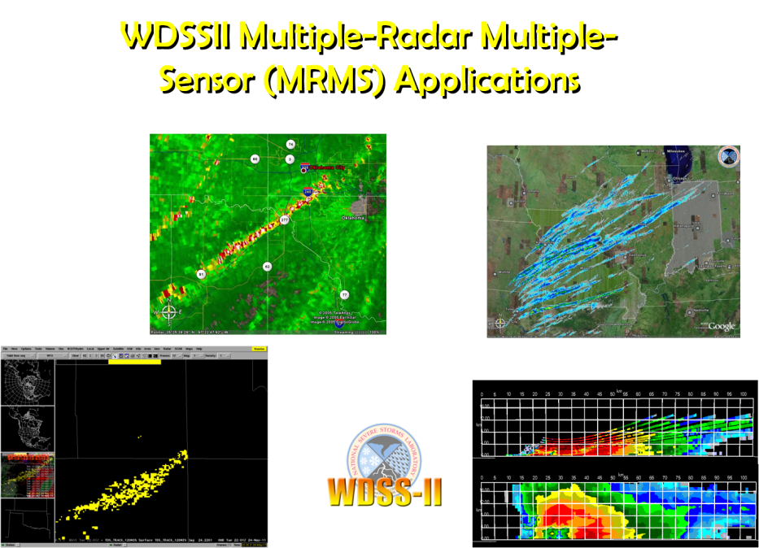
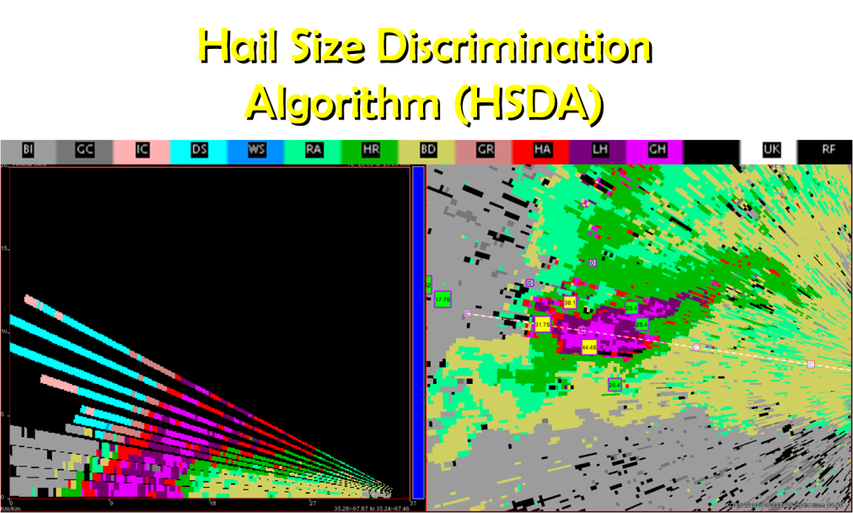
Week 3 – Warning Applications

Slide 6
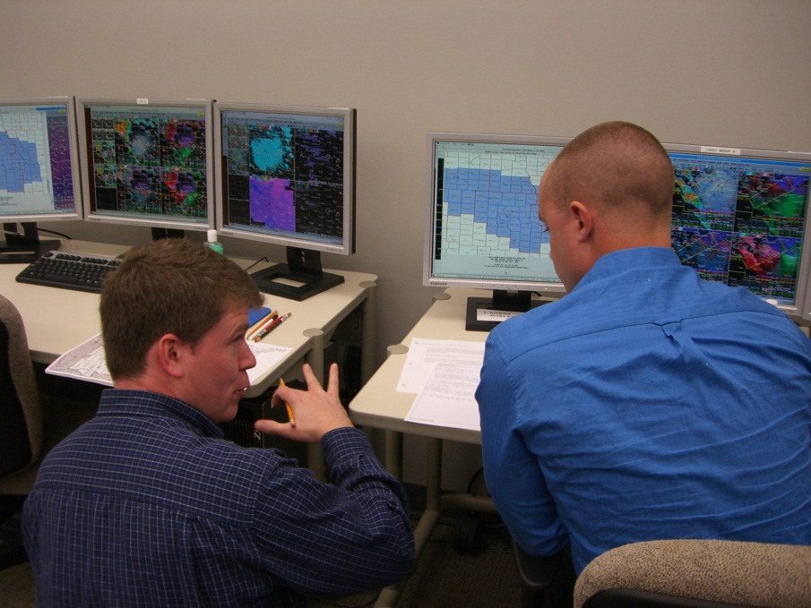
Facilitator Role
Assist you in building your presentation
  Help with screen capturing during the week
  Help consolidate screen captures on Thursday evening
  Build the pptx file on Thursday night / Friday morning
  Dry run the presentations on Friday morning
  Facilitate the webinar on Friday
Notes:
We as facilitators are here to help you in any way to develop this 5-min presentation. We will help you with screen capturing, working the pptx template, dry running the presentations, etc.

Slide 7
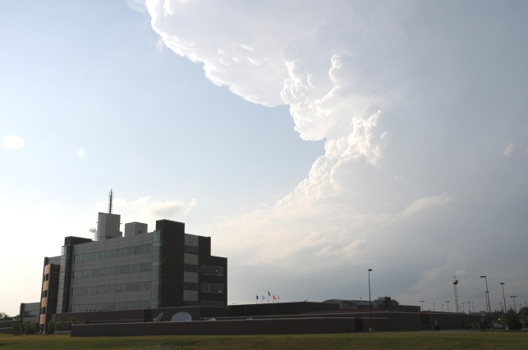
Why are we/you doing this?
You are key to this experiment!
  Ensures HWT goals aligned with operational needs
  Bring field expertise to research projects
  Provides operationally representative
  results
Improve R2O and O2R
Notes:
Why are we doing this. First, we recognize that operational forecasters like yourself are invaluable to this experiment. You help align the HWT goals with operational needs which helps give us operationally relevant results. Without you, this experiment would not be successful. However, the challenge we face every year is that capturing your thoughts and formalizing them is difficult. As you can imagine, when you get back to your office, the everyday duties return and it’s very difficult to reflect back upon what you did here in a formal manner. Thus, there have only been a few papers by participants and only 2 of 22 field participants have added to the HWT blog.

Slide 8
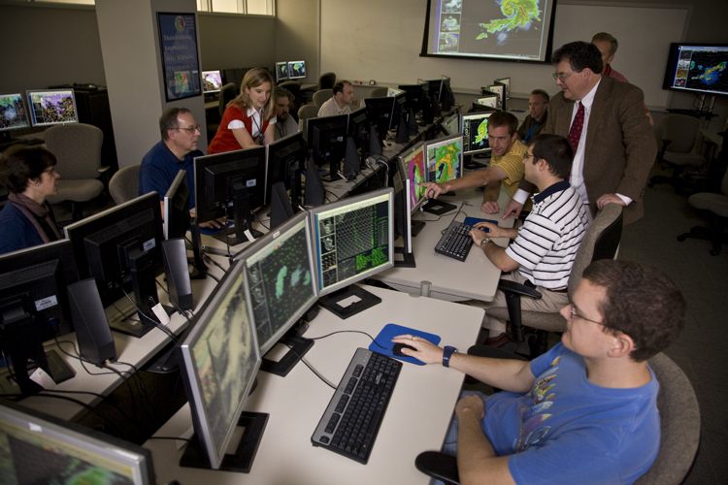
This is modeled after…
WDTB Dual-Pol Training Operations Course
  Train 2100 forecasters in 2 years
  Selected as NOAA’s “High Priority Performance Goal (HPPG)” to DOC and OMB
“Storm of the Month”
  WFOs “Tell Their Story”
  NWS offices & Universities
  WDTB & NSSL experts for Q&A
    Collaboration for Research to Ops
    Collaboration for Ops to Research
Notes:
New this year is our (WDTBs) involvement. We spoke with the HWT coordinators and shared with them a success story we have with our Dual-Pol Operations Course “Storm of the Month”. At WDTB, we recognized that learning is a continual process, not a fire hose. Therefore, we made “Storm of the Month”. It is a way for forecasters in WFOs to “share their story” of how dual-pol has been used in their operations and everyone gets to benefit from their stories. Additionally, there are researches listening in which allows them to here first-hand how research is being transferred into operations. It’s a win-win. And what makes this very effective, is the fast-paced, focused nature of the talks. The presenter is given only 20-min to present a topic/message, and then a 10-min Q&A ensues. After that, people are done.

Slide 9

“Storm of the Month”
Research to Operations Results
“Such interactions between the Dual-Pol researchers/ developers at NSSL & CIMMS and the operational users of that technology are invaluable to both groups.
Seeing the immediacy of two-way feedbacks happen like this is simply tremendous and should accelerate future improvements to the WSR-88D and the informed applications of Dual-Pol measurements.
I look forward to more such opportunities
in the future.”
Steve Koch, Director NSSL
Notes:
Here’s a quote from the NSSL director commenting on how invaluable this type of collaboration is between research and operations.

Slide 10
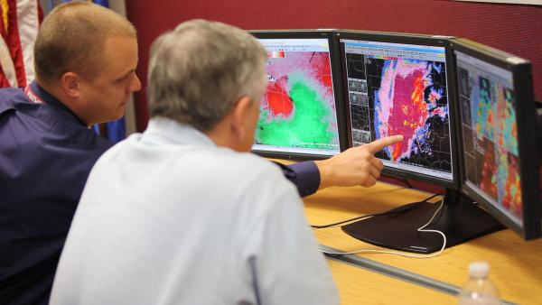
Applying These Results to the HWT
HWT to provide weekly operational reports
  You will present observations and examples from your participation
  Research and Operational meteorologists from across the nation will be listening
    This is your chance to have your voices heard…
Notes:
So, here is how we are going to apply these principles to your week here. As stated before, you will be doing a similar type talk at the end of the week, and we are here to help you build an effective 5-min presentation that will stress your message.

Slide 11
Aspects of a Good Briefing
Notes:
Very briefly, what is a good briefing and what is expected of you in your presentation?

Slide 12

Planning the Presentation
Define the audience’s characteristics
  Operational & Research Meteorologists
Determine how much they already know
  Most with working knowledge of operational meteorology
Tailor your presentation to meet their needs
  Focus on operational aspect of your experience
Anticipate audience reactions…

Slide 13
Creating a Presentation
A well-structured presentation has three sections:
Identify your main message in the opening
Reinforce your main message in the middle
Summarize with a memorable conclusion
The HWT was the best experience ever!

Slide 14
Ideas for presentation
What are the applications/limitations of the new techniques/software/hardware to my office?
What was surprising in this experiment?
Human factors impacts in your office?

Slide 15
Webinar Structure
Start promptly at 12pm (not 12:01pm)
22-min presentation:
  Slide 1: Intro Slide
  Slide 2-4: EWP Background (Greg)
  Slide 5-7: Background on Topic
  Slide 8: Main Point #1
  Slide 9-11: Illustrations of Main Point #1
  *** Repeat 8-11 for up to 3 Main Points
  End Slide: Takeaway(s)
8 minutes for Q&A

Slide 16
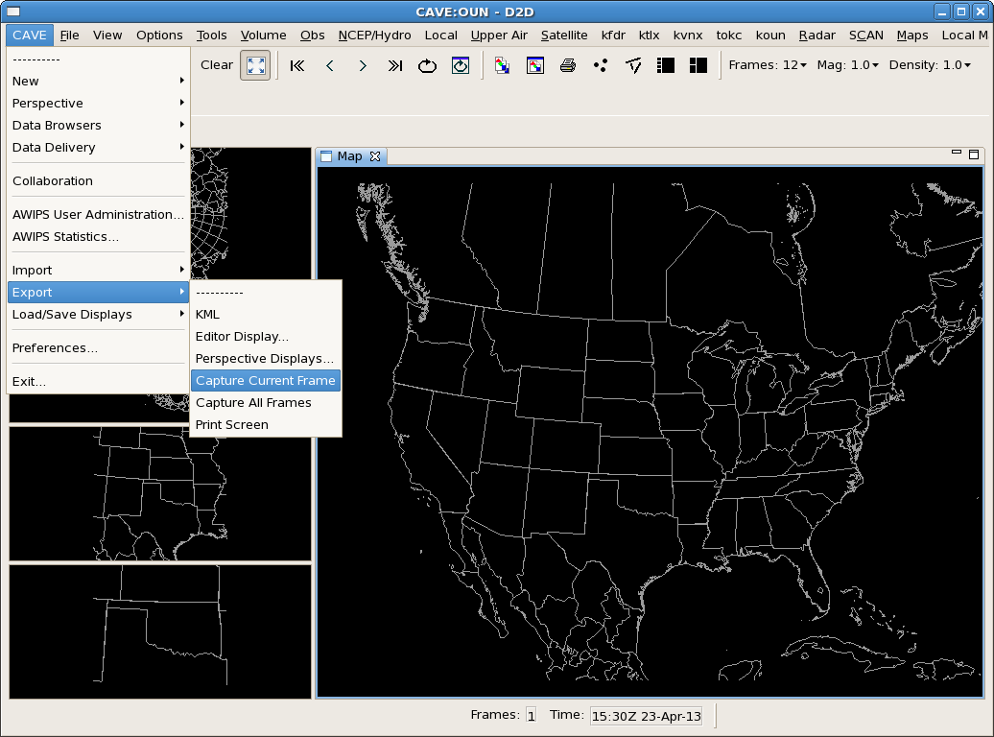
Screen Capturing
Use the AWIPS-2 built-in screen capturing software…

Slide 17
Thank you!!!

