Slide 1
Variational Local Analysis and Prediction System -- Analysis and Forecast
Hongli Jiang, Yuanfu Xie, Steve Albers, Isidora Jankov, Zoltan Toth
NOAA/ESRL/GSD
Forecast Application Branch

Slide 2
Local Analysis and Prediction System (LAPS)
and Variational LAPS
LAPS
Observation oriented analysis
Efficient system for fine resolution analysis with short latency
Portability and ease of use
Multiscale analysis
Hot-start
Cloud
Good performance in verification of real time forecast
Moving LAPS toward variational LAPS
Gradually merging LAPS processes into a unified variational system
Possessing the above traditional LAPS features
Providing spatial and temporal consistent analysis
Using CRTM for assimilation satellite data (AMSU under testing)
Terrain-following coordinate analysis is being tested for improving LAPS balance

Slide 3
LAPS Data Sources
High Resolution (500m – 20km), rapid update (10-60min)
Highly portable system – about 150 users world wide
Wide variety of data sources:

Slide 4
Transition from LAPS to Fully Variational LAPS
Svar. LAPS
Large Scale Model First Guess
Cycling Option
Basic 3DVAR,
cloud analysis
balance and constraints
In one variational analysis
Ultimately
Numerical
Forecast model
Temporary hybrid system using LAPS cloud analysis and balance
Wind
analysis
Temp/Ht analysis
Humidity analysis
Cloud analysis
balance
LAPS analysis: Wind, Temp, Humidity, Cloud, Balance
Notes:
*

Slide 5
Motivation and goal for 2013 EWP
Evaluate timeliness and performance of variational, high temporal and spatial resolution LAPS in real time.
Evaluate performance of the 0-3 h convective forecasts initialized with high resolution variational LAPS in the Warn-on-Forecast paradigm.
Assess how useful the variational LAPS analysis and its short term convective forecasts are for operational use? Identify improvements for future development?

Slide 6
Research questions
Model forecasts: 3 km and 1km
Can they add value to simple radar echo extrapolation at various forecast times?
Can they fill a gap especially for 0-3 h, at 1 km resolution?
Are the short-term forecasts useful for convective storm evolution?
Can the forecasts retain important features such as large scale frontal boundaries? and smaller scale outflow boundaries?
Temporal frequency
Is latency an issue? Is 15 min enough?
Will short latency increase your capability to diagnose the severe situation?

Slide 7
Products
Forecast: regional domain at 1 km and 3 km resolutions
Composite Reflectivity
CAPE
CIN
Updraft Helicity
Lifted index
Satellite simulated IR Brightness Temperature
Fractional Cloud Cover
Cloud Ceiling
Surface analysis: conus domain at 2.5 km resolution
Surface temperature
Dew Point temperature
U,V wind component
PMSL
surface pressure

Slide 8
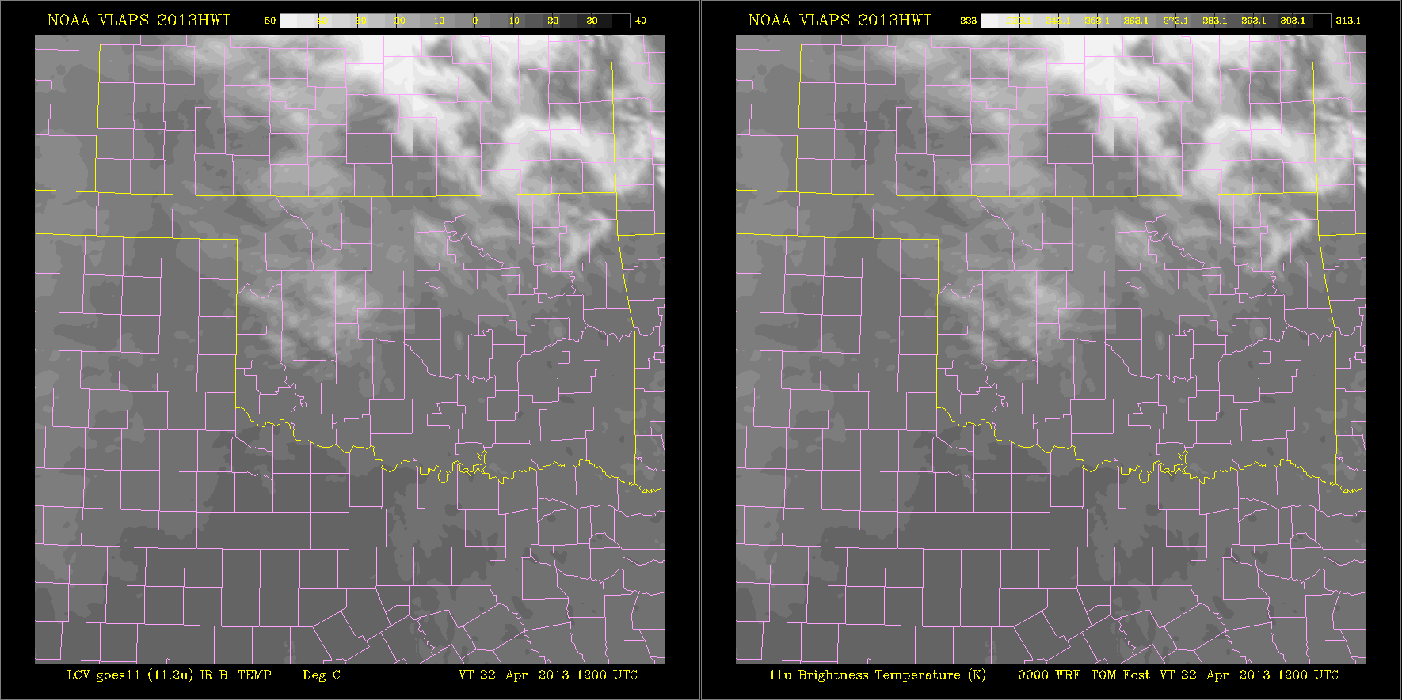
Observed and Forecast IR Satellite Brightness Temp
10 Apr 2013 18Z - 19Z
OBS
Forecast
Simulated VIS available (derived from cloud amount)
Forecasters are naturally familiar with satellite images
Used for objective cloud forecast verification

Slide 9
0-6 h Composite Reflectivity verification
3 April 2013 00Z
Var. LAPS Analysis
Higher ETS (best at short leads)

Slide 10
Example of Surface analysis Temp, wind 10 Apr 2013 15Z

Slide 11
How to evaluate the surface analysis on AWIPS
Open "CAVE”
Select "Volume > Browser”
In "Source", select “EWP > LAPS_CONUS_2.5km”
In "Field", select “Wind > Wind” and “Basic > Temperature”
In "Plane", select “Misc > Surface“
See example next page

Slide 12
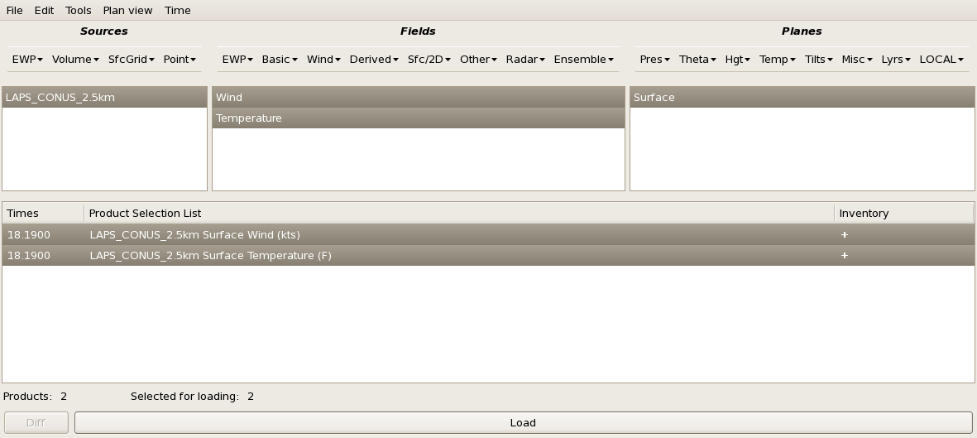
Example of surface analysis

Slide 13
Example of surface analysis of Wind and Temp

Slide 14
Additional resources
HWT pages:
Visit: http://laps.noaa.gov/hwt/hwt.html
Verification pages:
Visit: http://laps.noaa.gov/verif/
Under "Source" menu, the three source names are:
- LAPS_CONUS_2.5km
- LAPS_OUN_1km
- LAPS_OUN_3km

Slide 15
THANK YOU!

Slide 17
Backup slides for additional information.

Slide 18
LAPS HOT-START INITIALIZATION
Three-Dimensional Cloud Analysis
FH
FL
METAR
+ FIRST GUESS
*

Slide 19
3-hr Diabatically (hot-start) initialized
WRF-ARW forecast
Analysis

Slide 20
Cloud Analysis Flow Chart
Cloud Fraction 3-D Isosurface
(From radars and model first guess)
*

Slide 21
SCHEMATIC DATA FLOW in LAPS
Data
Background (or cycled forecast)
Observations
Data Ingest
Standalone downscaling module
Intermediate
data files
Analysis Scheme
LAPS
Variational LAPS (with downscaling)
Downscaling can work as a stand alone module from background → GSI or other applications such as Fire wx.
GSI
Model prep
Downscaling is also an integral part of variational LAPS (STMAS).
FORECAST
MODEL
Verification
Notes:
Yellow arrow shows conventional data only;
Green arrow shows all data;
Red arrow shows INCOMPLETE.

Slide 22
Cloud / Reflectivity / Precip Type (1km 15-min analysis)
Obstructions to visibility along approach paths
DIA

