Slide 1
Variational Local Analysis and Prediction System -- Evaluating its Analysis and Forecast
Hongli Jiang, Yuanfu Xie, Steve Albers, Zoltan Toth
NOAA Earth System Research Laboratory Global System Division
Forecast Application Branch

Slide 2
What is Local Analysis and Prediction System (LAPS)
-- Variational LAPS (vLAPS)?
Traditional LAPS:
Observation oriented analysis
Efficient and fine resolution analysis, short latency
Portability and ease of use
Multiscale analysis
Hot-start analysis
Cloud analysis
Good performance in verification of real time forecast
Modernizing LAPS from traditional toward variational (vLAPS)
Gradually merging LAPS processes into a unified variational system
Possessing the traditional LAPS features by a multigrid variational scheme
Providing spatial consistent analysis
Using CRTM for assimilation satellite data (AMSU under testing)
Terrain-following coordinate variational analysis is being tested

Slide 3
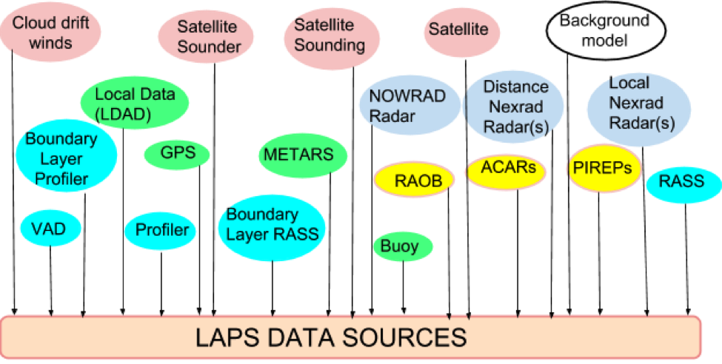
LAPS Data Sources
High Resolution (500m – 3km), rapid update (10-15min)
Highly portable system – about 150 users world wide
Wide variety of data sources:

Slide 4
Transition from Traditional to Fully Variational LAPS
SvLAPS
Large Scale Model First Guess
Cycling Option
state vars, wind (u,v)
clouds / precip
balance and constraints
in multi-scale variational analysis
Ultimately
Numerical
Forecast model
Temporary hybrid system using LAPS cloud analysis and balance
Wind
analysis
Temp/Ht analysis
Humidity analysis
Cloud analysis
balance
Traditional LAPS analysis: Wind, Temp, Humidity, Cloud, Balance
Notes:
*

Slide 5
Motivation and goal for EWP2014
Evaluate timeliness and performance of high temporal and spatial resolution, variational LAPS (vLAPS) in real time.
Evaluate performance of the 0-3 h convective forecasts initialized with high resolution vLAPS in the Warn-on-Forecast paradigm.
Answer the question, how useful are the vLAPS analysis and the short term convective forecasts initialized with vLAPS for operational use? What improvements are needed?

Slide 6
Research questions
Model forecasts: 1km
Can they add value to simple radar echo extrapolation at various forecast times?
Can they fill a gap especially for 0-3 h, at 1 km resolution?
Are the short-term forecasts useful for convective storm evolution?
Can the forecasts retain important features such as large scale frontal boundaries? and smaller scale outflow boundaries?
Temporal frequency
Is latency an issue? Is 15 min enough?
Will short latency increase your capability to diagnose the severe situation?

Slide 7
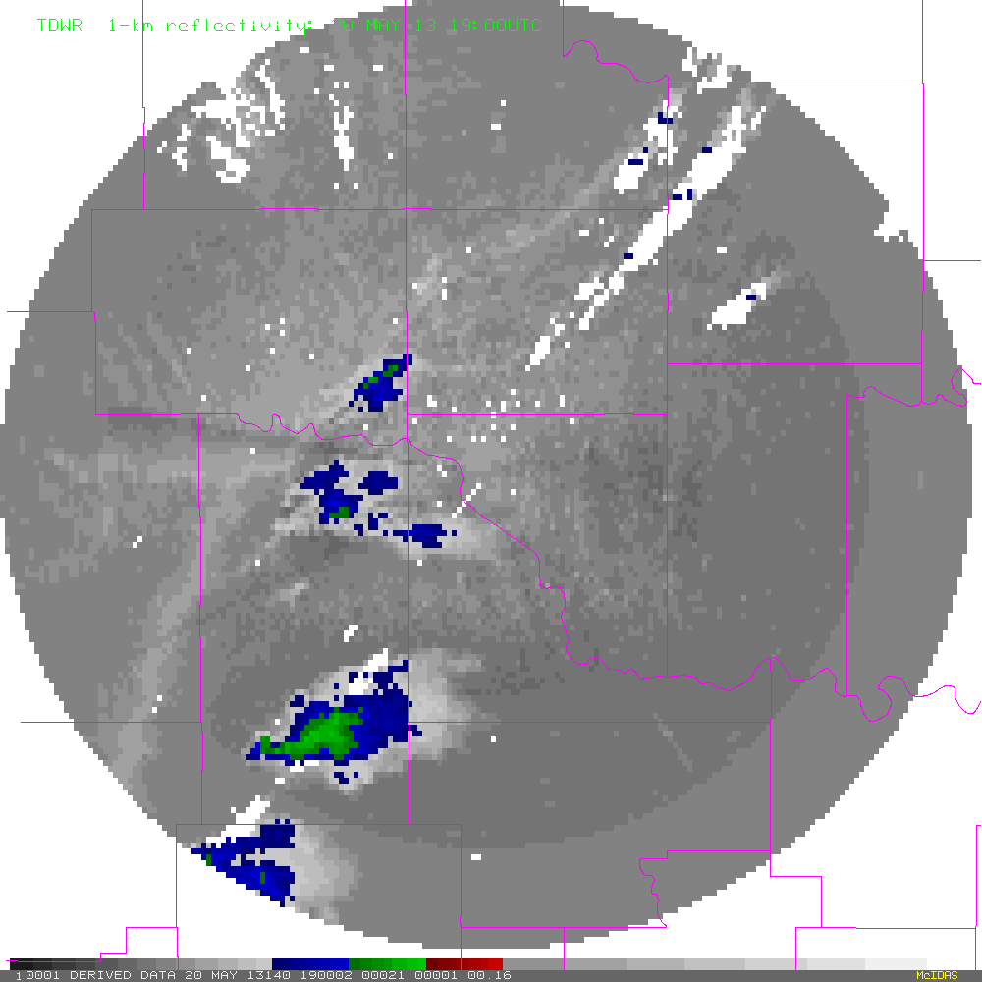
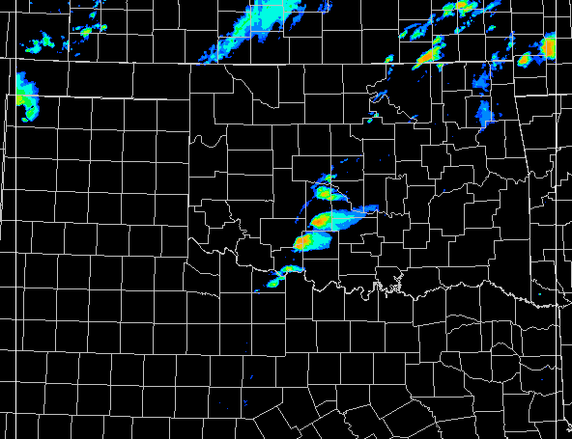
vLAPS 1-km Forecast for Moore Tornado:
Touch down at 19:56 UTC, dissipated about 20:35 UTC
vLAPS initialized at 1900 UTC, 2 h forecast, showing 1900 – 20:55 in 5 min interval (TDWR vs. vLAPS forecast)
TDWR, B. Rabin Composite Reflectivity (FCST)

Slide 8
Variational LAPS Product list EWP2014
Domain/grid spacing | Data frequency | Products
Regional, on demand, re-locatable domain, 1-km grid spacing, 800X800 grid points | Forecast cycled hourly, out to 3 h, output at 15 min | Composite reflectivity, SBCAPE, CIN, Updraft helicity, Storm relative helicity, Simulated IR brightness temperature
On demand, re-locatable domain, 1-km grid spacing, 200X200 grid points | Run analysis as frequent hourly, output 5 – 10 min | 3-D analysis of wind field, vorticity, reflectivity
CONUS domain, 2.5-km grid spacing), 2-D surface analysis only | Analysis runs and output at 15 min | T, T_{d}, U, V, MSLP, Surf Pressure

Slide 9
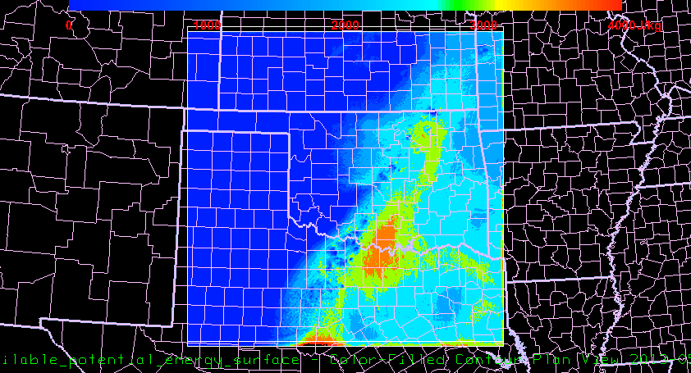
On demand, re-locatable domain, 1-km grid spacing, covering a 800X800 km domain
vLAPS forecast: 1800 UTC initialization, forecast valid at 1945 UTC 20 May 2013
Surface based CAPE (J kg⁻¹ )

Slide 10
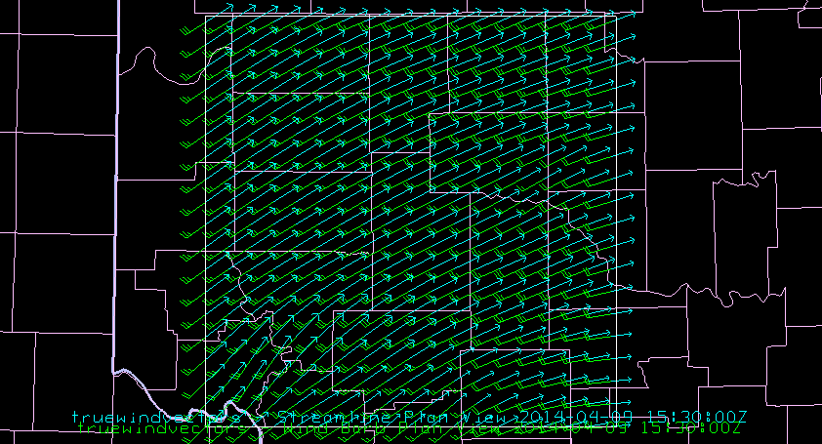
On demand, re-locatable domain, 1-km grid spacing, 200X200 km domain (analysis only)
vLAPS analysis: 1515 UTC 9 April 2014
850 hPa wind (green m s⁻¹) and streamline (blue)

Slide 11
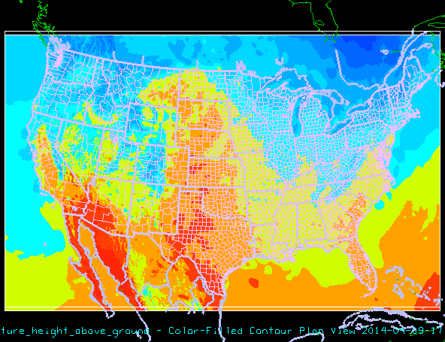
Surface analysis: conus domain 2.5 km res, 15 min
2-m Temp (K) valid 17 UTC 9 Apr 2014

Slide 12
Products
Analysis and Forecast: on demand, re-locatable, 800X800 km domain at 1 km resolutions
Composite Reflectivity
CAPE
CIN
Updraft Helicity
Storm Relative Helicity
Satellite simulated IR Brightness Temperature
Cloud Ceiling
Analysis only: on demand, re-locatable, 200X200 km domain, 1 km resolutions, 3-D fields
Wind field
Vorticity (derived from 3-D wind field)
Reflectivity

Slide 13
Products, continues...
Surface analysis: conus domain at 2.5 km resolution
Surface Temperature
Dew Point Temperature
U,V wind component
PMSL
surface pressure

Slide 14
How to evaluate the LAPS 1km both analysis and forecast product on AWIPS II
Open "CAVE"
Select "Volume", then "Browser"
in "Source", select "LAPS-oun1km (this name needs to be confirmed by Darrel)"
In "Field", select "Simulated IR brightness temp",
In "Plane", select "surface", See example next page

Slide 15
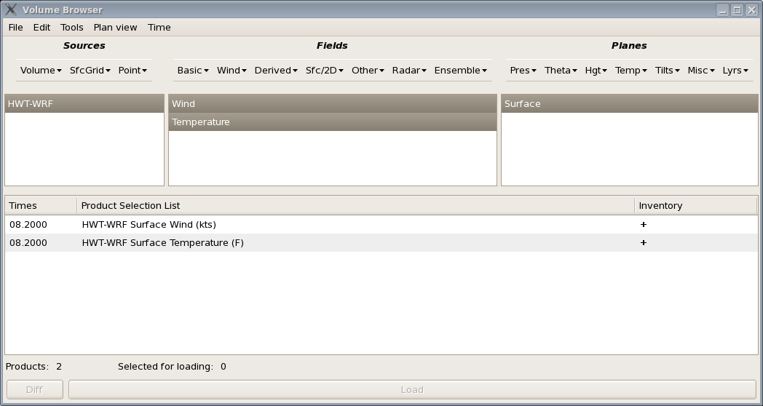
Example of surface analysis

Slide 16
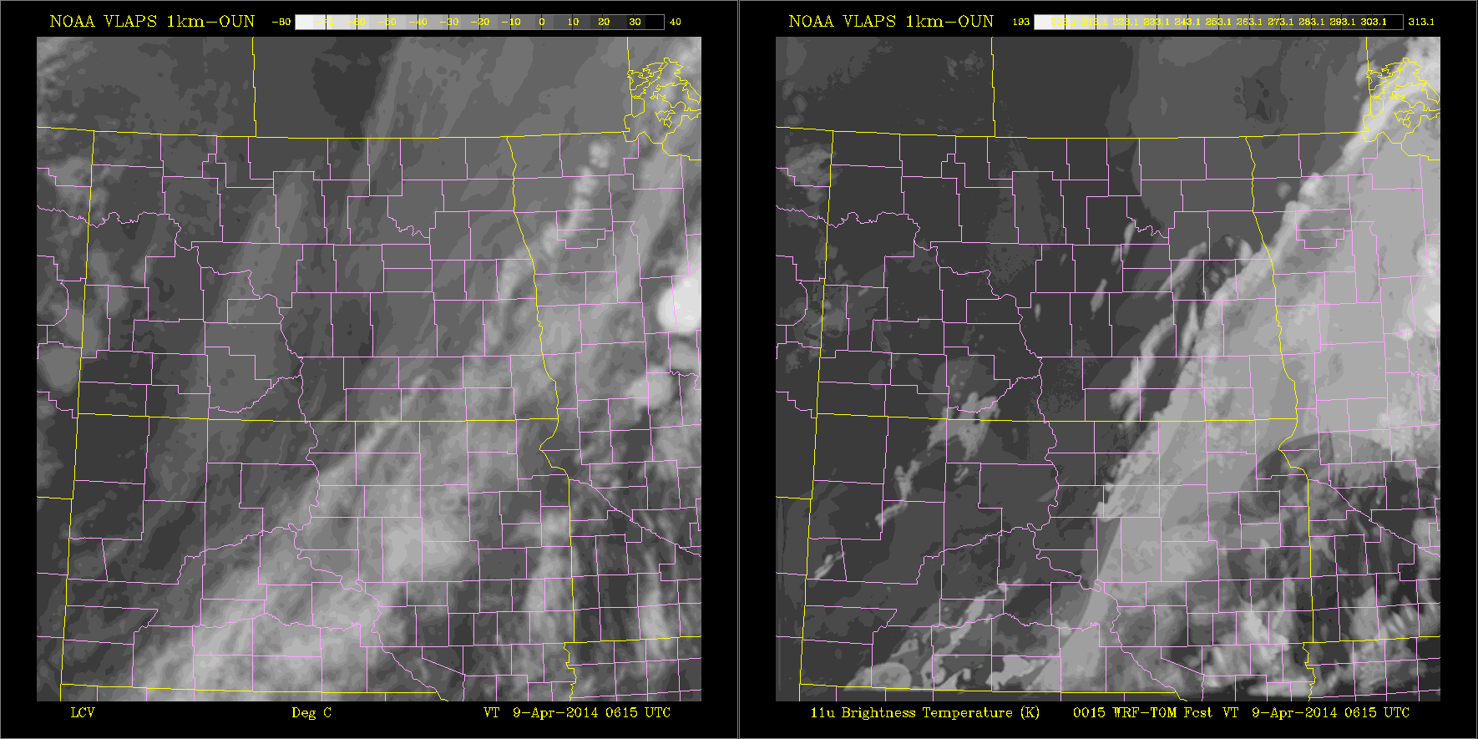
Observed and Forecast IR Satellite Brightness Temp
1 km domain 9 Apr 2014 0615 UTC - 0900 UTC
OBS
Forecast
Simulated VIS available (derived from cloud amount)

Slide 17
How to evaluate the surface analysis on AWIPS II
Open "CAVE"
Select "Volume", then "Browser"
in "Source", select "LAPS-CONUS (this name needs to be confirmed by Darrel)"
In "Field", select "WIND, TEMP",
In "Plane", select "surface", See example next page

Slide 18
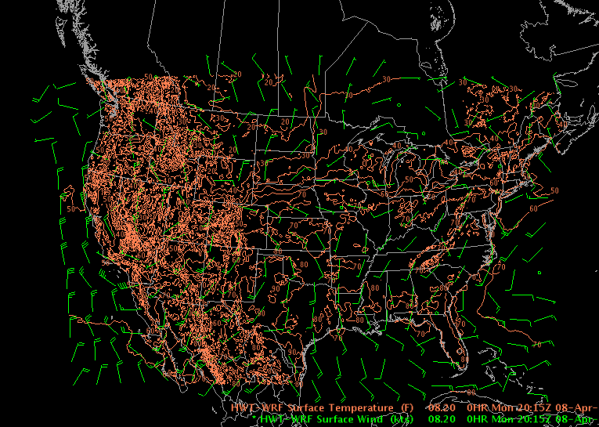
Example of surface analysis of Wind and Temp

Slide 19
Additional resources
HWT pages:
Visit: http://laps.noaa.gov/hwt/hwt.html
Verification pages:
Visit: http://laps.noaa.gov/verif/
Under "Source" menu, the three source names are:
- LAPS_CONUS_2.5km
- LAPS_OUN_1km

Slide 20
THANK YOU!

