Slide 1
CIMSS near real time GOES Sounder/GOES-R ABI TPW/LPW and instability indices products
CIMSS sounding team
April 2015
Contact: Tim.Schmit@ssec.wisc.edu
Jun.Li@ssec.wisc.edu

Slide 2
Content
Algorithms
  Forward calculation
  Inverse process
Validation
GEOCAT demonstration with GOES Sounder

Slide 3
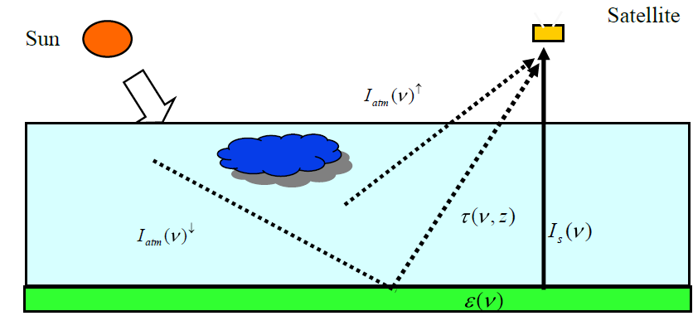
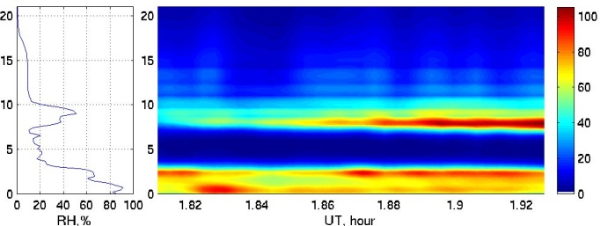
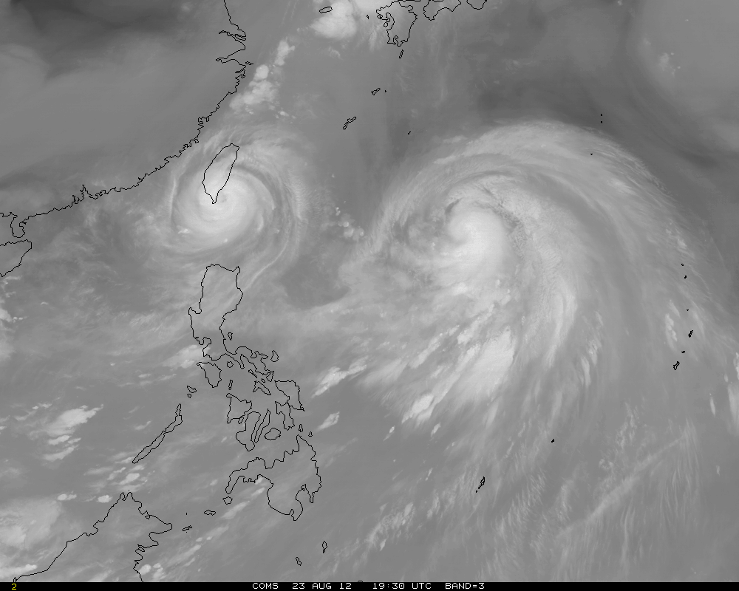
A radative transfer model (CRTM) is used, give atmospheric state X, the assumed radiances from satellite can be calculated: R=H(X)
Derive atmospheric state: X^{R} (products)
Mathematical Inverse algorithm: X=H⁻¹(R)
Apply inverse algorithm to the observed satellite radiances: Rº

Slide 4
Forward problem (1)
Given an atmospheric state X (T,q,T_{s}, …) a fast RT model F allows one to compute the top of atmosphere radiances Y for a radiometer within a few msecs. This allows Observed minus Calculated radiance values to be computed “on the fly”
Y = F(X)
X is a vector of atmospheric state
Y is a vector of radiances
Biases are possible in the forward model calculations

Slide 5
Radiative Transfer Process
Forward problem (2)
Top of Atmosphere (TOA) radiance:
satellite
Sun
atmosphere
Earth surface
I_{s}(ν) : contributed from surface emission
I_{s}(ν)^{h} : contributed from upwelling radiance
I_{s}(ν)^{i} : contributed from reflected downwelling radiance

Slide 6
Forward problem (3)
All the LAP algorithm derivations are based on the radiative transfer equation (fast and accurate radiative transfer model (CRTM) is used:
surface emission
upwelling radiance
ν: sensing frequency
ε: surface emissivity
τ: atmos. Transmittance
Ts: surface temperature
B: Planck function
T(p): air temperature at atmospheric pressure p
reflected downwelling radiance
Radiance is converted to Brightness Temperature (Tb) before retrieval process !

Slide 7
Inverse problem
Given Y, satellite observations (and the forward mapping), what are x, including the atmosphere and surface parameters ?
Difficulty of inverse problem
  ill posed problem – violation of any conditions of well posed problem
    Solution existence
    Solution uniqueness
    Stability of the solution or solutions
  Nonlinearity from radiative transfer equation
    Planck function with respect to temperature
    Transmittance with respect to temperature, moisture and pressure

Slide 8
Solving the nonlinear inverse problem
Statistically:
  Multivariable linear regression: seeking a relationship between satellite measurements and atmospheric state
Physically:
  Find an optimal solution of the atmospheric state so that the difference between the calculated and the observed satellite radiances is minimized.

Slide 9
All sky GOES sounding algorithm components
The all sky GOES sounding products are fused by three parts
  Clear sky using Legacy Atmospheric Profile (LAP) algorithm (regression + physical)
  Some cloudy region (thin/low clouds, regression only) using GOES-R Risk Reduction algorithm
  GFS fills in non-retrieval area

Slide 10
Clear sky LAP Algorithm
Two-step algorithm
  Regress for first guess followed by
  1D variational physical algorithm, which is similar to the current GOES Sounder physical retrieval algorithm
Features of the Selected Legacy Sounding Algorithm
  1D variational approach
  Regression as first guess,
  Regression from combined IR radiances and forecast information
  Emissivity information from database
  Surface pressure from forecast
  EOF representation of profile
  Forecast error covariance matrix
  Radiance bias adjustment
  Excellent historical heritage (e.g. current GOES and MODIS)
Advantages
  Low risks
  Efficient
  Algorithm is mature
Disadvantages
  Request surface IR emissivity information
  Need radiance bias adjustment
  Time continuity is not included

Slide 11
Processing Outline
– Regression Flowchart
GOES sounder IR
Radiances
(Calibrated, Navigated)
Radiance averaging
Bias adjustment
Cloud masking
Bias adjusted,
Clear Radiances
Forecast T/Q profiles
Apply regression
coefficient
First guess (T, Q, O, Ts)
Go to physical
Module

Slide 12
Processing Outline
- Physical Retrieval Flowchart
Error matrix, EOF file for T(p) and q(p), emiss
Start
Forward model calculation
Output
Input
BT, forecast
Surface analysis
parameters
Jacobian calculation
Calculate derived
products
Next iteration
Regression
(T,W,O,Ts)
Return updated
T,W,O,Ts
yes
No
Decrease gamma
Increase gamma
Inversion calculation
Update profiles
(To physical module)
Fail < f_{m}
Check Iteration < I_{m}
dR > dR_{c}
(Exit physical module)
yes
no

Slide 13
LAP Mathematical Description:
RT Linearization (1)
Linearization of the Radiative Transfer Equation: using RTM accompanying linear model or K-matrix. RTTOV and CRTM have K-matrix calculations. CRTM is used in GOES Sounder/ABI LAP retrievals.
Surface skin temperature Jacobian
Temperature profile Jacobian
WV mixing ratio Jacobian

Slide 14
LAP Mathematical Description:
RT Linearization (2)
Based on the RT linearization, we have:
For
example,
With background profiles and delta TB, the unknown profiles can be solve by the left equation (N: number of ABI IR channels, L: number of vertical pressure levels)

Slide 15
LAP Mathematical Description:
Variational Equation
Minimize the cost function for optimal solution of X
The first term reflects optimal solution, while the second term is added for stabilizing the solution due to the ill-posed inverse problem
Where
X: state vector
Y^{m}: measured brightness temperature vector
F: radiative transfer model (function of X)
E: Observation error covariance matrix (diagonal)
X^{b}: Background state vector from forecast
B: Background error covariance matrix
Notes:
Don’t forget to define what you mean by adopted and adapted—
Most won’t be familiar with that language.
Don’t forget to define what you mean by adopted and adapted—
Most won’t be familiar with that language.
Don’t forget to define what you mean by adopted and adapted—
Most won’t be familiar with that language.
Don’t forget to define what you mean by adopted and adapted—
Most won’t be familiar with that language.
Don’t forget to define what you mean by adopted and adapted—
Most won’t be familiar with that language.
Don’t forget to define what you mean by adopted and adapted—
Don’t forget to define what you mean by adopted and adapted—
Most won’t be familiar with that language.

Slide 16
LAP Mathematical Description:
Iterative Form (1)
Using Newtonian iteration to solve (by first order of Taylor expansion f(x)=f(x₀) + f’(x₀)(x-x₀)) the following equation
We can derive the iterative form:
Where
Notes:
Don’t forget to define what you mean by adopted and adapted—
Most won’t be familiar with that language.
Don’t forget to define what you mean by adopted and adapted—
Most won’t be familiar with that language.
Don’t forget to define what you mean by adopted and adapted—
Most won’t be familiar with that language.
Don’t forget to define what you mean by adopted and adapted—
Most won’t be familiar with that language.
Don’t forget to define what you mean by adopted and adapted—
Most won’t be familiar with that language.
Don’t forget to define what you mean by adopted and adapted—
Don’t forget to define what you mean by adopted and adapted—
Most won’t be familiar with that language.

Slide 17
LAP Mathematical Description:
Iterative Form (2)
Iterative form
Where:
X₀: starting point in iterations, also called first guess
Notes:
Don’t forget to define what you mean by adopted and adapted—
Most won’t be familiar with that language.
Don’t forget to define what you mean by adopted and adapted—
Most won’t be familiar with that language.
Don’t forget to define what you mean by adopted and adapted—
Most won’t be familiar with that language.
Don’t forget to define what you mean by adopted and adapted—
Most won’t be familiar with that language.
Don’t forget to define what you mean by adopted and adapted—
Most won’t be familiar with that language.
Don’t forget to define what you mean by adopted and adapted—
Don’t forget to define what you mean by adopted and adapted—
Most won’t be familiar with that language.

Slide 18
LAP Mathematical Description:
Iterative Form (3) – EOF Representation of Profile
Using EOFs for profile representation (2 for T(p), 3 for lnq(p), and 1 for Ts), assume
where
and
The new iteration form:
where
Notes:
Don’t forget to define what you mean by adopted and adapted—
Most won’t be familiar with that language.
Don’t forget to define what you mean by adopted and adapted—
Most won’t be familiar with that language.
Don’t forget to define what you mean by adopted and adapted—
Most won’t be familiar with that language.
Don’t forget to define what you mean by adopted and adapted—
Most won’t be familiar with that language.
Don’t forget to define what you mean by adopted and adapted—
Most won’t be familiar with that language.
Don’t forget to define what you mean by adopted and adapted—
Don’t forget to define what you mean by adopted and adapted—
Most won’t be familiar with that language.

Slide 19
LAP Mathematical Description
Background Error Covariance Matrix
L by L
temperature/temperature
Error covariance values
L by L
temperature/moisture
Error covariance values
(all 0)
0 0 0………………………………………..0
L: number of vertical atmospheric pressure levels
L by L
Moisture/temperature
Error Covariance values
(All 0)
L by L
Moisture/moisture
Error Covariance values
0 0 0…………………………………………………..0
10
Notes:
Don’t forget to define what you mean by adopted and adapted—
Most won’t be familiar with that language.
Don’t forget to define what you mean by adopted and adapted—
Most won’t be familiar with that language.
Don’t forget to define what you mean by adopted and adapted—
Most won’t be familiar with that language.
Don’t forget to define what you mean by adopted and adapted—
Most won’t be familiar with that language.
Don’t forget to define what you mean by adopted and adapted—
Most won’t be familiar with that language.
Don’t forget to define what you mean by adopted and adapted—
Don’t forget to define what you mean by adopted and adapted—
Most won’t be familiar with that language.

Slide 20
LAP Mathematical Description:
Notes on Background and First Guess
Background X^{b}, usually from forecast, ideally X^{b} should be independent of satellite observations
First guess X₀, is the starting point in physical iteration. First guess is very important, for example, if the first guess contains structure similar to the real atmosphere, the final solution will be good. Usually two types of first guess can be used:
  From background: X₀ = X^{b}
  From regression: X₀ = X^{Reg} (use in ABI LS algorithm)
Notes:
Physically, regression can not be used as background since it already contains radiance information, mathematically/technically/pratically regression can be used as background since most information in regression is from forecast in this case.

Slide 21
Derived Products from LAP
From the retrieved temperature and moisture profiles, the following products can be derived
  TPW; layered PW (WV1, WV2, WV3)
  LI
  CAPE
  K-Index
  Total-Totals
  Showalter Index

Slide 22
Derived Product:
Total Precipitable Water
The total atmospheric water vapor, or the Total Precipitable Water (TPW), is the vertically integrated amount of vapor from the surface to the top of the atmosphere.
Expressed in terms of the height to which that water substance would stand if completely condensed.

Slide 23
Derived Product:
Layered Precipitable Water
Layered Precipitable Water, is the vertically integrated amount of vapor from given two specific atmospheric levels in sigma coordinate.
WV1: Integrated PW from 0.9 - SFC
WV2: Integrated PW from 0.7 – 0.9
WV3: Integrated PW from 0.3 – 0.7

Slide 24
Derived Poduct:
Lifted Index (LI)
Lifted Index (LI) (Degrees Celsius): The Lifted Index is calculated by lifting a parcel of air dry adiabatically while conserving moisture until it reaches saturation. At that point the parcel is lifted moist adiabatically up to 500 hPa. The Lifted Index is the ambient air temperature minus the lifted parcel temperature at 500 hPa.
More negative values denote more unstable profiles.

Slide 25
Mathematical Description:
Lifted Index (LI)
LI = T500 – Taa
  0< LI → stable
  -3< LI <0 → marginally unstable
  -6< LI <-3 → moderately unstable
  -9< LI <-6 → very unstable
  LI <-9 → extreme instability

Slide 26
Derived Product:
Convective Available Potential Energy (CAPE)
Convective Available Potential Energy (CAPE, Joules/kg): Convective Available Potential Energy, a measure of the cumulative buoyancy of a parcel as it rises, in units of Joules per kilogram.
CAPE values larger than 1000 J/kg represent moderate amounts of atmospheric potential energy. Values exceeding 3000 J/kg are indicative of very large amounts of potential energy, and are often associated with strong/severe weather.

Slide 27
Mathematical Description:
Convective Available Potential Energy (CAPE)
Z_{f}: level of free convection
Z_{e}: the equilibrium level
T_{ve}: environmental virtual temperature
T_{ae}: air parcel virtual temperature

Slide 28
Derived Product:
Total Totals Index (TT):
Total Totals Index (TT): The Total Totals Index is computed using discreet pressure level information and is indicative of severe weather potential.
Total Totals Index is a sum of two separate indices
Vertical Totals (measure of static instability)
Cross Totals (measure of moist instability)
Total Totals = Vertical Totals + Cross Totals
TT = VT + CT = (T850 - T500) + (Td850 – T500)
Generally, TT values below 40-45 are indicators of little or no thunderstorm activity, while values exceeding 55 in the Eastern and Central United States or 65 in the Western United States are indicators of considerable severe weather.

Slide 29
Derived Product:
Showalter Index (SI):
Showalter Index (SI): The SI is a parcel-based index, calculated in the same manner as the Lifted Index, using a parcel at 850 hPa. That is, the 850 hPa parcel is lifted to saturation, then moist adiabatically to 500 hPa. The difference between the parcel and environment at 500 hPa is the Showalter Index.

Slide 30
Mathematical Description:
Showalter Index (SI):
T500: air temperature 500 hPa
T850: air temperature at 850 hPa

Slide 31
Derived Product:
K Index (KI):
K index (KI): The K-Index is a simple index using data from discreet pressure levels, instead of a lifted parcel. It is based on vertical temperature changes, moisture content of the lower atmosphere, and the vertical extent of the moist layer. The higher the K-Index the more conducive the atmosphere is to convection. The formula for KI is:
KI= (T850 hPa-T500 hPa) +
[(TD850 hPa - (T700 hPa - TD700 hPa)]
  where: T=Temperature, TD= Dewpoint Temperature

Slide 32
Cloudy LAP retrieval algorithm
The cloud algorithm uses the same linear regression technique as the clear sky, but without physical iteration
Y = K X
X is a vector of predictors, including Tb and forecast profiles.
Y is a vector of predictants, including profiles of T/Q/O3, Tsurf, cloud optical thickness, cloud top pressure, and cloud particle size

Slide 33
The flow chart of the cloudy LAP retrieval algorithm
Cloudy algorithm
Apply water clouds regression coefficients
Apply ice cloud regression coefficients
Calculate Tb_water
Calculate Tb_ice
Phase
determination
no
δ Tb_water < δ Tb_ice
yes
Ice clouds
Water clouds
yes
Pass quality control
no
Output profiles and cloud parameters
Failed retrieval

Slide 34
Cloudy LAP products
Same LAP products as clear sky:
  temperature and moisture profiles
  Derived products, including TPW, layered PW (WV1, WV2, WV3), LI, CAPE, K-Index, Total-Totals, Showalter Index
Plus cloud parameters
  Cloud optical thickness, cloud top pressure, phase, effective particle size

Slide 35
Summary on algorithm
GOES-R ABI LAP algorithm is used for GOES Sounder/GOES-R ABI and derived products
Multivariable linear regression technique is used to generate
  Clear sky profiles as first guess for physical iteration
  Cloudy profiles as well as cloud parameters
Physical iteration is applied to extract optimal clear sky LAP products
The all sky GOES LAP products are fused by
  Clear sky LAP products
  Cloudy LAP products
  GFS forecast for non-retrieval areas

Slide 36
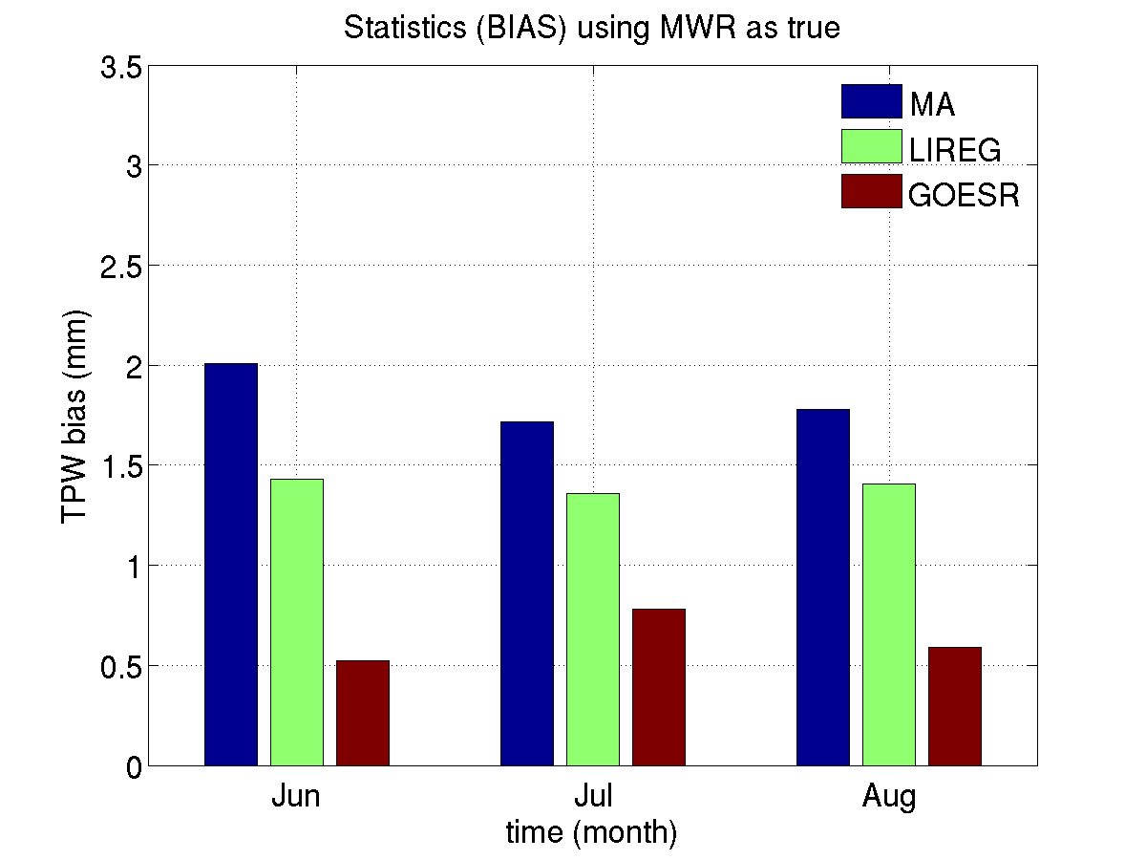
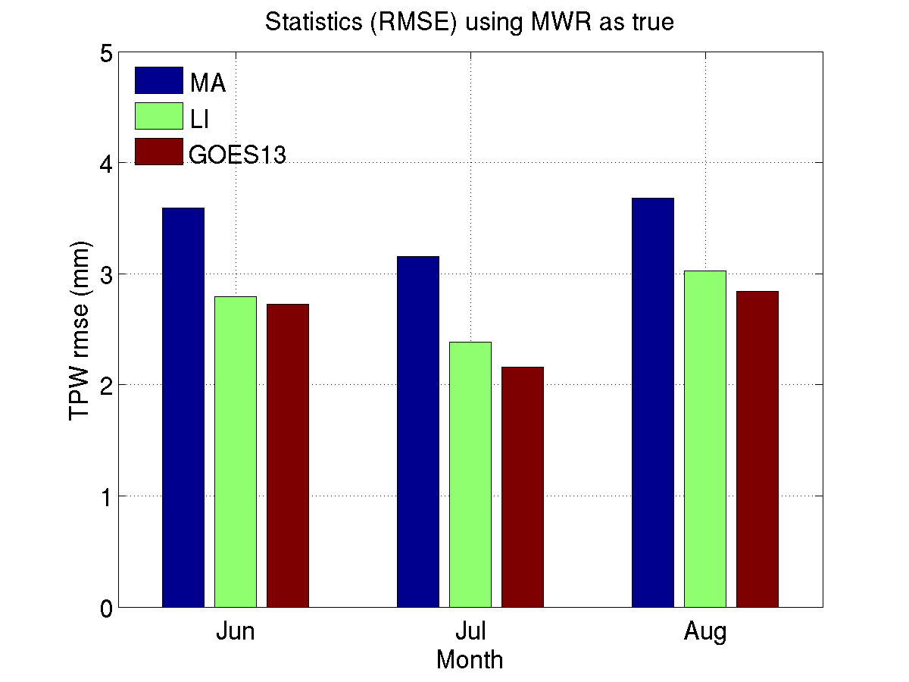
Comparison with the operational GOES sounder retrieval algorithms
Red (GOES13): GOES-R LAP algorithm
Green (LI): current NOAA operational algorithm, Li et al. (2008)
Blue (MA): old NOAA operational algorithm, Ma et al. (1999)
Period: Jun. 1, 2012- Aug. 30, 2012
RMSE and BIAS of GOES-13 TPW are smaller than that of TPW retrieved using operational algorithms.
Lee et al. JTECH (2013)
Notes:
GOES-R ABI LAP retrieval algorithm applied to the current GOES-13 sounder.
Comparison with the operational GOES sounder retrieval algorithms
TPW comparison with Ma et al. (1999) and Li et al. (2008)

Slide 37
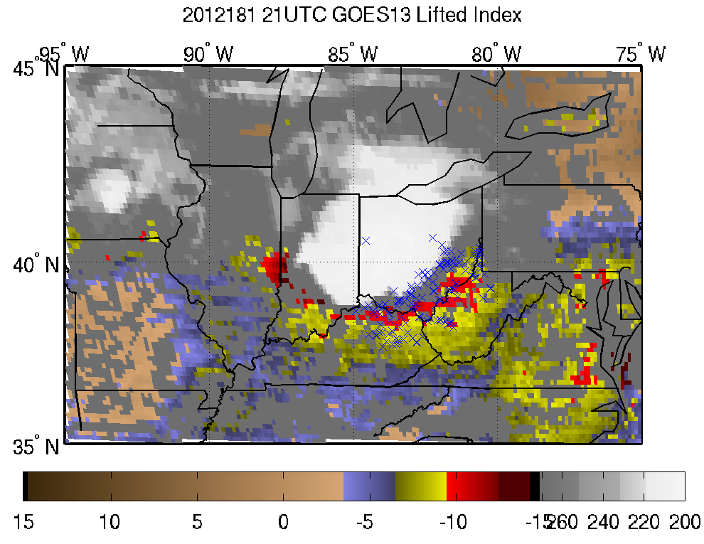
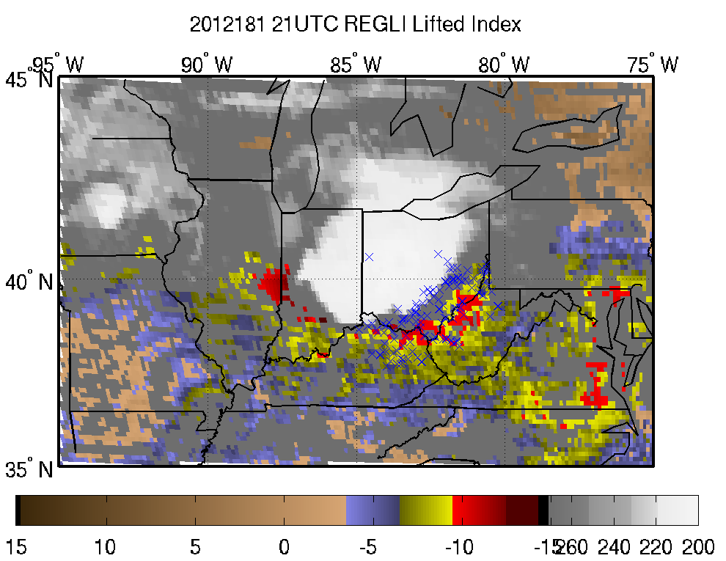
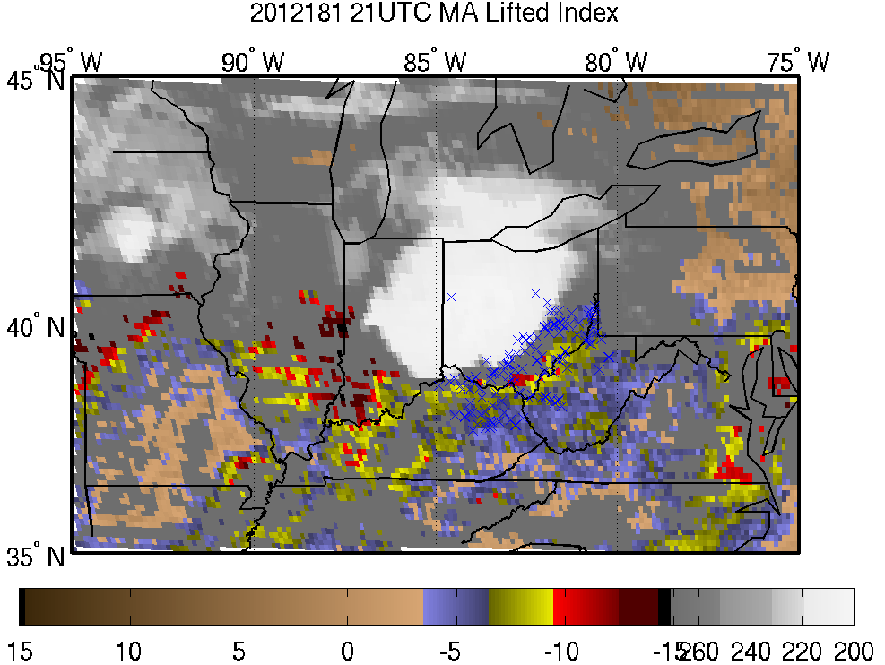
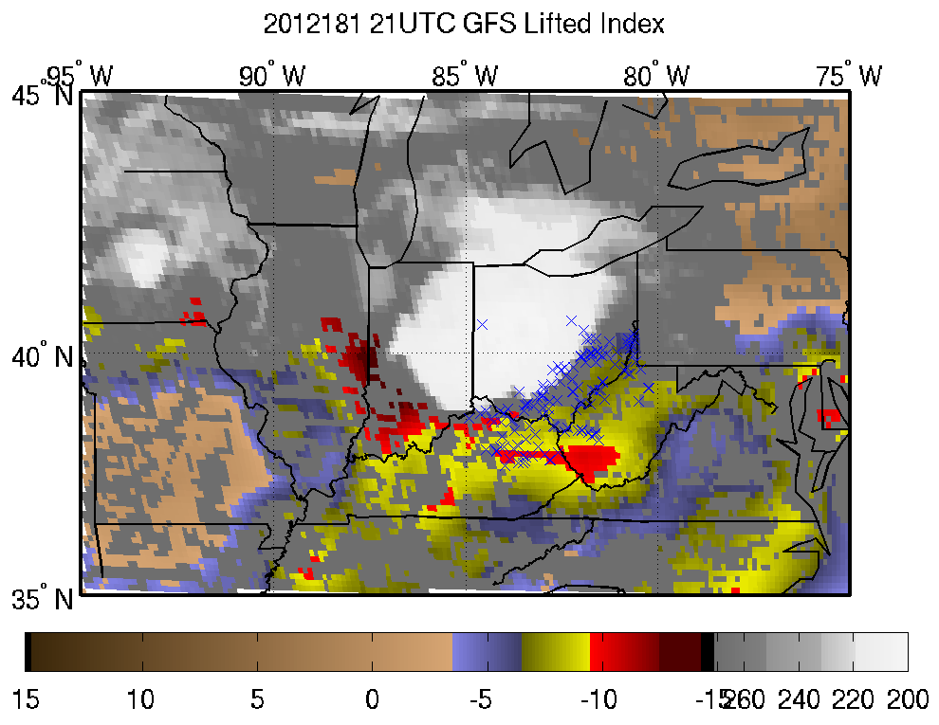
GOES-13 Sounder Lifted index with GOES-R algorithm comparison with Li et al. (2008) & Ma et al. (1999)
GOES13
Li et al.
June 29, 2012 derecho
x : locations of
wind and hail reports
between 2130-2330 UTC
Ma et al.
GFS
Lee et al.
JTECH (2013)
Lifted index
BT
Lifted index
BT
Notes:
GOES-R ABI LAP retrieval algorithm applied to the current GOES-13 sounder.

Slide 38
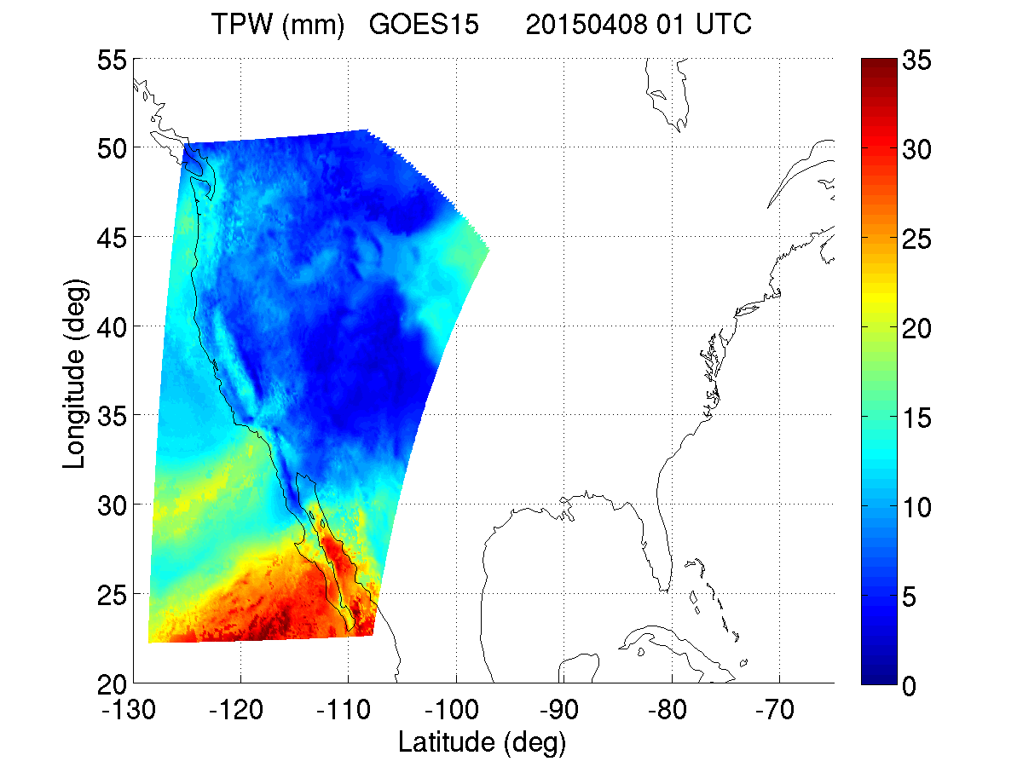
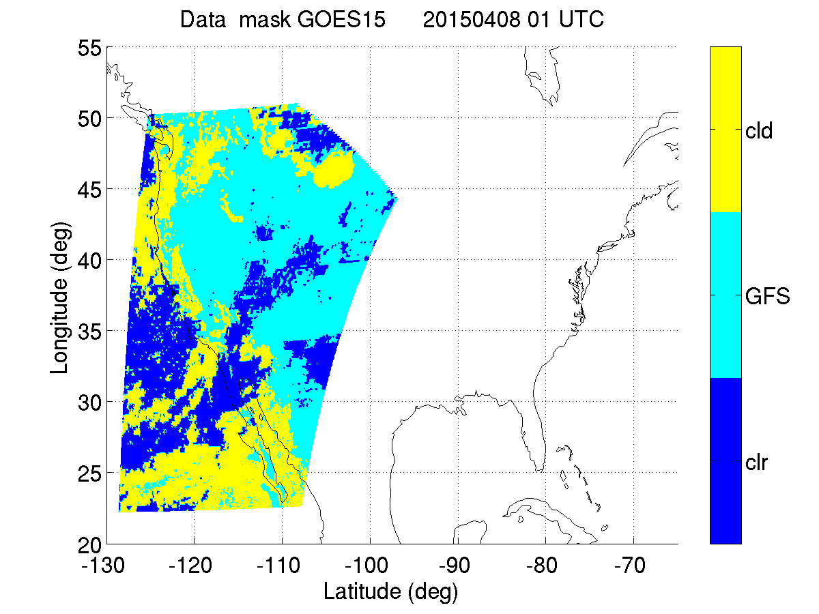
GOES-15 sounder TPW & Data mask clear + cloudy + GFS
TPW
Data Mask
Cld: successful retrieval coverage under cloudy skies
Clr: successful retrieval coverage under clear skies
GFS: failed retrieval coverage filled with GFS

Slide 39
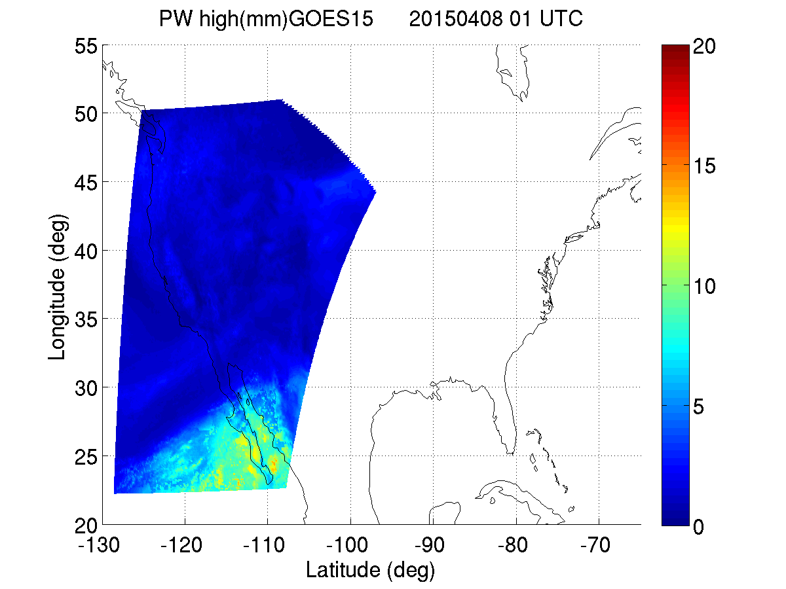
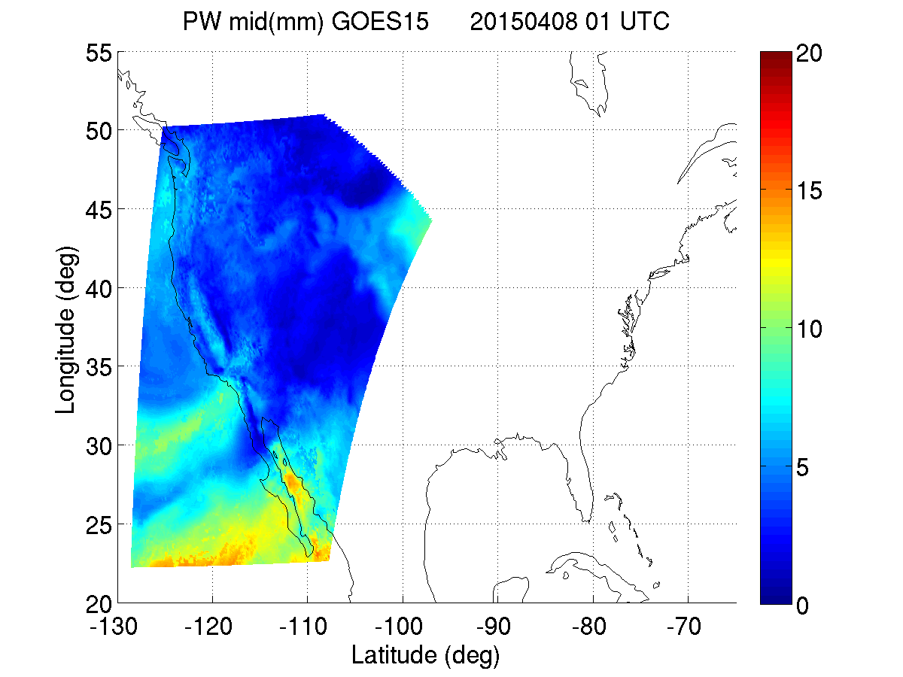
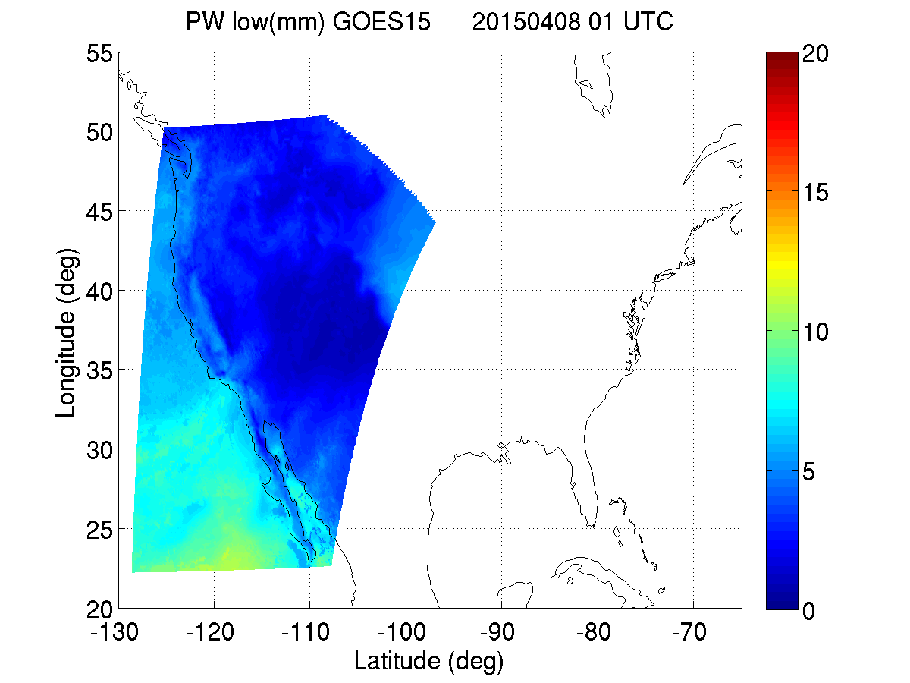
GOES-15 sounder PW clear + cloudy + GFS: three levels (high, middle, low)
PW High
(0.3 – 0.7)
TPW
PW Middle
(0.7 – 0.9)
PW Low
(0.9 – SFC)

Slide 40
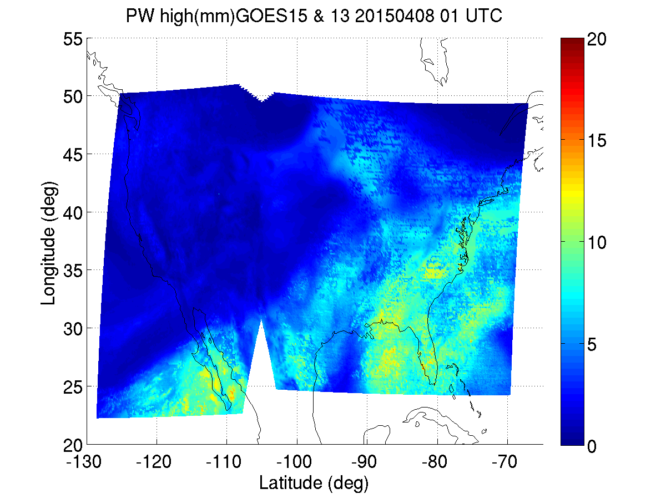
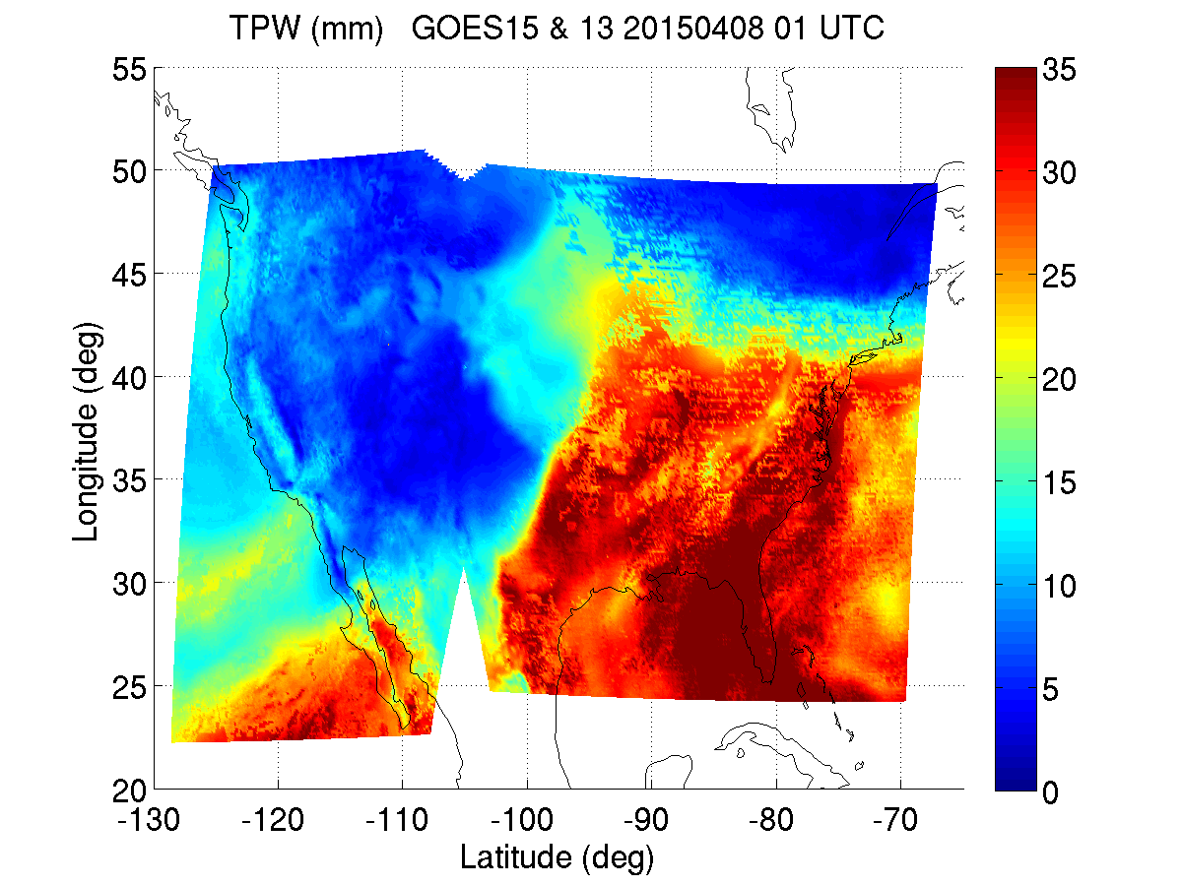
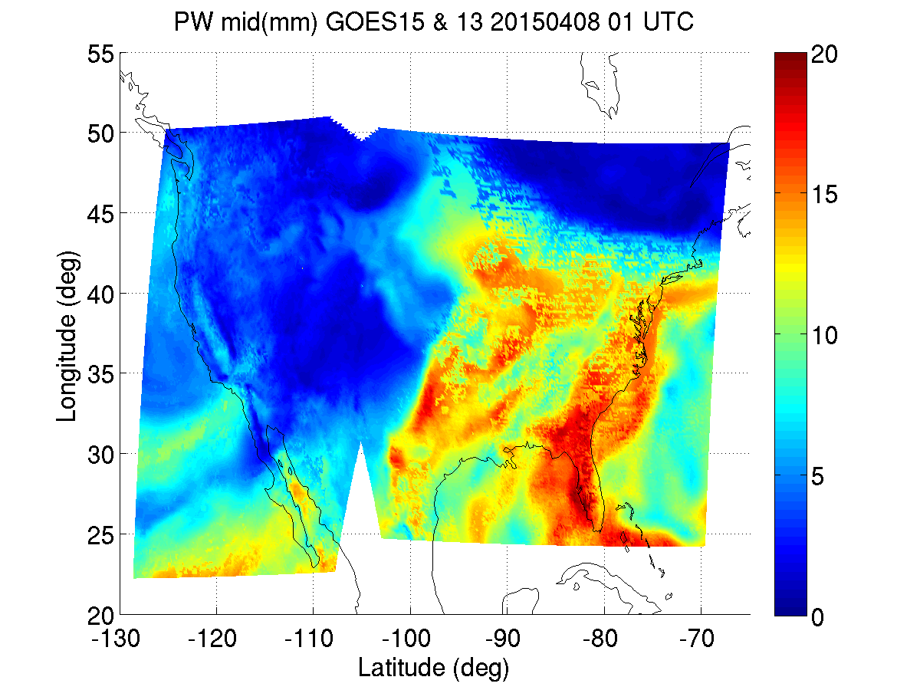
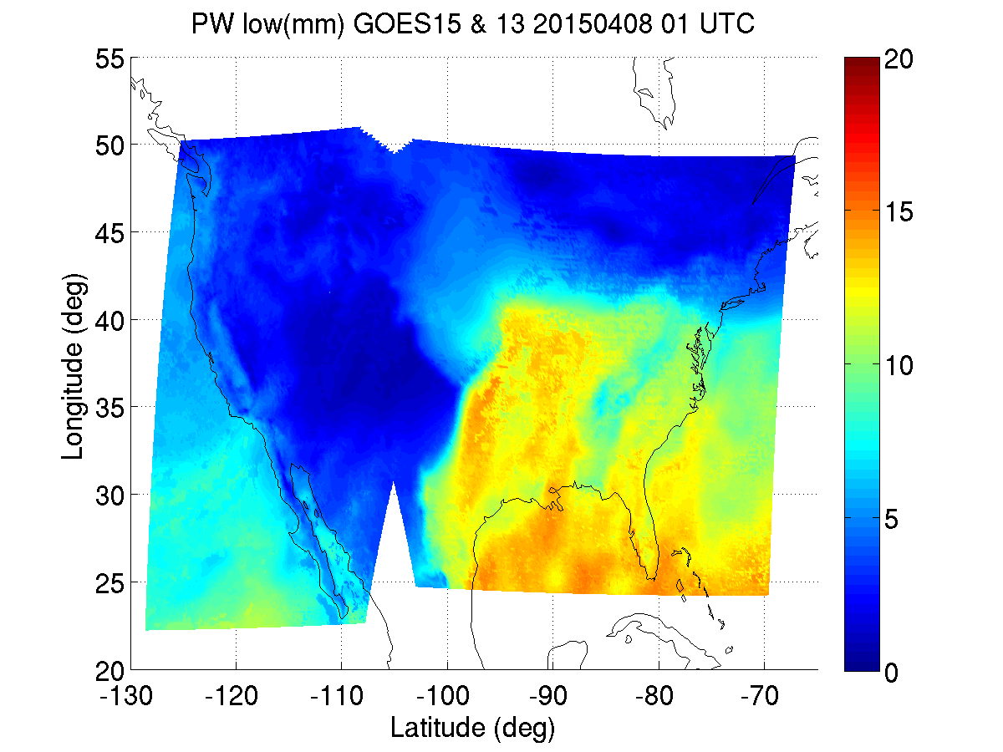
GOES-15 & 13 sounder TPW & PW clear + cloudy + GFS: three levels (high, middle, low)
PW High
PW High
TPW
PW Middle
PW Middle
PW Low
PW Low

Slide 41
Questions to forecasters
Which product (TPW, LPW, instability indices) is most useful for your application?
How do you use the products in this forecast case?
How can we improve the products to satisfy your needs?
Any other suggestions/comments on using the LAP products?

