Slide 1






Gridded NUCAPS for Anticipating Convection
Joint Project between
NASA SPoRT, NOAA, CIMSS, CIRA, GINA, and STC

Slide 2
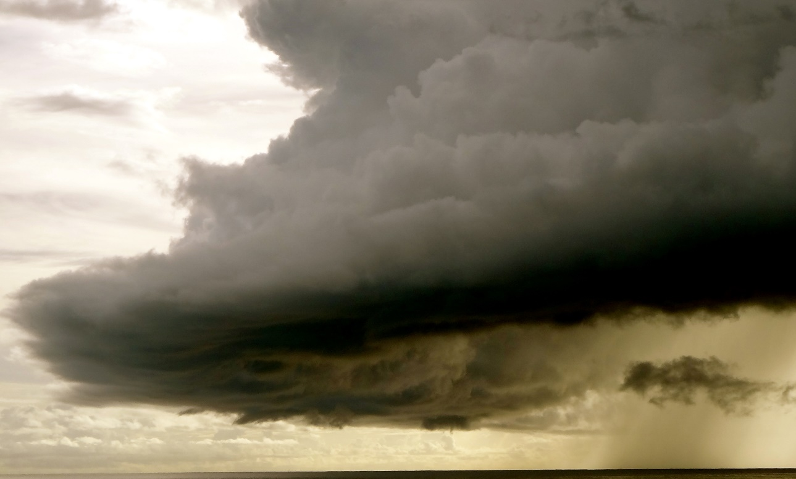
Introduction
This training module will take you through the steps on how to use the Gridded NUCAPS to increase situational awareness when diagnosing the pre-convective environment.
Forecasters will understand:
  Strengths and weakness of the Gridded NUCAPS
  Gridded NUCAPS in the forecast process to identify potential areas of convection

Slide 3
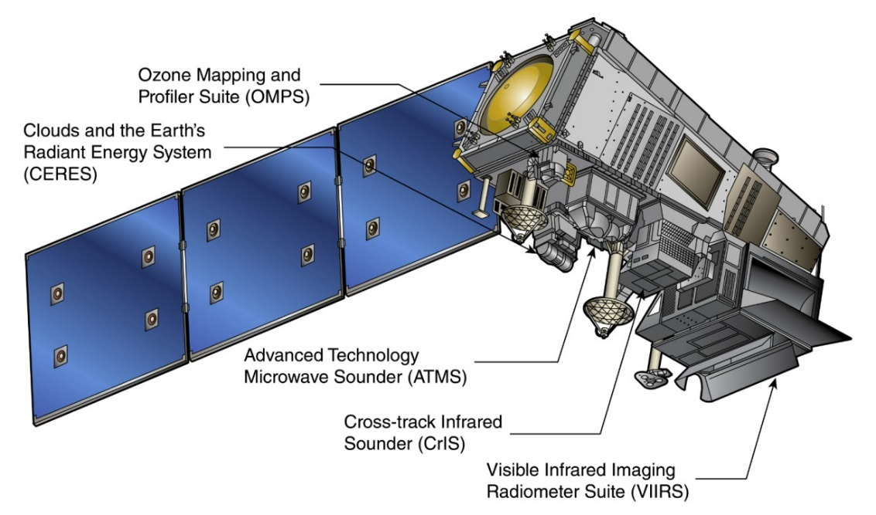
Hyperspectral Infrared Sounders
NUCAPS – NOAA Unique Combined Atmospheric Processing System
CrIS – Cross Track Infrared Sounder (1305 Channels)
ATMS – Advanced Technology Microwave Sounder (22 Channels)
Onboard Suomi/NPP overpasses between standard radiosonde launch times
  Passes over East Coast: 05z/17z
  The Plains: 07z/19z
  West Coast: 11z/23z
  Alaska: Multiple
Takes advantage of a much larger number of channels (as compared to current GOES, HIRS, legacy TOVS sounders) to better resolve vertical structure in the atmosphere
  Measure temperature and water vapor with height as well as ozone, other trace gases, and cloud information (e. g. cloud top fraction, cloud top pressure)
  Most accurate in the upper-levels under clear conditions
  Infrared and microwave measurements are paired to allow for measurements in partly cloudy regions
  Measurements are degraded in regions of thick clouds

Slide 4
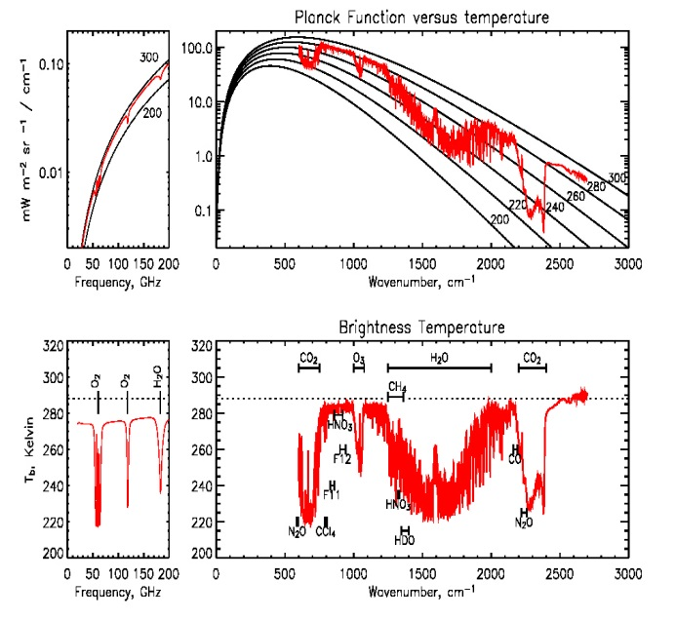
How is a NUCAPS Sounding retrieved?
MW spectrum
IR spectrum
Initial profile statistically derived from MW (ATMS) and full IR measurement (all channels of CrIS)
Brightness Temp
Which CrIS channels are used? 399 of them
24 for surface temperature
87 for atmospheric temperature
62 for water vapor
Adjacent Channels are not used
Channels chosen are predominantly sensitive to one gas only
Perform cloud clearing to remove cloud signal from IR radiance
Physical retrieval using both MW and a subset of cloud-cleared IR channels. This involves
Error checking, diagnostic tests, iteration
Sequential retrieval of T, q, CO, O3, CH4, etc.
Quality flags
Produce final IR+MW NUCAPS soundings at 100 layers
MW-only NUCAPS soundings available operationally but not in AWIPS yet

Slide 5
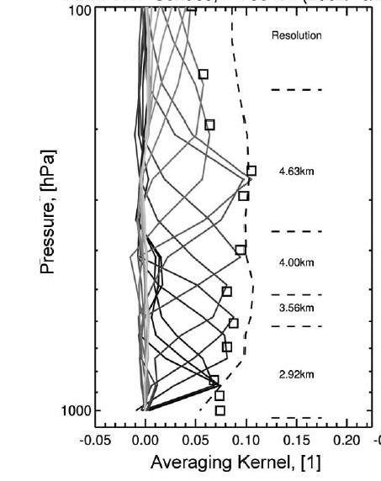
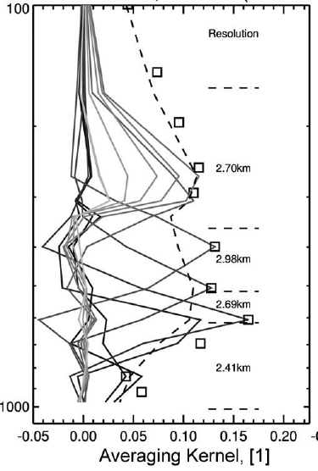
Effective Vertical Resolution of Satellite Soundings
CrIS and ATMS can resolve:
  4-6 layers of water vapor
  6-10 layers of temperature
… in the troposphere so
think layer values rather
than specific point values.
How are the layers
vertically distributed?
… it varies from scene to scene and is dependent on Earth surface as well as local weather conditions
Scene 1
Layers
Scene 2
Layers
Vertical Resolution Estimates
Images are from Maddy & Barnet, IEEE, 2008

Slide 6
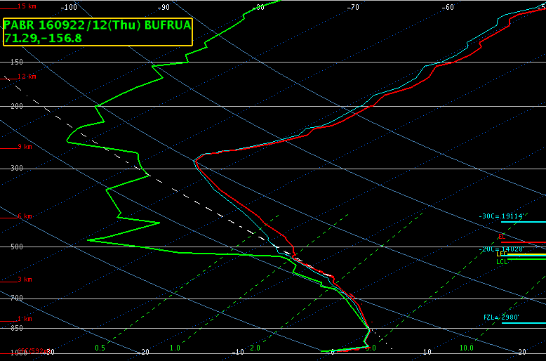
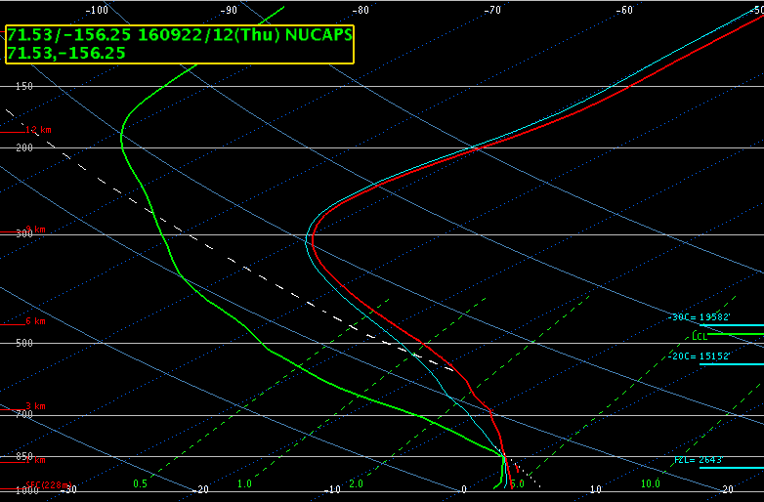
Effective Vertical Resolution of Satellite Soundings
So what does this mean in operations?
… satellite soundings, such as NUCAPS, will have a smoother appearance
Radiosonde
NUCAPS Sounding
Barrow, Alaska

Slide 7
NUCAPS Limitations
The amount/quality of retrievable information varies from scene to scene depending on local weather conditions
Infrared observations are sensitive to surface temperature
  Land vs ocean
  Day vs night
  Local conditions
No single parameter (T, q) is retrieved without interference from others (T, q, trace gases)
Cloud cover and edges of clouds
  Success in cloud cover up to 90%
  Does not retrieve atmospheric conditions inside/through clouds
  NUCAPS retrieves atmospheric conditions from clear-sky pathway around clouds
  Cloud clearing removes the radiative effects of clouds and preserves the clear-sky portion of the foot print or emission signal that reaches the top of the atmosphere

Slide 8
What about clouds?
To an IR Sounder clouds are an obstacle. A <5% probability that ~50km footprint is cloud-free
NUCAPS performs “cloud clearing” to increase global yield of soundings, thus soundings are retrieved under most cloud/surface conditions. NUCAPS have spatial + temporal consistency, it also has soundings of atmospheres nearly impossible for radiosondes to reach
Nadir
Nadir
Scan angle = 50˚
Scan angle = 50˚
✘
✔
NUCAPS does NOT retrieve thermodynamic environment THROUGH clouds
NUCAPS retrieves cloud-free thermodynamic environment AROUND/PAST clouds

Slide 9
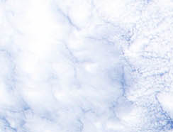
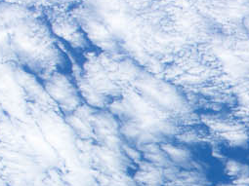
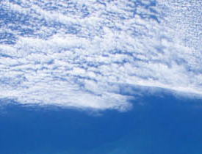
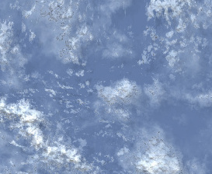
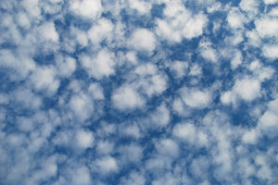
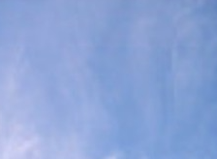
Cloud Clearing: Use clusters of footprints to remove cloudy signal from radiance measurement
✘
✓
✓
✓
✓
✘
Uniformly cloudy
Uniformly cloudy
High optical thickness
Low spatial variability
Cloud contrast, High spatial variability; NUCAPS retrievals in up to 90% cloudiness
Low optical thickness
Low spatial variability
Clear sky: high quality IR+MW retrievals (soundings)
Partly cloudy: use clear sky CrIS footprints to perform cloud clearing. Constrained by ATMS
Uniformly cloudy: retrieval fails and poor quality NUCAPS sounding results
Infrared Measurement (CrIS) in clusters of 3 x 3 (~50km at nadir)
Microwave measurement (ATMS) averaged to CrIS clusters

Slide 10
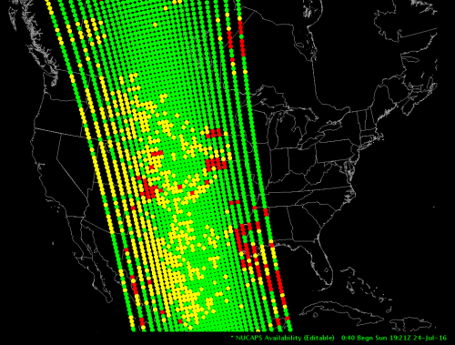
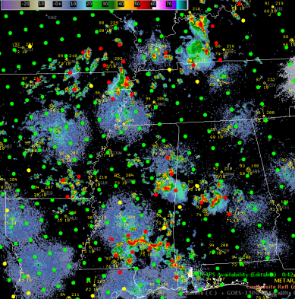
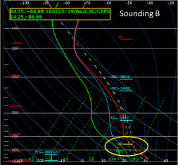
Current Operational NUCAPS Visualization
NUCAPS is the NOAA Operational Retrieval algorithm for CrIS/ATMS and IASI/AMSU T and q profiles
Capabilities for displaying individual Skew-T plots are available in the latest versions of AWIPS II with quality control flags
Skew-Ts are valuable for some forecast challenges, and visualizing the data in plan view or cross section may be more useful for others
NUCAPS allows forecasters to observe the 3D extent of the atmosphere where conventional observations are sparse
NUCAPS Sounding locations in AWIPS
NUCAPS Sounding in AWIPS
NUCAPS Sounding locations overlaying radar in AWIPS
Images by Kris White (NWS HUN/NASA SPoRT)

Slide 11
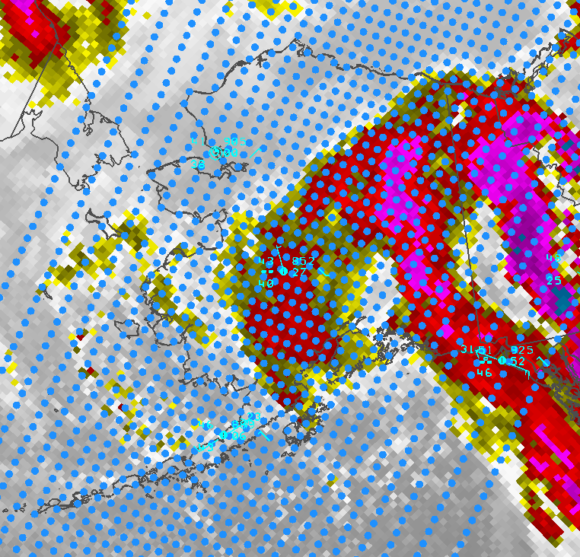
Gridded Product Overview
Stack of individual layers (Temp/SPFH)
P2G
AWIPS
NUCAPS Soundings:
Need to click on each ‘dot’ to review the vertical information
Pros: Can choose specific locations
Cons: A lot of individual interrogation
58 levels are output using Polar2Grid from the 100 layers output by NUCAPS.
Ingested into AWIPS on a uniform model grid, so AWIPS will interrogate the information in the same way it handles model data allowing for plan view and cross sections

Slide 12
NOAA CrIS/ATMS data delivery:
Operational (CLASS/SBN) vs Direct-Broadcast (CSPP)
FOV = field of view (yellow)
FOR = field of regard (blue)
Operational NOAA CrIS/ATMS footprints
9 x CrIS FOVs inside 1 x ATMS FOR
Dotted NUCAPS in AWIPS is delivered via operational SBN stream
Direct Broadcast NOAA CrIS/ATMS footprints
7 x CrIS FOVs inside 1 x ATMS FOR
Gridded NUCAPS in AWIPS is delivered via CSPP/DB stream
Two footprints (#4 and #6) are removed from real-time DB stream to decrease data latency
IMPACT: We can expect to see a mismatch in quality flags and retrieval quality at the edges of cloud fields between the dotted and gridded NUCAPS due to fewer footprints with which to calculate cloud cleared radiances

Slide 13
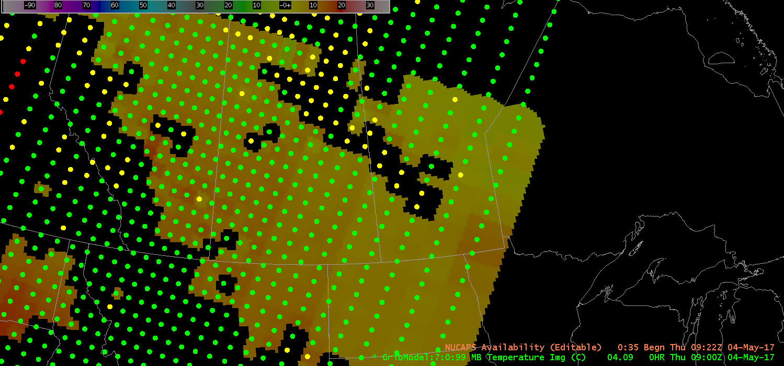
Dot NUCAPS overlaid on Gridded NUCAPS
Green: good retrieval
Yellow: IR retrieval failed but MW-only retrieval successful
Red: Both IR and MW failed
Gridded NUCAPS: polar2grid regrids NUCAPS to 10km from ~50km at nadir (~150km at edge of scan). NO INTERPOLATION. All this means is that a single retrieval footprint is now represented by ~25 (~225) identical grid cells. This breaks footprint into smaller parts and gives it a zig-zag edge but the benefits are that (1) it preserves a realistic footprint size towards edge of scan, and (2) allows a one-to-one comparison with dot NUCAPS product.
Note the mismatch in QC between dotted and gridded product. This is due to the latter being from the CSPP (direct broadcast) data stream which has 7 instead of 9 fields of view (previous slide).

Slide 14
Displaying Data & Recommended Fields
Can view as cross section or plan view via volume browser
Volume Browser → NUCAPS-CONUS → choose field → Misc → Gridded NUCAPS → choose level → load
Temp: Temp, Potential Temp, Temp Lapse Rate, Virtual Temperature
Moist: Dewpoint, Dewpoint Dep, Mixing Ratio, RH, Theta E, Saturated Theta E, Specific Humidity
Stability: Computed CAPE, Most Unstable CAPE, Computed CIN, Lapse Rate (can view on layers via Pres → Standard Layers → choose layer)
  Vertical Totals, Total Totals, Showalter Index, K Index, Cross Totals
Or use the NUCAPS_AllTilts.xml procedure to display temperature and toggle through all the levels

Slide 15
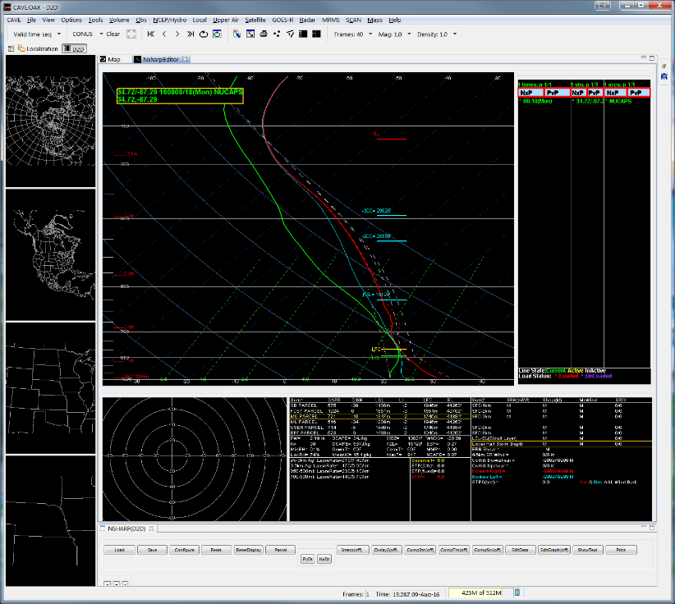
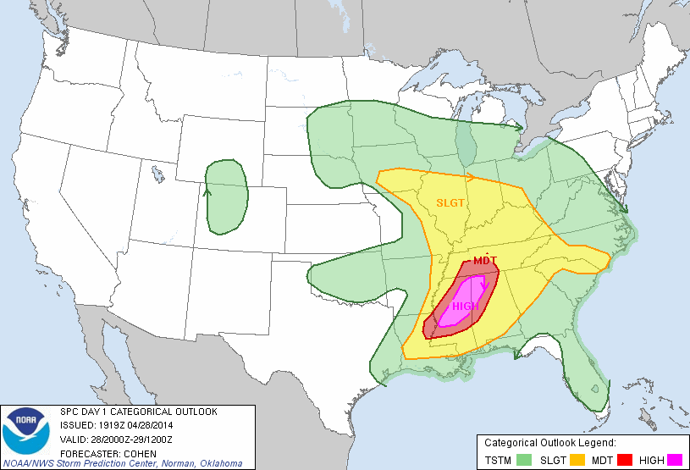
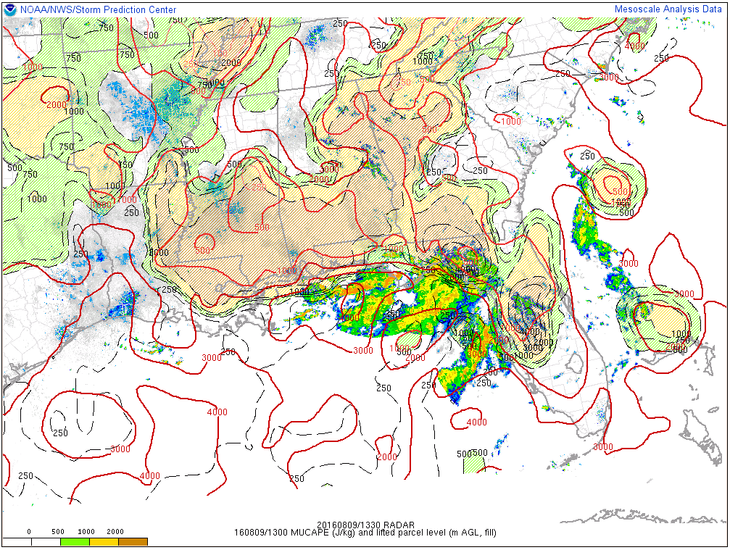
Forecast Challenge:
Diagnosing Pre-Convective Environment
The vertical distribution of temperature and moisture in the lower atmosphere determines convective potential
Forecasters use a combination of in situ observations, satellite data, and models to determine the location of boundaries and areas of instability
Ability to view plan view and cross sections of NUCAPS data in a beta version were demonstrated at the 2016 Hazardous Weather Testbed Experimental Warning Program
Sample convective outlook from SPC
Sample model analysis
Sample model analysis

Slide 16
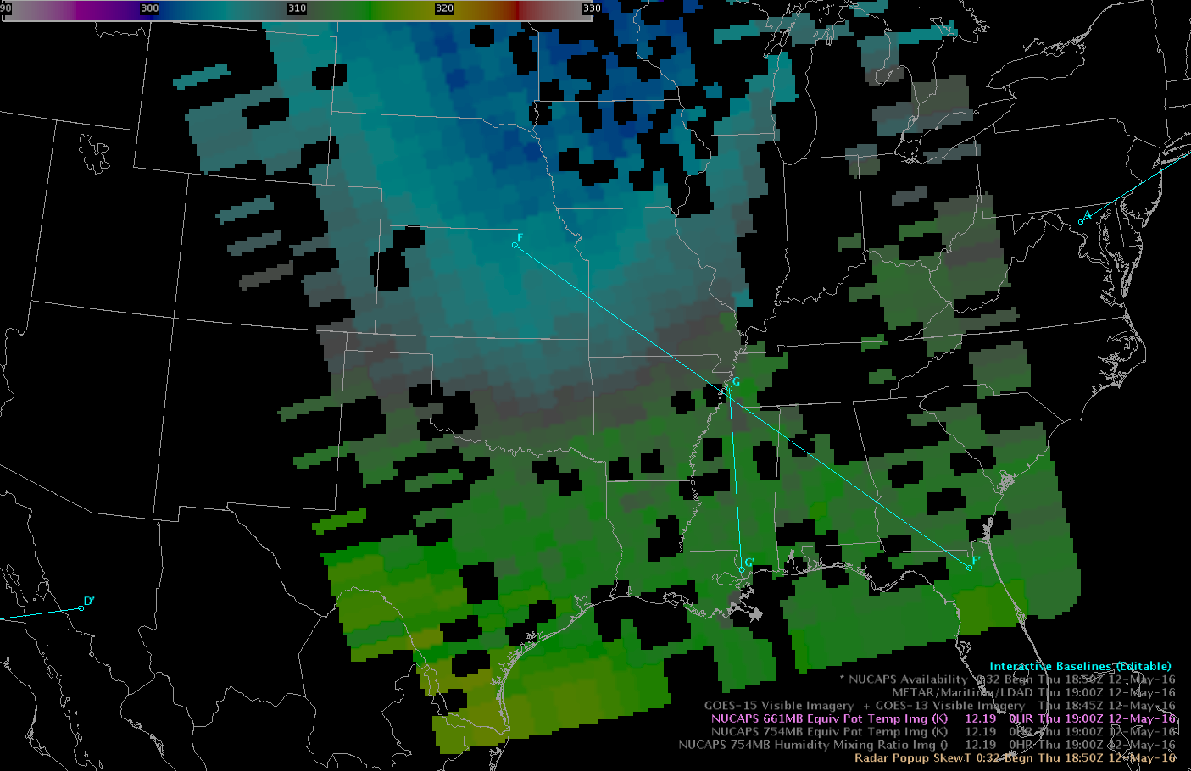
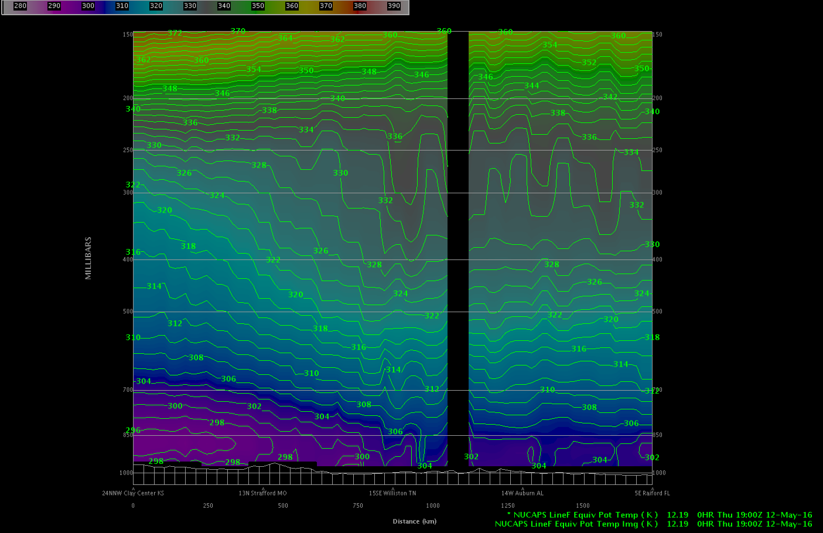
Gridded NUCAPS Convection Application
Images from GOES-R HWT Blog
Cold front easily identified in Gridded NUCAPS
“We recently gained the ability to create cross sections through the NUCAPS swaths. This will be helpful for diagnosing phenomena such as boundaries and convective instability. The first image below is a plan view display of theta-e at 660 mb across the region. Obvious is the much cooler, drier air behind the cold front (low theta-e) with moist, warmer air ahead of it to the east (high theta-e). Also plotted is a line, denoting the location for which the cross-section (image below) was taken, through the cold front. The cross-section depicts theta-e vertically through the atmosphere. This provides another perspective on the cold front, which is obvious in the image.”

Slide 17
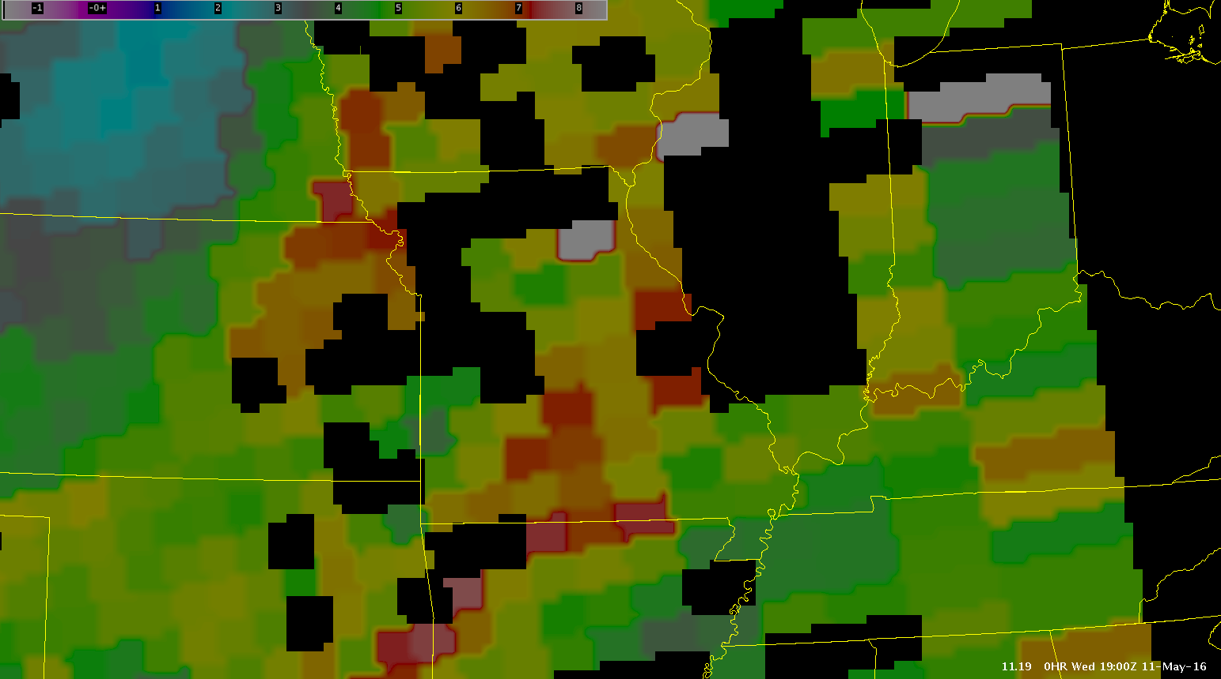
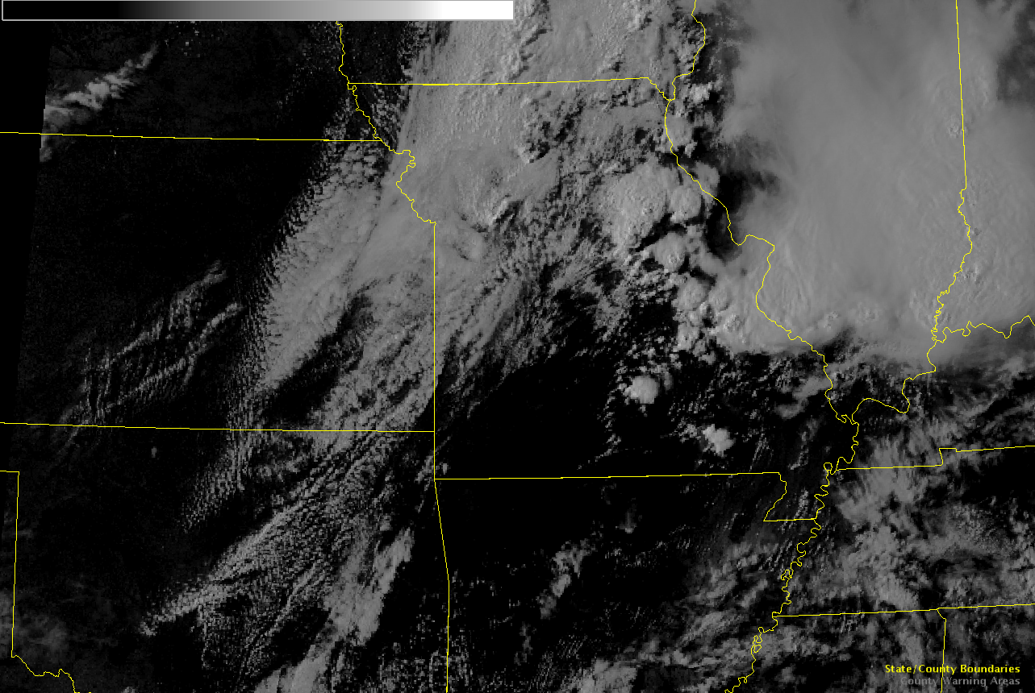
Gridded NUCAPS Convection Application
Images from GOES-R HWT Blog
“We took a look at a NUCAPS plan view image of mid-level moisture (754 mb mixing ratio) from 19Z. Image shown below. Areas of higher moisture were apparent over south-central Missouri in our SGF CWA, and over the St. Louis metro area.
Several hours later, we noted that convective activity was focused in these general areas. The few cells that developed over our CWA were over the south-central part of the state. Much more significant convection triggered over the St. Louis area. –JP”

Slide 18
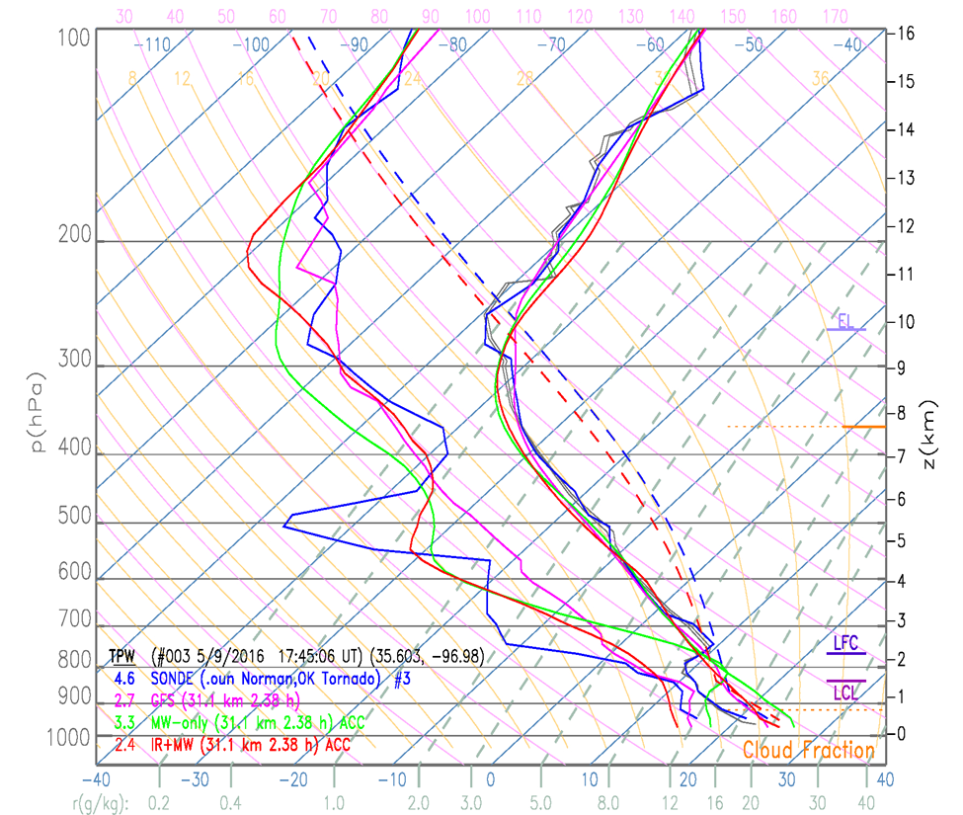

9 May 2016
Observed soundings taken at OUN 12/18 UTC
NUCAPS Sounding (Red) captured the mid-level dry air signature during 19-20 UTC overpass
Convective parameters (red in table) were within ~20 % of model CAPE and observations
NUCAPS provided additional Soundings over a large area and between special/synoptic observations
Tornado occurred near Moore, OK 2215 UTC

Slide 19
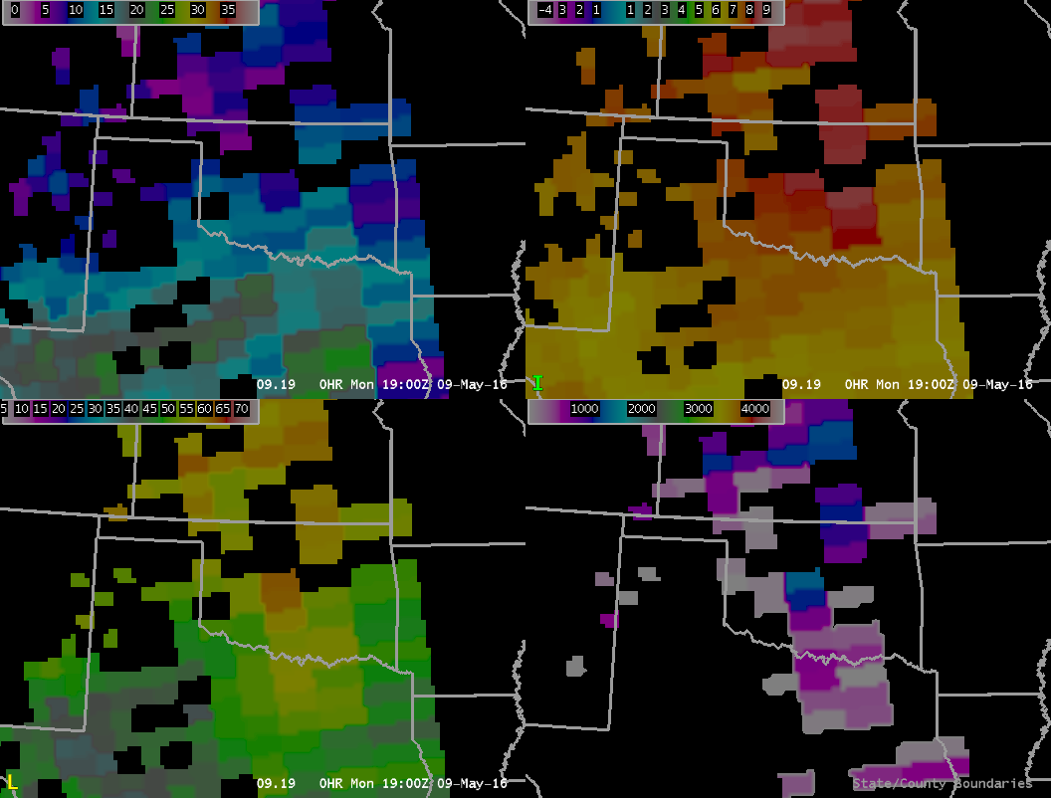
9 May 2016
700 mb Dew Point Depression
700-500 mb Lapse Rate
8-15 C
7-9 C/km
Gridded NUCAPS example to evaluate the pre-convective environment in OK and TX where severe weather was anticipated on this day
Gridded NUCAPS overpass 19-20 UTC indicates
  Mid-level dry air present
  Unstable conditions
  Strong potential for severe weather
Mid-level dry air present
Unstable conditions
Total Totals Index
850 mb Computed CAPE
> 55
1100-1400 J/kg
Strong potential for severe storms
Unstable conditions

Slide 20
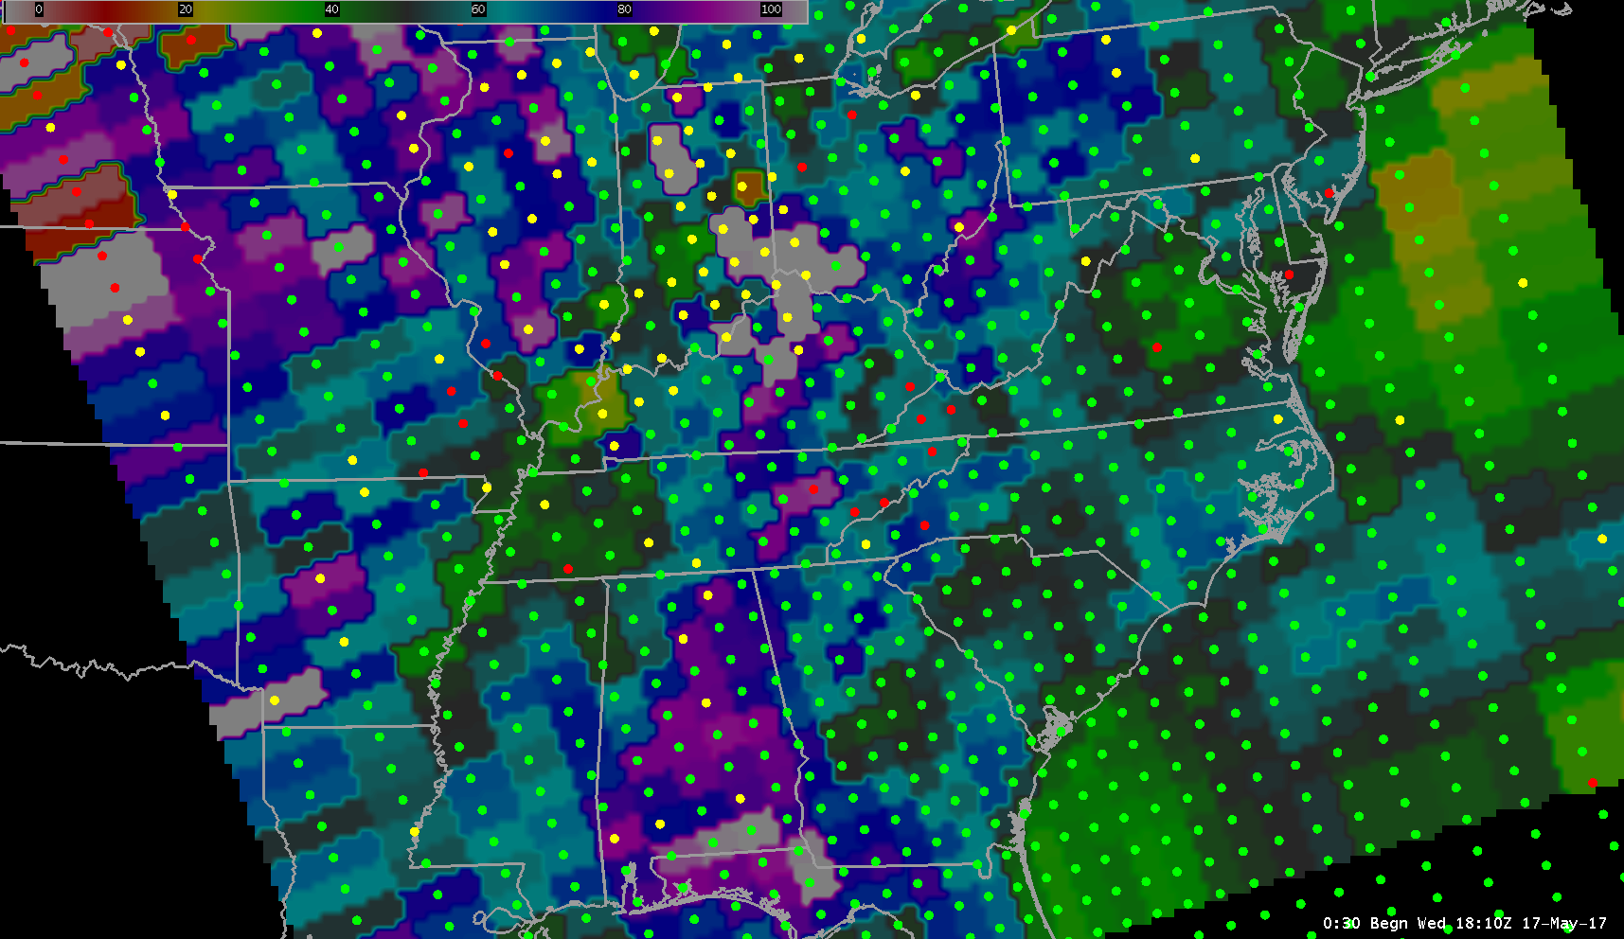
Dots can be overlaid on Gridded NUCAPS fields to help decide which skew-T to click on. Improved spatial context.
Notes:
The major challenge ahead of us is to build forecaster confidence in NUCAPS. We recognize forecasters are weary of satellite soundings. They know and trust their radiosondes. Moreover, they’re used to looking at imagers from which a lot can be inferred visually. The question is how do you reconcile the differences between radiosondes and NUCAPS soundings, or images and measurements in a forecaster environment that depends on fast, intuitive interpretation and decision making.

Slide 21
NUCAPS in AWIPS – Things to think about...
Radiosondes measures moisture through clouds, NUCAPS measures moisture around clouds
NUCAPS can retrieve super-saturation (no limit on 100% RH). May see RH values well above 100% in the gridded product which will impact how AWIPS calculates certain parameters such as dew point and stability indices
Data below the surface is masked out in the gridded product
NUCAPS resolution is 50 km near the center but closer to 150 km near the swath edge however the product is Gridded to a uniform 12 km grid for AWIPS
NUCAPS can resolve only 4-6 layers of water vapor 6-10 layers of temperature but data is output on the 100 layers used by the radiative transfer model. As a result profiles are smooth despite the number of level available
There are 58 levels available in AWIPS and some levels were forced to standard levels for consistency with the forecast process and to allow AWIPS to calculate stability indices (1000, 925, 850, 700, 500, 300, 250, 200, 100)

Slide 22
Summary
NUCAPS Soundings and Gridded NUCAPS can be used to diagnose temperature, moisture, and stability characteristics of the pre-convective environment.
NUCAPS Soundings provide soundings between routine radiosonde observations
Gridded NUCAPS allows the forecaster to view variables on either plan view or cross-sections
NUCAPS retrieves atmospheric information around clouds
The best quality data is retrieved under clear to partly cloudy conditions

Slide 23
Developer questions to Forecaster
Would you be interested to know how vertical resolution (or degree of smoothing) changes from scene-to-scene?
Given what you’ve learned about satellite soundings, is there any diagnostic, thermodynamic or quality control metric that you would like to visualize as a means to aid your real-time problem solving?
Would you be interested in MW-Only NUCAPS retrieval? It provides additional measurement and it can possibly be used to fill the IR+MW product gaps
Does NUCAPS (IR+MW) provide enough information (e.g., despite data gaps and coarse spatial resolution) to make sense of the pre-convective environment?
Other than the thermodynamic parameters (T/q) what other NUCAPS retrieval parameters (trace gases, surface and cloud properties) would you find valuable?
Notes:
These are some of the questions I (Nadia Smith) have.

