Slide 1
UAH GOES-R CI
Product Produced by UAHuntsville
Training Produced by NASA-SPoRT and UAHuntsville
Notes:
Welcome to the UAH GOES-R CI product training module, produced by the University of Alabama in Huntsville and NASA-SPoRT. This tutorial covers basic methodology and examples for the newest version of the UAHuntsville GOES-R CI operational product. The product was produced by UAHuntsville and is transitioned to operations and testbeds by NASA-Short-term Prediction Research and Transition Center, or NASA-SPoRT.

Slide 2
Summary of Contents
Introduction
GOES-R CI Product Background
GOES-R CI Application Example
GOES-R CI Product Details
Snow Contamination
Cirrus Contamination
Weaknesses
Strengths
Application Example
Acknowledgments and Notes
Notes:
This is the list of topics that will be covered in this training module. If you are familiar with GOES-R CI, you can skip ahead to the last slides titled “Updates” to learn about the most recent changes in the product and how they will impact your use of GOES-R CI in operations.

Slide 3
Introduction
Purpose: To develop familiarity with GOES-R CI algorithm and show operational examples and best uses
Mission of NASA-SPoRT: To transition unique NASA and NOAA datasets to operations in order to improve short-term predictions
Mission of UAH GOES-R CI Product Team: To develop satellite-based, multi-dataset products that leverage forecaster experience and solve unique weather prediction challenges
Notes:
The purpose of this training is to help end-users (primarily forecasters) develop familiarity with GOES-R CI, and to show a few examples of how the product appears in operations.
NASA-SPoRT transitions a number of NASA and NOAA datasets to operations with the objective of improving short-term predictions.
The GOES-R CI Team at UAHuntsville aims to partner with forecasters and other end-users to produce satellite-based multi-dataset products that solve forecast challenges.

Slide 4
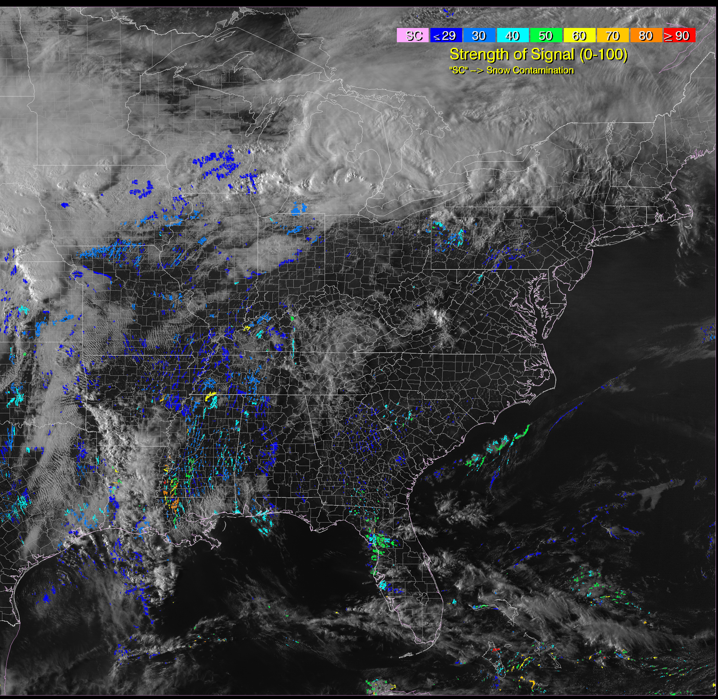
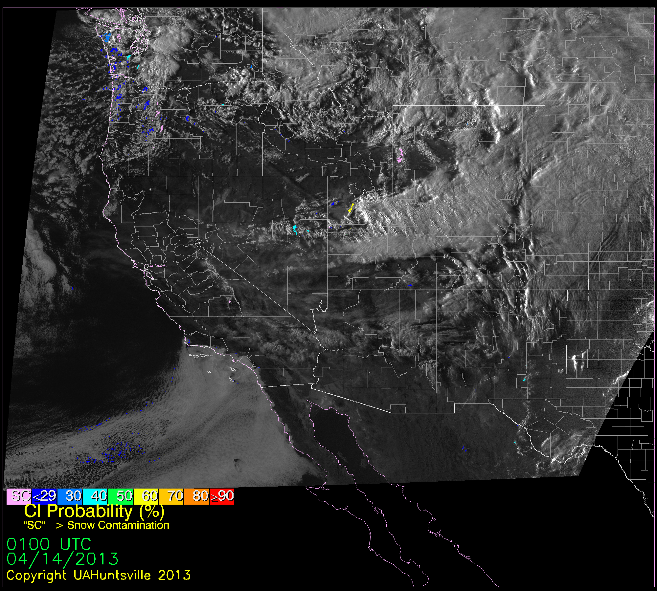
GOES-R CI Product Background
GOES-R Future Capabilities
Fuses NWP and geostationary satellite data
Used for 0-2hr nowcasting of convective initiation
  Tracks cloud objects
  IDs cloud types,
  properties
  IDs growing cumulus
  clouds in convective
  environments
  Calculates probability
  of CI based on
  training datasets
  Displays probability of
  CI for each cloud object
Some Image of CI
“under the hood”
And subject to updates
Decision support system:
Fairly permanent
Notes:
This is a GOES-R future capabilities product. It is currently being produced by UAH, and made available to WFOs through SPoRT.
It fuses Numerical Weather Prediction and geostationary data into a single product in order to produce a 0-2hour nowcast of convective initiation.
Part of the product’s capabilities are performed “under the hood”, so to speak. For example, there are algorithms for tracking cloud objects and identifying cloud types and properties. There are other mathematical methods for identifying those cumulus clouds that are most likely to become convectively active, based on compared training datasets from other regions and seasons. All of that occurs “under the hood” in a way that the end user will not be aware of each of these steps. Some of these steps might even be incrementally modified in future versions.
What the end user sees in their decision support system is the cloud objects themselves colored on a map by their probability of convective initiation, much like a radar reflectivity display. This display looks like the image on the right and will likely not experience much change in future versions of this product.

Slide 5
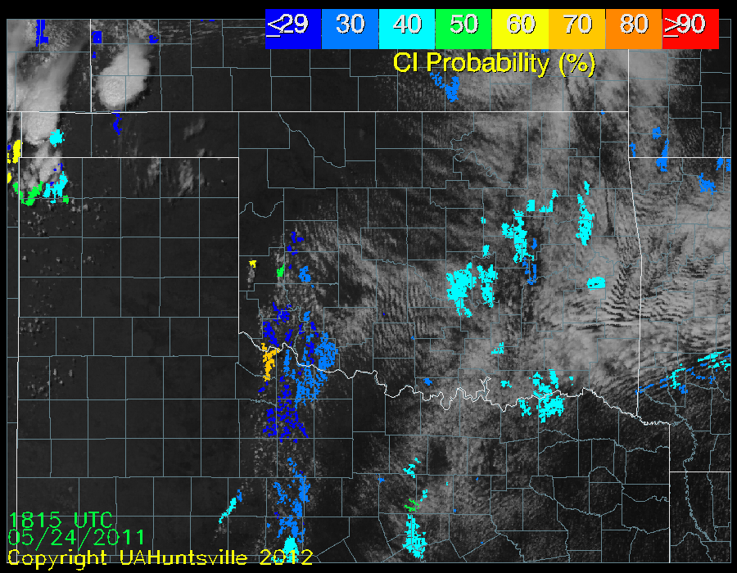
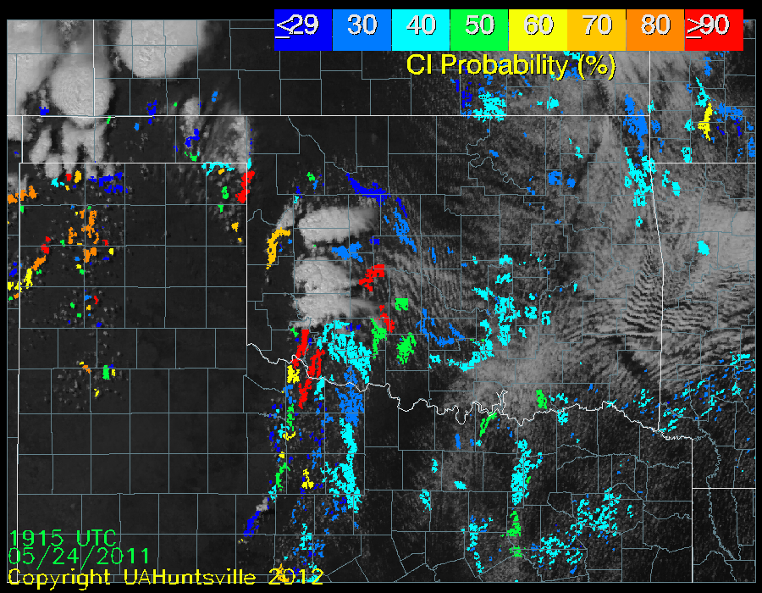
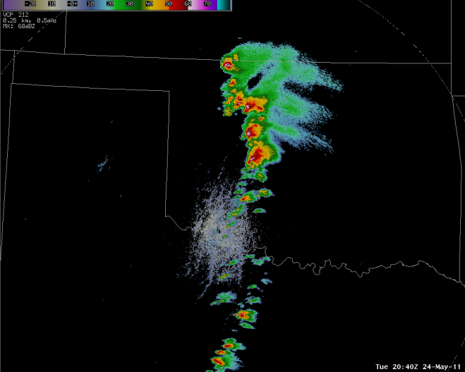
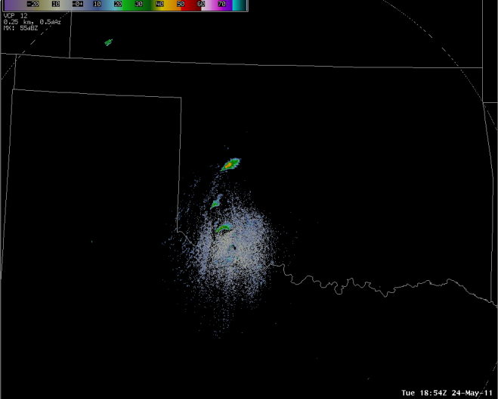
GOES-R CI Application Example
GOES-R CI gives advanced warning on convection (35dbz radar echoes) using a probability scale.
At 1815 UTC, GOES-R CI shows the first high probabilities of CI (top). At 1845 UTC, the 35 dbz echoes emerge (bottom).
For the developed system, at 1915 UTC, there are more cloud objects with strong CI probabilities. Mature convection is not shown by the product.
At 2040 UTC, the radar shows the objects producing the newest convection indicated by GOES-R CI.
2040 UTC
1845 UTC
Notes:
This initial example demonstrates the general purpose of the GOES-R CI product, providing lead time and locations of convective initiation, defined here as radar echoes of 35 dbz or greater. GOES-R CI shows a map of cloud objects that are colored by their probability of becoming convectively active in the next 2 hours, with warmer colors corresponding to higher probabilities of CI.
At 1815 UTC, the GOES-R CI output on top shows a few cloud objects with probabilities of CI of 50, 60, and 70% embedded within lots of other cloud objects with almost no probability of CI. These higher probability objects are worth paying attention to over the next few hours. Indeed, the radar image below, from 1845 UTC, show the first 35 dbz echoes for those objects advected downstream which were shown on the CI display.
Later on, at 1915 UTC, there has been substantial development along the dryline. GOES-R CI screens out mature convection, however, and only looks for convective initiation, picking up on a few cloud objects with a 90% probability of becoming convective in the next 2 hours in the southern section of the line.
The radar image at 2040 UTC verifies this prediction, showing the new development occurring.

Slide 6

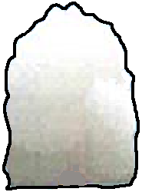
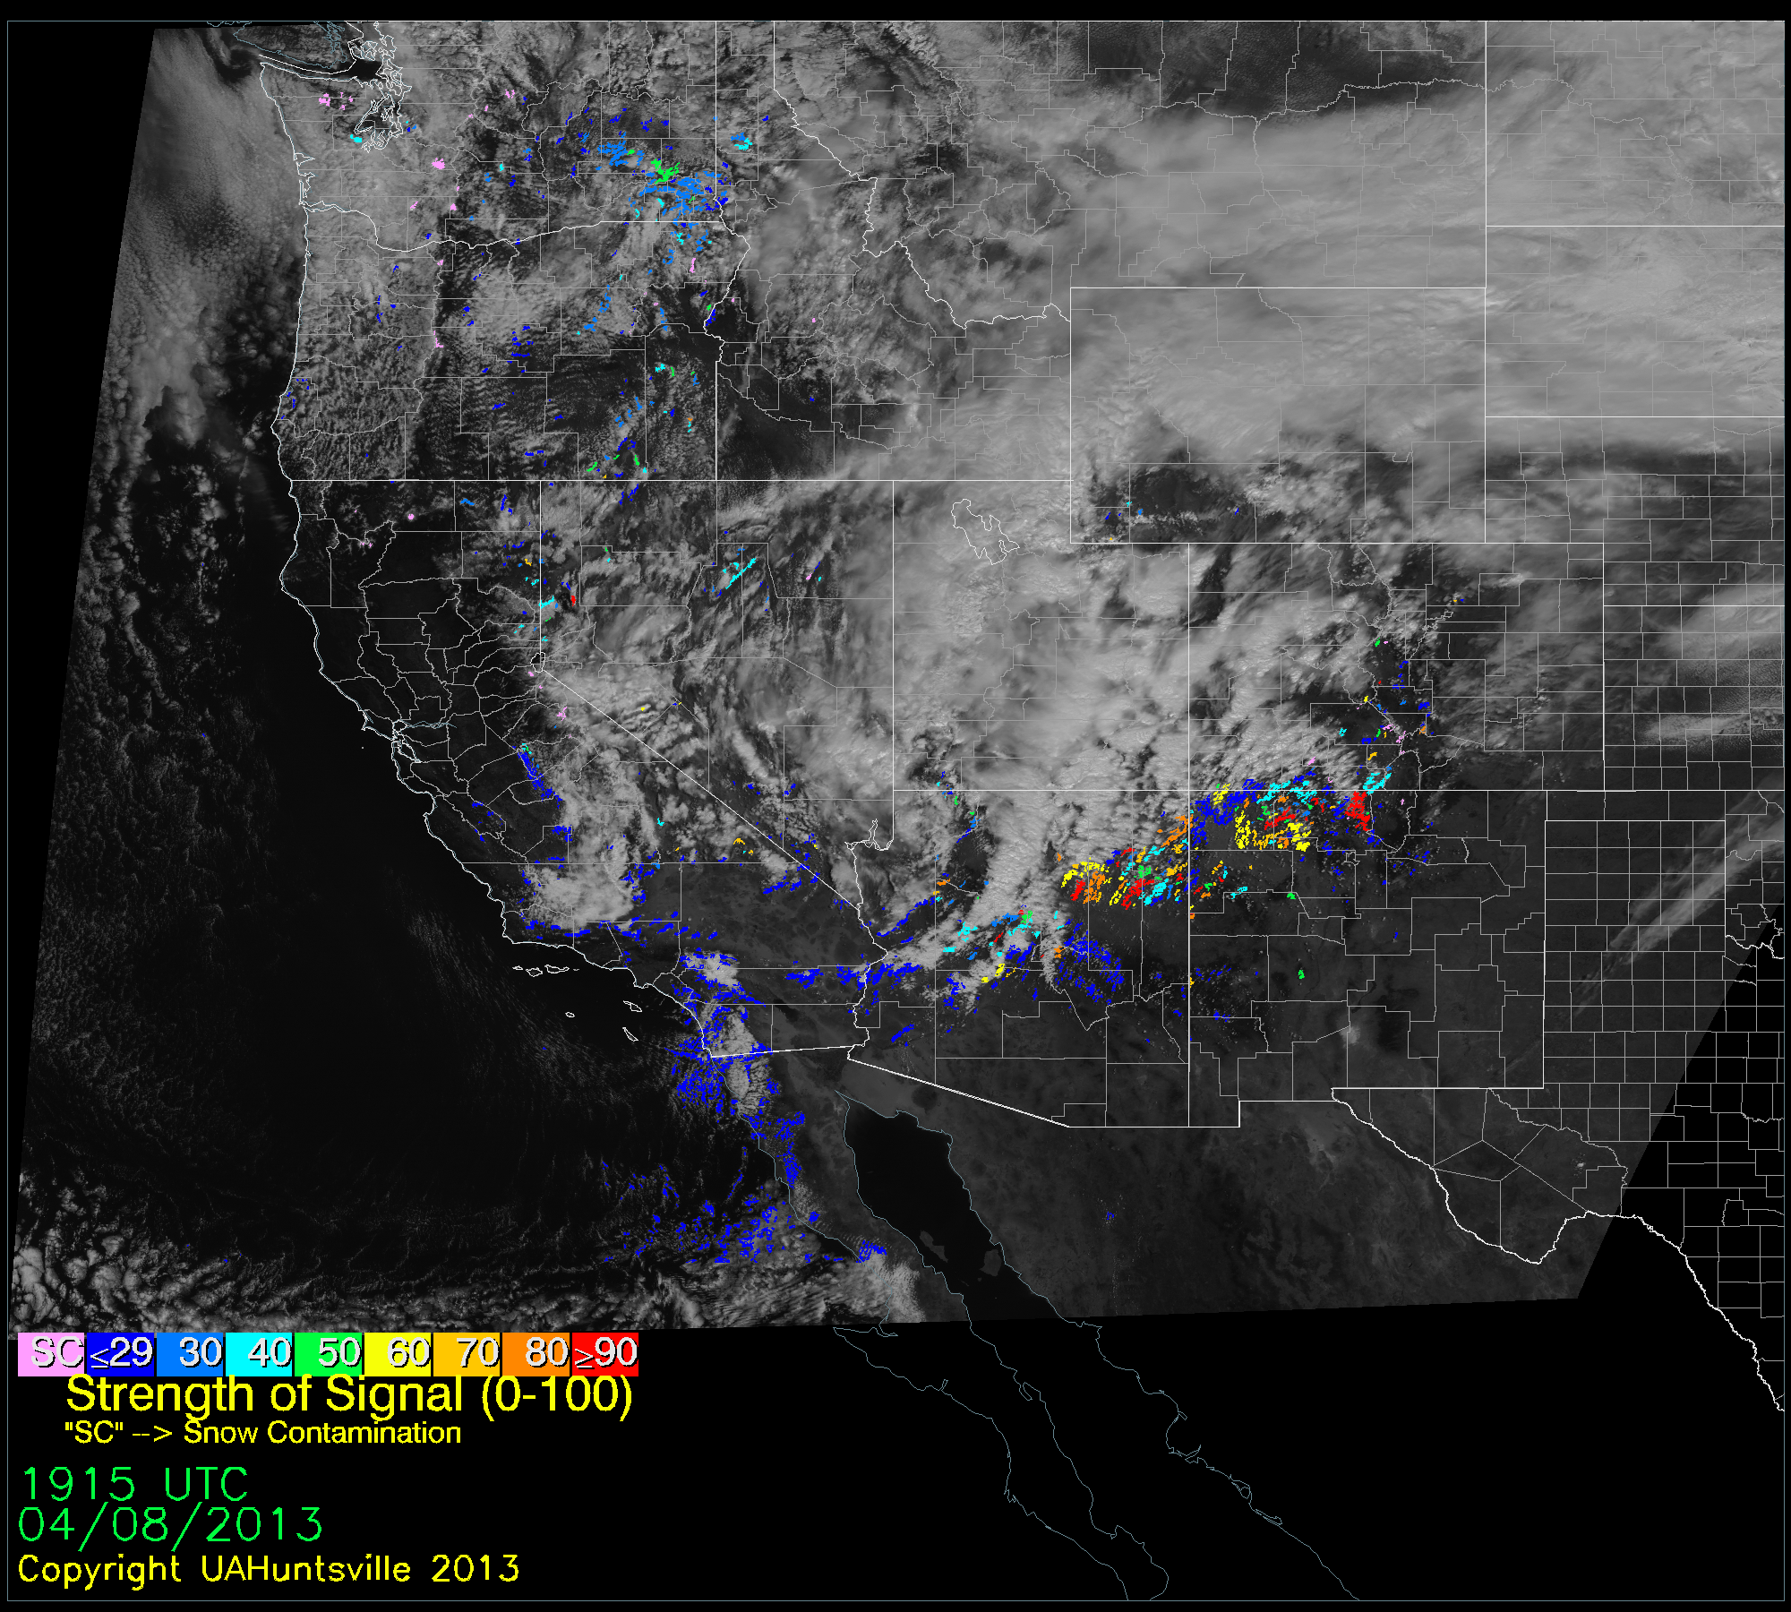
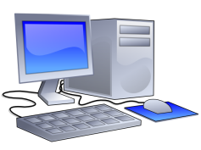
GOES-R CI Product Details
GOES: Cloud motion, growth, glaciation, and height
Spatial Resolution: 1km on current GOES (2km at night)
Temporal Resolution: 5 min
Domains: GOES-16, GOES-West (GOES-15)
Input:
  9 interest fields from GOES
    As training database becomes focused on GOES-16, there will be more interest fields developed due to the increased spectral resolution.
  15 NWP fields from RAP
  Ground snow cover (SNODAS)
Output:
  Probability of 0-2hr convective initiation
+
NWP Model: CAPE, CIN, LI…
=
Logistic Regression
Little bitty old CI image
Notes:
There are some details that are helpful to keep in mind when using this product.
For example, the spatial resolution is 1 km in the current GOES instrument in daytime operations and 4 km at night.
The temporal resolution for most scans is 15 minutes, but can be as frequent as 5 minutes for GOES rapid scan mode or as infrequent as 30 minutes for full disk scans.
This product operates on both the GOES-East and –West domains.
The input data for the product includes:
9 interest fields from the GOES satellite which indicate cloud motion, growth, glaciation, and height and their associated trends;
15 fields from the RAP Numerical Weather Predication Model which help indicate environmental information such as CAPE, CIN, Lifted Index, and several others;
and information from the SNODAS ground snow cover map.
The 24 fields of satellite and NWP data are given to a logistic regression equation. This type of regression technique uses a training dataset of variables and a binary outcome, in this case whether or not a cloud object becomes convective, and produces an equation to predict the probability of the outcome’s occurrence, given the values of the input variables. The resulting output is a probability of convective initiation within the next two hours for the identified cloud objects. This probability only tells the likelihood of convection, and does not in itself correspond to intensity of convection.

Slide 7
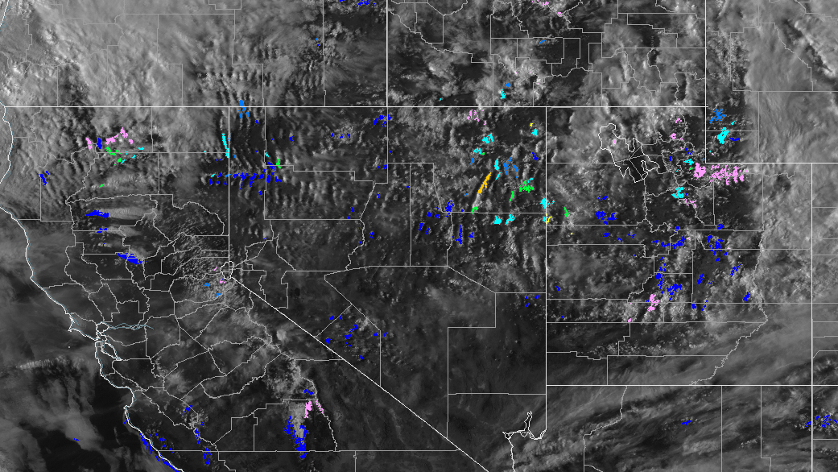
Snow Contamination
Clouds moving over cold snow-covered ground can make the snow appear as a cloud object in the cloud typing algorithm.
Snow contaminated objects are pink in the display.
Some image of snow contamination pointed out
Snow ground cover data provided by NOAA NWS Operational Hydrologic Remote Sensing Center SNOw Data Assimilation System (SNODAS).
Notes:
The snow coverage map information is used separately to identify areas of snow contamination.
Snow covered ground, and clouds moving over the snow can cause the snow to be incorrectly identified as cloud objects by the cloud typing algorithm.
For this reason, snow contaminated objects are labeled pink in the display, as shown below.

Slide 8
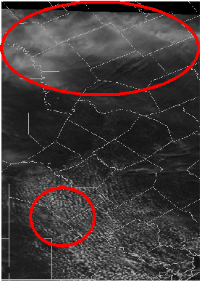
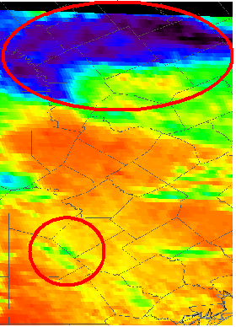
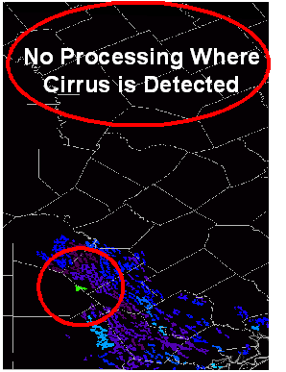
Cirrus Contamination
Cirrus above or “touching” cloud object will likely result in cloud object being masked out (top of images).
Undetected cirrus contamination results in anomalously high CI probabilities (bottom of images).
Visible Satellite
Satellite IR
UAH GOES-R CI
Notes:
Cirrus clouds are another source of potential problems for the IR processing portion of this product, because they obstruct the view of the growing cumulus clouds that are being assessed for convective properties.
Cirrus clouds above or optically touching other tracked cloud objects will usually be removed by the cloud masking algorithm and none of the cirrus contaminated area will be included in the processing, as shown in the top part of the image.
If cirrus clouds are inadvertently missed, they appear very cold and therefore abnormally “convective-likely” to the CI product, as shown on the bottom portion.

Slide 9
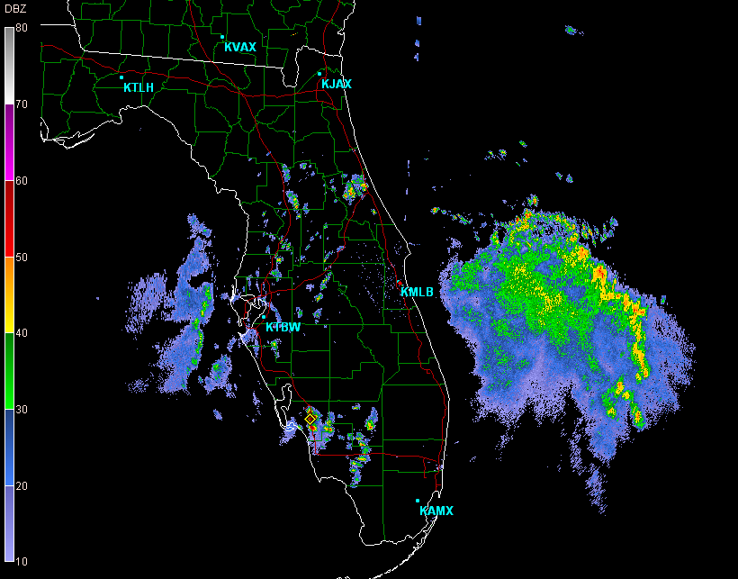
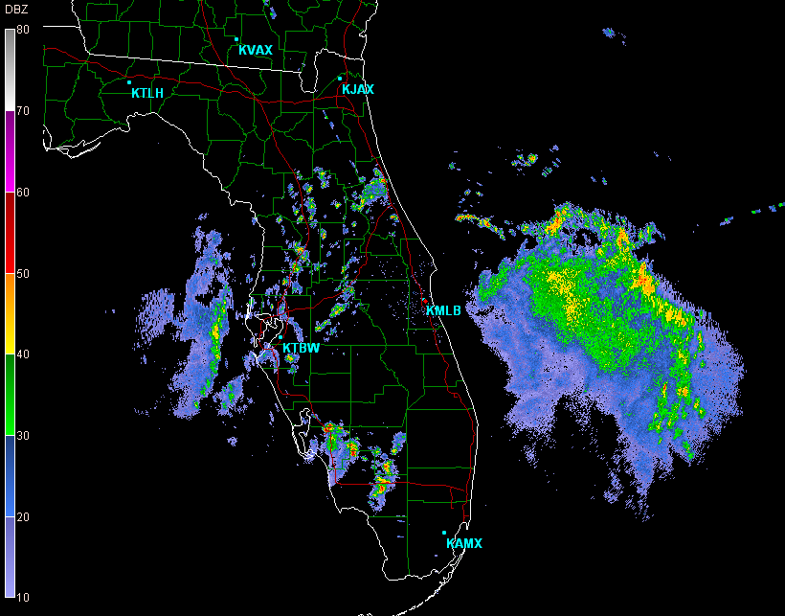
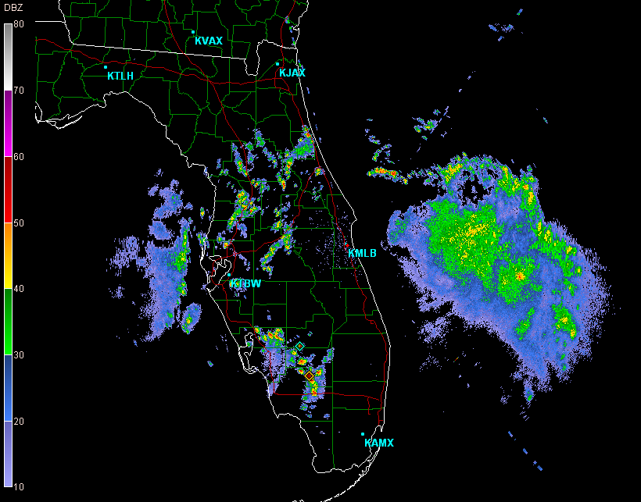
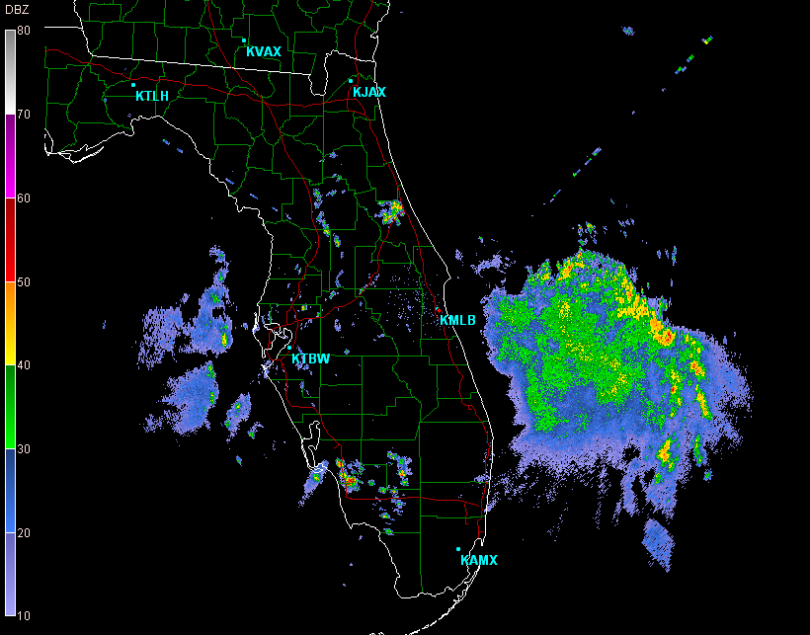
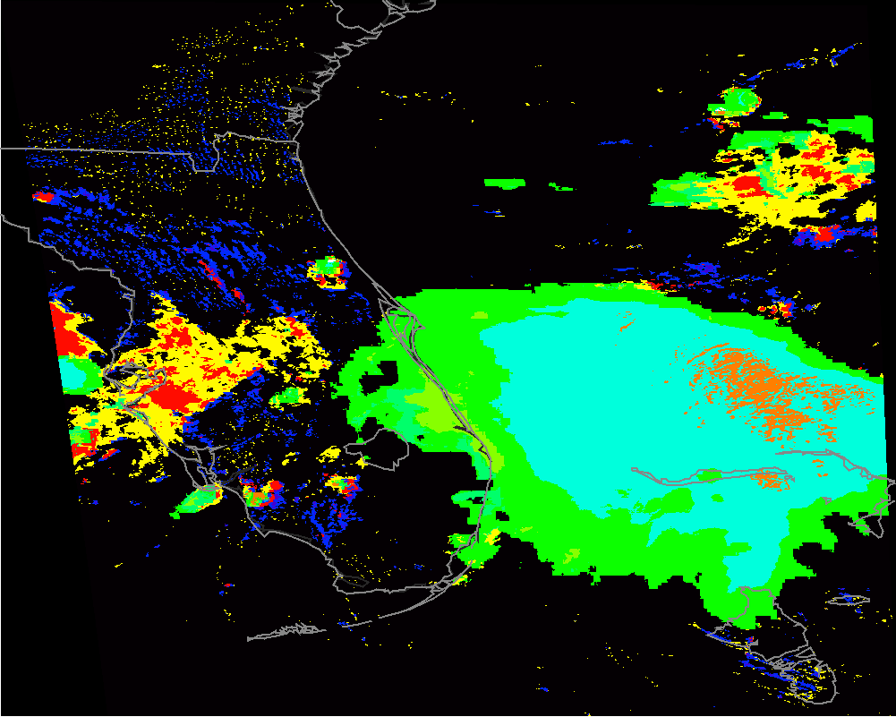
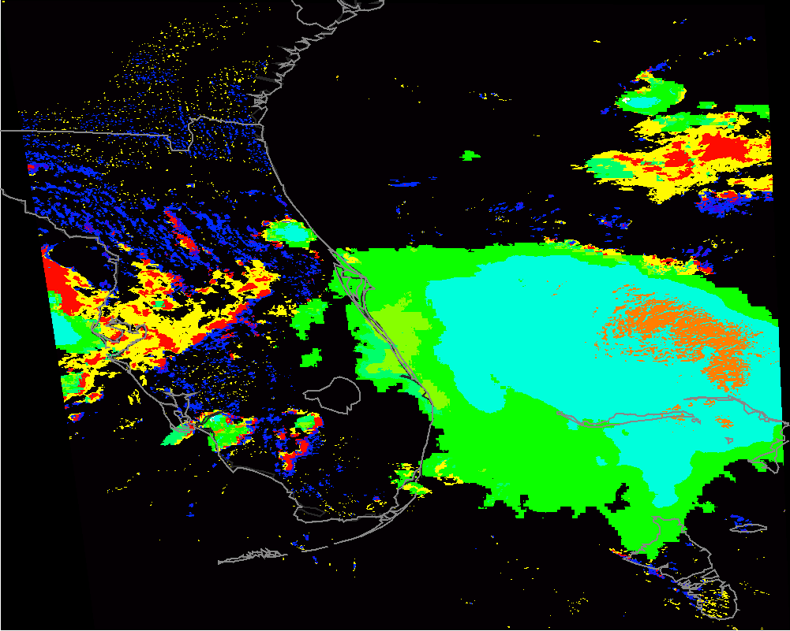
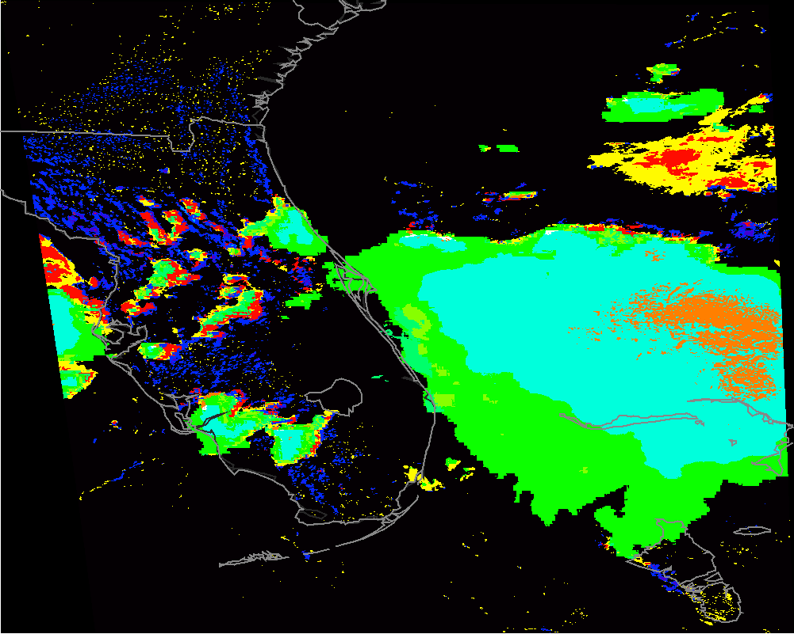
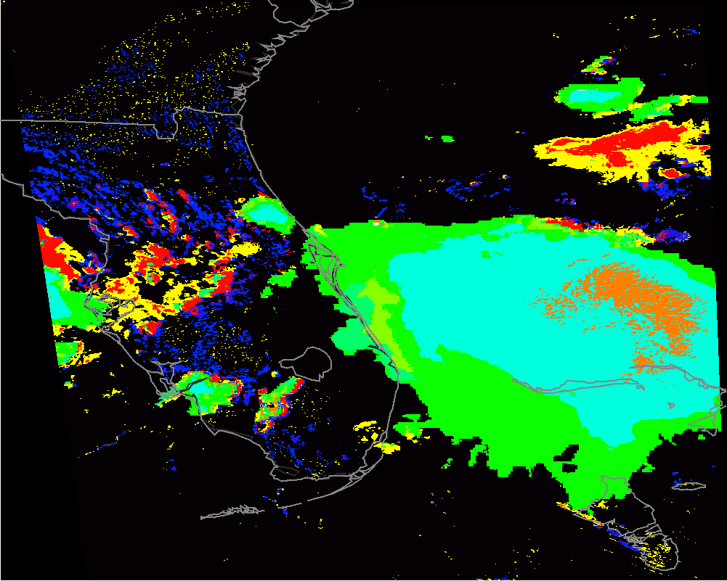
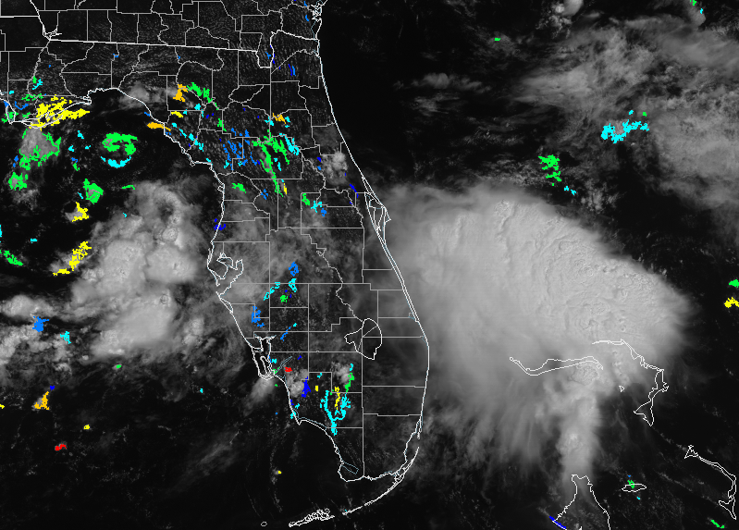
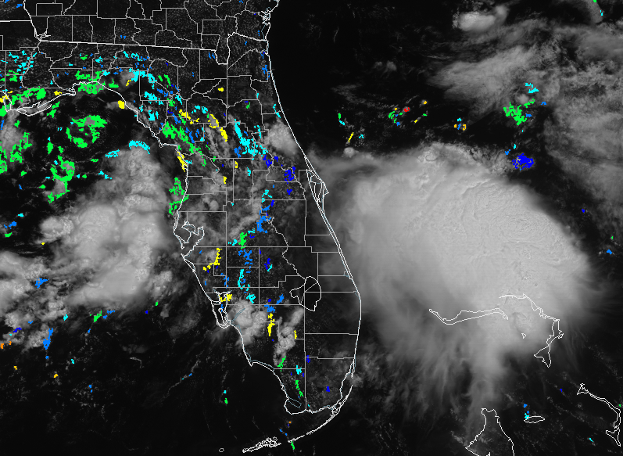
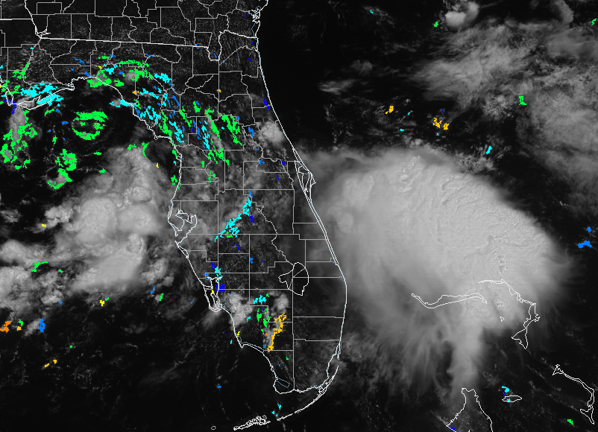
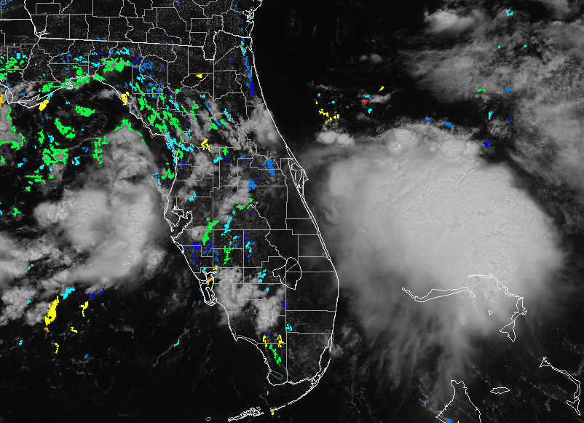
Cirrus Contamination and Cloud Typing
How a cell can go from “cirrus contaminated” to “mature convection” without being a CI object.
1633 UTC
1656 UTC
1725 UTC
1607 UTC
Recall that only cumulus clouds are given a probability of CI
1602/1607: Isolated cloud object is shielded by cirrus and ID-ed as cirrus in the CTA (green) rather than CI-likely cumulus (blue)
1632/1633: Cloud object develops in radar but is still associated with cirrus in CTA
1655: Developed convection now ID-ed as overshooting CB (white) and stratocumulus (red)
1725: Cloud object now is mature convection (light blue)
Radar
1602 UTC
1632 UTC
1655 UTC
1725 UTC
1602 UTC
1725 UTC
1655 UTC
1632 UTC
Case study provided by NWS-MLB
GOES-R CI overlaid with VIS
Cloud Type Algorithm (CTA)
Notes:
Cirrus contamination can be a pretty tricky hazard for the GOES-R CI product, causing some unexpected results. Here is an example in which a cloud object was initially masked by some thin cirrus clouds, and by the time the object had “detached”, it was already a mature convective cloud, and therefore it was never given a probability of CI by the algorithm. We’ll walk you through it.
First off, recall that the algorithm identifies cloud types and only gives cumulus clouds a probability of CI.
In the first timestep, the image on the bottom at 1602 shows the cloud typing algorithm. The blue arrow indicates where our cloud object is, and in the cloud typing algorithm, it is within a large cirrus shield, which is all the green color you see. If it were a cumulus cloud and CI-likely, it would be one of the blue objects on the cloud typing panel. The CI and VISIBLE image to the lower left shows our object a little better, as a slightly thick cloud in the VISIBLE. The radar image from 1607 shows it as a distinct cloud object.
At 1632 and 1633, the radar actually identifies this object as having a 35 dbz echo within it. But as the thin cirrus clouds are still lingering around it, as seen in both the VIS and in the cloud typing image, the cloud typing algorithm still identifies the object as part of a cirrus cloud and removes the whole section from processing.
At 1655, the object now has an overshooting top, according to the cloud typing algorithm.
And by 1725, it is obviously a mature convective cell. It is plain to see that if this object developed in your CWA and GOES-R CI provided no warning, you’d probably wonder why it missed such an obvious convective event, particularly if you were looking at the radar image alone (you never see the associated cirrus on the radar image). So the rule of thumb is, no matter how thin the cirrus is, if you can see it on the VIS, it’s enough to get the whole section masked out, and objects optically touching it, from that scan.

Slide 10
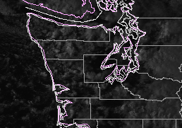
Weaknesses
Cirrus Contamination
Data flow
  Requires at least 2 consecutive scans to achieve object track -> CI
Due to early calibration issues on that lasted through a majority of 2017, the Logistic Regression dataset is still based on the prior series of GOES. With the 5 minute temporal scans of GOES-16, there could be potential false alarm issues until the new training database can be created this year.
Resolution at night is purely IR-based and is only 2km vs 1km during the day (Daytime CI product had to be reduced to 1 km due to latency issues)
0100 UTC-daytime processing
0111 UTC-nighttime processing
Notes:
Here we state some caveats of the GOES-R CI product and its usage.
Again, the presence of thin cirrus close to growing cumulus clouds, might occasionally net some unexpected results, as previously mentioned.
Another potential problem is data flow. In order to track cloud objects, and therefore reach the steps to produce a probability of CI, the product needs two consecutive satellite scans (3 when satellite AMV winds are used). When there are data interruptions, it takes at least 2 scans to produce the next CI image. Therefore, even brief data interruptions can cause delays in the GOES-R CI product as the processing “catches up”.
Another caveat to mention is that the current GOES-16 is currently using the logistic regression model developed using GOES-13/15 data. We could not train on the 2017 GOES-16 data to calibration issues which led to “pulsing” in the thermal IR channel. Since that is a main component in the satellite “interest” fields, we will now train using data as the 2018 convective season moves along. Unfortunately, the training database developed for GOES-13/15 mostly contained 15 minute scans, so as a result, the 5 minute scans of GOES-16 may lead to some false alarms. We wanted to point that out as it is something we are aware of at the moment.
The final caveat to mention is that the resolution for nighttime processing is 2 km, vs the daytime resolution of 1 km. This means that nighttime images appear blocky in comparison to daytime images. Also, as shown on the images at the right, the jump from day to nighttime processing can even result in cloud objects becoming “lost” between scans.

Slide 11
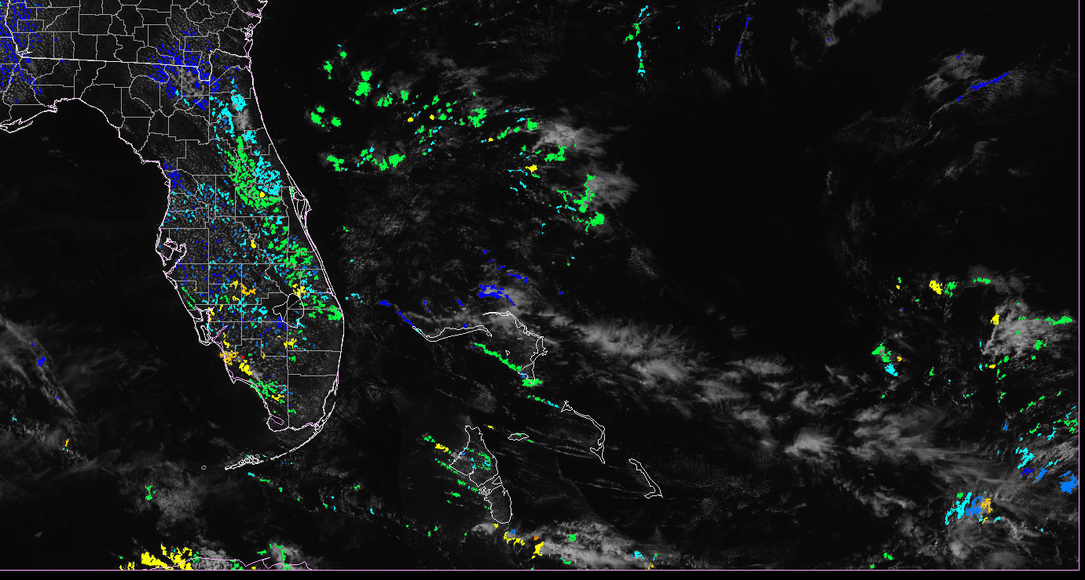
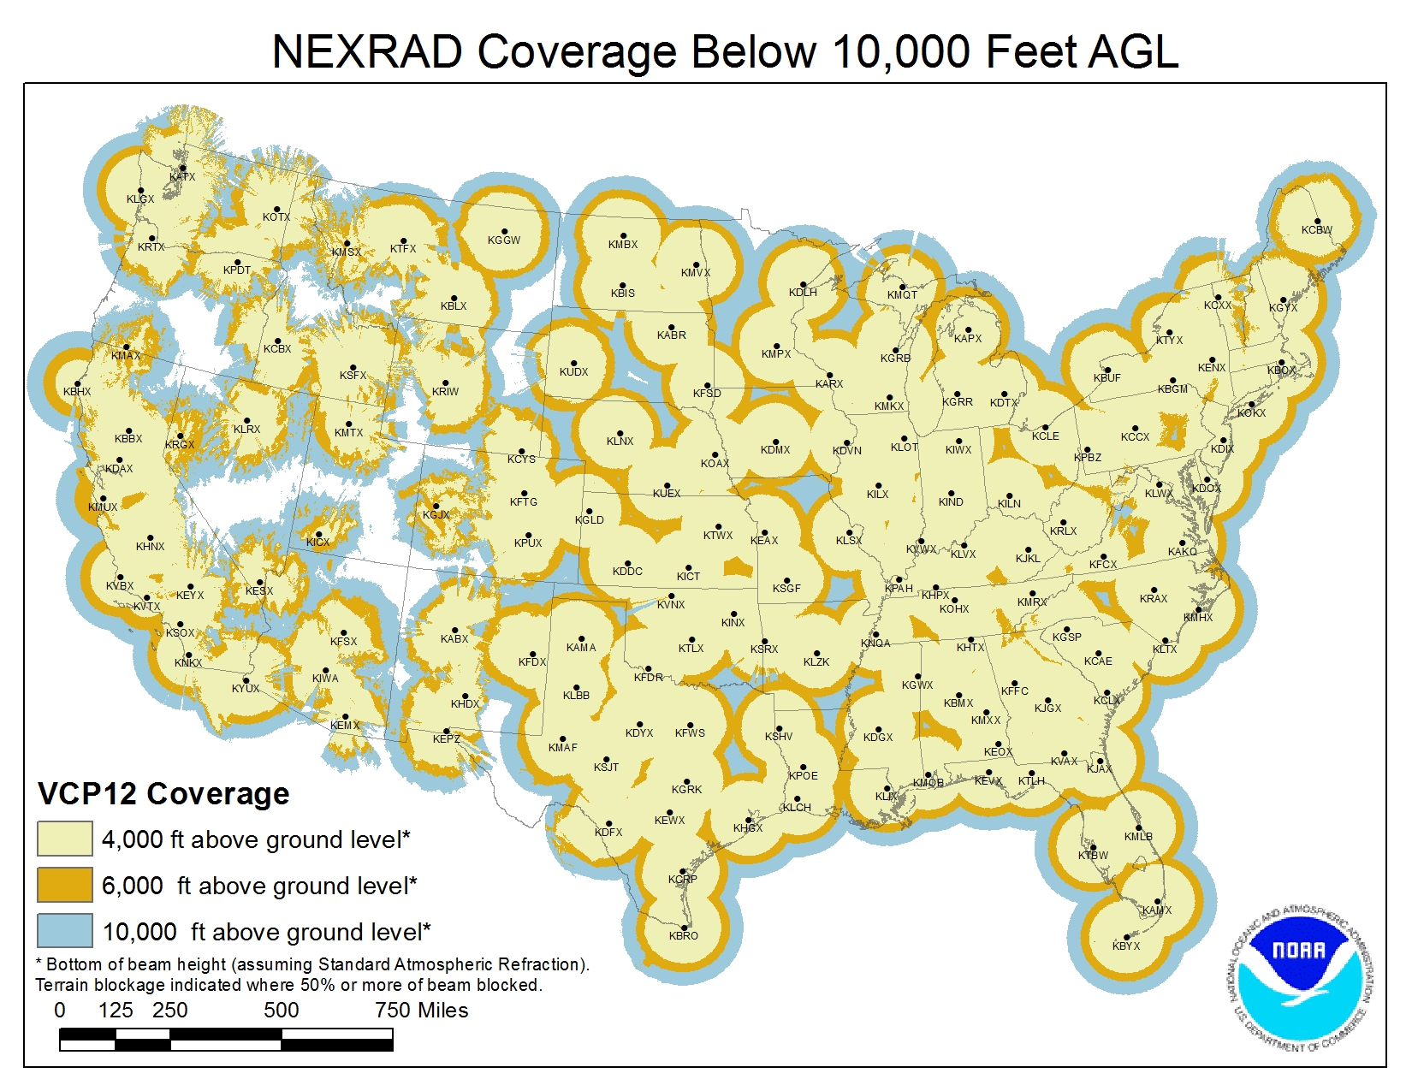
Strengths
Satellite observes CI in data-deprived regions, like mountains, off-shore/over oceans, instrument sparse locations
Data-fused input increases lead time and greatly improves FAR.
GOES-R era provides improved spatial and temporal resolution and provide more IR channels.
Severe CI product offers lead times to severe weather events not offered by radar products
CI image offshore or in other data-deprived area
4000 ft
6000 ft
10000 ft
Radar Coverage Map from NOAA Radar Operations Center
Notes:
There are several strengths to this product as well.
For one, being satellite-based, this product helps provide data in regions that are generally data-sparse, like off-shore, over mountains, or in other locations where there is little other instrumentation.
Also, being data-fused with NWP had greatly improved the False Alarm Ratio of this version of GOES-R CI over previous versions.
In the GOES-R era, the improved spatial and temporal resolution will continue to improve the utility of this product for end-users.

Slide 12
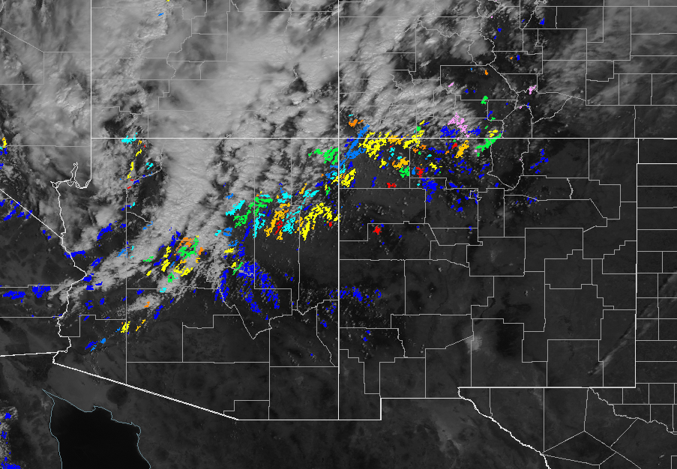
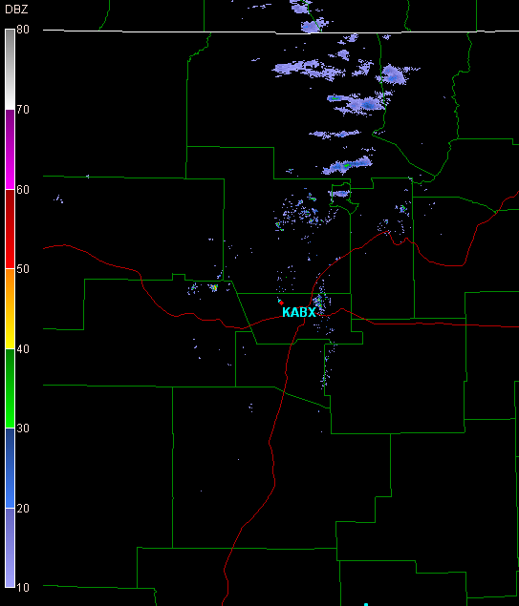
Application Example
Terrain challenges result in poor radar coverage (circled area in lower maps).
In this case, developing CI was not picked up by radar in NW New Mexico, but was picked up by UAH GOES-R CI.
35+ dbz echoes are represented by arrows on radar image.
1845 UTC
1915 UTC
San Juan County
Rio Arriba County
Radar Coverage Map
4000 ft
6000 ft
10000 ft
2200 UTC
Notes:
In this application example, we demonstrate how GOES-R CI can provide additional guidance in data-deprived locations. Mountainous terrain causes considerable radar beam blockage in the western US in places like northwestern New Mexico, as shown in the radar coverage map to the right.
In the series of convective cells that developed over the course of a few hours ending at 2200 UTC, none of them were visible on radar until they were in western Rio Arriba County (that’s the second county to the left on the northern border, just outside our orange circle).
The GOES-R CI product gave advanced warning of the convection, at 1845 and 1915 UTC, and also indicated a very high probability that convection was likely to occur in San Juan County, where our radar coverage was most compromised.

Slide 13
Updates
Current training database has approximately 250,000 cloud objects (based on GOES-13/15)
  Due to calibration issues, the new training database is currently being constructed as the current convective season unfolds.
Use of cloud properties from UW-CIMSS
  Improves nighttime detection
Detection under thin cirrus
Notes:
The GOES-R CI team is continually working to expand the algorithm training database. The database has gone from about 17,000 cloud objects to over 250,000 and is now CONUS-wide. This means that the product should perform better in all regions.
The GOES-R CI product algorithm uses cloud properties from UW-CIMSS. We’ll show some examples of how those cloud properties have improved the detection of CI at night.
Finally, the GOES-R CI product is also able to detect convective initiation under thin cirrus clouds. We’ll show an example of that, too.

Slide 14
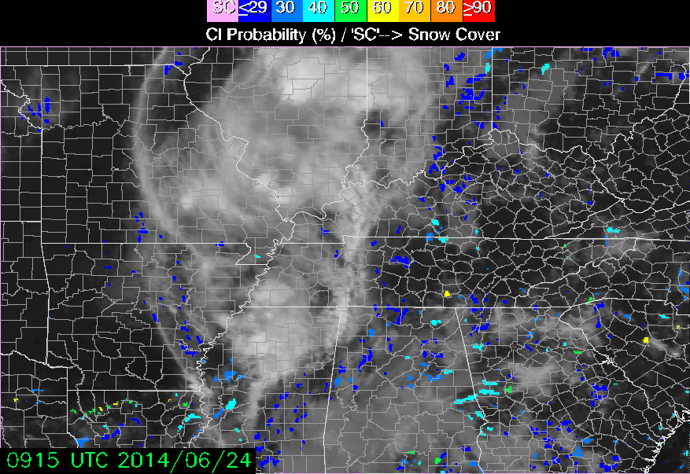
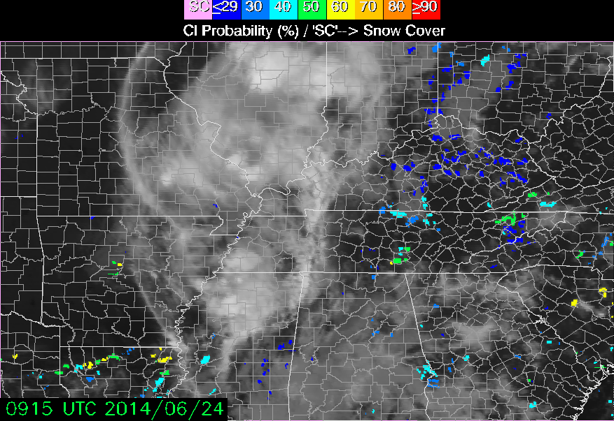
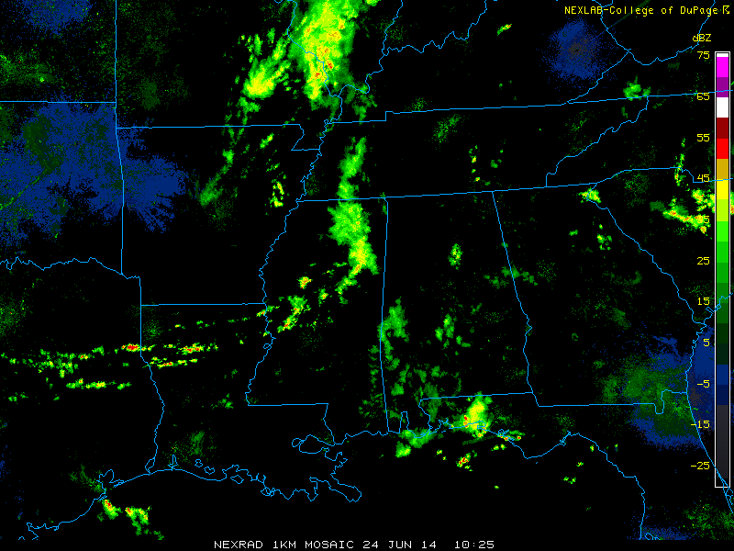
Improvement in Nighttime Detection
Original Nighttime Algorithm
WSR-88D Reflectivity
Updated Cloud Type algorithm
Cloud mask using Jedlovec and Laws (2003)
Uses a texture technique to eliminate stratus clouds
Eliminated clouds <-20 C
Thin cirrus is a problem
Cloud typing using UW-CIMMS cloud product
Uses a texture technique to eliminate stratus clouds
Keeps liquid water, supercooled water, and mixed phase clouds
Enhances CI detection and reduces noise
Notes:
Algorithm cloud typing improvements have had a positive effect on detecting CI in nighttime GOES scans. The image on the left shows the CI display using the legacy algorithm. In the legacy algorithm, cirrus clouds produce low probability “noise” in some locations, and objects tend to be blocky.
Now the image on the right shows a comparison of the two algorithms. The new algorithm retains certain cloud types to produce more appropriately-sized cloud objects and reduces the miscellaneous “noise”.

Slide 15
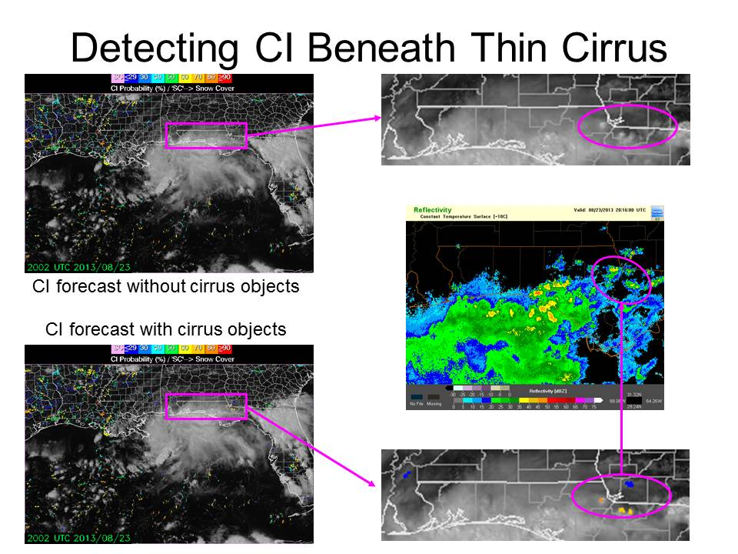
Detection under thin cirrus
2015
Notes:
Changes in the cloud typing algorithm have significantly improved GOES-R CI’s ability to detect convective initiation under thin cirrus clouds. The two images on top show where GOES-R CI’s legacy algorithm was unable to detect any cloud objects with a potential for convection because of cirrus contamination. The bottom two images show a few objects of moderately high potential for CI in northern Florida that did produce convection, based on the new cloud typing algorithm. Note that under the thicker cirrus, CI detection is still NOT available.

Slide 16
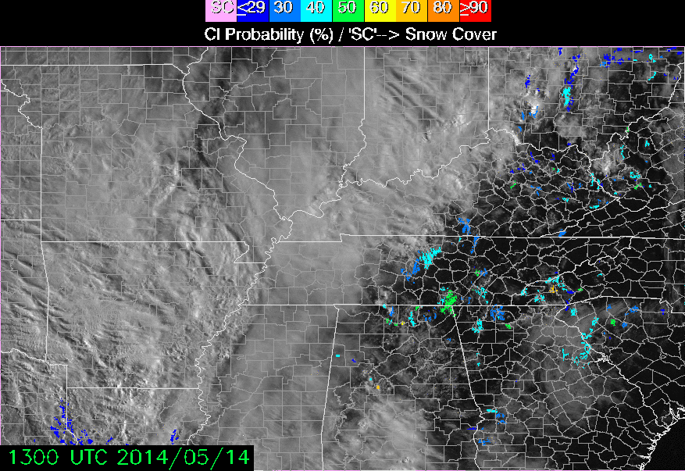
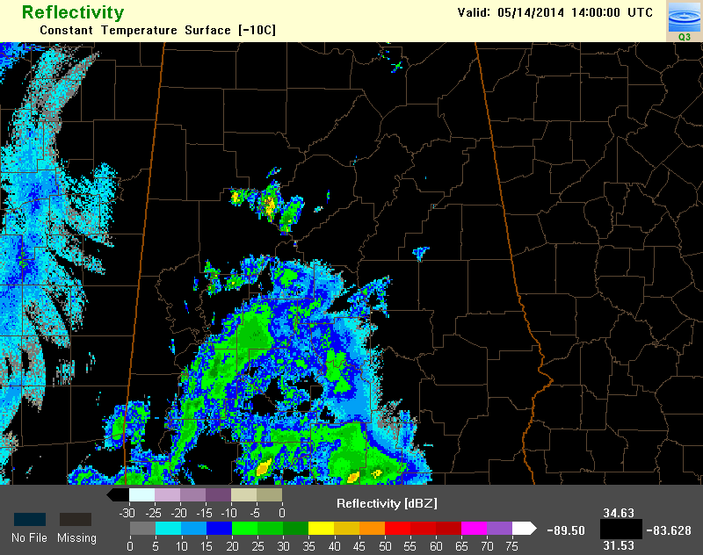
Detection under thin cirrus
CI objects identified under thin cirrus
Valid 1400 UTC
Thin cirrus
Thick cirrus
Notes:
This is another example of CI detection under thin cirrus. The CI display on the left is overlaid with satellite imagery to show areas of thin and thick cirrus coverage over Alabama. CI cloud objects are only detected under the thin cirrus clouds.

Slide 17
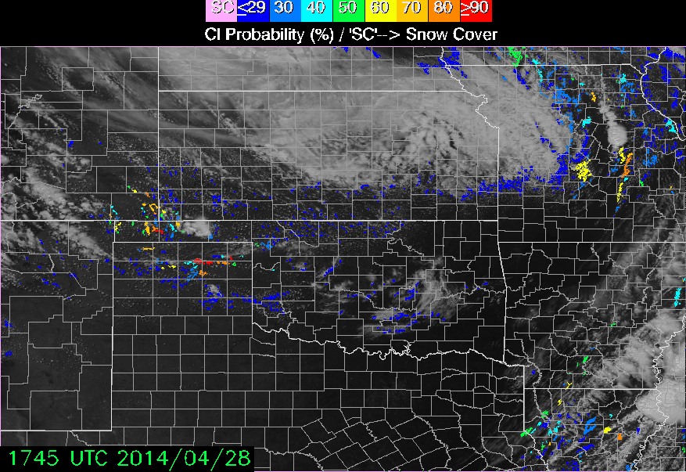
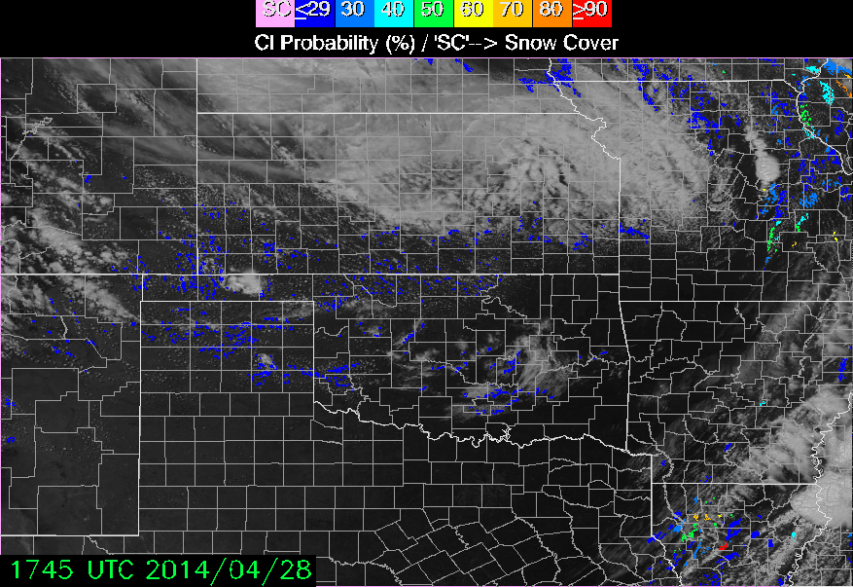
Severe CI Product
Identifies CI cells associated with severe threats
Similar to the standard CI product but uses a “severe cell” database for training purposes→ produces probability of severe weather
CI Product
Severe CI Product
Notes:
The Severe CI product identifies threats likely associated with satellite-observed convective cells. The Severe CI algorithm has been trained to detect only those initiation events that are expected to meet the NWS criteria of severe weather.
Note that the display is identical to the standard CI product. In the Severe CI product, the color of the cell indicates the probability of the cell becoming “severe” in the next 2 hours.
See the images below. The image on the left shows the standard CI product, in which the probability of convective initiation is being displayed. The image on the right shows the Severe CI product, which displays the probability of severe weather being produced for those same cells. As always, the color scales in both products are only showing the likelihood of the event occurring, not the intensity of the events.
In order to produce these cells, the algorithm uses a database of severe weather events similar to the convective database used in the standard GOES-R CI product. This training database allows the algorithm to identify cells with specific characteristics, like cooling rate, cloud growth, and model-derived environmental conditions, and identifies what combinations of those characteristics produce severe weather threats. Using the NOAA/NWS Severe Storm Database, over 10 days of convective storm events have been included so far in the training database. With the relatively low number of training cases, the algorithm currently tends to pick out the most robust storms, and may miss some storms which are on the lower end of severe levels. Other mesoscale factors such as storm mergers and gravity wave interactions which may turn a non-severe storm into a severe storm also cannot be handled by the severe CI algorithm as these storms are already in their mature phase. The algorithm only predicts for a future occurrence of severe weather and does not depict what type of severe weather.

Slide 18
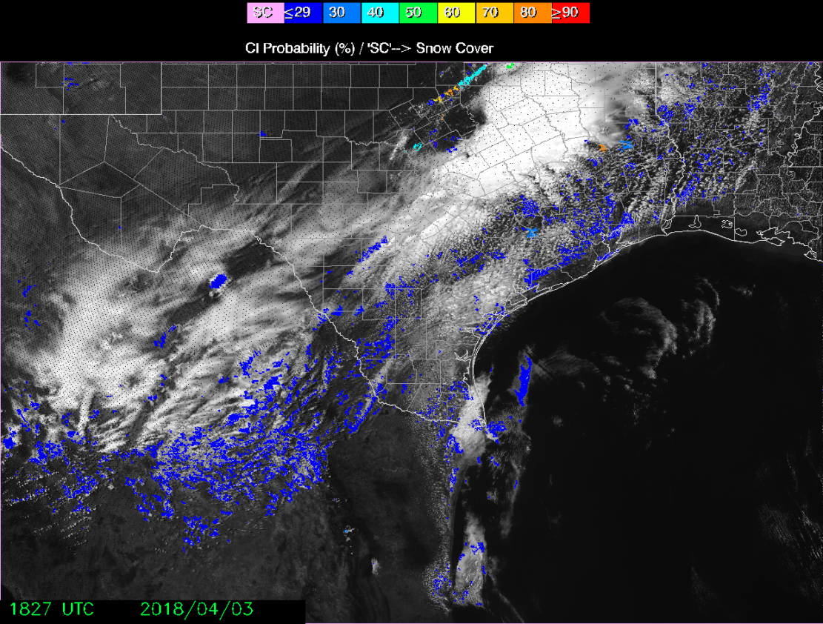
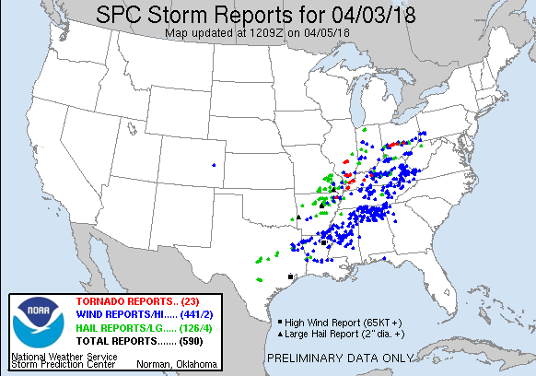
Severe CI Example - 2018 April 3
Reports of large hail, strong winds, tornadoes of varying strengths
Product does not discriminate between types of severe weather
Notes:
In this example, Severe CI identifies a clusters of severe cells along a cold front, cells in which the probability of becoming severe in the next 2 hours is very high. The cells along the south of the Dallas metro area formed a line that went on to produce numerous storm reports. Observations of severe winds dominate this report, although there are a few hail reports related to the identified Severe cells. Again, recall that the Severe CI product will not discriminate between different severe weather threats; cells that are likely to produce severe wind are labeled the same as cells that are likely to produce large hail and even tornadoes.

Slide 19
Acknowledgments and Notes
The UAH GOES-R CI team deeply appreciates the time, effort, and thoughtful feedback given by the forecast community at partner NWS WFOs, CWSUs, and at various testbeds.
Additional information, real-time product images, and peer-reviewed journal articles related to this project can be found at http://nsstc.uah.edu/uahci
Additional information about NASA-SPoRT, SPoRT core products, and the NASA-SPoRT blog can be found at http://weather.msfc.nasa.gov/sport
Notes:
The UAH GOES-R CI product development team deeply appreciates the time, effort, and thoughtful feedback provided by the forecasters and various end-users of this experimental product. It is through these collaborative efforts that our work is made possible.
For more in-depth information about this product, including peer-reviewed publications, and real-time data feeds, visit the website at nsstc.uah.edu/uahci
For more information about NASA-SPoRT, SPoRT products and product training, or to see the NASA-SPoRT blog, visit the website at weather.msfc.nasa.gov/sport

Slide 20
Thank You!
Questions? Contact…
  John Mecikalski Principle Investigator, Product Developer, UAH GOES-R CI
    johnm@nsstc.uah.edu
  Chris Jewett, Co-Investigator/Product Developer
    jewett@nsstc.uah.edu
Notes:
Thank you for your time and attention!

