Slide 1
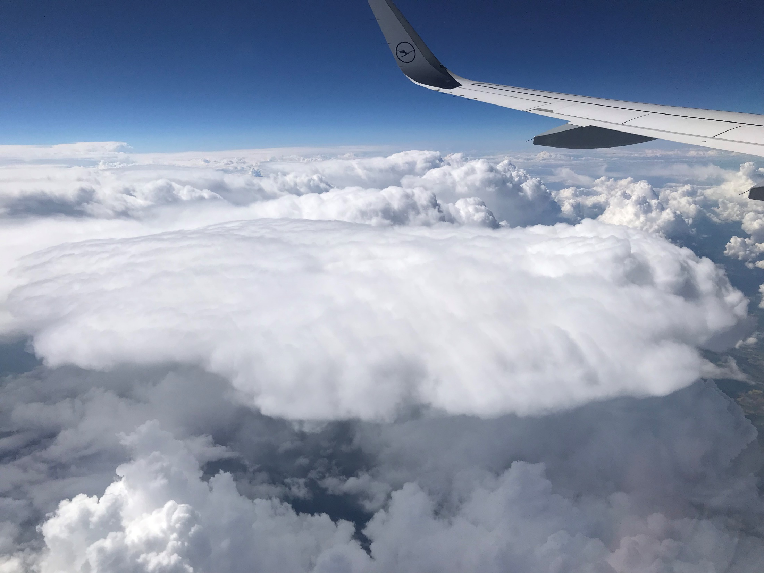
Meteorology 101
Part 2
Weather for Teachers
National Weather Service

Slide 2
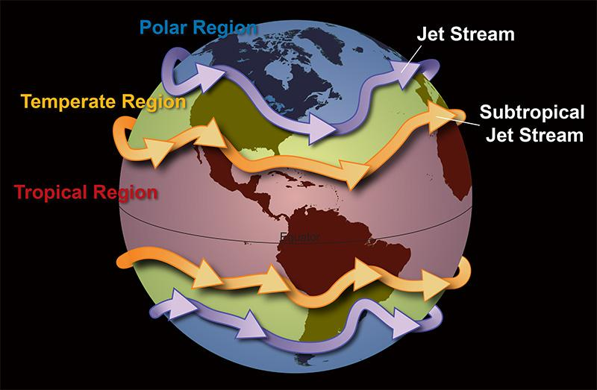
Jet Stream
Notes:
The locations of the three broad circulations are climatological averages. In reality, the north/south locations varies with the undulations of the jet streams.

Slide 3
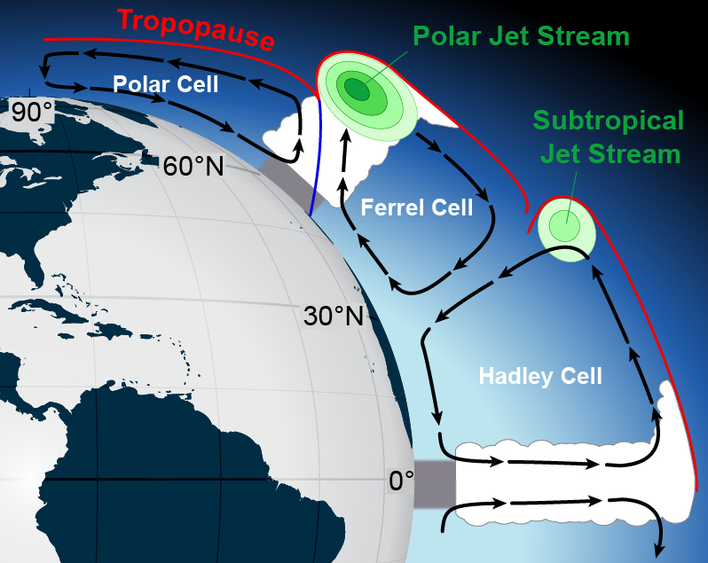
Jet Stream
Notes:
Three large circulations in the transport of heat to the poles and cold air toward the equator. The jet streams for where temperature change is greatest. The jet streams/circulations follows the sun in that they move north and south as the as the sun’s zenith changes each season. At the equator air converges and is forced to rise forming the Intertropical Convergence Zone. At 30°N the air descends, the latitude where most deserts are located. At 60°N, rising air leads to much rainfall and many of the world’s forests. Descending air at the poles leads to desert-like conditions.

Slide 4
Chasing Rabbits #4
Notes:
Chasing Rabbits: Deserts

Slide 5
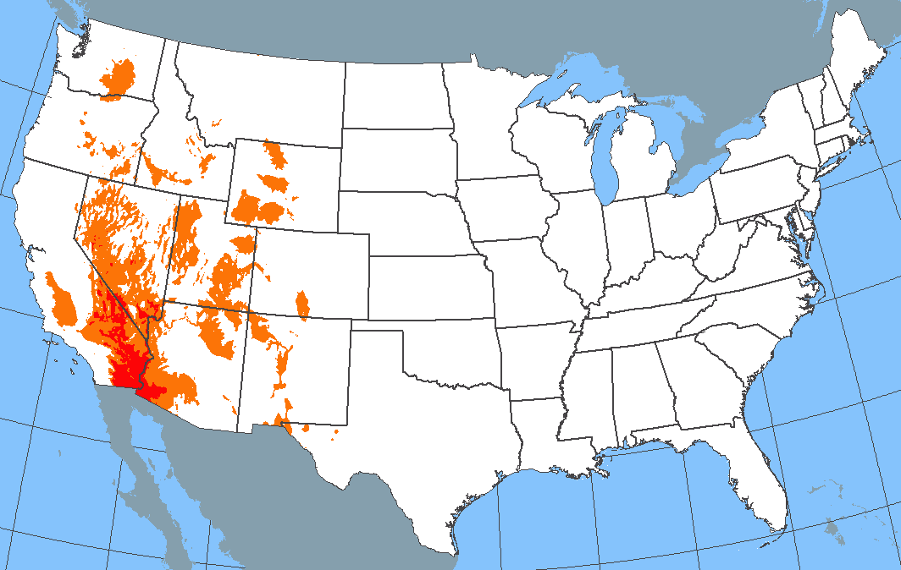
Chasing Rabbits #4
A desert is defined as any region where the annual rainfall is LESS than 10 inches.
Temperature is irrelevant.
Annual Rainfall
<10”
< 5”
Notes:
There are deserts in Alaska (northern AK) and Hawaii (NW portion of the big island) as well.

Slide 6
Jet Stream
What is the Jet Stream?
The atmosphere’s response to where the temperature gradient is strongest (which is also where the greatest density change occurs).
Is identified when and where wind speed is ≥50 kt (but can exceed 200 kt).
Notes:
Three large circulations in the transport of heat to the poles and cold air toward the equator. The jet streams for where temperature change is greatest. The jet streams/circulations follows the sun in that they move north and south as the as the sun’s zenith changes each season. At the equator air converges and is forced to rise forming the Intertropical Convergence Zone. At 30°N the air descends, the latitude where most deserts are located. At 60°N, rising air leads to much rainfall and many of the world’s forests. Descending air at the poles leads to desert-like conditions.

Slide 7
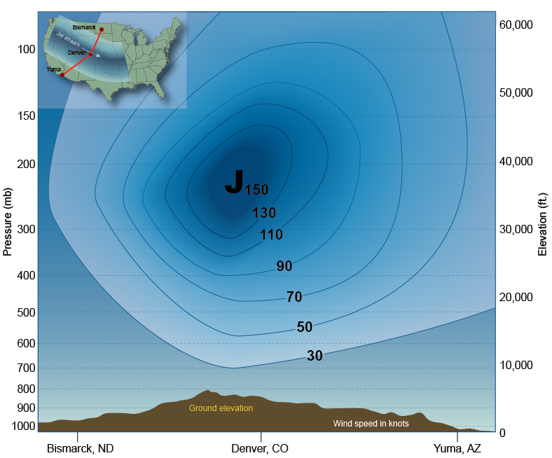
Jet Stream
Notes:
Referred to as a river of air, it is more like a tube of air. Depicted as a line of weather maps it is a 3-D phenomena. 500 mb level is the solid red line. When determining the location of the jet stream we often look at the 300 mb and 200 mb constant pressure chart.

Slide 8
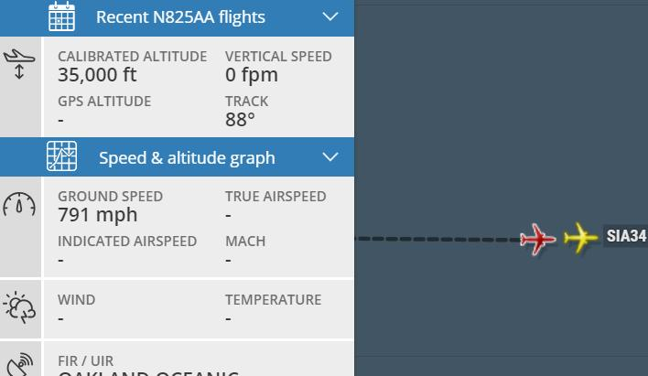
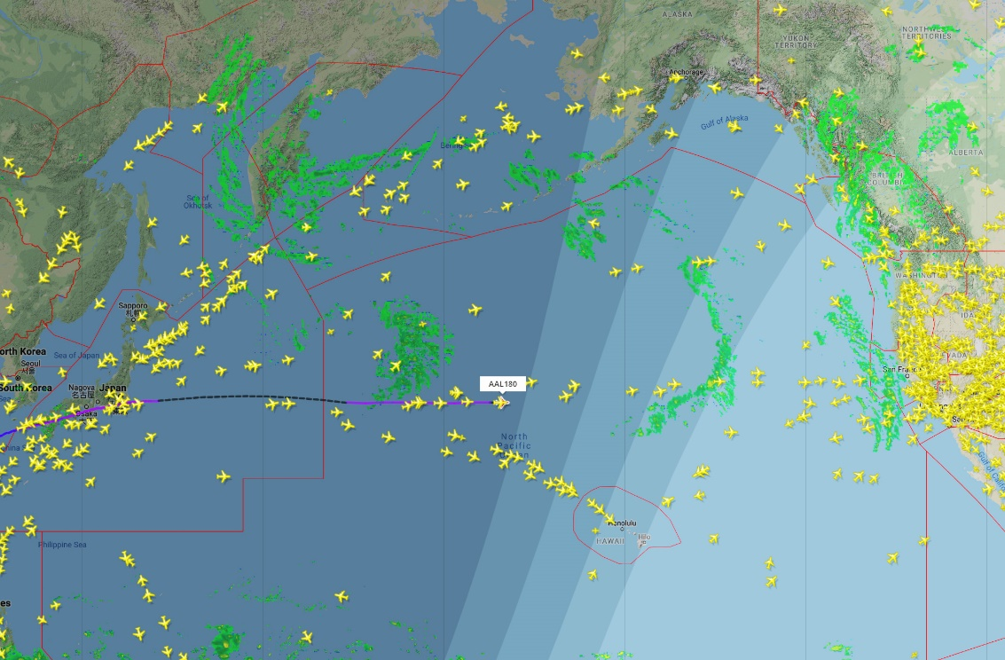
Jet Stream
American Airlines #180
January 11, 2019
791 mph
Boeing 787 cruising
speed is 587 mph
Notes:
Jet stream across the Pacific Ocean pushed this flight to as high as 791 mph relative to the ground. Actual air speed of aircraft was less than 580 mph.

Slide 9
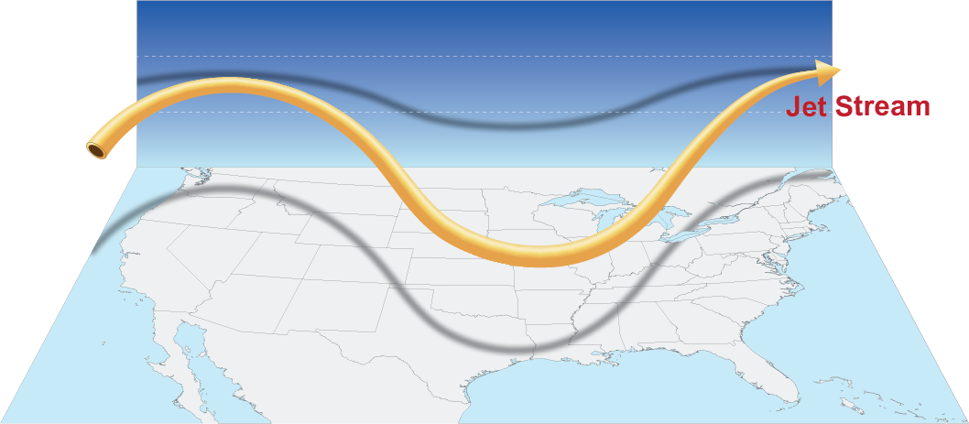
Jet Stream
Does not occur at any one level but changes in elevation
Elevation
Notes:
Not only does the jet stream change latitude but in height. It is located physically lower in the atmosphere in troughs as compared to ridges.

Slide 10
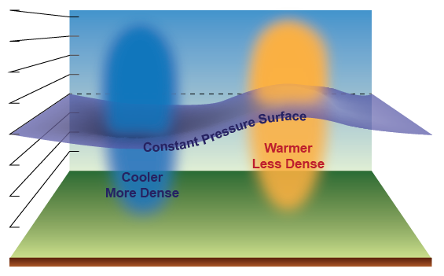
Jet Stream
Notes:
Why the dips and ridges? Cooler, more dense air means pressure levels occur closer to the earth's surface. Warmer, less dense air pressure levels occur higher in the atmopshere.

Slide 11
Jet Stream
Elevation
Warmer Air
Cooler Air
Notes:
The air is cooler in the trough and warmer in the ridge.

Slide 12
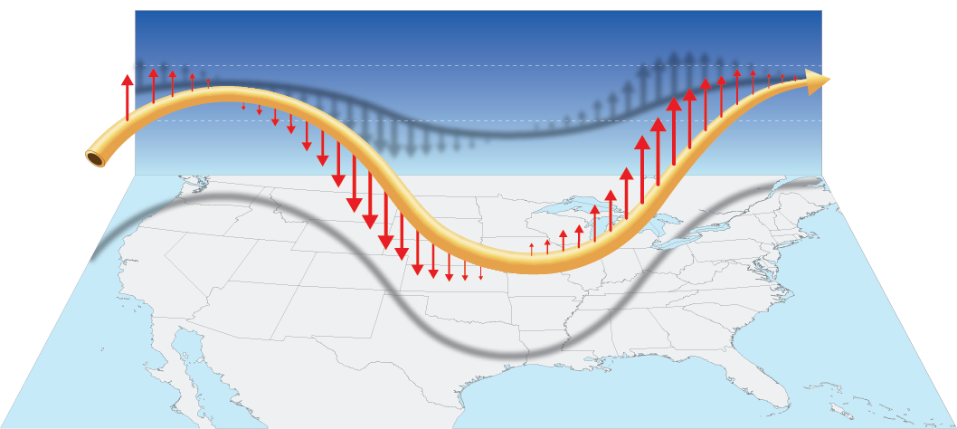
Jet Stream
The change in jet stream elevation imparts vertical motion in the atmosphere.
Notes:
The vertical motion of the jet stream imparts an upward and downward force. Where the jet stream DECREASES in elevation the fastest produces the greatest downward motion in the atmosphere. Conversely, where the jet stream INCREASES in elevation the fastest is where the greatest upward motion occurs int eh atmosphere.

Slide 13
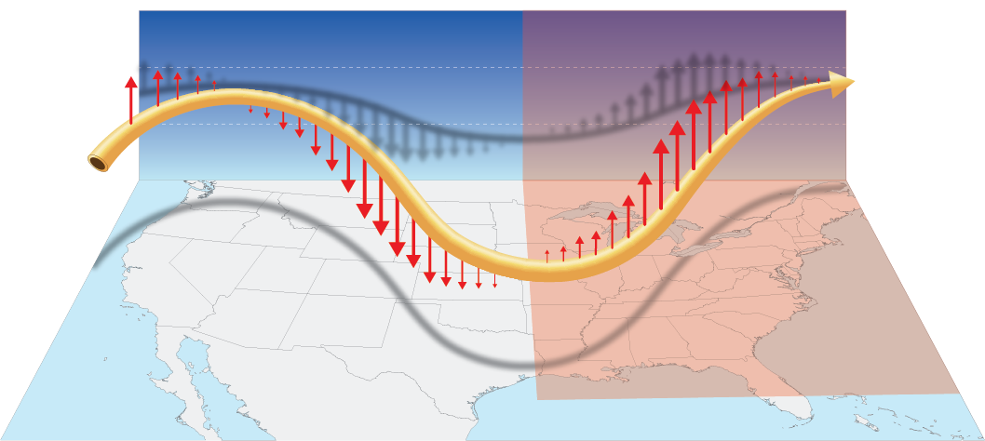
Jet Stream
Inclement weather typically occurs between the trough and downstream ridge.
Notes:
The Jet stream’s vertical motion therefore determines the locations of fair or fowl weather. This explains why the majority of inclement weather occurs between the trough and DOWNSTREAM ridge.

Slide 14
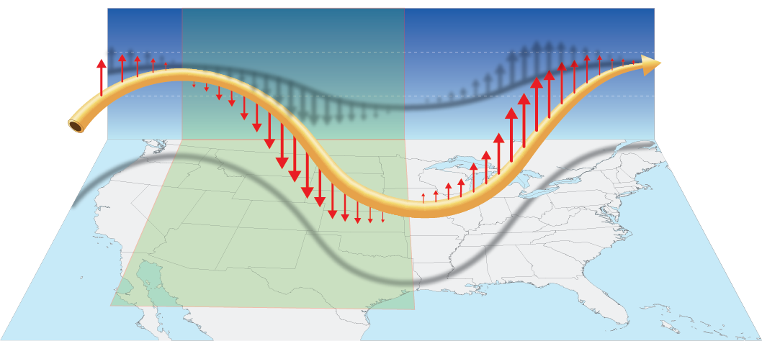
Jet Stream
Fair weather typically occurs between the ridge and downstream trough.
Notes:
The Jet stream’s vertical motion therefore determines the locations of fair or fowl weather. This explains why the majority of inclement weather occurs between the trough and DOWNSTREAM ridge.

Slide 15
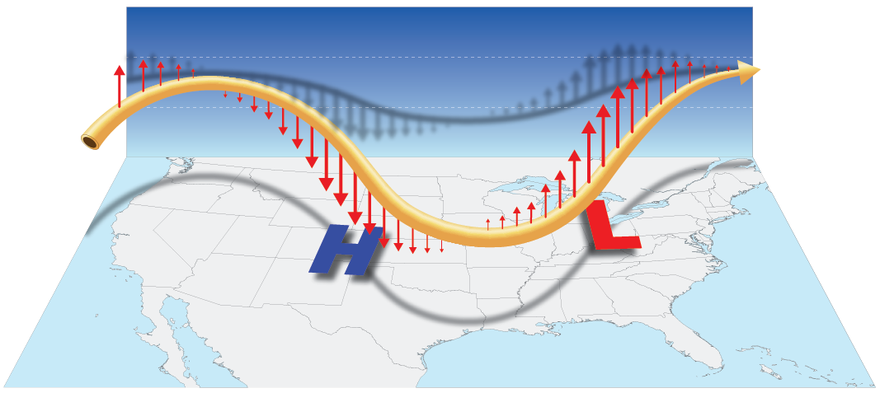
Jet Stream
Vertical motions create surface pressure systems.
Notes:
The vertical motion of the jet stream creates high and low SURFACE pressure centers.

Slide 16
Jet Stream
Greatest rise in height is typically where surface low pressure is located.
Notes:
The vertical motion of the jet stream creates high and low SURFACE pressure centers.

Slide 17
Jet Stream
Greatest decrease in height is typically where surface high pressure is located.
Notes:
The vertical motion of the jet stream creates high and low SURFACE pressure centers.

Slide 18
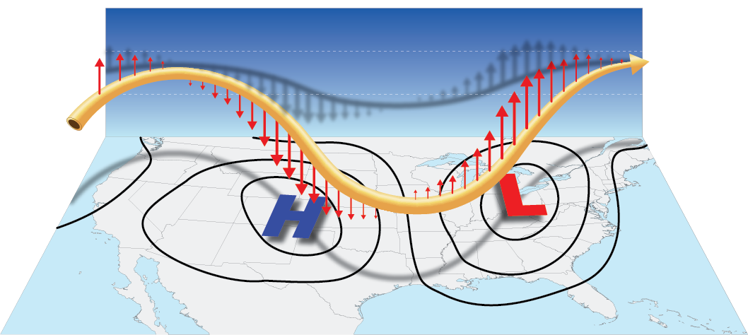
Jet Stream
Greatest vertical motion of air impacts air pressure at the surface.
Isobars are lines of equal pressure.
Notes:
Greatest downward motion increases air pressure at the surface. Greatest upward motion decreases air pressure at the surface. Isobars are lines of equal pressure drawn on a surface weather map and indicate where the greatest upward and downward motion is occurring.

Slide 19
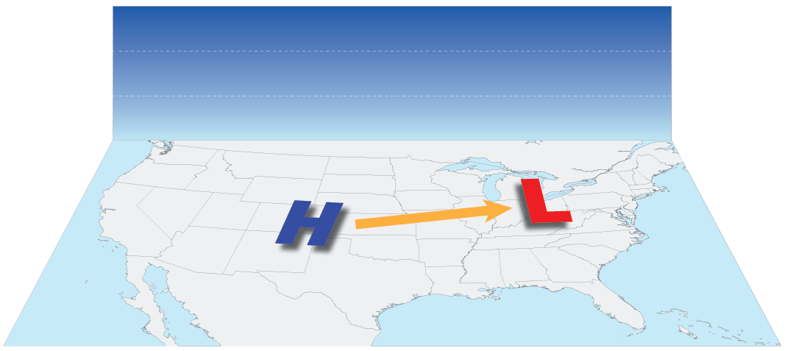
Surface Wind
What direction does the wind blow around high- and low-pressure areas?
Notes:
Pressure gradient is the difference between two pressure centers. At its basic level, the pressure gradient moves air (wind) from high pressure to low pressure.

Slide 20
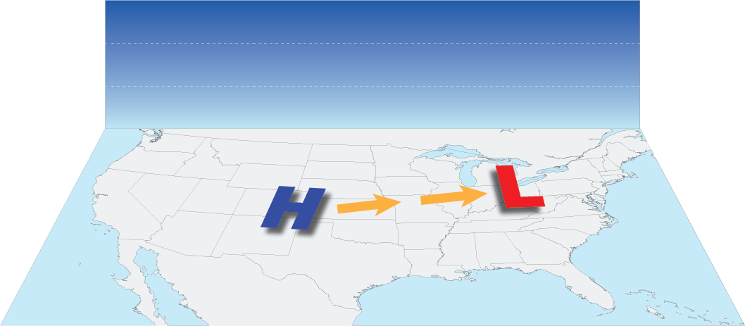
Surface Wind
Let’s look at how the Coriolis effect impacts the winds direction.

Slide 21
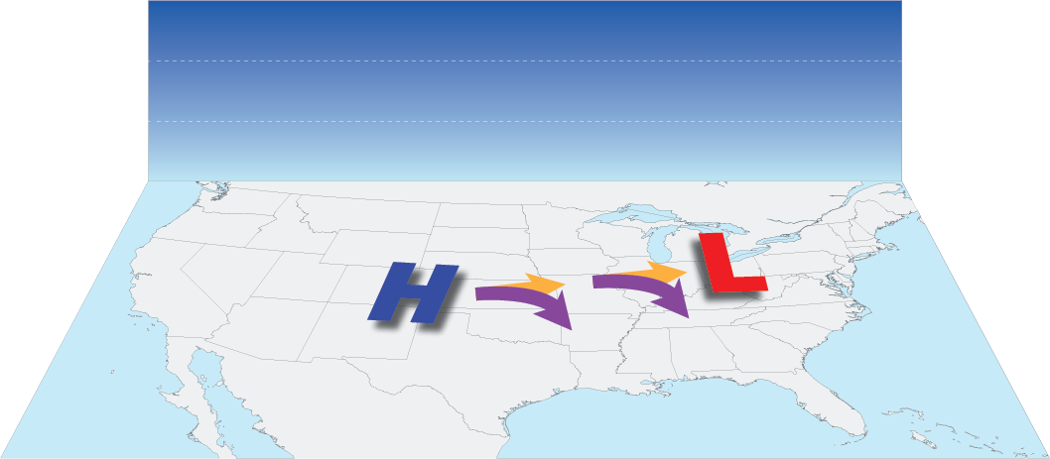
Surface Wind
Let’s look at how the Coriolis effect impacts the winds direction.
Notes:
Wind is deflected to the right in the Northern hemisphere. (Deflects to the left in the Southern Hemisphere.)

Slide 22
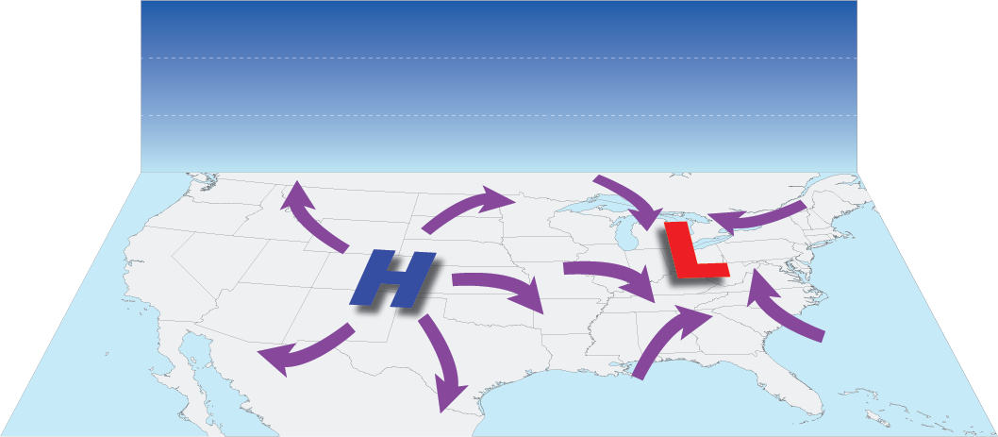
Surface Wind
Let’s look at how the Coriolis effect impacts the winds direction.
Notes:
Wind spirals away from high pressure in a clockwise direction and spirals toward low pressure in a counter-clockwise direction. But the wind is constantly wanting to turn to the right because of the Coriolis effect. Opposed to that is the pressure gradient force which wants to take air from high pressure to low pressure. These two opposing forces balance each other.

Slide 23
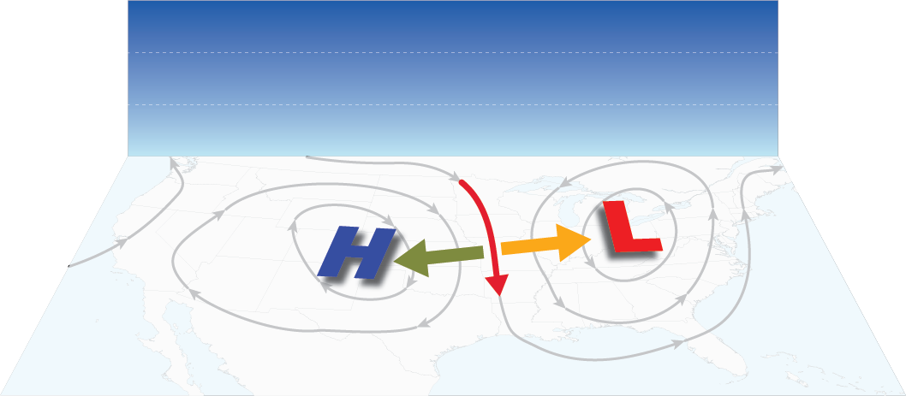
Surface Wind
Coriolis effect is balanced by the pressure gradient. Results in the geostrophic wind.
Notes:
The tug of war between the Coriolis effect (turning the wind to the right) and the pressure gradient force (wind flowing from high pressure to low pressure) become )more or less balanced and the wind parallels the isobars. The resulting wind direction is called the geostrophic wind.

Slide 24
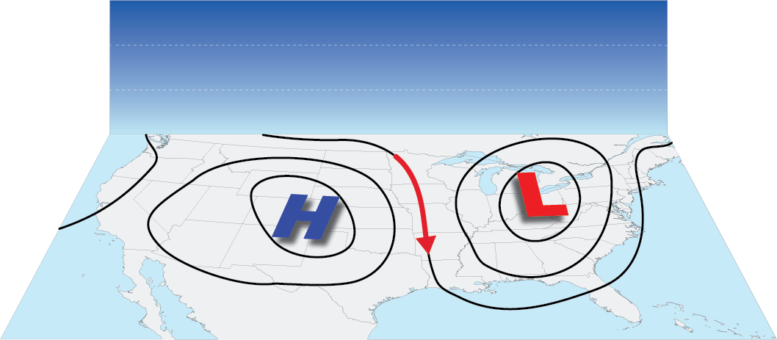
Surface Wind
The wind flows along isobars
(more or less)
Notes:
Friction causes the wind to slow slightly and therefore wind flows out of high pressure and into low pressure, across the isobars at a shallow angle.

Slide 25
Chasing Rabbits #5

Slide 26
Chasing Rabbits #5
How to find high- and low-pressure centers outdoors*
Face into the wind.
Hold your arms out from the
side of your body.
3. Your left hand points to the
center of High pressure.
4. Your right hand points to the center
of Low pressure.
* Not so much for the Seattle area.

Slide 27
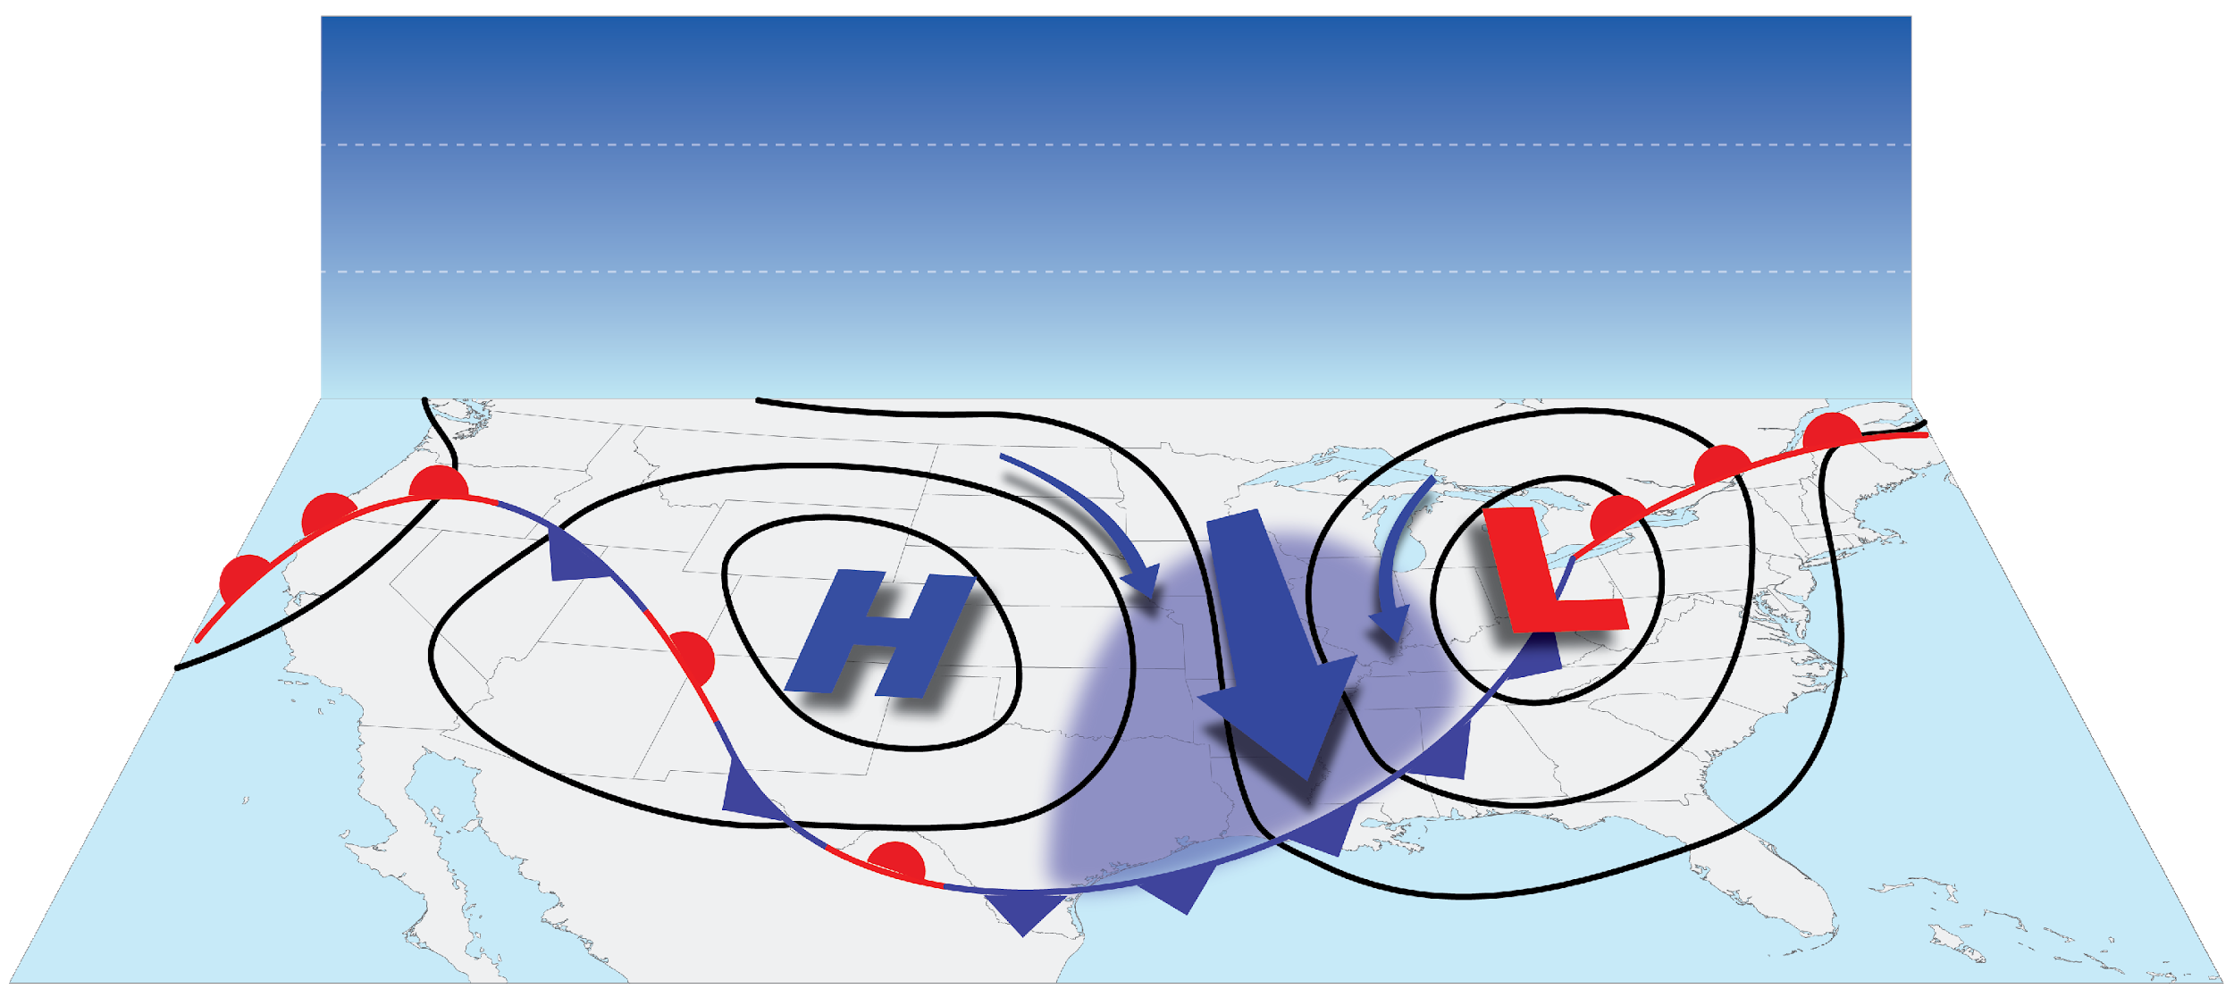
Fronts
Cold Front
Cold (cooler) air replacing warm air.
Notes:
The air’s motion around high and low pressure can create sharp boundaries. Cold front – cold air replacing warm air. (Regardless of temperature difference.)

Slide 28
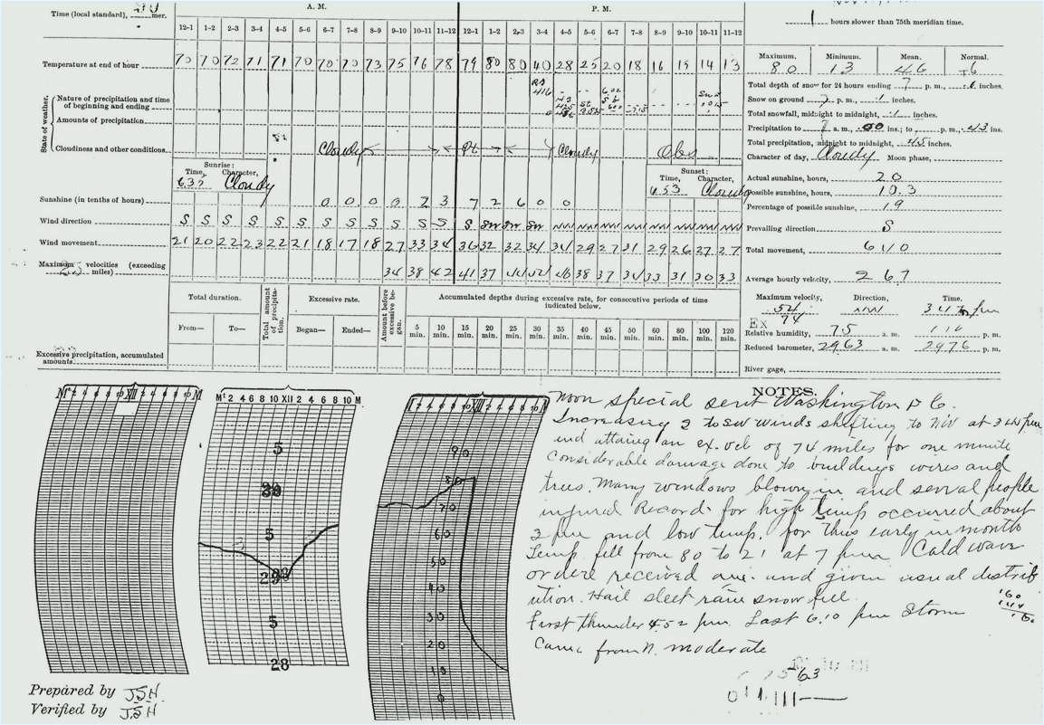
Fronts
Notes:
In extreme cases cold front boundaries can be shockingly strong. The daily weather summary for Springfield, MO. November 11, 1911. Look at the temperature graph.

Slide 29
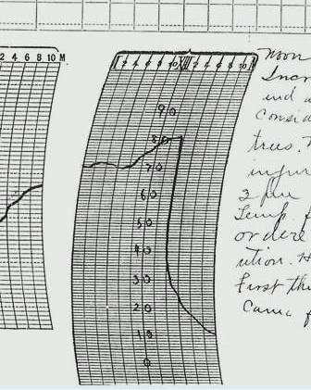
Fronts
3:45 pm 80°F
4:00 pm 40°F
Notes:
Cold front with arctic air causes a decrease of 40°F in 15 minutes after passing the weather station. Another oddity, on the same day, November 11, 1911, Oklahoma City set record high for the date of 83°F. The temperature just prior to midnight was 17°F; a record low, for the same date.

Slide 30
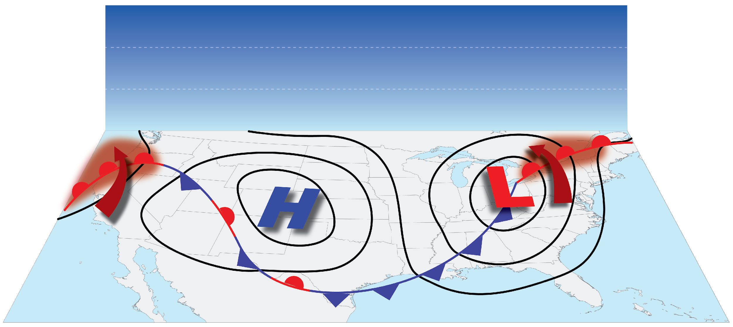
Fronts
Warm Front
Warmer air replacing cold air.
Notes:
Warm front – Warm air replacing cold air. Warm front boundaries tend to not be as well defined as cold front boundaries.

Slide 31
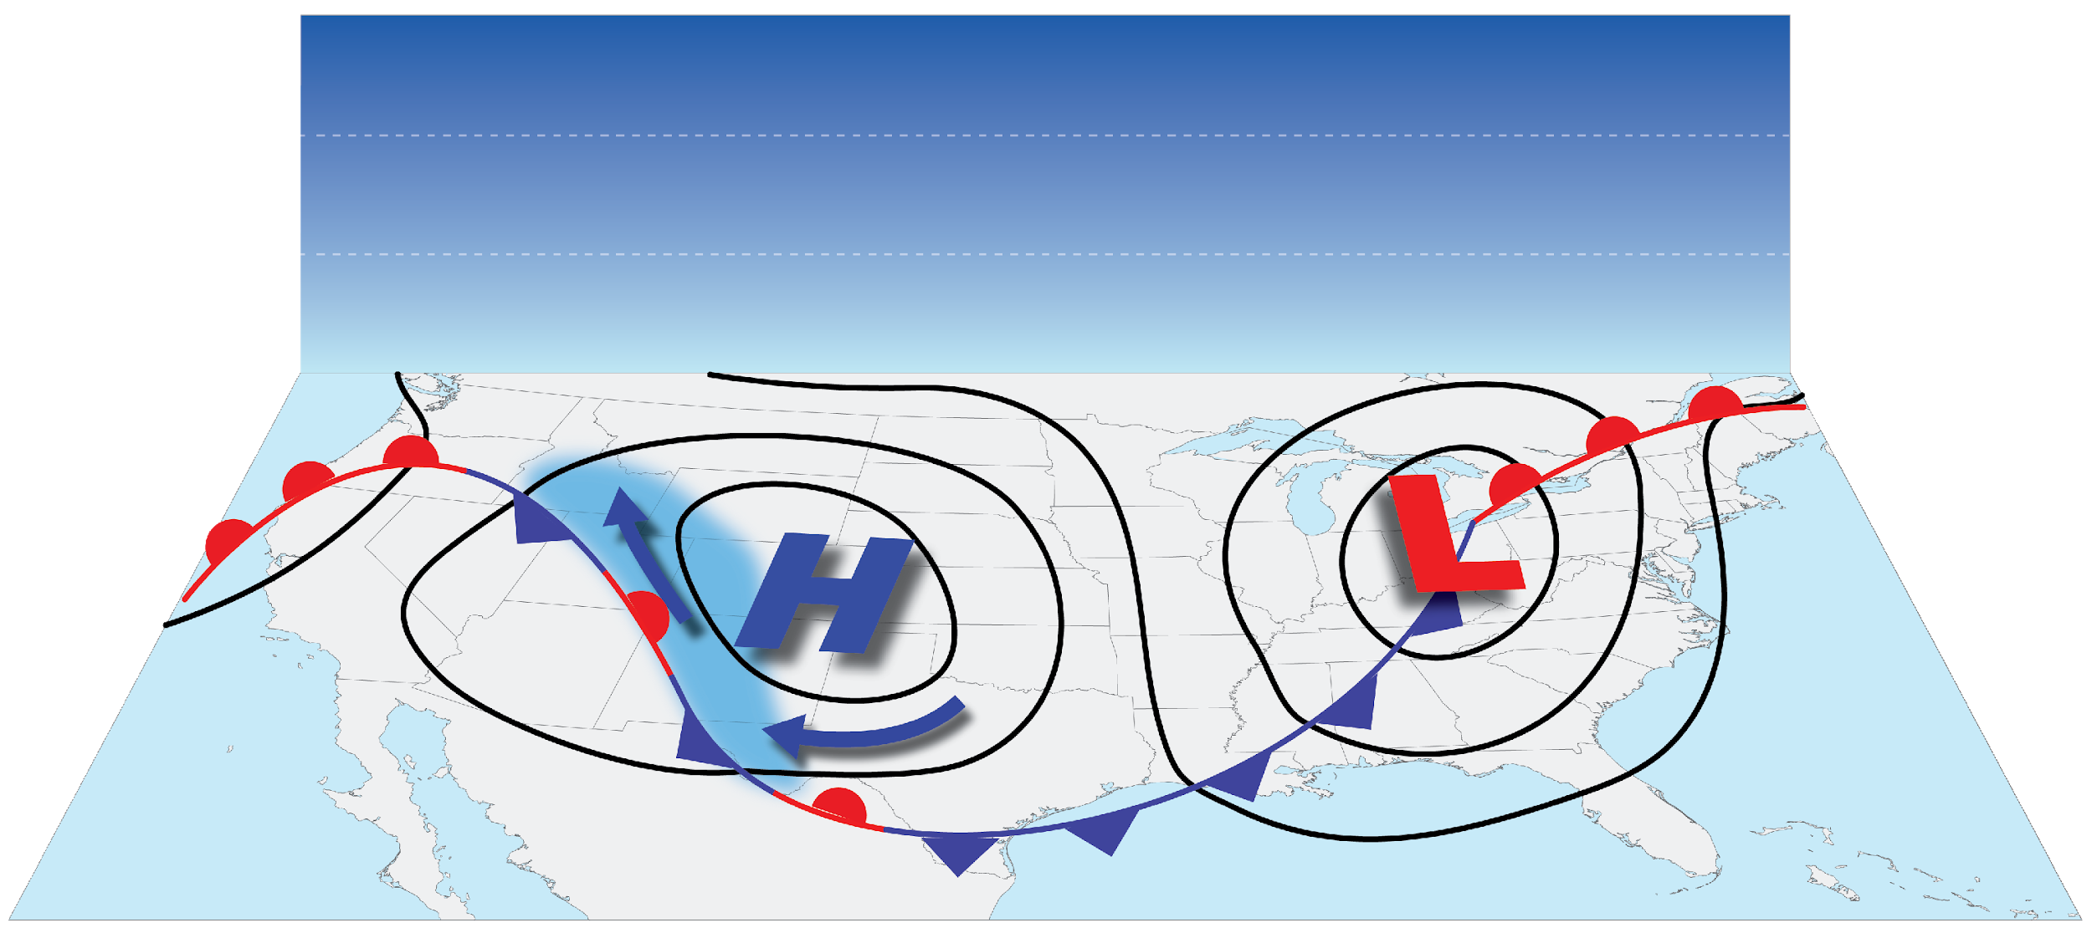
Fronts
Stationary Front
Boundary between two air masses with no frontal movement.
Notes:
Stationary front can become warm or cold front if the boundary begins to move.

Slide 32
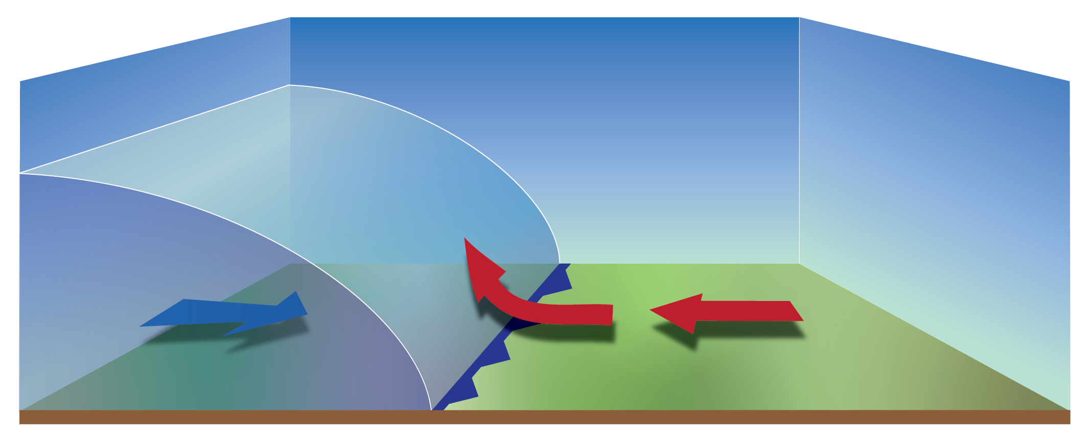
Fronts
Cold Fronts
Cooler/Colder more dense air undercuts the warmer less dense air.
Notes:
As the cold front advances, its cooler, more dense air undercuts the warmer, less dense air forcing it up over the front.

Slide 33
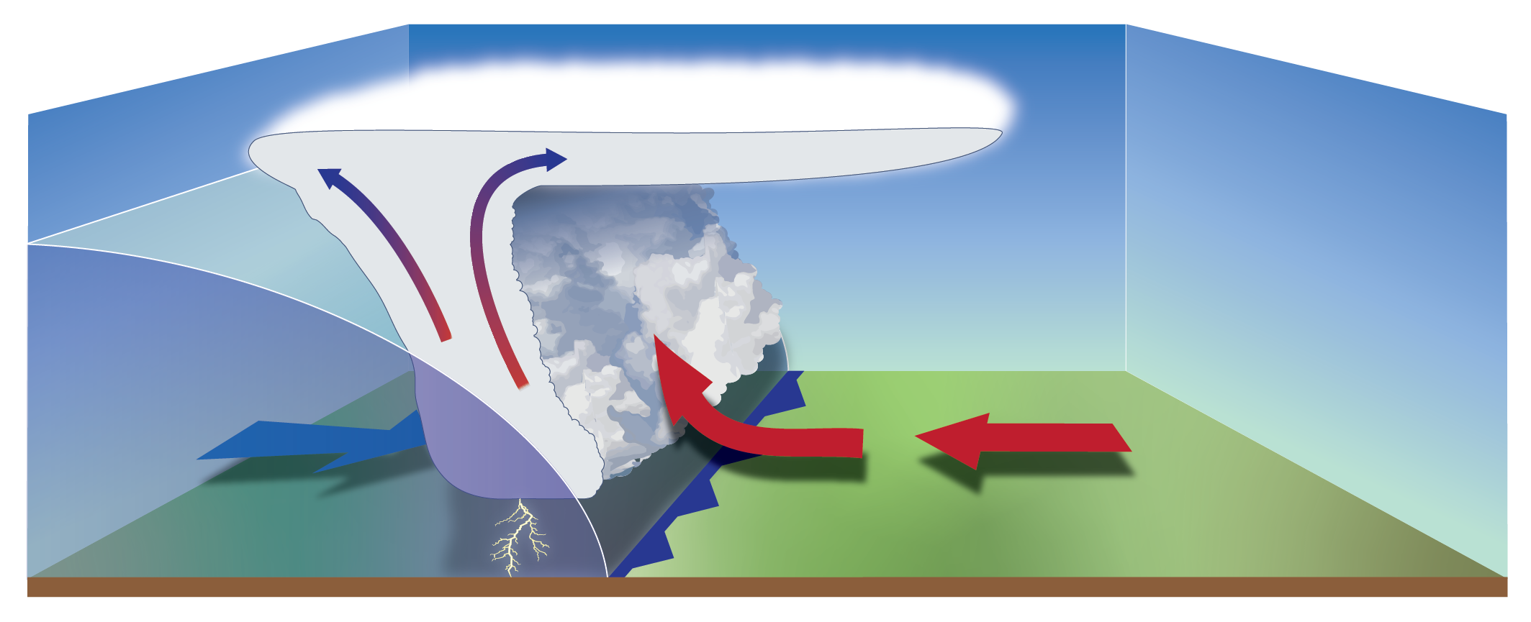
Fronts
Cold Fronts
Forceful rising of warm air helps create thunderstorms.
Notes:
The rapid, forceful rising of warm air is why thunderstorms often form on cold fronts.

Slide 34
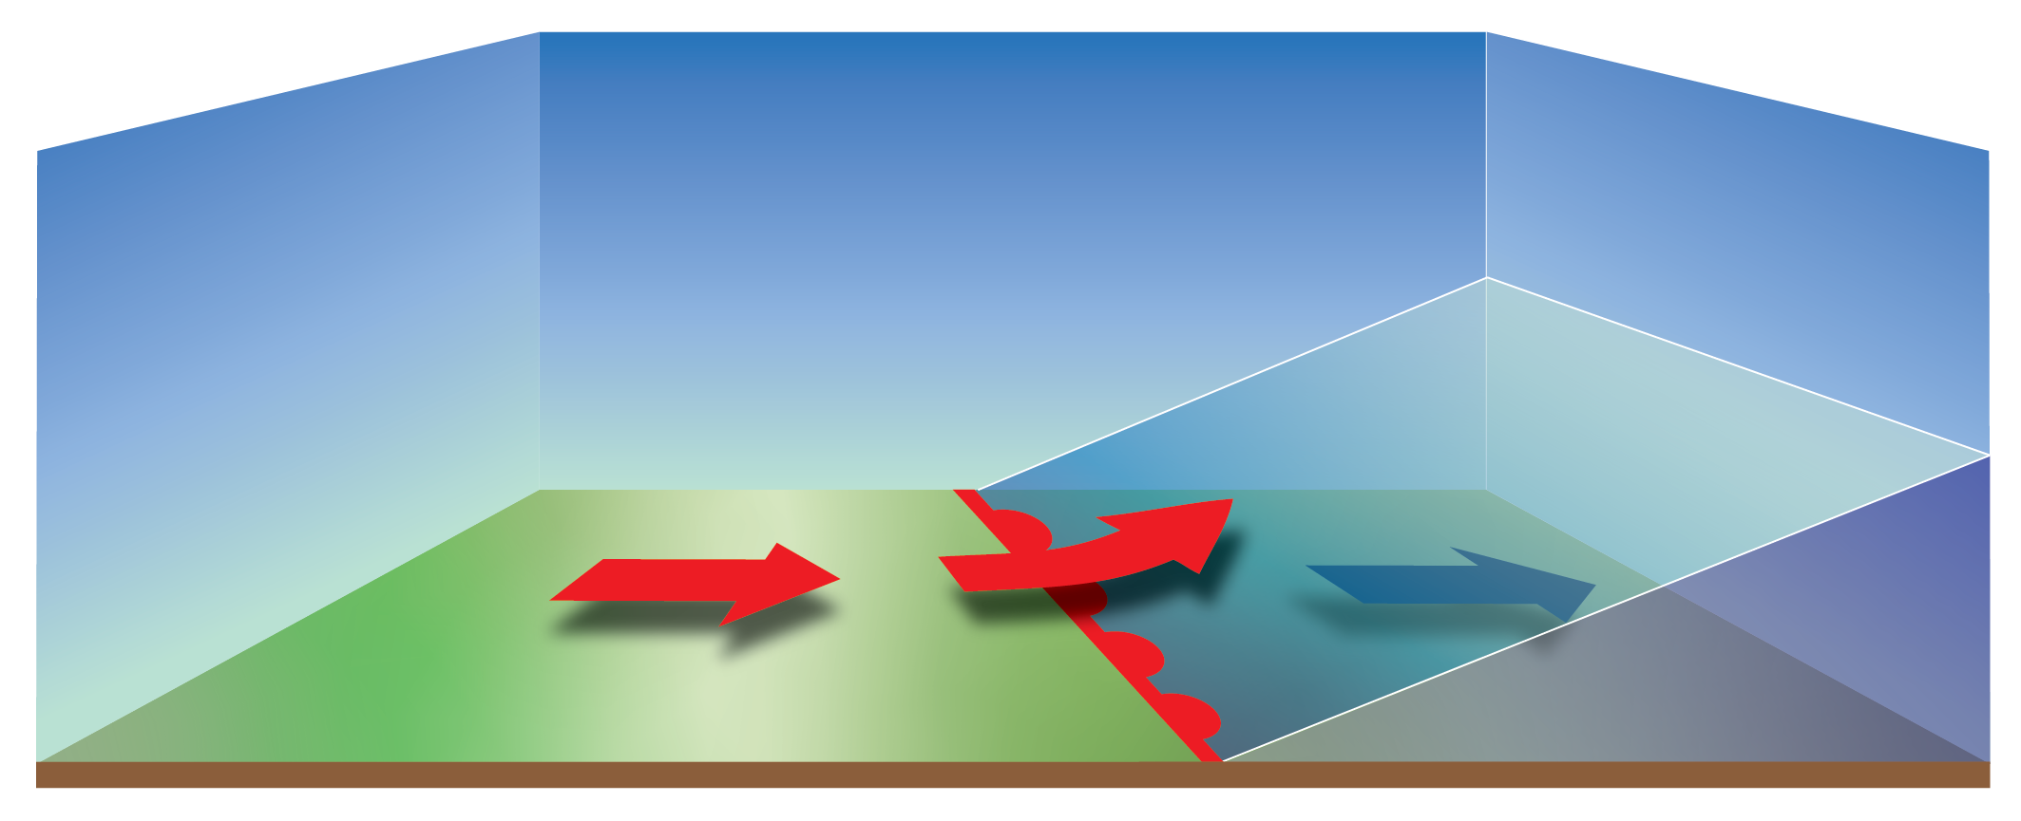
Fronts
Warm Fronts
Lighter, denser warm air moves faster than the retreating warm front causing it to rise.
Notes:
The lighter denser warm air moves faster than the retreating warm front forcing to rise.

Slide 35
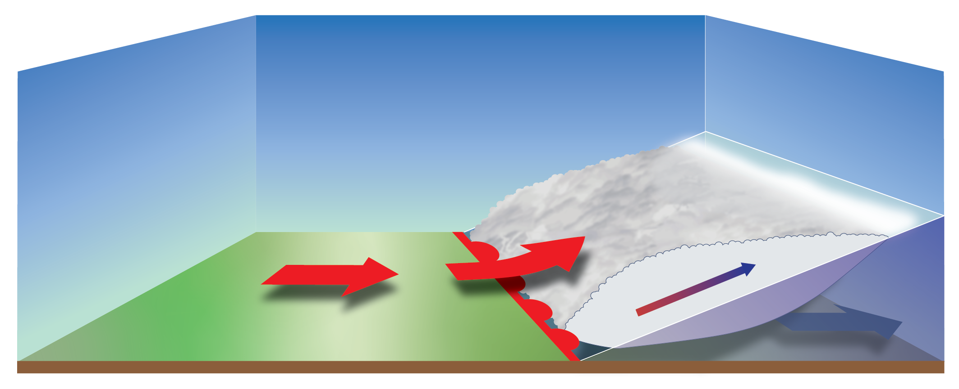
Fronts
Warm Fronts
Clouds and rain develop “ahead” of warm front.
Notes:
Clouds and rain develop “ahead” of warm front. Occasionally, the warm air lifted over the front is unstable enough for the formation of thunderstorms.

Slide 36
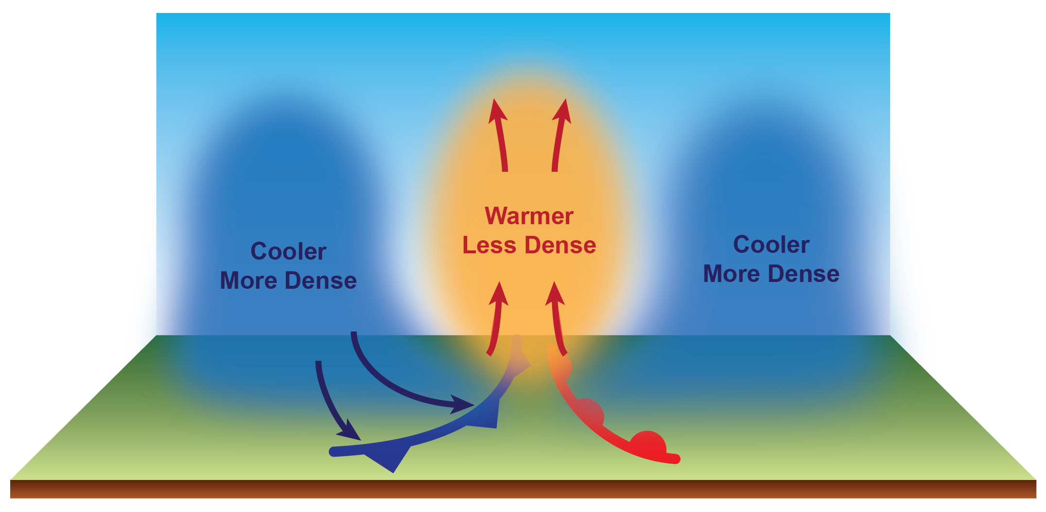
Back to the Future
We return back to the beginning and complete the weather cycle.
Notes:
We return back to the beginning and complete the weather cycle. Inclement weather occurs near fronts as these locations are where the air is most readily lifted.

Slide 37
Learn MORE at…
JetStream – An Online School for Weather
www.weather.gov/jetstream
A free resource with over 35 lesson plans and activities

