Slide 1
High and Low Pressure
Meteorologist Aaron Treadway
National Weather Service Austin/San Antonio

Slide 2
Air Pressure
The number of molecules in the atmosphere decreases with height
Pressure can change by adding or taking away air
Temperature also impacts pressure
  Adding Heat Increases pressure
  Subtracting Heat Decreases pressure

Slide 3
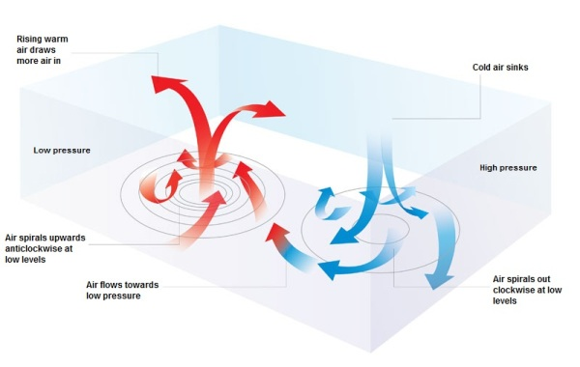
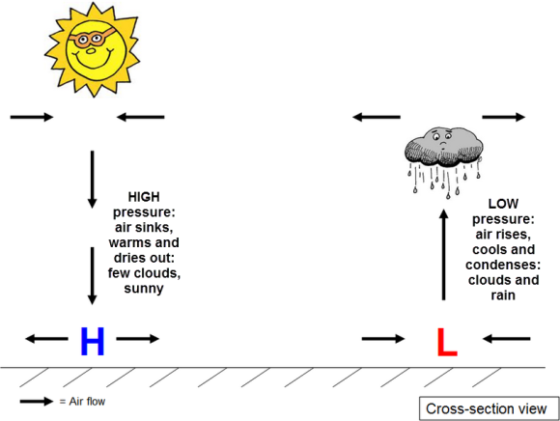
H and L
High Pressure
  Sinking air
  Clockwise rotation at low levels
  Warm and dry air
  Few clouds, sunny Skies
Low Pressure
  Rising air
  Counter-clockwise rotation at low levels
  Air cools and condenses
  Clouds, rain, bad weather

Slide 4
Trough and Ridge
Trough
  Cooler air mass
  Lifting air
  Low Pressure
Ridge
  Warmer air mass
  Sinking air
  Higher Pressure

Slide 5
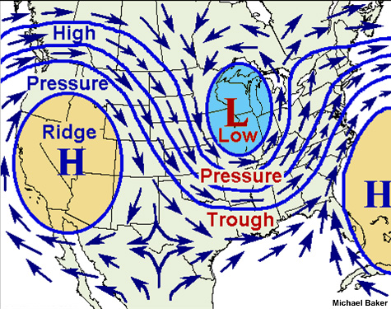
On the Map

