Slide 1
The Life of a Meteorologist
Meteorologist Aaron Treadway
National Weather Service Austin/San Antonio

Slide 2
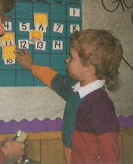
Early Childhood
Interested in Weather from a young age.
Sheltering from a Tornado in Kindergarten.
Had a meteorologist come to my school.
Was scared of thunderstorms: Astraphobia

Slide 3
Middle School
Would watch the weather every morning.
Met my first storm chasers.
Had a close encounter with a tornado while camping.
Still afraid of storms…

Slide 4
High School
Lots of Math!
  Calculus
Lots of Science!
  Physics, Environmental Science
Picking a College!
Meeting local meteorologists

Slide 6
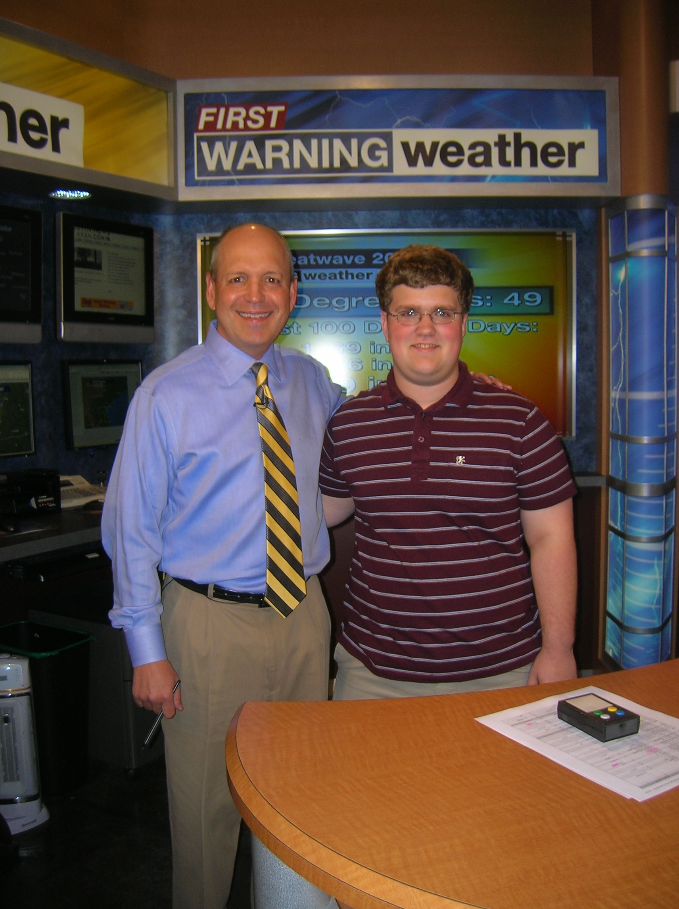
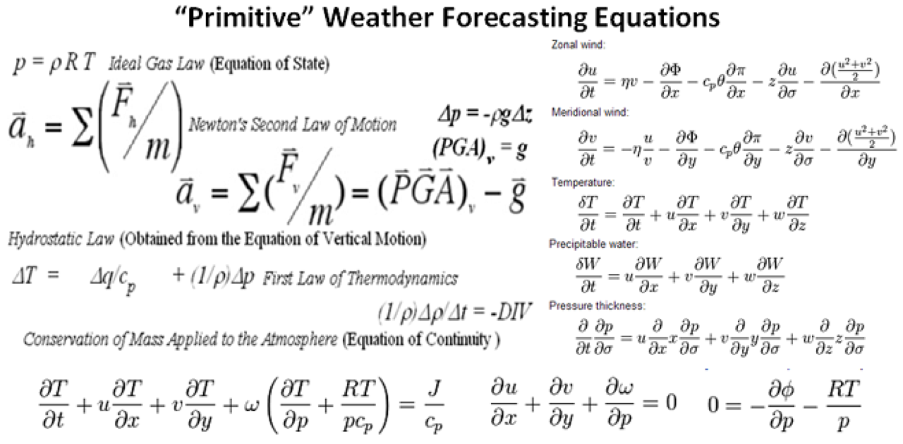
College
Interned at TV Station, the National Weather Service, and SHAVE Hail Project.
More math! More Science!
Storm Chasing!!!
Find a mentor, role model!
Don’t give up if it is your passion and dream job!

Slide 7
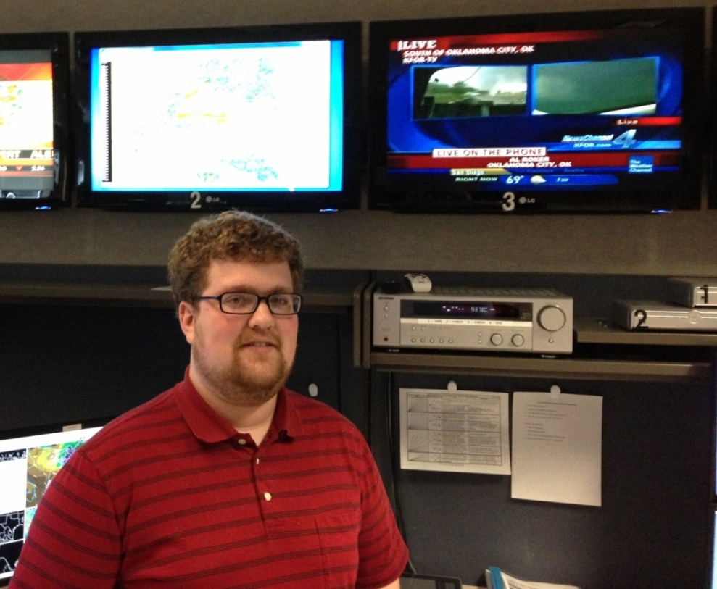
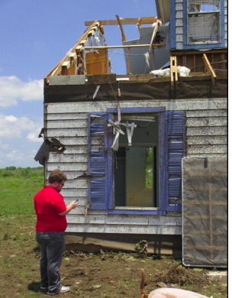
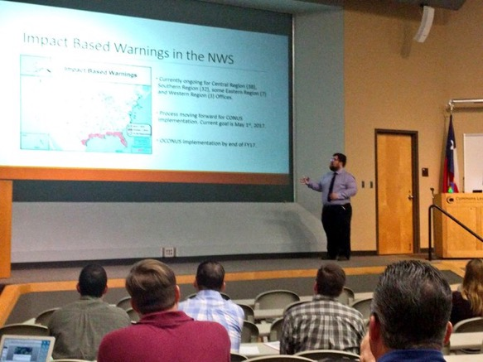
National Weather Service
Worked several big flooding and tornado events.
Done Tornado damage surveys
Numerous school and conference presentations
Forecasting!
Everyday presents something different and a new challenge

Slide 8
