Slide 1
radar
Meteorologist Aaron Treadway
National Weather Service Austin/San Antonio

Slide 2
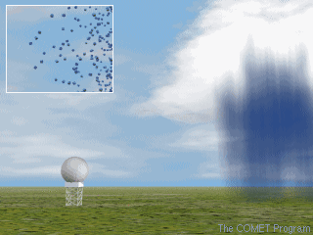
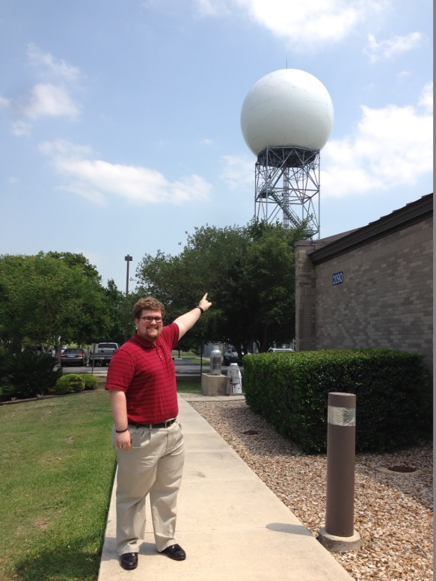
Radio detection and ranging

Slide 3
How radar works?
Movement and Position of Targets
Radar tracks phase (shape/position/form) shift (change) in radar pulse after hitting target.
Weather radar spends 59 minutes, 53 seconds each hour listening, 7 seconds sending.
Radar Data every 1-15 minutes.

Slide 4
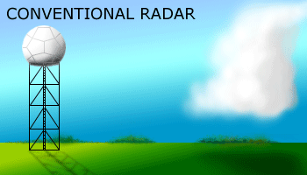
Dual-polarization
New software and hardware to provide a 3D picture of targets.
Dual-pol can identify rain, hail, snow, debris, natural objects.

Slide 5
The Future Of Radar

Slide 6
Tornado on radar

Slide 7
Large Hail on Radar

Slide 8
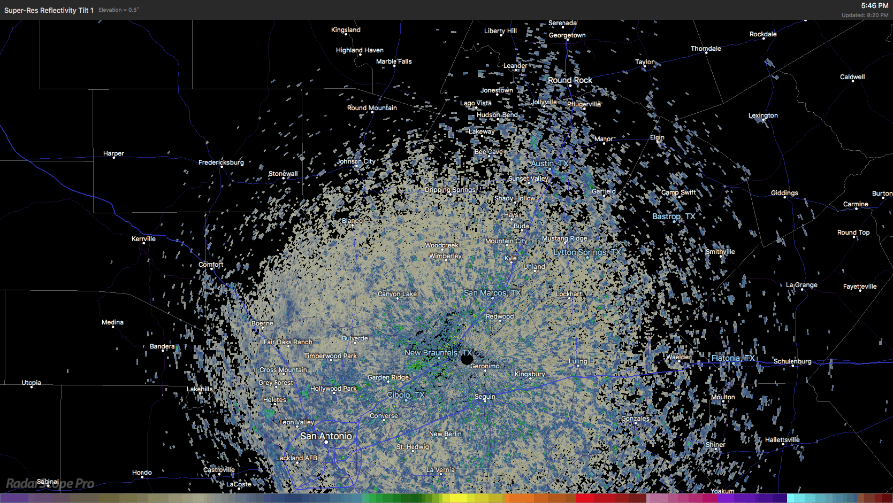
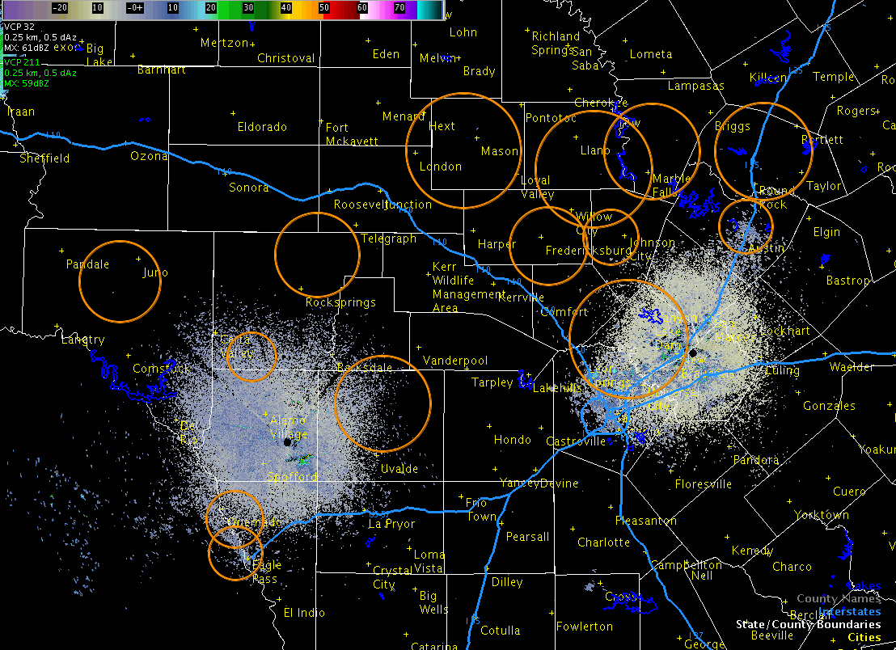
The bat signal

Slide 9
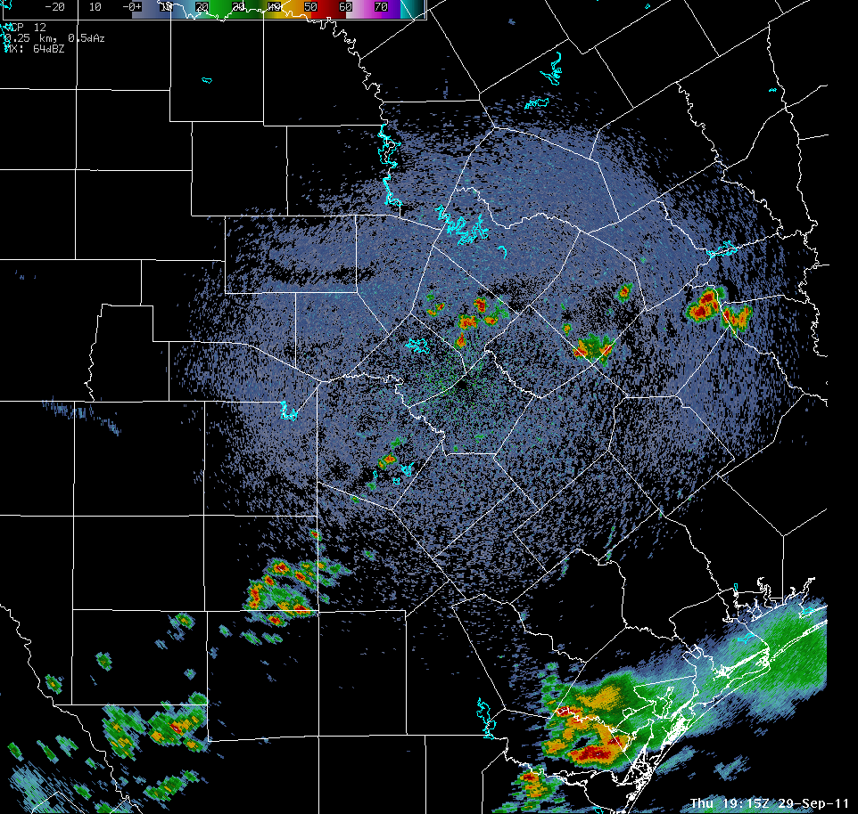
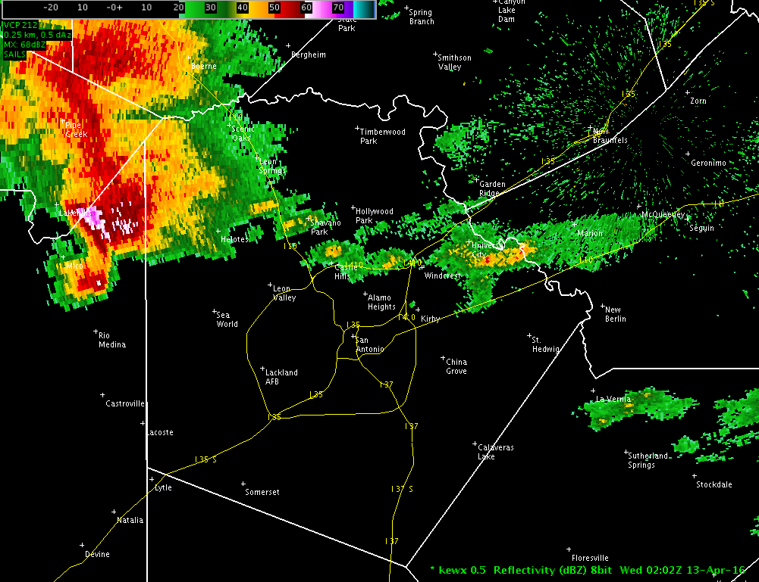
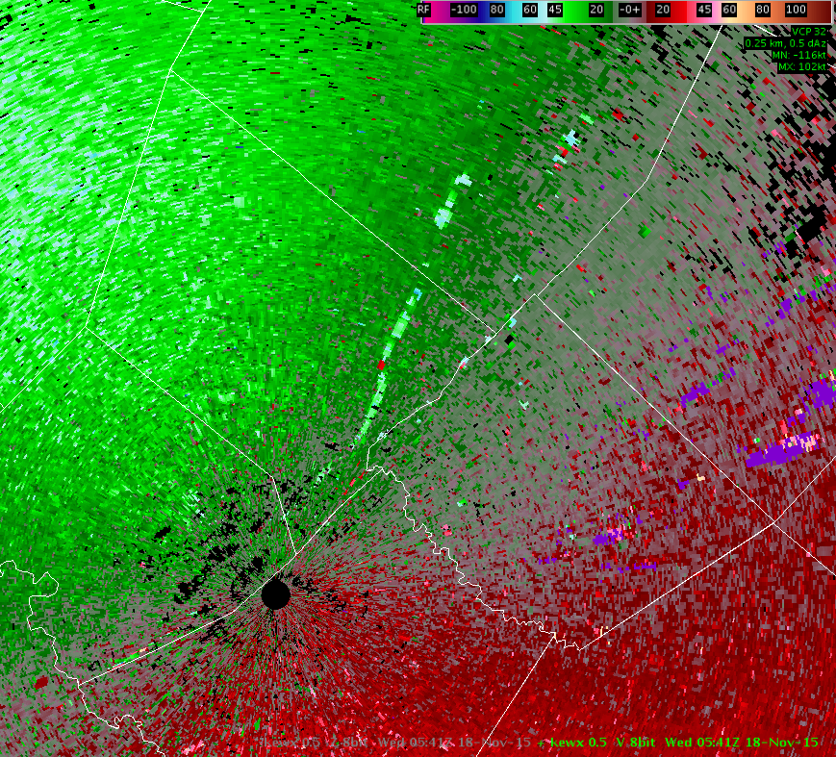
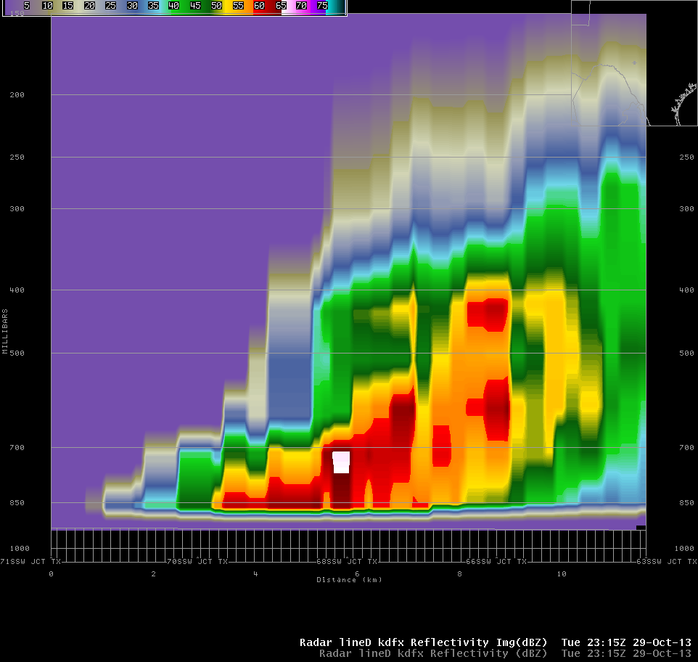
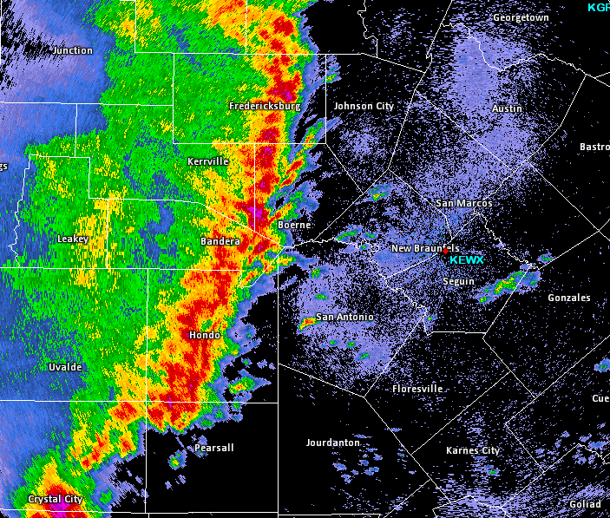
More!

