Slide 1
tornadoes
Meteorologist Aaron Treadway
National Weather Service Austin/San Antonio

Slide 2
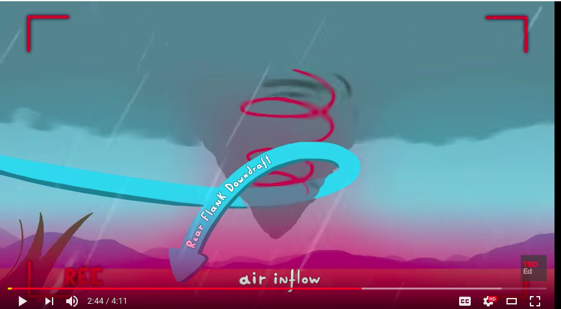
How tornadoes form
This is our best guess
Still a lot to learn about tornadoes
We know enough to be able to warm the public! Keep you safe!
https://www.youtube.com/watch?v=lmWh9jV_1ac

Slide 3
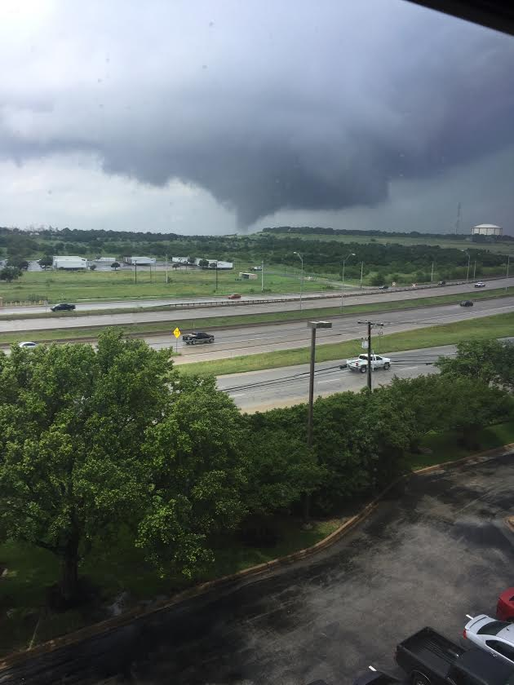
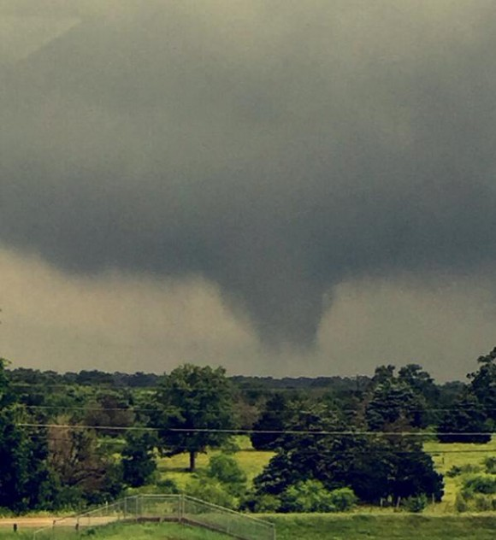
Funnel cloud vs. tornado
Funnel cloud – not in contact with the ground
Tornado – rotating column of air from the cloud to ground

Slide 4
Tornado Rating

Slide 5
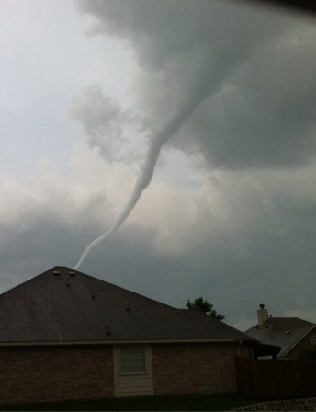
Weak tornadoes ef0-ef1
Life span 1-2 minutes
Path length < 1 mile
Winds up to 110 mph.
Difficult to detect by radar
Difficult to get spotter confirmation
Many go unreported

Slide 6
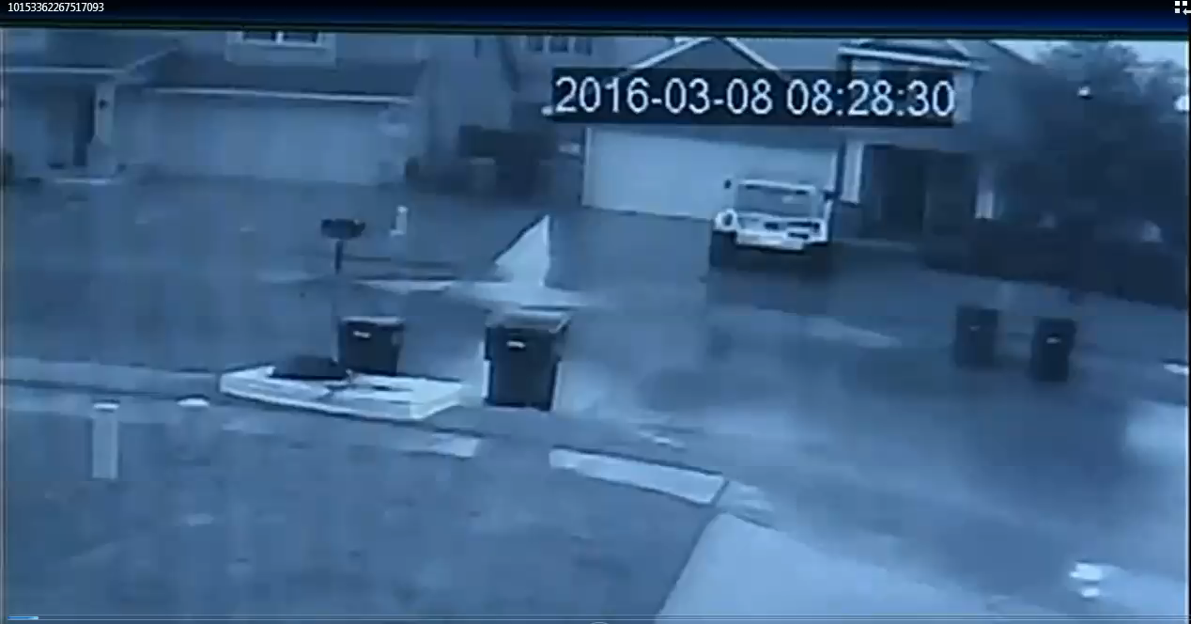

Slide 7
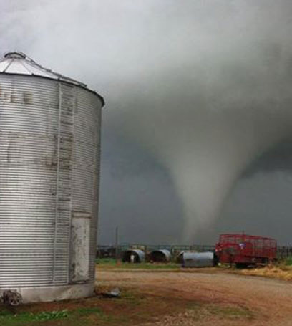
strong tornadoes ef2-ef3
Life Span 15-20 minutes
Path up to 15 miles
Path Width up to 500 yards
Winds up to 165 mph.
Identified by Doppler radar
Good reports/confirmation

Slide 8
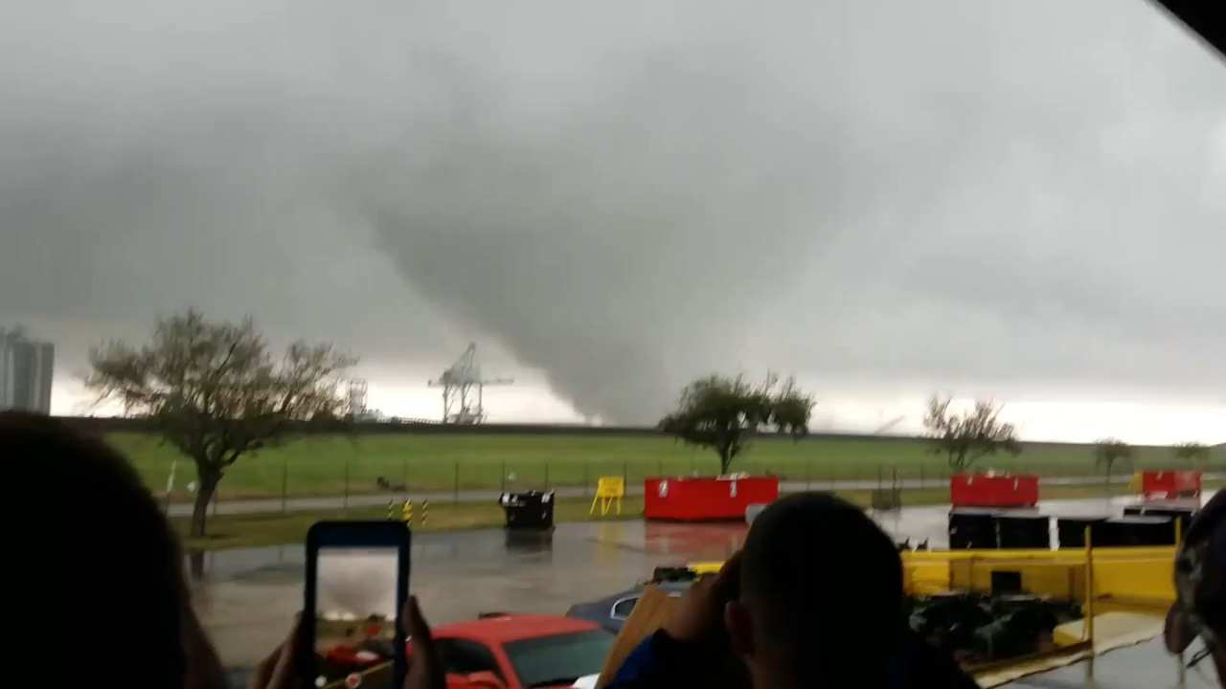

Slide 9
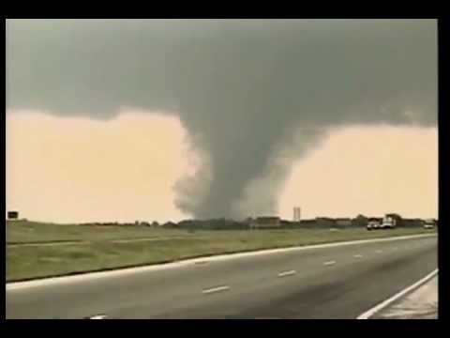
Violent tornadoes ef5
Life span of 1-2 hours
Path length of 20 - 50 miles
Wind speeds over 200 mph
Most deadly tornado

Slide 10
