Slide 1
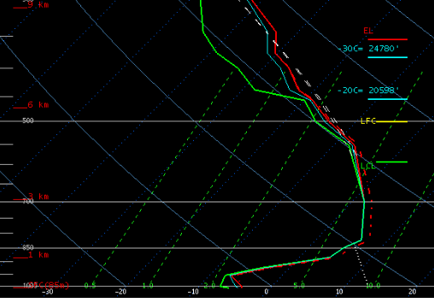
Weather balloon sounding at NWS Sterling, Sat morning Dec 17, 2016
Standard
atmosphere –
temperature
decreases with
height
Pollutants can
rise to the top
of the inversion
and will spread out within
the layer but do not
escape until the
inversion is broken
Temperature rising
with height in this layer.
This a temperature
inversion
Red line = temperature, green line = dew point

