Slide 1
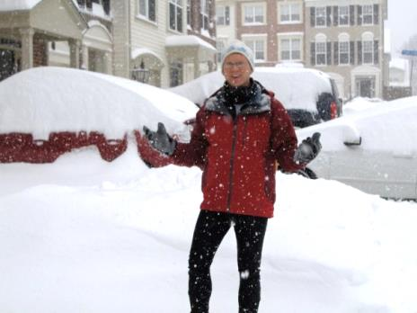
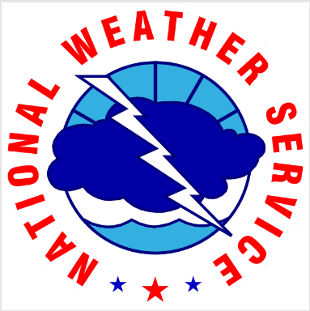
Doppler Radar
Andrew Woodcock
Lead Forecaster
National Weather Service
Baltimore/Washington DC
Forecast Office

Slide 2
Terms we’ll be discussing…
Electromagnetic energy - all known frequencies and their linked wavelengths
Wavelength – the distance between the crests (or troughs) of two waves
Frequency – the time it takes for two successive crests to pass a certain location
Inversely proportional – longer wavelength=lower frequency & vice versa
Radar modes - precipitation and clear air
Doppler Effect/Doppler Mode – the raising/lowering of a frequency (‘the train passing”)
which allows the radar to detect the movement of precipitation
Reflectivity Mode – what is usually displayed on TV “like an echo”
Storm Total Precipitation – radar product used to estimate rainfall. Provides guidance
that forecasters use when deciding whether to issue flood warnings
We’ll finish with some examples of radar images that are available on the internet

Slide 3
Barack Obama, The way ahead, “The Economist,” Oct 6, 2016
“…in recent years, we have seen incredible technological advances through the internet,
mobile broadband and devices, artificial intelligence, robotics, advanced materials,
improvements in energy efficiency and personalized medicine. But while these innovations
have changed lives, they have not yet substantially boosted measured productivity growth.”

Slide 4
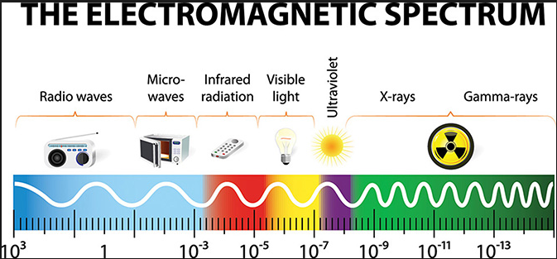
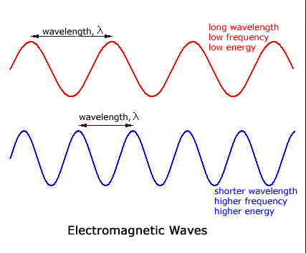
Radar waves fall
approximately in this part
of the EM spectrum
7.5–15 cm
Visible light
Waves can be expressed by
wavelength – distance
between crests or troughs,
or by frequency – the
speed at which those pass
a point.
These are inversely proportional –
if wavelength is long, frequency is low
if wavelength is short, frequency is high

Slide 5
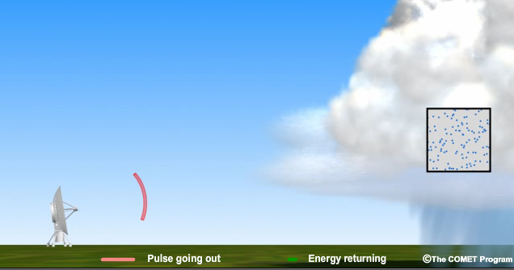
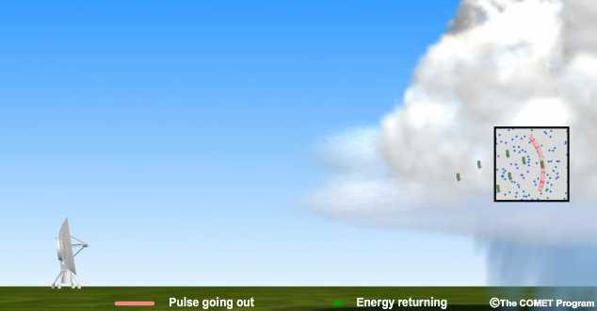
Energy transmitted out from the radar
in waves at speed of light
If that energy hits an object, a fraction
of the energy will be reflected back
After transmitting, the radar “listens”
to receive the reflected energy

Slide 6
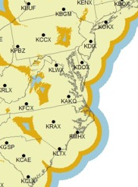
Locations of NWS Doppler radars in
the Mid Atlantic. The distance between
these ranges from 120 to 230 miles apart

Slide 7
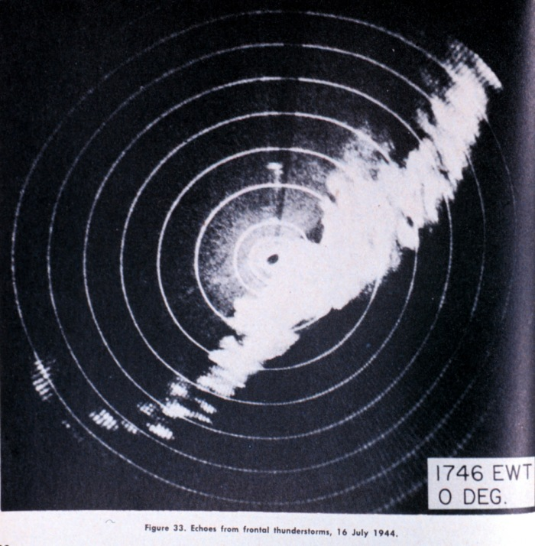
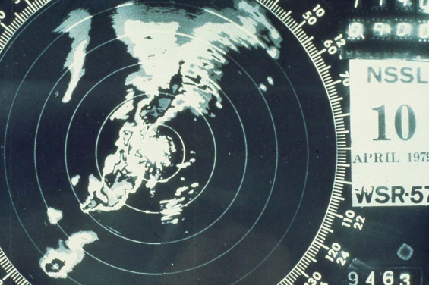
Radar image of thunderstorms, July 1944
And in 1979…but the radar is circa 1957

Slide 8
Doppler Radar
Tower is approximately 100 feet tall
The radar dish sends waves of energy in a circle to detect clouds and precipitation.
The waves run into particles in the atmosphere. Some energy is reflected back to the radar dish. The
returned energy is displayed on a display and interpreted by forecasters.
The more energy that comes back to the radar, the stronger the storm is.

Slide 9
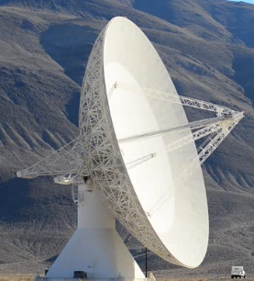
Radar dish inside is 25 feet wide and spins constantly
The 30 ft. wide white ball houses the radar dish

Slide 10
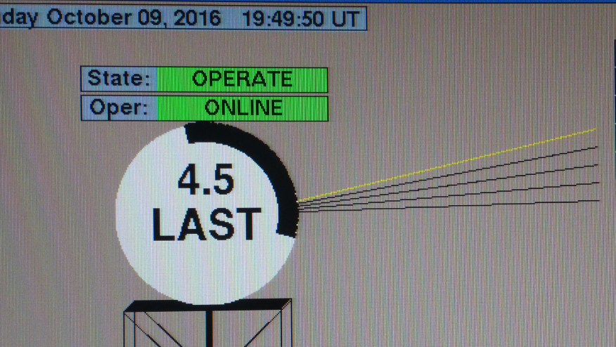
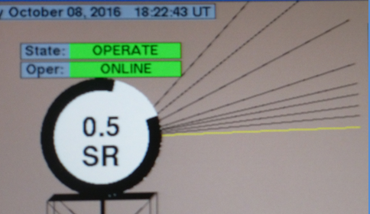
Radar can be operated in different modes
Clear air mode – no precipitation detected
Radar dish turns slower
It does five sweeps of the atmosphere,
from 0.5 degrees to 4.5 degrees
This allows the radar to scan farther and “see” more detail
Precipitation mode
Radar dish turns faster
It does more sweeps of the atmosphere,
from 0.5 up to 19.5 degrees
There are multiple precipitation modes
depending upon the type of weather

Slide 11
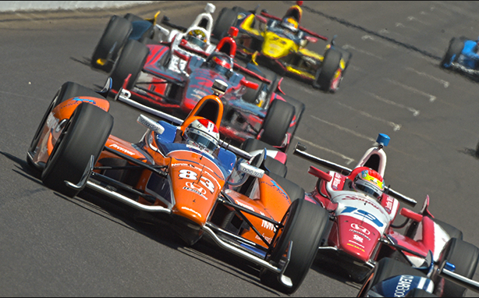
You hear the Doppler Effect
if you watch a race car go
past a microphone. The
sound wavelengths get shorter/
frequency higher as the car
approaches. The wavelengths get
longer/frequency lower as the car
goes past making the “whoosh”
sound.
The same phenomenon occurs
if you are near a train track as
the train passes.

Slide 12
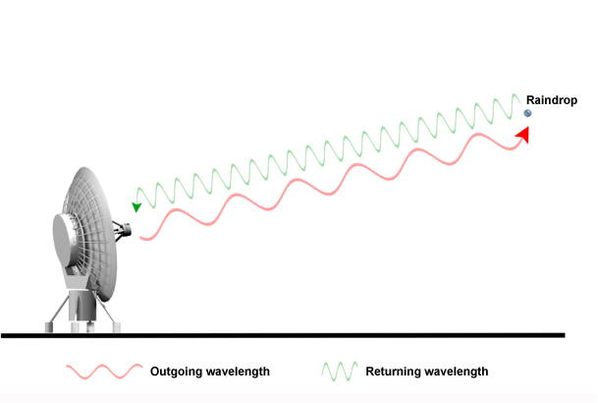
Incoming
1 Wavelength
1 Wavelength
Outgoing
Radar sends out energy at a known wavelength. It hits a raindrop and a portion
of the energy returns to the radar dish. If the drop is moving towards the radar
the returned wavelength will be shorter than the outgoing wavelength. The radar
will interpret the drop/wind as moving towards the radar. If the return wavelength is
longer, the wind is moving away.

Slide 13
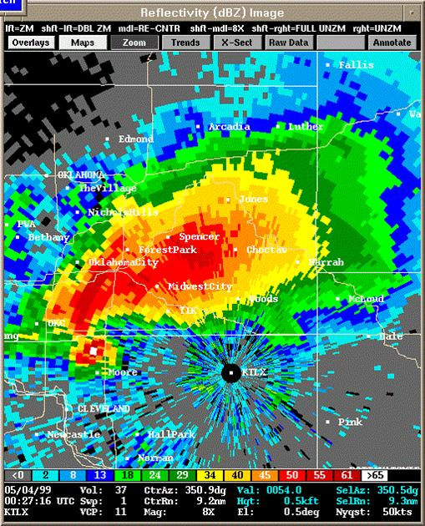
Doppler radar image
Reflectivity mode
Oklahoma City radar
May 4, 1999
Moore, OK tornado
Hook echo to west
of the radar

Slide 14
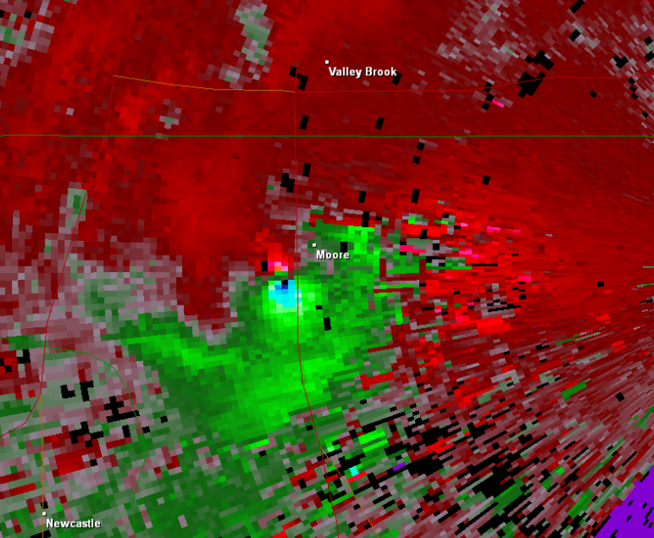
Radar
location
Red – air flows away from radar
The Doppler effect
is the change in
frequency of something
moving towards or
away from you. On
radar green is air
moving towards
the radar, red away.
The brighter the
color, the faster
the wind.
Strongest winds,
tight rotation =
tornado
Green – air flowing towards the radar
Doppler image of the May 20, 2013 Moore, OK tornado

Slide 15
Doppler radar image
Velocity mode
Oklahoma City radar
May 4, 1999
Moore, OK tornado,
Same time as the reflectivity
image
Hook echo to west
of radar (“red/green
couplet”)
Radar location

Slide 16
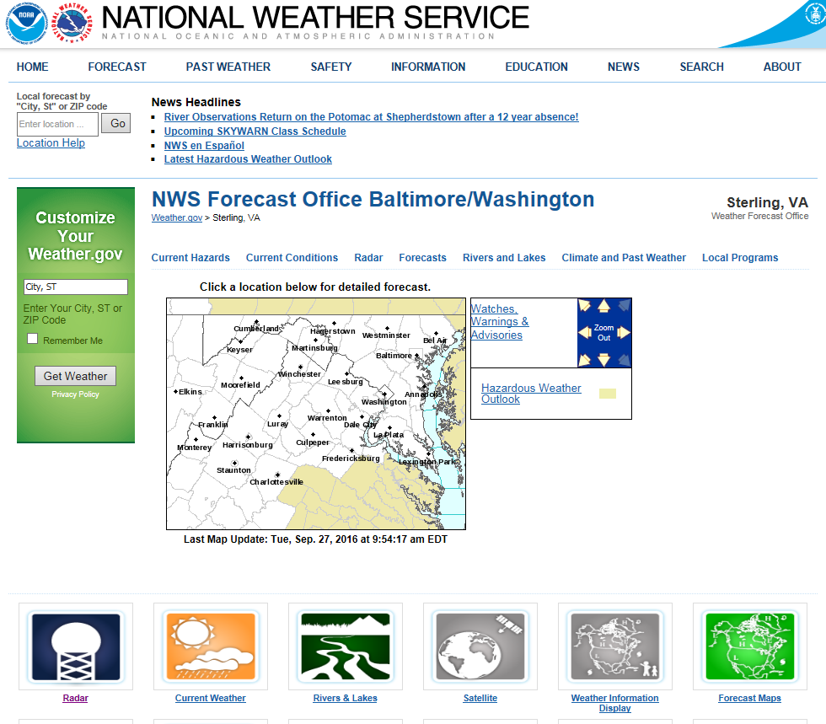
Anyone with an internet connection can access our radar on the weather.gov/lwx web page

Slide 17
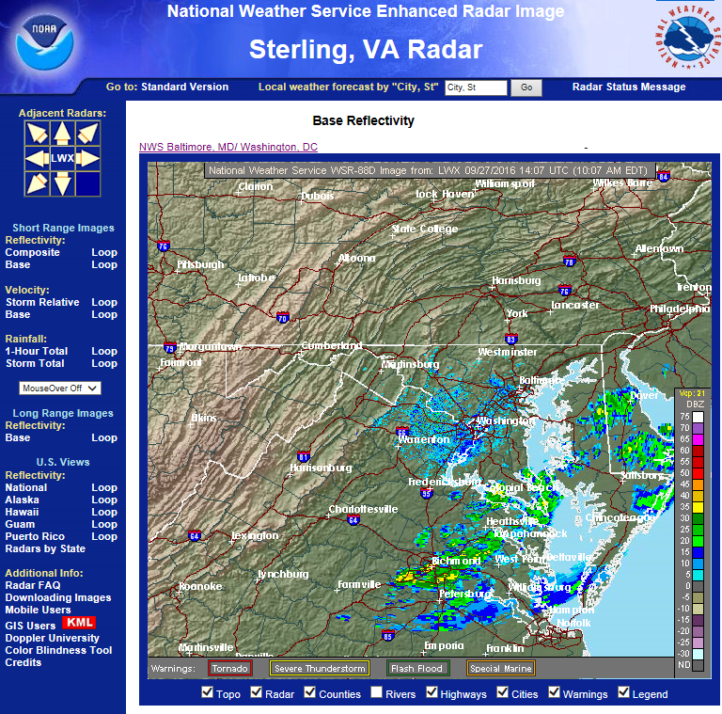
Reflectivity mode
Showers across
Lower Southern
Maryland
Reflectivity key
goes up – the farther
into the red the
stronger the storm
will be

Slide 18
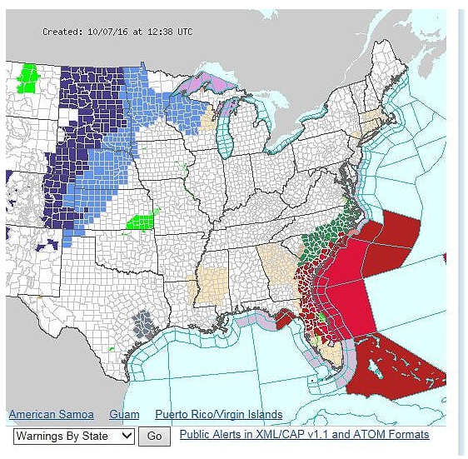
weather.gov – National Weather Service main page
Two ways to get
to other offices’
radar displays
Frost and freeze
Warnings/advisories
Flash flood
warnings
Hurricane
warnings
At the bottom of the
radar section of our
web page

Slide 19
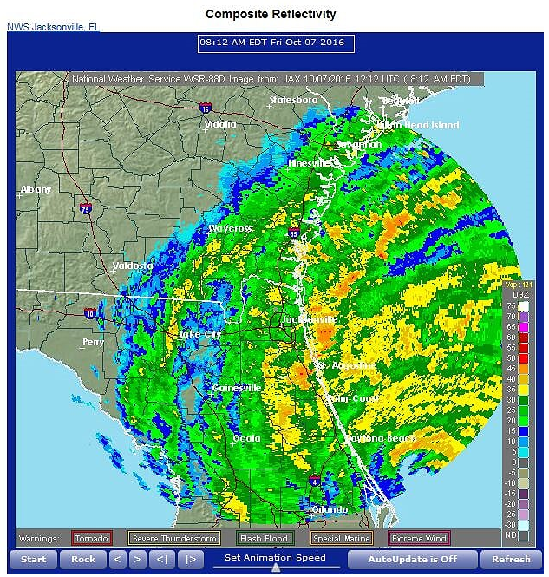
NWS Jacksonville
radar. The eye of
Hurricane Matthew
is located east of
Daytona beach.
Eye

Slide 20
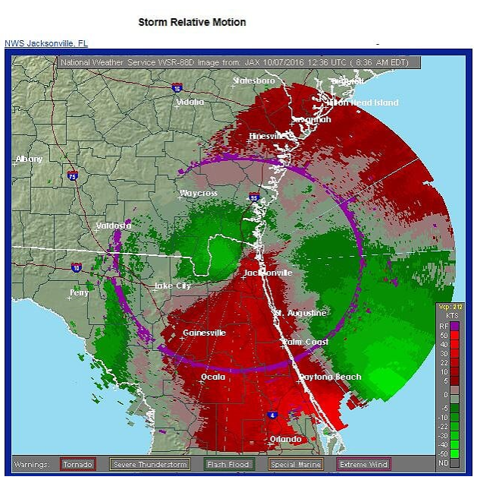
Using Doppler
mode to show
the wind speed
in Hurricane
Matthew.
Green means
air is moving
toward radar.
red away
Color key
showing
wind speed
1 knot = 1.2 mph

Slide 21
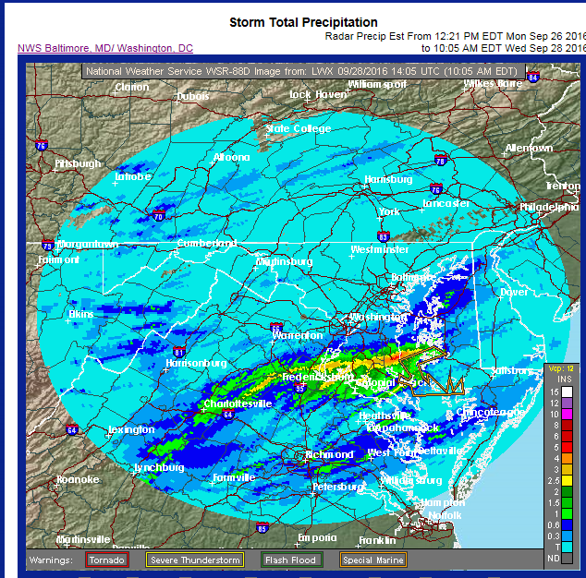
Radar uses the
reflectivity to
estimate how
much
precipitation
has fallen
Flooding this
day in Prince
Frederick, MD
Color key
for inches
of rain

Slide 22
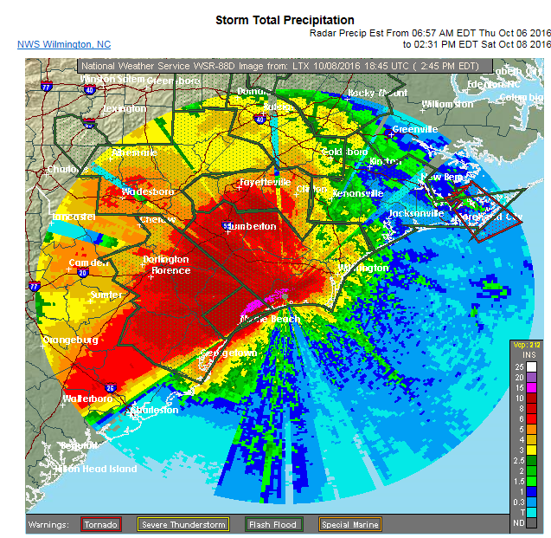
Rainfall
estimation
in southeast
NC during
Matthew
Tornado
warning
15”
estimation
Many flash
flood
warnings

Slide 23
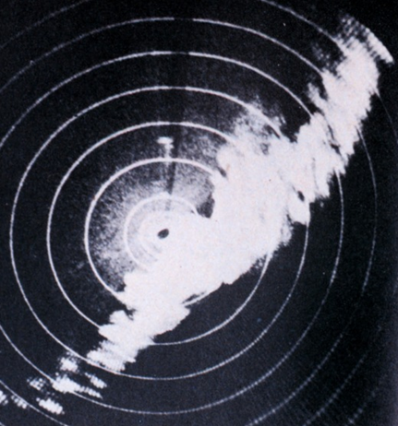
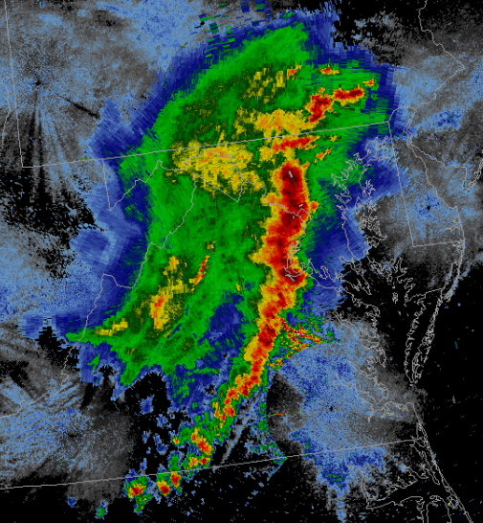
Compare the radar of the past to today’s….
This 1944 thunderstorm image looked
quite similar to what offices were using
almost fifty years later in 1992…
…And this regional composite image
captured during the June 29, 2012 derecho

Slide 24
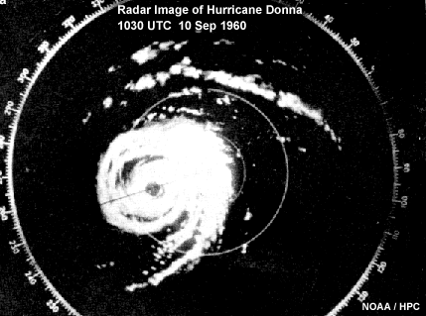
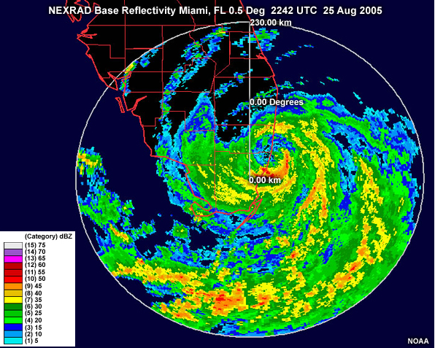
Compare the radar of the past to today’s…
Katrina crossing Florida

Slide 25
If you have questions, would like a copy of this narration, or have ideas for other weather topics you’d like us to explain…
Please send an email from your educator email account to
andrew.woodcock@noaa.gov

