Slide 1
Instructions
Replace the “Your RFC” text in Slide Master (go to: View > Slide Master)
Replace highlighted (yellow) text in slides
Complete (optional) slides where indicated
Add/remove/edit slides as required. Several optional/alternative slides are included at the end
Review the speaker notes below each slide
Delete this slide
Questions to: james.brown@hydrosolved.com

Slide 2
XXRFC briefing, Month, Year
The Hydrologic Ensemble Forecast Service (HEFS): a new era of water forecasting at XXRFC
Name, Position, XXRFC
e-mail address
Notes:
2
The Hydrologic Ensemble Forecast Service (HEFS) quantifies the uncertainties associated with hydrologic forecasts for hours to years into the future
The HEFS is being implemented at all NWS RFCs and coverage with expand gradually over the coming period
There will be ample opportunity for feedback from partners and users as the implementation progresses
The purpose of this briefing is to provide an overview of the HEFS and an opportunity for initial feedback and discussion

Slide 3
Contents
Ensemble streamflow forecasts that:
span lead times from one hour to more than one year
are unbiased (unconditionally and conditionally)
are consistent across time and space
leverage information in NWS weather/climate models
have dependable characteristics
are verifiable
aid user’s decisions
What are ensemble forecasts; why use them?
What is the HEFS?
  Goals
  Structure, inputs and outputs
Status of implementation and applications
  National status, applications, and products
  Status and applications at XXRFC
Forecast quality (validation results)
Summary and conclusions
Notes:
3

Slide 4
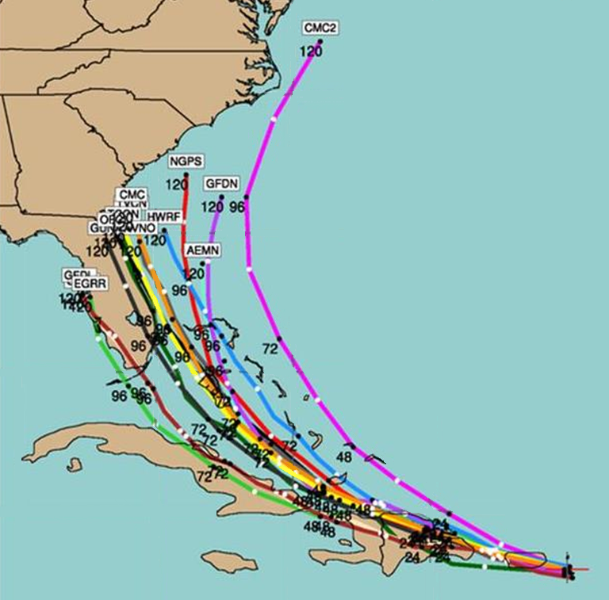
What are ensemble forecasts?
A collection of forecasts to capture uncertainty
Single-valued forecasts are known to be imperfect (data and models contain errors)
For example, multiple weather models predict multiple hurricane tracks →
Ensemble forecasts capture these uncertainties by producing an “ensemble” of weather (or water) forecasts
Each ensemble member represents one possible outcome (e.g. one track)
Hurricane Irene track forecasts, 08/22/11
35°N
30°N
25°N
20°N
Notes:
4
Single-valued forecasts are known to be imperfect. The are based on models that include imperfect descriptions of physical processes. The parameters of those models are estimated with limited data and the data are collected with techniques that involve measurement and other errors
These imperfections are reflected in differences between forecasts of weather and water events and corresponding observations of these events. The differences generally increase with forecast lead time and are typically much larger for extreme events
In contrast to single-valued forecasts, ensemble forecasts provide a collection of possibilities. Each ensemble member represents one possible outcome and, collectively, all of the ensemble members aim to capture the range of possible outcomes
Ensemble forecasting is a highly practical approach to quantifying uncertainty. It can be applied to a single-valued forecasting system without requiring wholesale changes to that system. Rather, it involves producing a collection of single-valued forecasts, each one using slightly different inputs (to reflect the input uncertainties)
For example, the initial conditions and weather forcing may be slightly different for each ensemble member

Slide 5
Why use hydrologic ensemble forecasts?
National Research Council, 2006
“All prediction is inherently uncertain and effective communication of uncertainty information in weather, seasonal climate, and hydrological forecasts benefits users’ decisions. These uncertainties generally increase with forecast lead time and vary with weather situation and location. Uncertainty is thus a fundamental characteristic of weather, seasonal climate, and hydrological prediction, and no forecast is complete without a description of its uncertainty.” [emphasis added]
COMPLETING THE FORECAST
Characterizing and communicating Uncertainty for Better Decisions Using Weather and Climate Forecasts
Committee on Estimating and Communicating Uncertainty in Weather and Climate Forecasts
Board on Atmospheric Sciences and Climate
Division on Earth and Life Studies
NATIONAL RESEARCH COUNCIL OF THE NATIONAL ACADEMIES
THE NATIONAL ACADEMIES PRESS
Washington, D.C.
www.nap.edu
Notes:
5
The need to include explicit estimates of uncertainty in weather and hydrologic forecasting is now widely accepted
This is reflected in calls by the National Research Council (NRC) and others to expand and strengthen the use of ensemble forecasting in all areas of operational weather, climate and hydrologic prediction
As indicated by the NRC in their 2006 publication, “Completing the Forecast”, uncertainty is a fundamental characteristic of weather, climate and hydrologic forecasting and these uncertainties must be properly quantified and communicated to end-users
Within the NWS, the need to quantify and communicate uncertainty has been consistently identified as an important service objective in stakeholder engagement activities over recent years

Slide 6
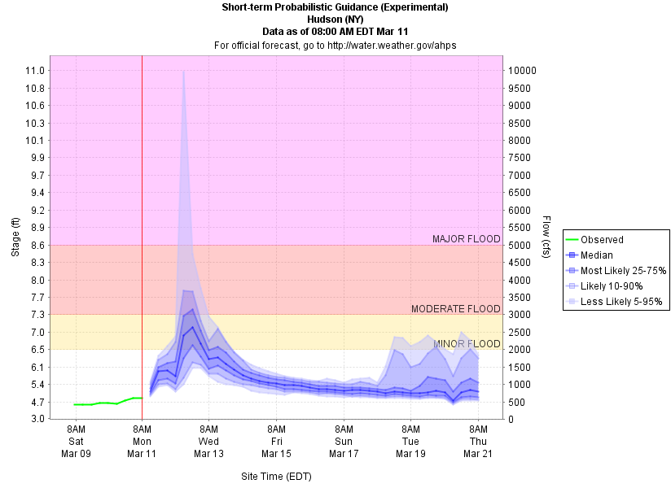
Why use hydrologic ensemble forecasts?
Goal: better-informed water decisions
11.0
9.0
7.0
5.0
3.0
Observed
Hudson, NY
8am EDT, Mar 11
HEFS median
Risk of flooding
HEFS (25-75%)
HEFS (10-90%)
The current (issue) time is 12Z on 11 March
HEFS (5-95%)
At peak stage, HEFS says ~75% chance of Minor Flood or above, and ~25% chance of no flooding
River stage (ft)
MAJOR FLOOD
At peak stage, HEFS says ~50% chance of Minor Flood (25-75% of HEFS spread in Minor Flood band)
MODERATE FLOOD
MINOR FLOOD
Mar 09 Mar 11 Mar 13 Mar 15 Mar 17 Mar 19
Date
Notes:
6
Ultimately, the goal of ensemble forecasting is to support better decisions about water resources by end users
A single-valued forecast does not explicitly provide information about the range of possible outcomes and their probabilities
Thus, the interpretation of a single-valued forecast involves a large degree of subjectivity
In contrast, an ensemble forecast provides an explicit assessment of the probability that a particular river stage might occur

Slide 7
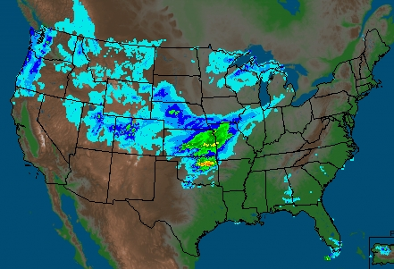
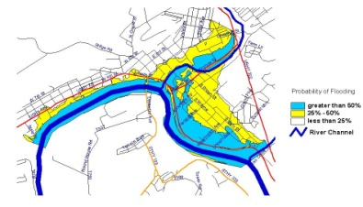
Why use hydrologic ensemble forecasts?
Goal: capture skill in weather ensembles
Ensembles are standard in weather forecasting
Include single models and “multi-model” ensembles
Essential that water forecasts capture this information
But, should not use them directly: wrong scale, biases
Major flood
River stage (ft)
Date
Notes:
7
As indicated earlier, ensemble forecasting is becoming standard practice in meteorology and there are many operational weather and climate models that use ensemble techniques
Examples include the North American Ensemble Forecast System (NAEFS), the Global Ensemble Forecast System (GEFS) and the Short-Range Ensemble Forecast System (SREF)
In order to leverage these ensemble forecasts and to translate their skill into hydrologic forecasting, there is a need for hydrologic modeling tools that can process ensemble weather and climate forecasts
However, weather and climate models produce outputs at different scales than hydrologic models and frequently contain large biases in precipitation and temperature
Thus, it is generally not possible (or at least advisable) to use the outputs from weather and climate models directly in hydrologic models. Rather, it is necessary to bias-correct and downscale these outputs for use in hydrologic modeling, for which tools are provided in the HEFS

Slide 8
Why use hydrologic ensemble forecasts?
Goal: improve NWS hydrologic services
Feature | ESP (old service) | HEFS (new service)
Forecast time horizon | Weeks to seasons | Hours to years, depending on the input forecasts
Input forecasts (“forcing”) | Historical climate data (i.e. weather observations) with some variations between RFCs | Short-, medium- and long-range weather forecasts
Uncertainty modeling | Climate-based. No accounting for hydrologic uncertainty or bias. Suitable for long-range forecasting only | Captures total uncertainty and corrects for biases in forcing and flow at all forecast lead times
Products | Limited number of graphical products (focused on long-range) and verification | A wide array of data and user-tailored products are planned, including standard verification
Notes:
8
In order to capture the skill in ensemble weather and climate forecasts as the basis for more informed water decisions, the NWS has developed the Hydrologic Ensemble Forecast Service (HEFS)
The NWS has traditionally used Ensemble Streamflow Prediction (ESP) to produce ensemble forecasts of streamflow for the long-range. However, this system has several limitations and needs to be replaced
In particular, ESP uses climatological forcing, which is only appropriate for seasonal or long-range prediction. It is not suitable for short-to-medium range forecasting (i.e. 1-2 weeks), as weather forecasts improve substantially over climatology (historical observations) at these timescales
The HEFS accommodates weather and climate forecasts from a variety of sources, including the RFC quantitative precipitation forecasts and quantitative temperature forecasts, as well as ensemble weather forecasts from the GEFS and the CFSv2
In addition to using weather and climate forecasts, the HEFS captures the total uncertainty in the hydrologic predictions and corrects for biases in the forecast probabilities. In contrast, ESP does not account for the uncertainties associated with hydrologic modeling or correct for biases in the hydrologic forecasts. As such, the forecast probabilities from the HEFS should be more accurate and more skillful than ESP
The HEFS will also provide a more comprehensive suite of forecast products for end users, including products for the short- medium- and long-range and verification products that will allow users to objectively assess the strengths and weaknesses of the HEFS forecasts for their applications

Slide 9
What is the HEFS?
Goal: quantify total uncertainty in flow
HEFS aims to “capture” observed flow consistently
So, must account for total uncertainty & remove bias
Total = forcing uncertainty + hydrologic uncertainty
Observed streamflow
Weather (forcing) uncertainty in flow
Hydrologic uncertainty
Streamflow
Total
Forecast horizon
Notes:
9
Ultimately, the aim of any hydrologic ensemble forecasting system is to quantify the total uncertainty in the hydrologic forecasts, and this is the aim of the HEFS
Unless the total uncertainty is quantified adequately, the forecast probabilities cannot be accurate; in other words the ensemble spread will not consistently “capture” the observed streamflow
The total uncertainty originates from two main sources: 1) the weather forecasting or “forcing” uncertainty (i.e. uncertainty about the future values of temperature, precipitation and any other forcing variables used by the hydrologic models); and 2) the hydrologic uncertainty
The hydrologic uncertainty comprises all of the uncertainties associated with hydrologic modeling, including the initial conditions, model parameters, model structure and any other operations, such as manual modifications to the hydrologic model states and modeling of river regulations
The HEFS aims to quantify the total uncertainty, in order to produce accurate forecast probabilities. As such, the HEFS includes separate components for modeling the weather forecasting uncertainties and the hydrologic modeling uncertainties

Slide 10
What is the HEFS?
= forcing unc.
= hydro. unc.
= users
Ensemble Post-Processor (EnsPost)
WPC/RFC
forecasts
(1-5 days)
Flow bias / uncertainty accounting
Correct flow bias
Add spread to account for hydro. model uncertainty
GEFS
forecasts
(1-15 days)
Meteorological Ensemble Forecast Processor (MEFP)
Hydrologic
models (CHPS)
Bias-corrected ensemble flow forecasts
Correct forcing bias
Merge in time
Downscale (basin)
CFSv2
forecasts
(16-270 days)
Climatology
(271+ days)
NWS and external user applications
(MEFP forcing also available to users)
Notes:
10
This slide shows the main components of the HEFS and how they account for the two sources of uncertainty identified above, namely the weather forecasting uncertainties and the hydrologic modeling uncertainties
The forcing uncertainties are represented by green boxes and the hydrologic uncertainties are represented by blue boxes
The Meteorological Ensemble Forecast Processor (MEFP) captures the forcing uncertainties and corrects for biases in the forcing inputs to the HEFS
Specifically, the MEFP ingests raw forcing information from multiple weather and climate models, as well as the RFC deterministic weather forecasts. The MEFP corrects for biases in the forcing inputs and downscales them for input to the NWS hydrologic models
These forcing inputs are then used by the Community Hydrologic Prediction System (CHPS) to produce “raw” streamflow forecasts, which account for the forcing uncertainties and biases, but do not account for the hydrologic uncertainties and biases
A separate tool captures the hydrologic modeling uncertainties and corrects for biases in the raw streamflow forecasts. This is known as the Ensemble Postprocessor (EnsPost)
The final outputs from the HEFS include bias-corrected and downscaled precipitation and temperature forecasts, together with bias-corrected ensemble streamflow forecasts

Slide 11
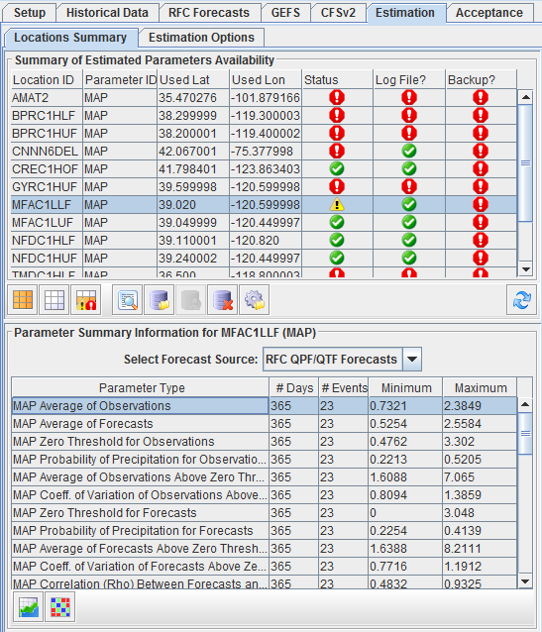
What is the HEFS?
MEFP (“forcing processor”)
Does three things to raw forcing
  Adds sufficient spread to account for forecast errors
  Corrects systematic biases
  Downscales to basin
The MEFP uses separate statistical models for temperature and precipitation
The MEFP parameters are estimated using historical data (forecast archive or hindcasts)
The outputs from the MEFP are FMAP and FMAT for a basin
MEFP Parameter Estimation Subpanel
Notes:
11
The MEFP quantifies the uncertainties in the “raw” weather forecasts from the weather and climate models and corrects for biases in these forcing inputs. The MEFP produces bias-corrected ensemble forecasts of MAT and MAP at the basin scale
As indicated above, the MEFP can ingest raw forcing from the RFC deterministic forecasts, as well as ensemble forecasts from NCEP’s weather and climate models. For ensemble inputs, the MEFP uses the ensemble mean forecast only
The MEFP learns from the historical errors in the input forecasts; that is, the differences between the forecasts and observations over a suitably long historical period
By modeling the forecast errors historically, the MEFP can adjust these forecasts operationally to correct for biases and to add spread in proportion to the historical errors in the raw forecasts
A separate error model is used for the precipitation and temperature forecasts, but they both involve a linear regression between the observed and forecast amounts
The regression parameters are estimated using a software tool known as the MEFP Parameter Estimator (MEFPPE), for which a screen capture is provided here

Slide 12
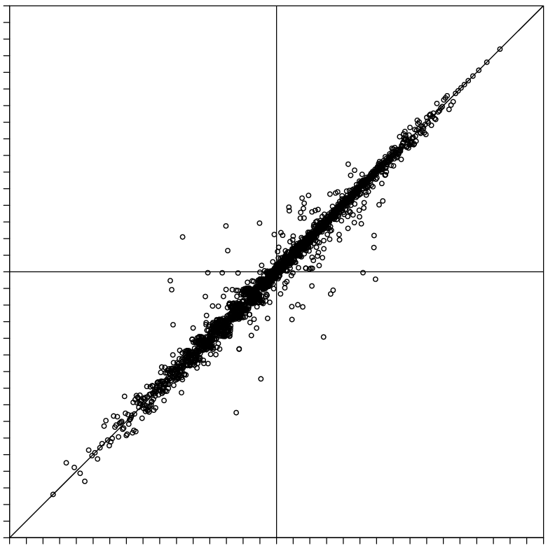
What is the HEFS?
EnsPost (“flow processor”)
Does two things to flow forecast
  Adds spread to account for hydrologic model errors
  Corrects systematic biases
Uses linear regression between observed flow and historical simulated flow (observed forcing)
Scatter around line of best fit represents the hydrologic error (i.e. no forcing uncertainty)
Prior observation (“persistence”) also included in regression (not shown here)
Observed flow (normalized units), Z_{obs}(t+1)
A hydrologic model error
Simulated flow (normalized units), Z_{mod}(t+1)
Notes:
12
The goal of the EnsPost is to quantify the uncertainties contributed by the hydrologic modeling (increasing the spread in the raw streamflow forecast) and to correct for any biases in the hydrologic models
By combining the forcing and hydrologic uncertainty, the HEFS produces a streamflow forecast that captures both sources of uncertainty
As indicated above, the EnsPost models the hydrologic uncertainty independently of any forcing uncertainty. This is achieved by computing the differences between historical simulated flows (hydrologic model predictions generated with observed forcing) and observed flows
The EnsPost uses a linear regression model (equation shown) to capture the relationship between the historical observations and simulations. The regression line can be thought of as an “adjusted simulation”
For each historical date, the difference between the regression line (the “adjusted simulation”) and the observed flow represents the hydrologic error
As with the MEFP, there is a separate tool to estimate the parameters of the regression model, which is known as the EnsPost Parameter Estimator (EnsPostPE)
In operational forecasting, each “raw” streamflow forecast from the HEFS is adjusted by the regression line (removing bias) and a sample of the hydrologic error is added to the adjusted flow to account for the hydrologic uncertainty
In practice, the EnsPost error model also uses the observed streamflow immediately prior to the forecast issue time. In this way, the EnsPost benefits from “hydrologic persistence”. However, for simplicity, the equation shown here does not include the prior observed flow

Slide 13
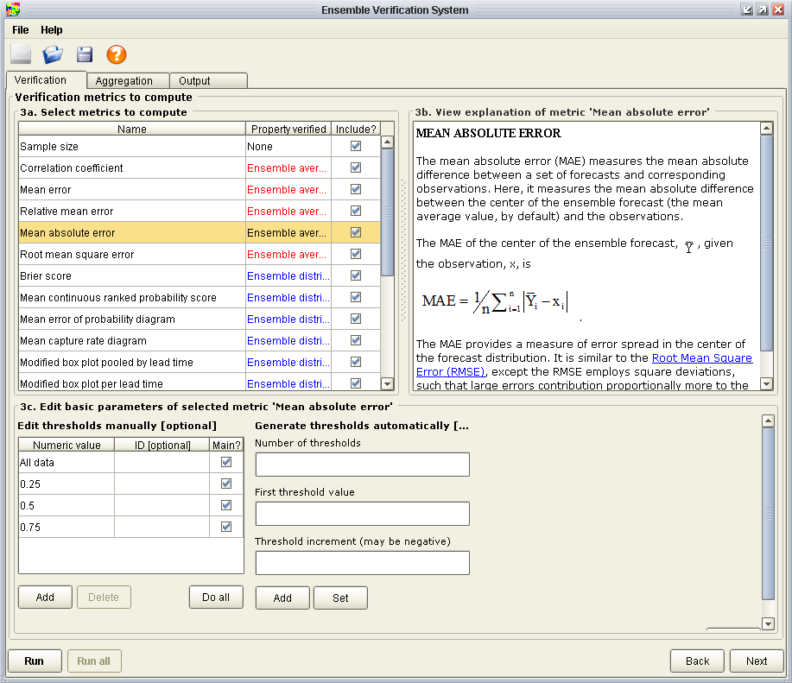
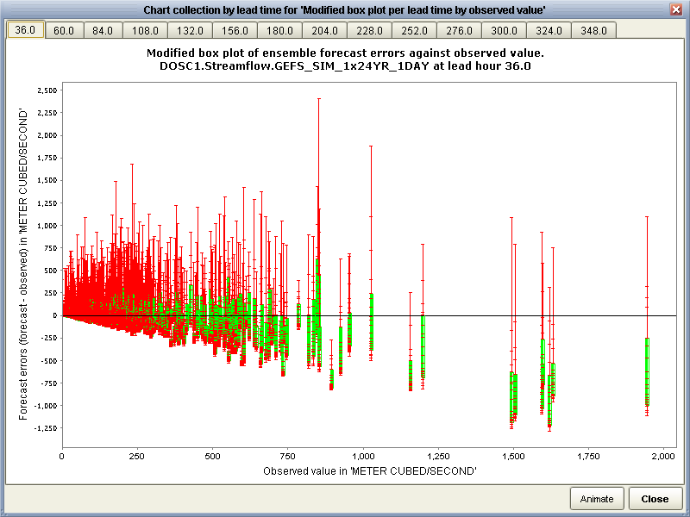
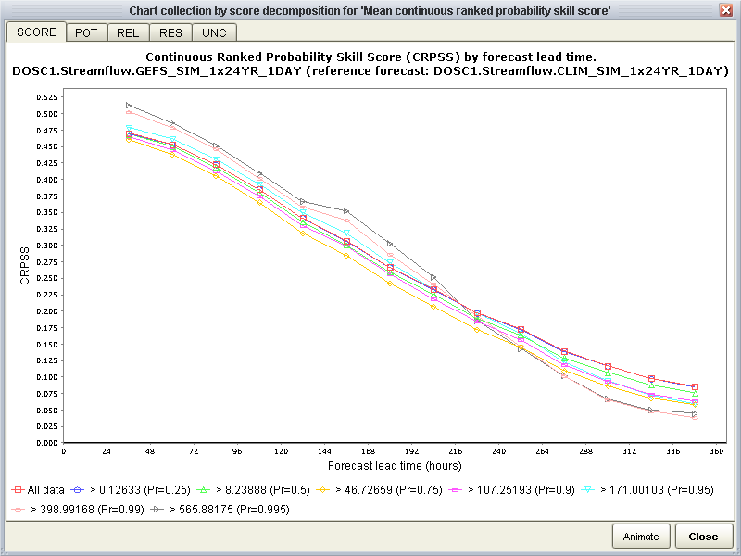
What is the HEFS?
Ensemble Verification Service
Supports verification of HEFS including for precipitation, temperature and streamflow
Verification of all forecasts or subsets based on prescribed conditions (e.g. seasons, thresholds, aggregations)
Provides a wide range of verification metrics, including measures of bias and skill
Requires a long archive of forecasts or hindcasts
GUI or command-line operation
Notes:
13
The Ensemble Verification Service (EVS) was designed to verify forecasts of continuous numerical variables, such as precipitation, temperature or streamflow, at discrete forecast locations, which include basin outlets or basin averages
The EVS includes a variety of options for verifying subsets of data, such as choosing particular times of the year or verifying with respect to particular thresholds. It’s also possible to condition on the values of multiple variables, such as verifying precipitation forecasts when temperatures are below freezing
The EVS comprises most of the well-known verification metrics and a few new metrics that are designed for operational forecasting
These metrics can be produced in a graphical or numerical format and the numerical outputs can be read into other tools to produce custom displays
In terms of operating the EVS, there’s a Graphical User Interface (GUI), as well as command line options, which are useful for batch-producing the configuration necessary to verify forecasts across a large number of locations

Slide 14
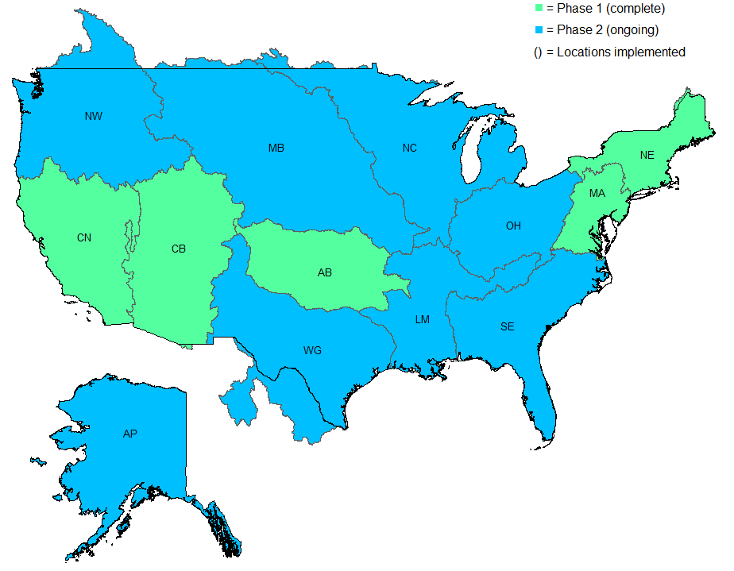
HEFS national implementation status
(11)
(20)
(22)
(196)
(168)
(224)
(10)
(332)
(239)
(2)
(8)
(7)
(57)
NWS river forecast locations: 3,514
HEFS locations: 1,296 (at 04/01/15), and counting
Notes:
14
The HEFS has been implemented in two phases. The first phase involved five RFCs (MA, AB, CN, CB and NE), and was completed in 2014. The second phase is ongoing and involves the remaining eight RFCs
Of the 3,514 river forecast locations in AHPS, the HEFS is running at roughly 1,300 or 1/3rd of these locations, and new locations are being added each month
NOTE: the numbers in this slide can be edited directly as the counts are updated (they are text boxes, not part of the image)

Slide 15
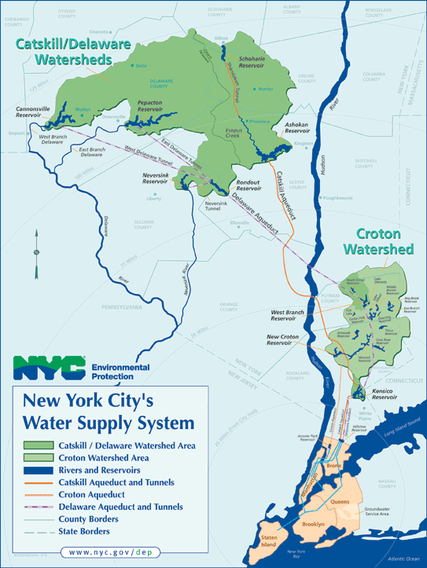
Example of early application of HEFS
Managing NYC water supply
Croton; Catskill; and Delaware
Includes 19 reservoirs, 3 lakes; 2000 square miles
Serves 9 million people (50% of NY State population)
Delivers 1.1 billion gallons/day
Operational Support Tool (OST) to optimize infrastructure, and avoid unnecessary ($10B+) water filtration costs
HEFS forecasts are central to OST. The OST program has cost NYC under $10M
Notes:
15
The New York City Department of Environmental Protection (NYCDEP) are concerned with managing water supply to NYC, both in terms of quantity and quality
They want to place their decisions within a risk-management framework that properly accounts for the uncertainties associated with different sources of information, allowing them to be weighted appropriately when reaching decisions
To do this, they have developed an Operational Support Tool (OST)
The OST comprises a series of hydrologic and decision-support models, with associated inputs, that allow the NYCDEP to forecast various water quantity and quality variables and to make decisions on the basis of risk to water volume or water quality objectives
For example, one of the critical applications for NYCDEP is the level of turbidity in the NYC water supply reservoirs. When the turbidity reaches a certain threshold, filtration is required, for which an engineering capacity is needed
The HEFS streamflow forecasts are used as input to the OST, in order to provide forecasts of future reservoir conditions and support risk-based decision making. The NYCDEP provided $1m to the NWS to accelerate the implementation of the HEFS
The use of the OST is an important condition for NYC avoiding $10B+ in new infrastructure costs for water filtration

Slide 16
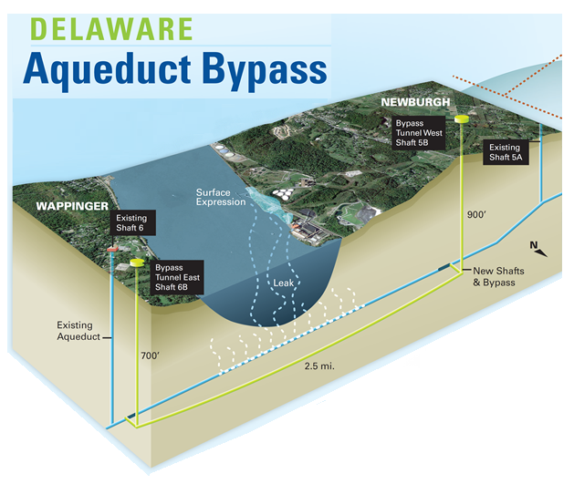
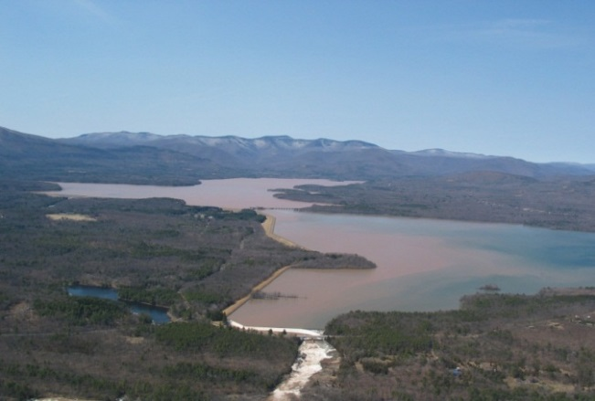

Example of early application of HEFS
“Mission critical decision to manage shutdown of RBWT Tunnel based on HEFS forecasts”
Ashokan Reservoir
HEFS streamflow forecasts are used to optimize and validate the NYC OST for million/billion dollar applications
“HEFS forecasts critical to protecting NYC drinking water quality during high turbidity events”
Observed
Modeled
Risk to water availability from Delaware Basin reservoirs
Flow (mgd)
“HEFS forecasts help optimize rule curves for seasonal storage objectives in NYC reservoirs”
High
(Cannonsville Reservoir Spillway)
“HEFS forecasts used to determine risks to conservation releases”
Notes:
16
Within the OST, there are four areas of applications of the HEFS, namely: 1) water quality; 2) flood mitigation through reservoir regulation; 3) construction; and 4) habitat preservation
Examples from each category are provided here
In terms of construction, the HEFS is being used to support a $2.1 billion upgrade of the Delaware Aqueduct, which is a vital component of the NYC drinking water supply system. The Rondout-West Branch Tunnel (RWBT) is leaking between 15 and 35 million gallons of water each day. The HEFS is being used to help time the shutdown of the tunnel for repair work
In terms of water quality, the HEFS is being used to mitigate against high turbidity in the NYCDEP water supply reservoirs, such as the Ashoken. By using the OST to forecast high turbidity events, the need to add expensive (multi-billion dollar) filtration capacity for extreme conditions is reduced
In terms of habitat preservation, the HEFS is being used within the OST to manage conservation releases from the Delaware Basin Reservoirs. Here, there is a need to retain drinking water capacity in the reservoirs while providing essential water for downstream ecosystems during the dry summer months
The HEFS forecasts are also being used to help meet seasonal storage objectives in the NYC reservoirs and to avoid the risk of overtopping of the reservoirs during flood conditions

Slide 17
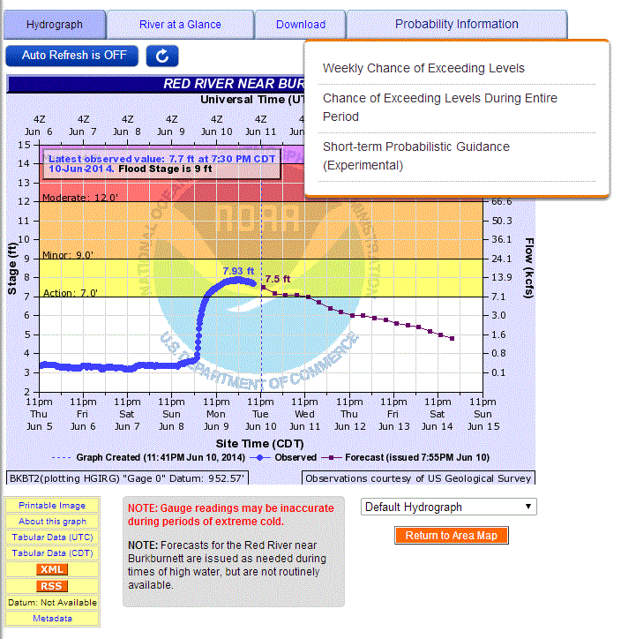
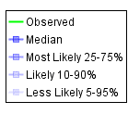
Example of national HEFS product
AHPS short-range probabilistic product
See: http://water.weather.gov/ahps/
Notes:
17
Designing forecast products to display uncertainty information both accurately and succinctly is a complex requirement and one that must be approached iteratively
As such, the products and services associated with the HEFS will be implemented gradually and improved over time
As part of the implementation of the HEFS, the AHPS webpages are being updated to display new probabilistic products
In particular, a new short-range probabilistic product has been developed to show the forecast uncertainty (spread) over a 14-day forecast horizon
The new product, as illustrated here, conveys the range of possible river stages and corresponding flows at a particular forecast location using different categories of forecast probability, ranging from most likely to less likely
The short-range probabilistic product is currently available on the AHPS webpage for selected forecast locations, but remains an experimental product
In terms of moving from an experimental product to a fully operational product, there is an orderly process for documenting changes and gathering external feedback, which is ongoing

Slide 18
HEFS implementation status at XXRFC
[Intentionally blank: optional slide to insert map or text summarizing implementation status at your RFC]
Notes:
18

Slide 19
Example application(s) at XXRFC
[Intentionally blank: optional slide to provide example(s) of, or plans for, application(s) at your RFC]
Notes:
19

Slide 20
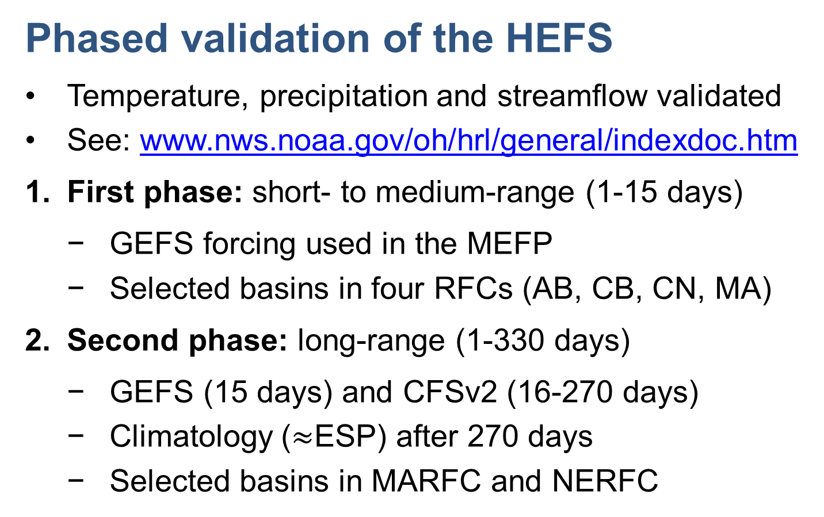
Forecast quality: validation results
Phased validation of the HEFS
Temperature, precipitation and streamflow validated
See: www.nws.noaa.gov/oh/hrl/general/indexdoc.htm
First phase: short- to medium-range (1-15 days)
  GEFS forcing used in the MEFP
  Selected basins in four RFCs (AB, CB, CN, MA)
Second phase: long-range (1-330 days)
  GEFS (15 days) and CFSv2 (16-270 days)
  Climatology ($≈$ESP) after 270 days
  Selected basins in MARFC and NERFC
Notes:
20
As part of the initial implementation of the HEFS, the forcing and streamflow forecasts were evaluated at selected river forecast locations
The aims of the evaluation were to: establish the expected performance and limitations of the HEFS; demonstrate that the outputs from the HEFS were reasonably unbiased and skillful; identify the key factors responsible for forecast error and skill in different situations; and establish a baseline for future enhancements to the HEFS
The validation was conducted in two phases. In both cases, the precipitation and temperature forecasts from the MEFP were validated, alongside the raw and bias-corrected streamflow forecasts.
The first phase considered the medium-range forecasts with forcing inputs from the GEFS. The second phase considered the long-range forecasts with forcing inputs from the GEFS and CFSv2, as well as climatology after 9 months
The validation reports are available online at the link provided, and only a brief overview will be provided here

Slide 21
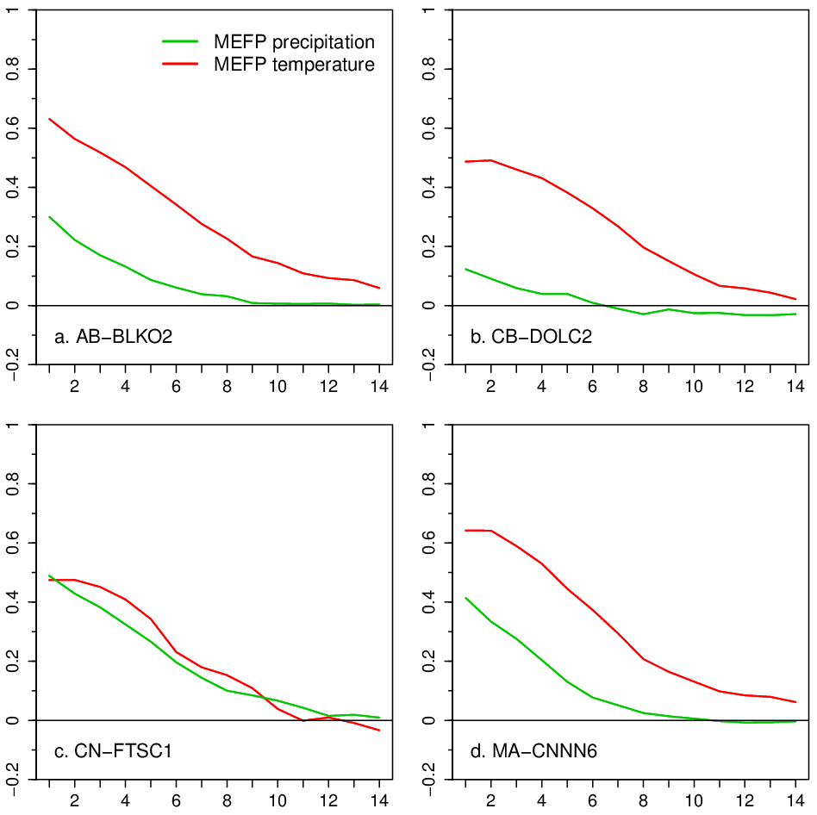
Forecast quality: validation results
MEFP forcing
Skill of the MEFP with GEFS forcing inputs
Positive values mean fractional gain vs. climatology (e.g. 50% better on day 1 at FTSC1)
MEFP temperature generally skillful, even after 14 days
MEFP precipitation skillful during first week, but skill varies between basins
Skill (fractional gain over climatology)
“50% better than
climatology”
Forecast lead time (days)
Notes:
21
This slide shows the skill of the MEFP precipitation and temperature forecasts at four basins, one in each of AB-, CB-, CN- and MA-RFCs
There is one plot for each basin; the x-axis shows the forecast time horizon and the y-axis shows the forecast skill
Here, skill is measured against a climatological forecast (akin to ESP forcing) and positive values denote a fractional improvement over climatology. For example, 0.5 denotes a 50% improvement. The measure of skill is the Continuous Ranked Probability Skill Score (CRPSS)
The MEFP temperature forecasts are substantially more skillful than climatology, particularly at early forecast lead times
While the MEFP precipitation forecasts are also skillful at early forecast lead times, the skill is more variable between basins and is much smaller during the second week
This is understandable, because precipitation is more difficult to predict in general, and for some basins in particular, such as CB-DOLC2 (Dolores, CO)
Dolores is located in the San Juan mountains of south-west Colorado. Here, the mountainous terrain and mixed precipitation regime leads to lower predictability in the raw GEFS forecasts and hence in the MEFP outputs
To a large extent, the quality of the MEFP outputs depends on the quality of the raw inputs, with greater skill where the GEFS inputs are better

Slide 22
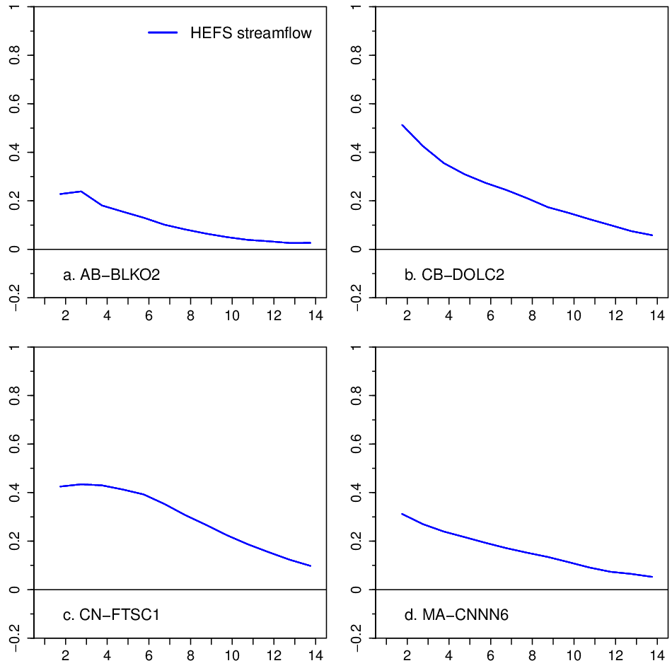
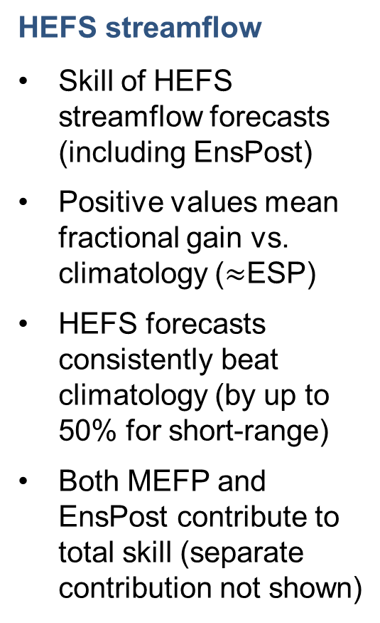
Forecast quality: validation results
HEFS streamflow
Skill of HEFS streamflow forecasts (including EnsPost)
Positive values mean fractional gain vs. climatology ($≈$ESP)
HEFS forecasts consistently beat climatology (by up to 50% for short-range)
Both MEFP and EnsPost contribute to total skill (separate contribution not shown)
Skill (fractional gain over climatology)
Forecast lead time (days)
Notes:
22
This slide shows the quality of the HEFS streamflow forecasts using the forcing information from the previous slide and after applying the EnsPost to account for the hydrologic uncertainties and biases
Again, the forecast skill is shown for one basin in each RFC and the baseline forecast comprises climatological forcing, akin to ESP. Thus, for example, 0.5 denotes a 50% improvement over ESP. Again, the measure of skill is the Continuous Ranked Probability Skill Score (CRPSS)
As indicated here, the HEFS streamflow forecasts consistently improve upon climatology, particularly at early forecast lead times, but the degree and duration of that improvement varies between basins
The greatest improvement occurs in CN-FTSC1 (Fort Seward, CA), where the GEFS benefits from the predictability of heavy precipitation in the northern CA mountains during the winter months
The skill is also high in CB-DOLC2 (Dolores, CO), but for different reasons. Here, the MEFP forcing is much less skillful (see the previous slide), but the EnsPost benefits from hydrologic persistence, particularly during the snowmelt period, and therefore adds considerable skill to the streamflow forecasts
The skill is generally lower at AB-BLKO2 (Blackwell, OK) in ABRFC. Here, the precipitation forecasts are also less skillful, particularly during the summer months when convection leads to a strong temporal and spatial variability in precipitation over the Great Plains, which reduces predictability

Slide 23
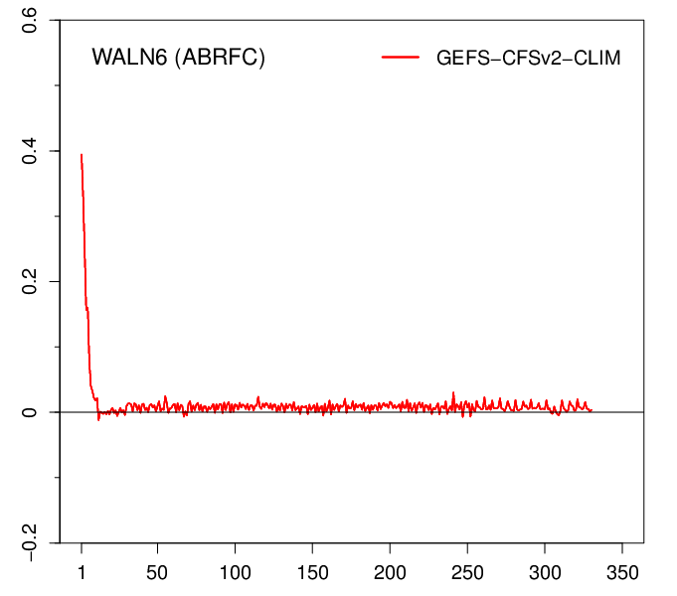
Forecast quality: validation results
Long-range forecasts
Example of MEFP precipitation forecasts from Walton, NY
Beyond one week of GEFS, there is little skill vs. climatology
In other words, the CFSv2 adds little skill for the long-range (but forcing skill may last >2 weeks in flow)
If climate models improve in future, HEFS can be updated
WALN6 (MARFC)
Walton, NY
MEFP precipitation forecast
Skill (fractional gain over climatology)
No skill after ~one week
GEFS
CFSv2
CLIM
Forecast lead time (days)
Notes:
23
This slide shows an example of the quality of the MEFP precipitation forecasts for the long-range. The results are shown for Walton, which lies on the West Branch of the Delaware River in NY State. The results are indicative of those observed at other locations
The plot shows the forecast skill for the MEFP with combined inputs from the GEFS, CFSv2 and climatology as a function of forecast lead time on the x-axis. The measure of skill is the Continuous Ranked Probability Skill Score (CRPSS)
As indicated, there is substantial skill in the precipitation forecasts during the first week because the GEFS forecasts are skillful over this timeframe. However, the skill declines rapidly towards the end of the first week where the MEFP forecasts are essentially no better than climatology
This is to be expected, as the raw CFSv2 is known to have limited skill for long-range forecasting
However, it is worth noting that the skill in the MEFP temperature forecasts typically lasts for longer than precipitation
Furthermore, any skill in the precipitation and temperature forecasts during the first two weeks could last much longer in the streamflow, particularly in slow-responding basins where the hydrologic states can persist for weeks or even months (e.g. snow states).
Thus, in slow responding basins, the HEFS streamflow forecasts may improve on ESP, even for the long-range, and should certainly do no worse. For the short- to medium-range, the HEFS forecasts will consistently improve upon ESP

Slide 24
Forecast quality: validation at XXRFC
[Intentionally blank: optional slide to provide example(s) of, or plans for, validation at your RFC]
Notes:
24

Slide 25
Summary and conclusions
Ensemble forecasts are the future
Forecasts incomplete unless uncertainty captured
Ensemble forecasts are becoming standard practice
HEFS implementation, products, and validation is ongoing and expanding
Initial validation results are promising
HEFS will evolve and improve
Science and software will improve through feedback
Guidance will improve through experience
We are looking forward to supporting end users!
Notes:
25
In terms of limitations, the EnsPost lumps together all sources of hydrologic uncertainty, including those from the initial conditions, model parameters, and hydrologic model equations
Separating out these different sources of hydrologic uncertainty and using all available observed data to minimize them (e.g. soil moisture, streamflow and others sources) should improve the streamflow forecast quality in future (using a technique known as “data assimilation”)

Slide 26
Additional resources
Demargne, J., Wu, L., Regonda, S.K., Brown, J.D., Lee, H., He, M., Seo, D.-J., Hartman, R., Herr, H.D., Fresch, M., Schaake, J. and Zhu, Y. (2014) The Science of NOAA's Operational Hydrologic Ensemble Forecast Service. Bulletin of the American Meteorological Society, 95, 79–98.
Brown, J.D. (2014) Verification of temperature, precipitation and streamflow forecasts from the Hydrologic Ensemble Forecast Service (HEFS) of the U.S. National Weather Service: an evaluation of the medium-range forecasts with forcing inputs from NCEP's Global Ensemble Forecast System (GEFS) and a comparison to the frozen version of NCEP's Global Forecast System (GFS). Technical Report prepared by Hydrologic Solutions Limited for the U.S. National Weather Service, Office of Hydrologic Development, 139pp.
Brown, J.D. (2013) Verification of long-range temperature, precipitation and streamflow forecasts from the Hydrologic Ensemble Forecast Service (HEFS) of the U.S. National Weather Service. Technical Report prepared by Hydrologic Solutions Limited for the U.S. National Weather Service, Office of Hydrologic Development, 128pp.
HEFS documentation: http://www.nws.noaa.gov/oh/hrl/general/indexdoc.htm
Notes:
26

Slide 27
Optional slides
Notes:
27

Slide 28
What are ensemble forecasts?
A collection of forecasts to capture uncertainty
Single-valued forecasts are known to be imperfect
An ensemble provides a collection of forecasts
Each ensemble member is one possible outcome
Observed flow
Single-valued forecast
Ensemble forecast (“spaghetti”)
Streamflow
Ensemble range
Forecast horizon
Notes:
28
OPTIONAL ALTERNATIVE TO SLIDE 4 (E.G. FOR RIVER-FOCUSED AUDIENCE)
Single-valued forecasts are known to be imperfect. The are based on weather and water models that use simplified representations of real processes and ingest data that contain measurement and other errors
These imperfections are reflected in the differences between forecasts of weather and water events and corresponding observations
The differences between forecasts and observations generally increase with forecast lead time and are typically much larger for extreme events
In contrast to single-valued forecasts, ensemble forecasts explicitly quantify the data and modeling uncertainties. Each ensemble member represents one possible outcome and, collectively, all of the ensemble members aim to capture the range of possible outcomes
Ensemble forecasting is a highly practical approach to quantifying uncertainty. It can be applied to a single-valued forecasting system without requiring wholesale changes to that system. Rather, it involves producing a collection of single-valued forecasts, each one using slightly different inputs (to reflect the input uncertainties)
For example, the initial conditions and forcing may be slightly different for each ensemble member

Slide 29
Why use hydrologic ensemble forecasts?
Demand from the science community
Single-valued forecasts are primitive and can mislead
Ensemble techniques are rapidly becoming standard
Demand from operational forecasters
For simple and objective ways to assess uncertainty
For clear products to communicate uncertainty
Demand from users of water forecasts
Increasingly, water decisions seek to evaluate risks
Range of possible outcomes needed to assess risk
Notes:
29
OPTION TO INSERT AS SLIDE 6
The calls for ensemble forecasting originate from scientists, operational forecasters and decision makers alike
Scientists have argued that single-valued forecasts are primitive, because they fail to capture the uncertainties inherent in building models and collecting data. All weather and water models simplify complex processes and their parameters are estimated with limited data. These limitations inevitably introduce uncertainties into model outputs
In weather and climate forecasting, ensemble techniques have become standard practice for quantifying uncertainty. Increasingly, these techniques are also becoming standard practice in hydrology
For operational forecasting, the methods used to assess and communicate uncertainty must be objective, practical, and simple to implement
While end users vary in their needs and levels of sophistication, they are interested in better understanding the risks associated with too much or too little water
An understanding of the different possible outcomes and their probabilities is critical to managing risk, because some of those outcomes (e.g. flooding) involve large costs, whether doing something (e.g. warning) or nothing

Slide 30
What is the HEFS?
HEFS service objectives
An end-to-end hydrologic ensemble capability that:
Spans lead times from hours to years, seamlessly
Uses available ensemble forcing and corrects biases
Is consistent across time and space (between basins)
Captures the total flow uncertainty, corrects for biases
Provides hindcasts consistent with real-time forecasts
Facilitates verification of the end-to-end system
Aids user’s decisions
Notes:
30
OPTION TO INSERT AS SLIDE 9
The HEFS aims to provide a comprehensive, end-to-end, hydrologic ensemble forecast service that properly accounts for the total uncertainty in the hydrologic predictions, while correcting for any residual biases
As such, it overcomes many of the limitations of ESP and extends the scope of ensemble prediction to applications that were previously not supported (or not fully supported), such as short- to medium-range forecasting
Several desirable attributes or hydrologic ensemble forecasts were identified and built into the design requirements for the HEFS
These include the ability to provide hydrologic forecasts at lead times ranging from hours to years and to produce accurate forecast probabilities by accounting for the hydrologic uncertainties and biases, as well as the forcing uncertainties and biases
As well as producing accurate forecasts at individual times and locations, an important requirement in developing the HEFS was to ensure that the precipitation and temperature forecasts properly capture the spatial and temporal patterns in the observed MAP and MAT and the streamflow forecasts show similar patterns to the observed flow
Clearly, there is a need to validate the HEFS, in order to provide guidance on the strengths and weaknesses of the forecasts and to target improvements to the science and software
To support this validation, the HEFS can produce retrospective forecasts or hindcasts that are (as far as possible) consistent with the operational forecasts. Hindcasting is necessary to generate the large sample of historical forecasts required for statistical verification

Slide 31
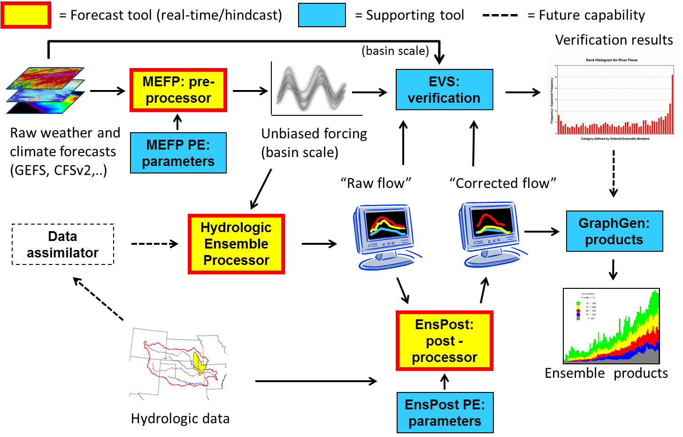
What is the HEFS?
Notes:
31
OPTION TO INSERT AS SLIDE 11
This slide shows the various components of the HEFS, each one designed to account for a particular source of uncertainty or for generating forecast or verification products
The main components used to produce forecasts operationally or in hindcast mode are shown in yellow and several tools that support the production of these forecasts are shown in blue
The MEFP takes raw forcing information from a range of different sources and aims to produce unbiased forcing for input to the hydrologic models
This bias correction is supported by a parameter estimator that looks at the biases present in the historical raw forecasts and decides on an appropriate adjustment to make in real-time
The bias-corrected forcing forecasts are input into the Hydrologic Ensemble Processor
The hydrologic uncertainties and biases are then accounted for the by the EnsPost
Much like the MEFP, the EnsPost has a parameter estimator than looks at past performance and identifies an appropriate adjustment to apply in real time
You’ll then notice that the verification system, known as the EVS, is a central component of this scheme, with many arrows point into it.
The reason that the EVS has several arrows is that we don’t just want to establish that the forecasts are good, but that they are good for the right reasons
At the end of the chain, you’ll also see the Graphics Generator, which produces operational forecast products from the HEFS outputs

