Slide 1
A convective Dust Storm Severity Index (DSSI) Based on Dust Concentration, Wind and Storm Size for Arizona
Joshua White PhD Candidate
2014 Arizona Dust Storm Workshop

Slide 2
Why Create a Dust Storm Severity Index?
Dust storms have the potential to take lives and damage property
A classification system could help increase public understanding and help refine warning systems
Useful tool for governmental entities such as the EPA or State level air quality departments

Slide 3
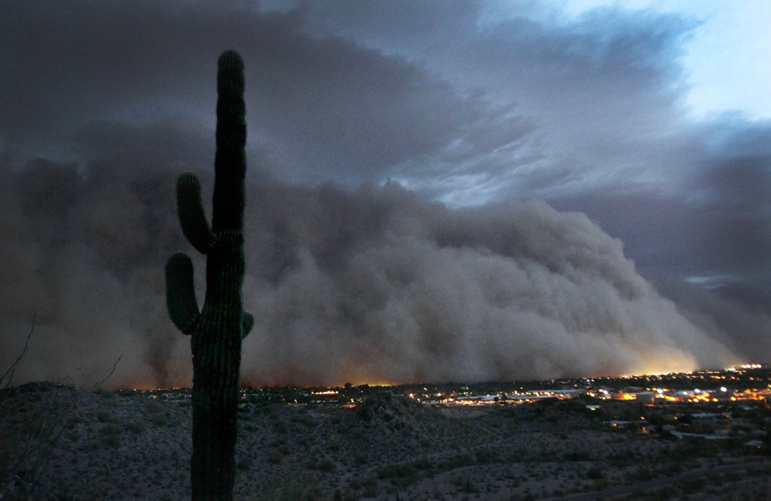
Phoenix Area Dust Storms
Most dust storms in the Phoenix Metro area are caused by convective storms
Typical convective storm duration 1 hour
Convective storms usually occur during the Arizona Monsoon Season (June 15 – September 30)
A dust downtown Phoenix on Tuesday night, July 5, 2011, bringing strong winds and low visibility (Schumacher
2011).

Slide 4
Research Question: How effectively can measured variables such as atmospheric dust concentration, wind speed, and storm size for specific dust storm events be combined into a useful severity index for Arizona dust storms?
Not Adaptable to a DSSI
Potentially Adaptable to a DSSI
Satellite data not sufficiently available
Radar has many blind spots in the affected areas
Density monitors are readily available
monitor network contains wind data
Geographic coordinates of the monitor network can be used to determine aerial coverage
Visibility data are subjective but useful for outlying the affected area

Slide 5
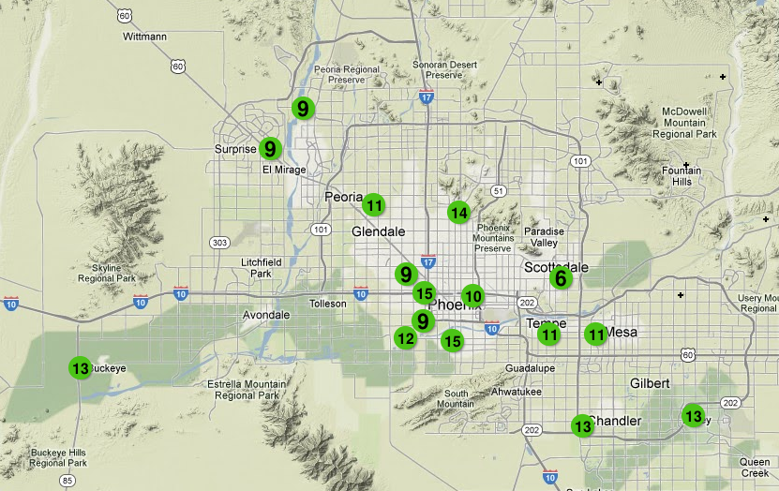
Hypothesis: Dust storm events can be adequately differentiated to produce an accurate hierarchical ranking system through the use of the network of existing PM10 stations set up around the state. Those station sites will provide the data for a classification system based on: 1) density of a given dust event, 2) wind speed, 3) the aerial extent of the storm.
1 Maricopa County Air Quality Department PM10 stations throughout the Phoenix metropolitan area (Maricopa-County-Air-Quality-Department-Air-Monitoring-Division 2010b)

Slide 6
NCDC Surface Hourly Data
National Climatic Data Center (NCDC) Airport Stations collect hourly meteorological observations that can supplement the rest of the data
Provides temperature
Wind (speed and Direction)
Precipitation
Visibility (Which can be used to help outline the size of the affected area)

Slide 7
AZMET Weather Data
The Arizona Meteorological Network (AZMET) provides meteorological data and weather-based information
Automated Stations (hourly data)
Temperature (air and soil)
Humidity
Wind (speed and direction)

Slide 8
Other Classification Schemes
Fujita Scale (Fujita 1971)
Saffir-Simpson Hurricane Scale (Saffir and Simpson 1971)

Slide 9
Volcanic Explosivity Index
Volcanic Explosivity Index, Criteria are listed in decreasing order of reliability (Newhall and Self 1982)

Slide 10
PM10 monitors
Continuous monitors
Tapered Element Oscillating MicroBalance (TEOM)
TEOM monitor in white refrigerated box with silver collection tube on top.(Maricopa-County-Air-Quality-Department-Air-Monitoring-Division 2010b)

Slide 11
PM10 data for 7/5/2011 Dust Storm
Hourly breakdowns of PM10 data in µg/m³ using local Arizona Mountain time

Slide 12
Wind Speed data for 7/5/2011 Dust Storm
Hourly breakdowns of Wind Speed data in m/s using local Arizona Mountain time

Slide 13
Area data for 7/5/2011 Dust Storm
Top left: dust concentrations over the estimated geographical station locations, Top Right: wind speeds over the estimated geographical station locations, Bottom: Overlay of dust concentrations and wind speeds

Slide 14
Methods for Classification: PM10
PM10 data will be put into concentrations from each event by first constructing a frequency-distribution histogram
EXAMPLE: PM10 data from exeedances in 2011-2012

Slide 15
Methods for Classification: Wind Speed
Wind Speed data will also be put into concentrations from each event by constructing a frequency-distribution histogram
EXAMPLE: Wind Speed data from exeedances in 2011-2012

Slide 16
Methods of Classification: Aerial Coverage
Minimum PM10 concentrations will define the bounds of the area
PM10 continuous stations within closed area which is approximately 8.5 X 10⁸ m². (Maricopa-County-Air-Quality-Department-Air-Monitoring-Division 2010b)

Slide 17
Dust Storm Severity Index
An example of the potential thresholding of characteristics in a Dust Storm Severity Index (DSSI). Values are hypothetical and the example is designed to simply identify the techniques of classification by thresholding of specific values.
DSSI | Density (µg/m³) | Wind Speed (m/s) | Aerial Coverage (m²)
5 | >8000 | >18 | >8.50 x10⁸
4 | 6000 - 7999 | 17.0 - 17.9 | 7.5 x10⁸ - 8.4 x10⁸
3 | 4000 - 5999 | 15.0 - 16.9 | 6.5 x10⁸ - 7.4 x10⁸
2 | 2000 - 4999 | 13.0 - 14.9 | 5.5 x10⁸- 6.4 x10⁸
1 | 500-1999 | <12.9 | <5.4 x10¹⁰

Slide 18
Conclusions
To date, no severity or intensity classification system for dust storms have been attempted.
Arizona Sonoran Desert Region PM10 network increased the amount of available data
The provided data can create a classification system based on: 1) density of a given dust event, 2) wind speed, 3) the geographical coordinate’s necessary to examine the aerial coverage

Slide 19
Significance
Classification of these events could help increase public understanding
Help refine warning systems
Useful tool to government entities like EPA in assessing exeedance days
Help prevent loss of life and property

Slide 20
Citations
Maricopa County Air Quality Department Air Monitoring Division 2010. Maricopa County Air Monitoring Network: Technical Assessment 2005–2009. ed. M. C. A. Q. Department. Phoenix, AZ: Maricopa County Air Quality Department.
Fujita, T. T. (1971) Proposed characterization of tornadoes and hurricanes by area and intensity.
Rodríguez, S., X. Querol, A. Alastuey, G. Kallos & O. Kakaliagou (2001) Saharan dust contributions to PM10 and TSP levels in Southern and Eastern Spain. Atmospheric Environment, 35, 2433-2447.
Saffir, H. & R. Simpson. 1971. A proposed scale for ranking hurricanes by intensity. In Minutes of the eight NOAA, NWS Hurricane Conference, Miami, Florida.
Shcumacher, R. 2011. 7/5/2011 Phoenix Dust Storm. Arizona Republic.

Slide 21
Questions?
A dust downtown Phoenix on Tuesday night, July 5, 2011, bringing strong winds and low visibility (Schumacher
2011).

