Slide 1
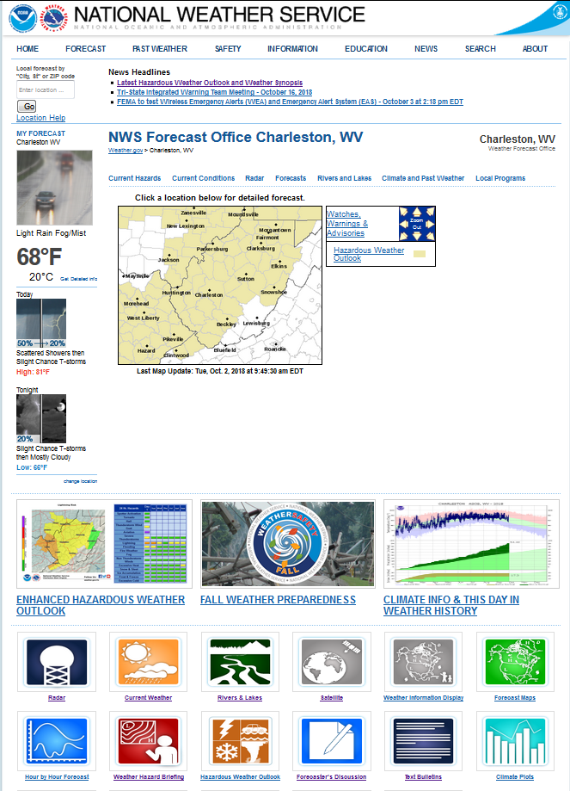
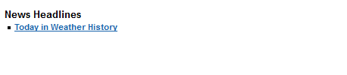
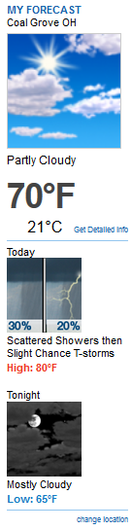
NWS Forecast Office
Weather.gov > NWS Forecast Office

Slide 2
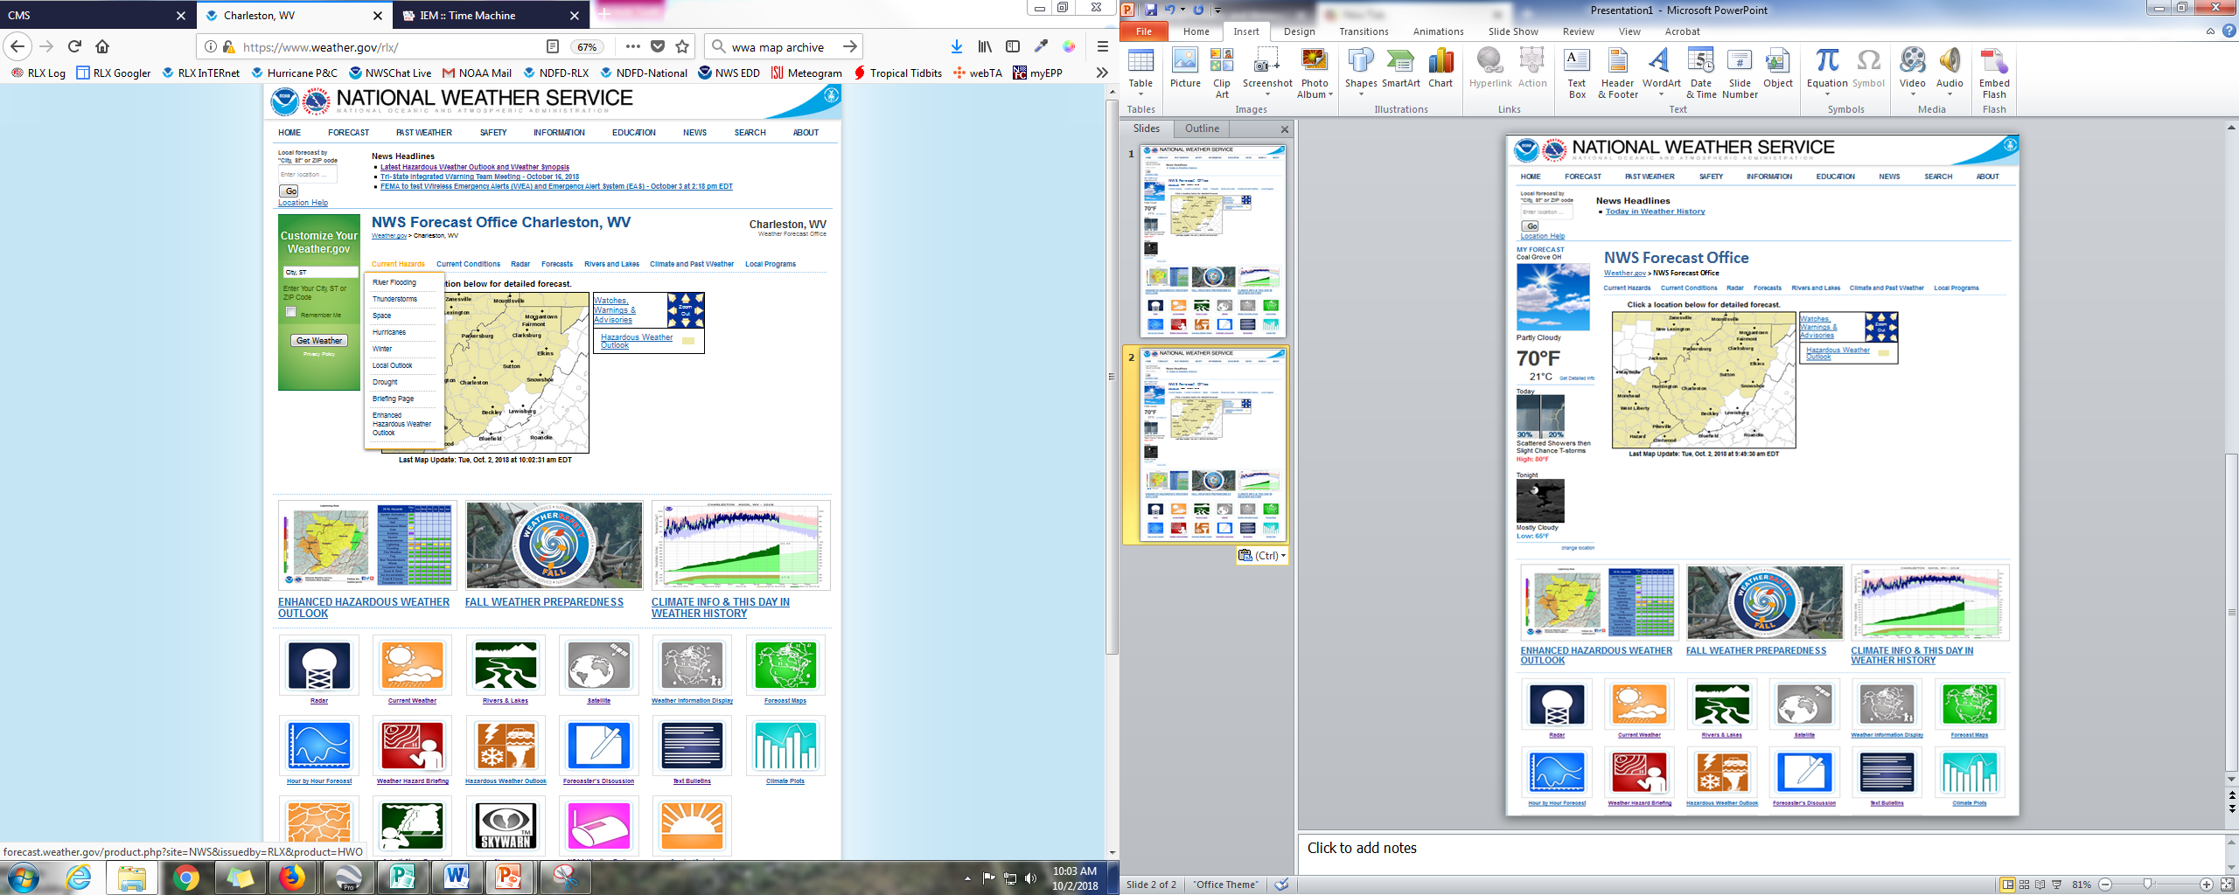
NWS Forecast Office
Weather.gov > NWS Forecast Office

Slide 3
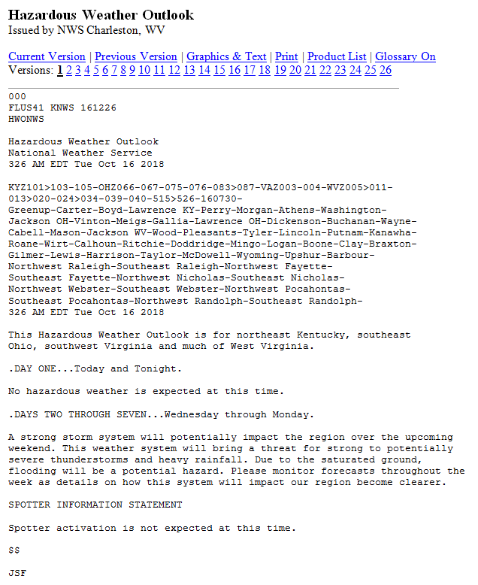

Slide 4
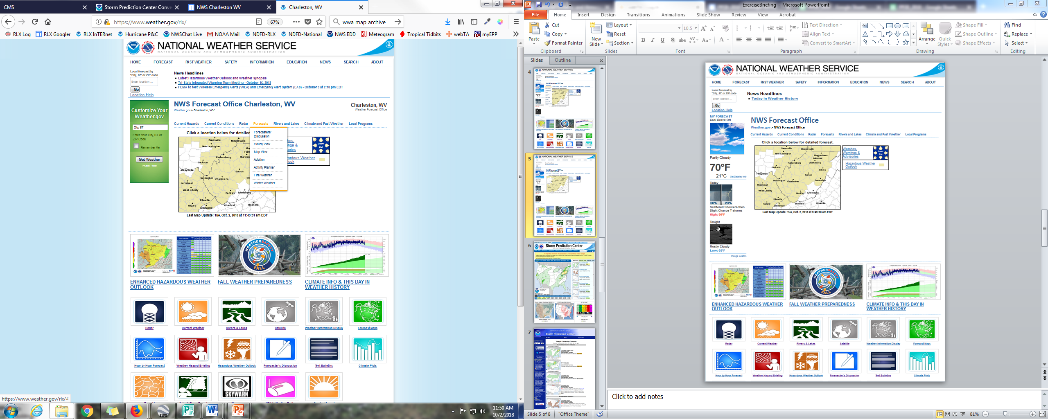
NWS Forecast Office
Weather.gov > NWS Forecast Office

Slide 5
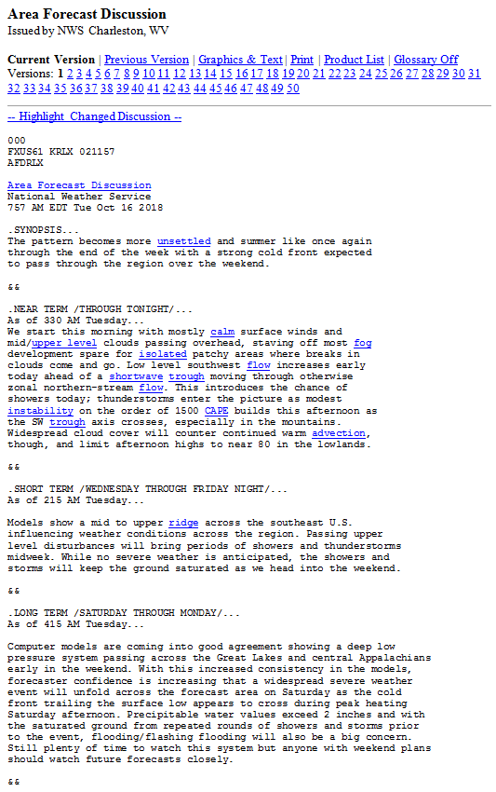

Slide 6
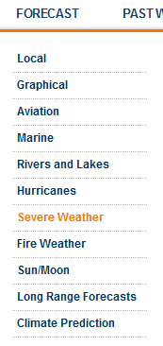
NWS Forecast Office
Weather.gov > NWS Forecast Office

Slide 7
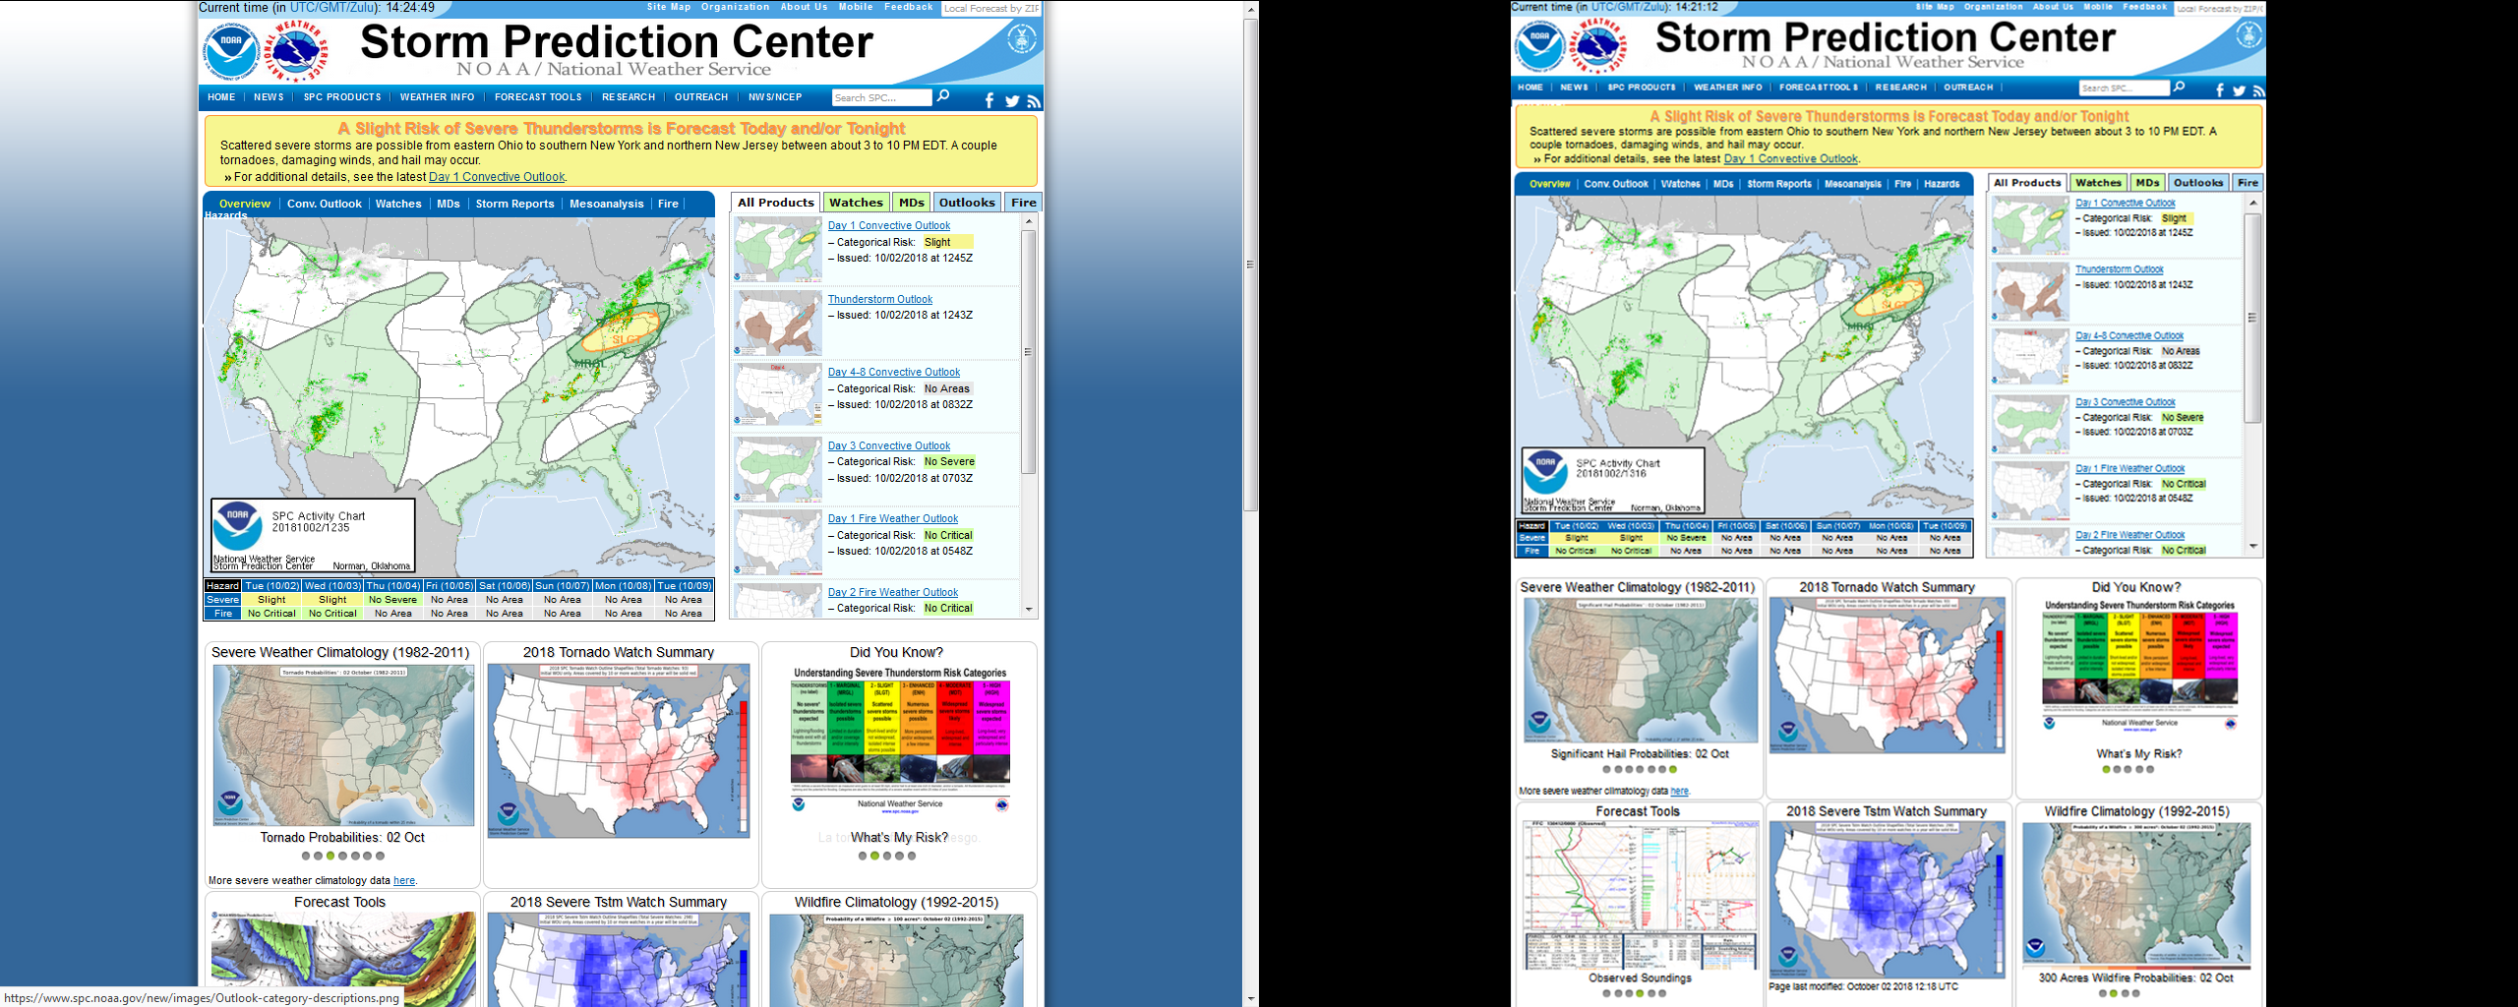

Slide 8
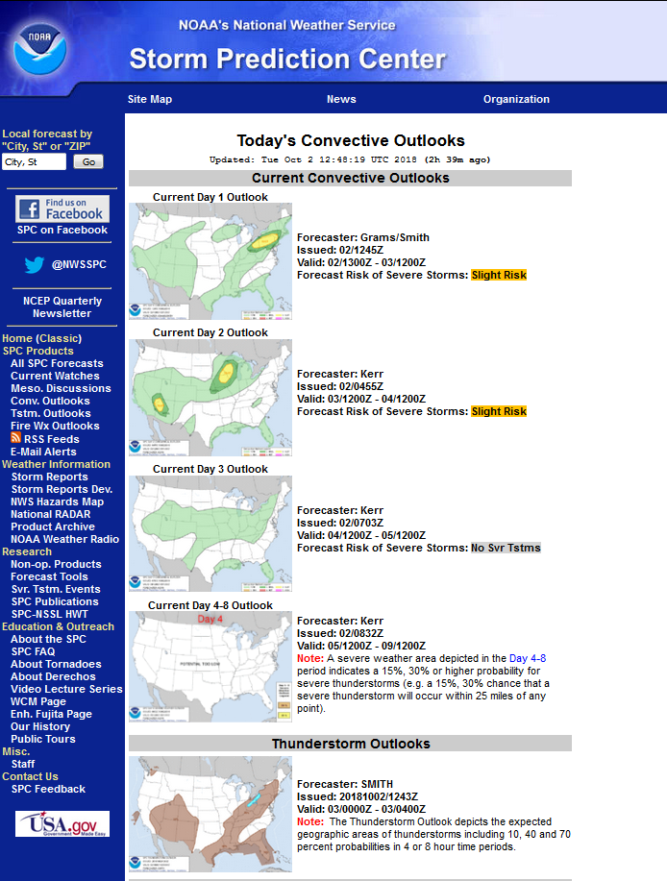

Slide 9
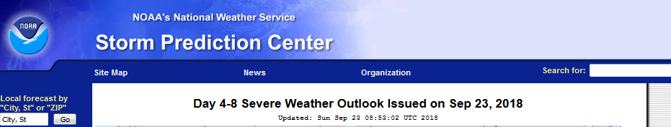
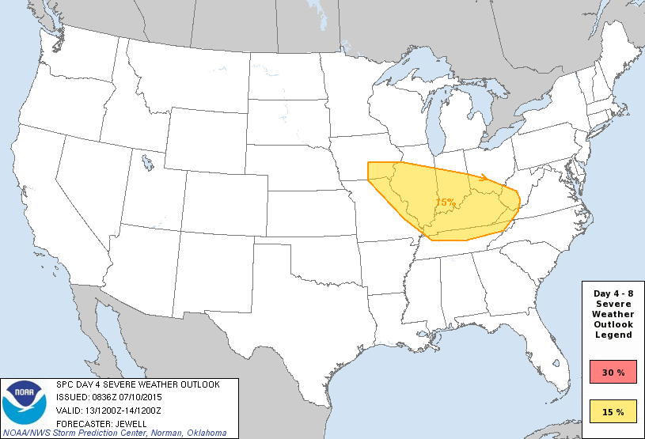
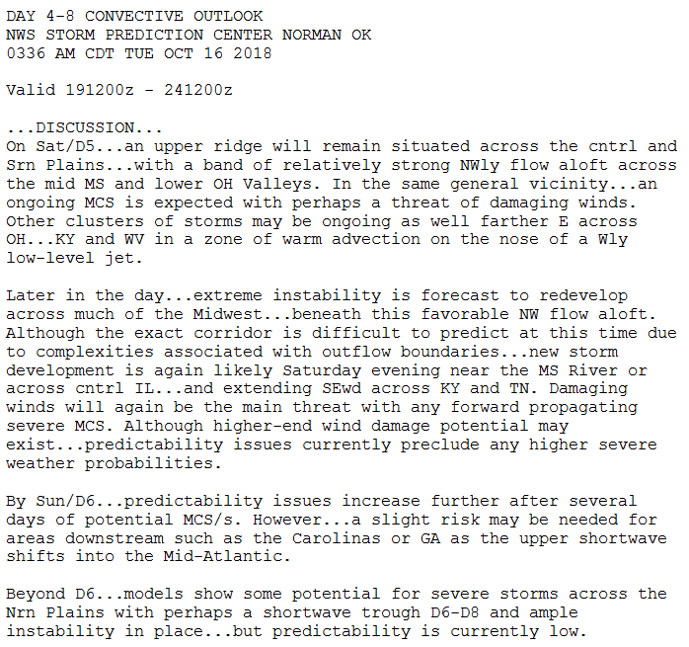
Day 4-8 Severe Weather Outlook Issued on October 16, 2018
Day 5 Severe Weather Outlook
Valid: 20/1200Z-21/1200Z

Slide 10
Module 1: Severe Thunderstorm and Flood Potential Outlook – Five Days Out
Questions
Were you aware of the Hazardous Weather Outlook product before this exercise? If so, how often do you view this product and how do you normally view it?
Were you aware of the Area Forecast Discussion product before this exercise? If so, how often do you view this product and how do you normally view it?
Were you aware of the SPC Outlooks before this exercise? Do you understand the various categories used in the outlooks?
Are the products used in Module 1 sufficient to deliver to you the information you would need about this event at this time frame? What additional products and services would be helpful to you and why?
What actions would you take based on this briefing and why?

